Slide 1

https://github.com/RhodaJiang/Social-Work-Making-a-difference
W7 Tutorial
Social Work:
Making a Difference
✉️ ljiang3@ed.ac.uk

Slide 2
Paired presentations (within 20 min)
First 20 minutes: Two students (a pair) will deliver their presentation (in 15 minutes maximum), followed by a short Q&A session (5 minutes).
Please note that presentations are timed, and you will be asked to stop if you exceed the limit to ensure there is sufficient time for discussion. In weeks where two pairs are scheduled to present, the first 40 minutes will be allocated to presentations and Q&A.
Final 5 minutes: The tutor will provide verbal feedback (on both the content and delivery of presentation) to the pair/s that presented. Please note that final grades will be communicated at the end of the course (by 17/12/25) after moderation by the course organiser.

Slide 3
Activity ( ~30 min)
This week’s discussion topic: Adult social work services
What is the main purpose of adult social care (including social work)?
What are the current challenges of adult social care and social work?
How might adult social care and social work be delivered more effectively?
To prepare for this tutorial please read Chapters 1, 2, and 12 of the Independent Review of Adult Social Care, which amount to approximately 23 pages.

Slide 4
Verbal feedback
Final 5 minutes: The tutor will provide verbal feedback (on both the content and delivery of presentation) to the pair/s that presented. Please note that final grades will be communicated at the end of the course (by 17/12/25) after moderation by the course organiser.

Slide 5
https://github.com/RhodaJiang/Social-Work-Making-a-difference
W6 Tutorial
Social Work:
Making a Difference
✉️ ljiang3@ed.ac.uk

Slide 6
Paired presentations (within 20 min)
First 20 minutes: Two students (a pair) will deliver their presentation (in 15 minutes maximum), followed by a short Q&A session (5 minutes).
Please note that presentations are timed, and you will be asked to stop if you exceed the limit to ensure there is sufficient time for discussion. In weeks where two pairs are scheduled to present, the first 40 minutes will be allocated to presentations and Q&A.
Final 5 minutes: The tutor will provide verbal feedback (on both the content and delivery of presentation) to the pair/s that presented. Please note that final grades will be communicated at the end of the course (by 17/12/25) after moderation by the course organiser.

Slide 7
Activity ( ~30 min)
This week’s discussion topic:Children and Families Social Work
Question: What are the roles, tasks and key challenges of children and families social work?
Please read the following two documents to prepare for this week's tutorial.
Clapton, G. (2018) Social work with children and families (Chapter 11). In Cree, V. E. and Smith, M. (eds) (2018) Social Work in a Changing Scotland. London: Routledge.
Children's Socal Srvices in Scotland.PDF

Slide 8
Verbal feedback
Final 5 minutes: The tutor will provide verbal feedback (on both the content and delivery of presentation) to the pair/s that presented. Please note that final grades will be communicated at the end of the course (by 17/12/25) after moderation by the course organiser.

Slide 9
https://github.com/RhodaJiang/Social-Work-Making-a-difference
W5 Tutorial
Social Work:
Making a Difference
✉️ ljiang3@ed.ac.uk

Slide 10
Recap (5-10min)
What did you think of the Lecture?
W1
Lecture 1 - Welcome and Introduction (Dr. Hadijah Mwenyango)
Lecture 2 - The History of Social Work (Dr Sarah Henning)
W2
Lecture 1 - Social Work Today. (Dr. Gary Clapton)
Lecture 2 - Social Work in a Global Context (Prof. George Palattiyil)
What did you think of the Lecture?
W3
Lecture 1 - Social Work Tomorrow (Dr. Hadijah Mwenyango)
Lecture 2 - Social Work: Making a Difference Briefing: Assessment 1 (Dr. Hadijah Mwenyango)
W4
Lecture 1 - Research for Practice for Children and Families Social Work (Dr. Autumn Roesch-Marsh)
Lecture 2 - The Professional Role (Children & Families Social Work - statutory practitioner) (Dr Yukti Lamba)

Slide 11
Activity (40-45min)
Please identify your presentation partner, (if present), and provide responses to the following questions.
What are the key themes or concepts we have covered thus far, and how do they connect to your selected presentation topic?
Which social work challenge will your pair focus on? How will you frame the challenge: as a policy issue, a practice dilemma, an ethical concern, or a systemic problem?
What format or visual or supporting materials will you use (slides, handouts, short video, news clips)?
How will you share roles/tasks to ensure equal division of labour?

Slide 12
https://github.com/RhodaJiang/Social-Work-Making-a-difference
W4 Tutorial
Social Work:
Making a Difference
✉️ ljiang3@ed.ac.uk

Slide 13
Recap (10min)
What did you think of the Lecture?
What did you learn？
Lecture 1 - Social Work Tomorrow (Dr. Hadijah Mwenyango)
Lecture 2 - Social Work: Making a Difference Briefing: Assessment 1 (Dr. Hadijah Mwenyango)
What points stood out?
Any questions?

Slide 14
Activity (35-45min)
Part 1
How are social services organised in Scotland, what are the main overall challenges and where is it heading?
What innovations or improvements do you aspire to see in social work?
Please read the following documents before the tutorial:
Scottish Parliament Information Centre (SPICe) (2022) Social Work in Scotland. [Online] ( Please read pages 22-34). Available at: Social Work in Scotland | Scottish Parliament Website
Scottish Government (2015) Social Services in Scotland: A shared vision and strategy 2015-2020. [Online] (Please read pages 7-14). Available at: Social Services in Scotland 2015-2020.pdf (www.gov.scot)
Part 2
What is your presentation about? What strategies or steps will you use to structure and organise your presentation to ensure a clear and coherent argument?

Slide 15
Activity (15-20min)
Part 1
How are social services organised in Scotland, what are the main overall challenges and where is it heading?
What innovations or improvements do you aspire to see in social work?

Slide 16
Activity (20-25min)
Part 2
What is your presentation about?
What strategies or steps will you use to structure and organise your presentation to ensure a clear and coherent argument?

Slide 17
From your experience (5-10min)
Any other additions?
…

Slide 18
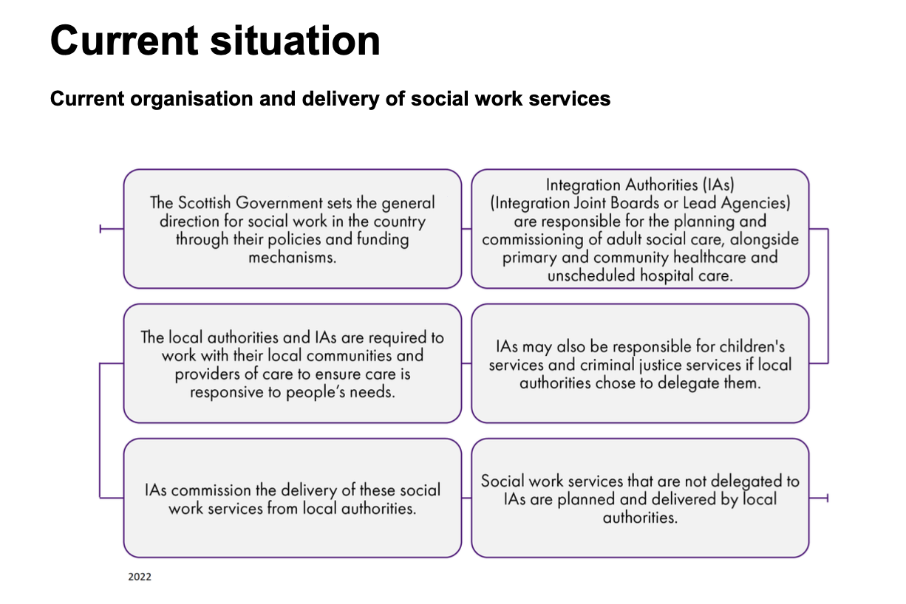
Wrap-up
Challenges:
Funding issues
Workforce issues
Workforce wellbeing: Workload; Support; COVID-19 impacts on workforce wellbeing; Addressing wellbeing
Retention and recruitment
Identity and image
Integration issues
Service delivery and consistency issues: Local authority; variation in the eligibility criteria; funding pressures
Future:
Workforce planning
National Care Service

Slide 19
https://github.com/RhodaJiang/Social-Work-Making-a-difference
W3 Tutorial
Social Work:
Making a Difference
✉️ ljiang3@ed.ac.uk

Slide 20
Recap (10min)
What did you think of the Lecture?
What did you learn？
Lecture 1 - Social Work Today (Dr. Gary Clapton)
Lecture 2 - Social Work in a Global Context (Prof. George Palattiyil)
What points stood out?
Any questions?

Slide 21
Activity (25-30min)
The History of Social Work
Key reading: Cree, V. E. (2018) A history of social work in Scotland. In Cree, V. E. and Smith, M. (eds) (2018) Social Work in a Changing Scotland. London: Routledge.
Drawing from the above book chapter, please discuss the following questions in your tutorial groups.
How did Scotland’s approach to social work differ from the rest of the UK historically?
What are the most influential elements in the history of social work?
How can understanding the history of social work help in shaping its future role in Scotland and beyond?

Slide 22
Activity
How did Scotland’s approach to social work differ from the rest of the UK historically?

Slide 23
Activity
What are the most influential elements in the history of social work?

Slide 24
Activity
How can understanding the history of social work help in shaping its future role in Scotland and beyond?

Slide 25
From your experience (5-10min)
Any other additions?
…

Slide 26
Wrap-up
Comparison between Scotland and England (also Wales)
Ability to work + moral worth = basis for policy
Social geography
Religion
Key points to think about its past, today and future
Human Nature
Responsibility, and
Moral Judgement

Slide 27
https://github.com/RhodaJiang/Social-Work-Making-a-difference
W2 Tutorial
Social Work:
Making a Difference
✉️ ljiang3@ed.ac.uk

Slide 28
Recap (10min)
What did you think of the Lecture?
What did you learn?
What points stood out?
Any questions?

Slide 29
Activity (20-25min)
Read (link will open in a new browser tab) Chapter 9 by Karen McAlister: 'How One Social Worker Made a Difference' in Becoming a Social Worker (3rd ed.), edited by V.E. Cree (2022), published by Routledge. After completing the reading, answer the following question in your tutorial groups.
How would you define social work based on the content of this chapter?
Considering the author's experiences shared throughout the chapter, what insights do you gain about the challenges and rewards of social work in real-world practice?

Slide 30
Activity
How would you define social work based on the content of this chapter?

Slide 31
Activity
Considering the author's experiences shared throughout the chapter, what insights do you gain about the challenges and rewards of social work in real-world practice?

Slide 32
From your experience (10-15min)
What is social work?
…
Rewards and challenges social work faces?
…

Slide 33
Wrap-up
What is social work?
From this case: Relationships; Changes; Collaboration; User-centered
Rewards and challenges social work faces?
Rewards (individual level)
Rewards (system/systemic level)
Challenges

