Slide 1
Cody Rhodes
GEOG 5201
11/5/2018
Crane tracking in Kansas
Data range: 9/1/13 – 10/22/13

Slide 2
Source
https://catalog.data.gov/dataset/sandhill-crane-locations-autumn-2013-migration
Using tracking data from this source confined to Kansas, USA to visualize flight paths of migrating Sandhill Cranes.

Slide 3
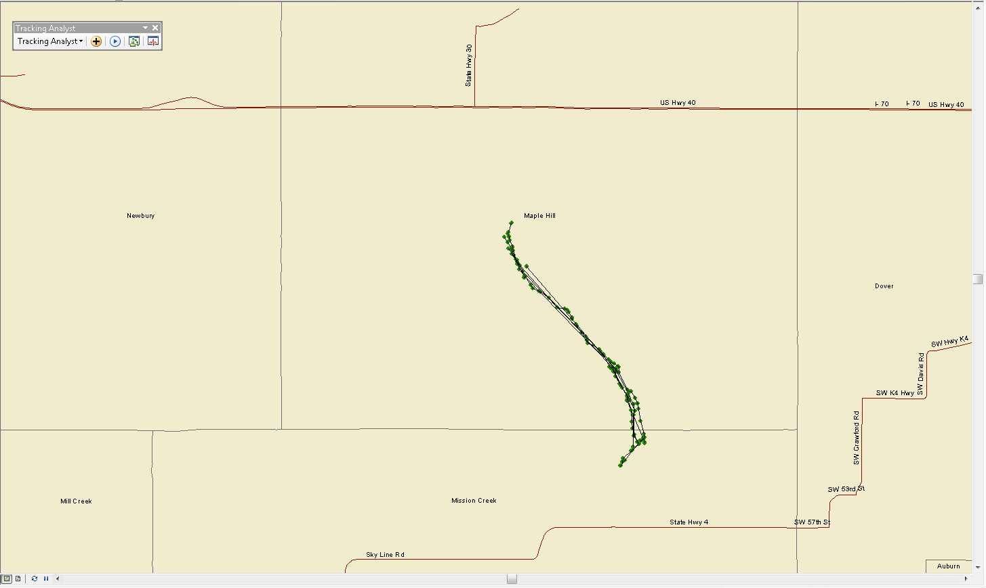
Crane Track Full Extent Kansas, USA
The cranes only move just out of the county within the span of a month (9/1/13 – 10/17/13)

Slide 4
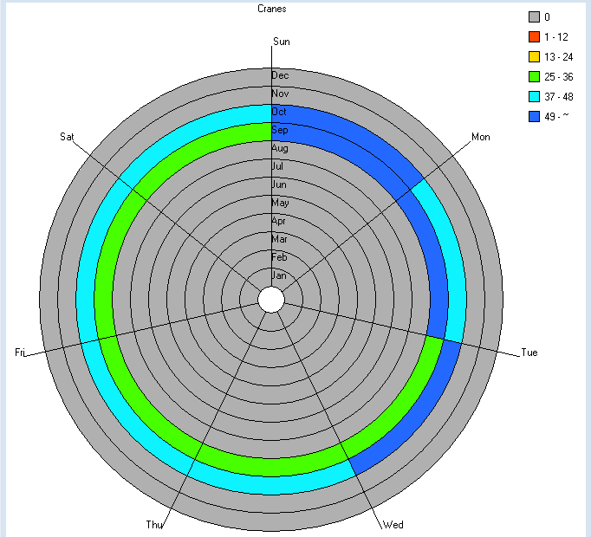
This data clock for the crane track shows that the data was exclusively collected in the months of September and October
The day of the week varies for the dataset but from a glance more of the data seems to be collected from Sunday to Tuesday

Slide 5
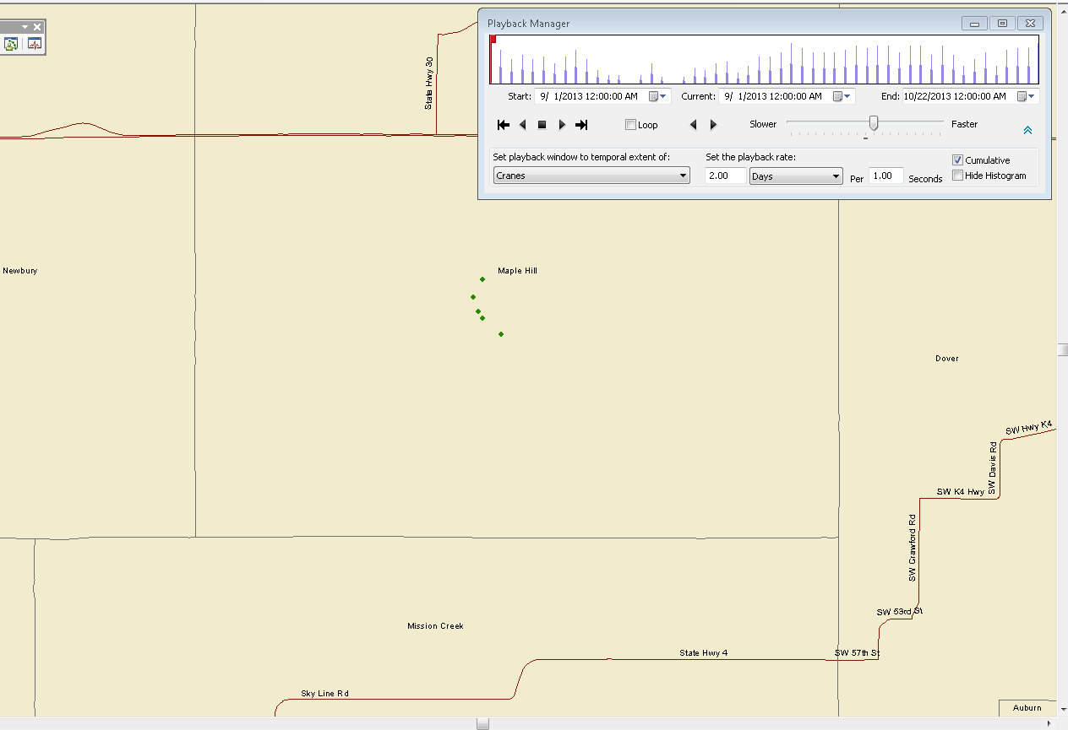
Date shown: 9/1/2013
5 cranes shown at starting position when data collection started
Based on this data and the following frames I would say that cranes do not move very far very fast

Slide 6
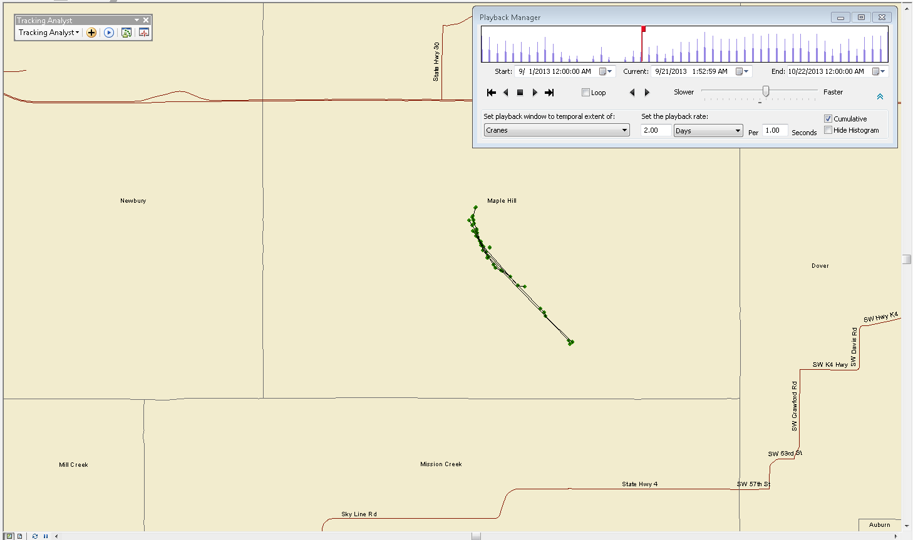
Date shown: 9/21/2013
Over the course of 20 days the cranes have moved further south and have become more separated but have not travelled even as far as the county line

Slide 7
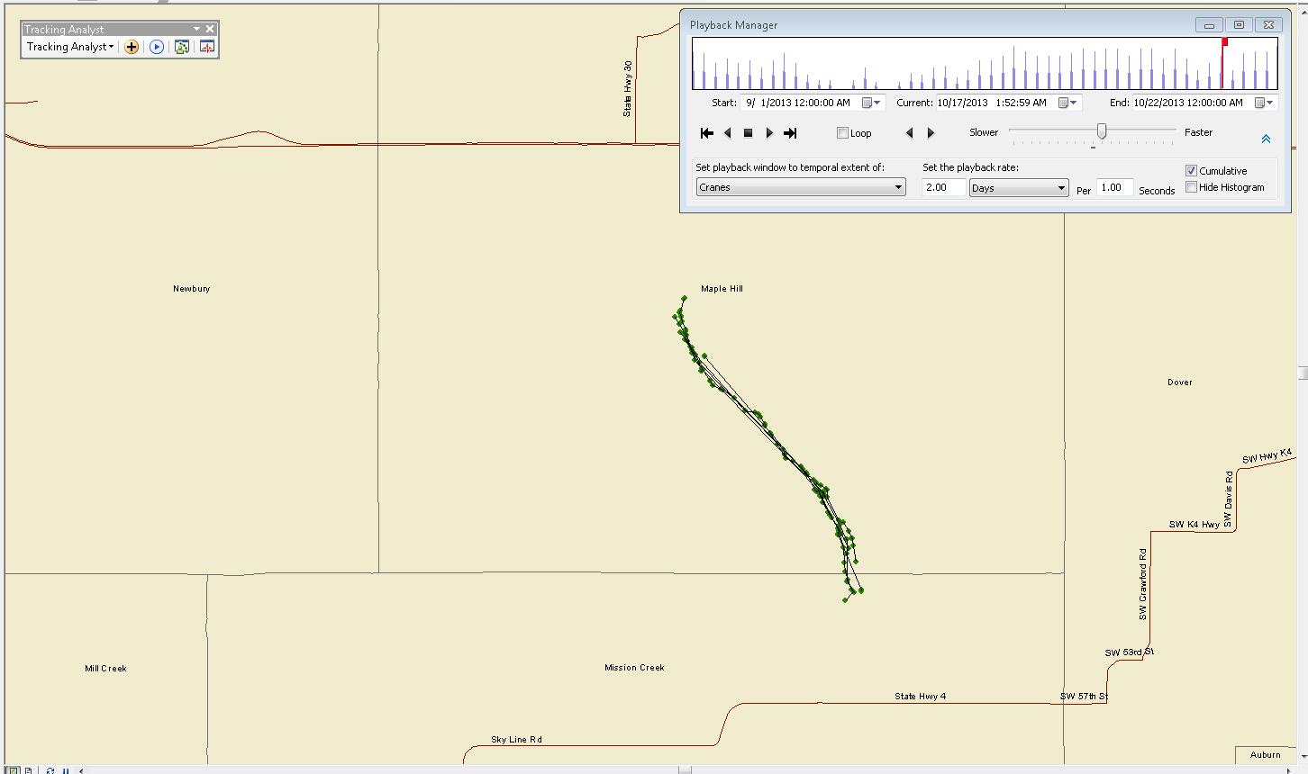
Date shown: 10/17/2013
Finally the cranes have crossed the county line after a month.
One might be able to tell from this frame that there are many days the cranes hardly move

Slide 8
Conclusions
This data set is helpful for analyzing the movement and migration of cranes. However it would have been nice to have access to a wider temporal range to observe the long term migration pattern of these birds. The cranes move very small distances in the span of one week but a more obvious and interesting trend would be seen over the course of several months.

