Slide 1

MyMD. A program with potential…
Workshop on Computer Programming and Advanced Tools for Scientific Research Work
Manuel Proissl on behalf of MyMD Team
Miramare, Trieste
Get the code: git clone https://github.com/Rhouli/ljmd-c.git
Notes:
ATLAS UK HLT Meeting – Manuel Proissl

Slide 2
MyMD. A program with potential…
Project Management
With the intention to restructure an existing C version of a MD code, we have decided to turn this into an object-oriented C++ version and applied the following class structure:
In addition we have developed a flexible Python interface to run the program with different inputs.
Working as a group in an amateur-software-company-style:
One main meeting to plan the program structure
Individual work on classes in sub-groups
Several meetings to debug and compile the code
Validating the output with reference data from original C version.
Classes | Group members
MyMD (main class), Helper | Rodrigo
Atoms, Integrator | Manuel, Maksim
Force, Pair(_LJ) | Giovanni, Aris
Python interface | Leopold
Workshop on Computer Programming and Advanced Tools for Scientific Research Work Manuel Proissl 2

Slide 3
MyMD. A program with potential…
Development Problems / Status
The baseline: group members with none, a little and a lot C++ experience.
No coding style conventions were defined.
Code was only compiled at the end, rather than iteratively.
Once all pieces were put together, the program “obviously” did not compile.
Spent one day only on debugging the code and getting it into a working state.
No improvements in terms of functionality (e.g. adding Morse potential) have been made, BUT the program structure allows now easily extensions!
A Doxygen website has been created and mostly inline documentation provided.
A flexible interface in Python has been developed and allows convenient config.
Workshop on Computer Programming and Advanced Tools for Scientific Research Work Manuel Proissl 3

Slide 4
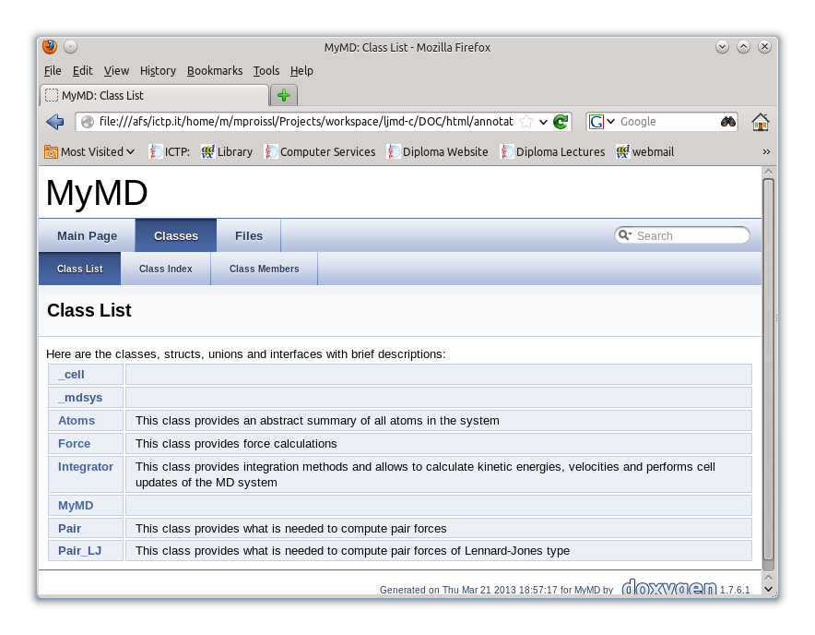
MyMD. A program with potential…
MYMD documentation
Workshop on Computer Programming and Advanced Tools for Scientific Research Work Manuel Proissl 4

Slide 5
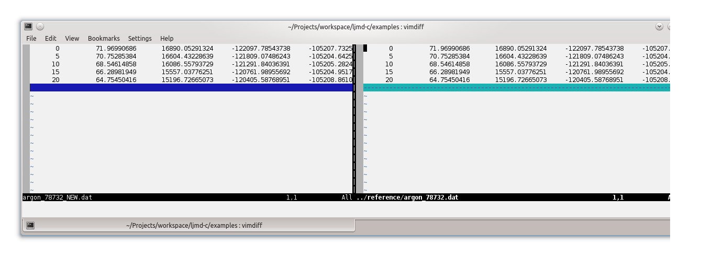
MyMD. A program with potential…
MYMD Validation
Simple validation using reference data and gdb.
It WORKS!!! (most likely..)
Workshop on Computer Programming and Advanced Tools for Scientific Research Work Manuel Proissl 5

Slide 6
MyMD. A program with potential…
Interface – The API PROBLEM
MyMD code to be completely reorganized
No fixed C++ API
No working code to test against
Decisions:
Start with ‘API’ = input file format
Postpone cython C++ interface to later
Workshop on Computer Programming and Advanced Tools for Scientific Research Work Manuel Proissl 6

Slide 7
MyMD. A program with potential…
Interface – The TIME PRoblem
Coding a usable interface = lot of work
4 x ½ day = not a lot time
What can we do? Check what already has been done for us!
Workshop on Computer Programming and Advanced Tools for Scientific Research Work Manuel Proissl 7

Slide 8
MyMD. A program with potential…
Interface – ASE
Workshop on Computer Programming and Advanced Tools for Scientific Research Work Manuel Proissl 8

Slide 9
MyMD. A program with potential…
Calculator CLASS
Workshop on Computer Programming and Advanced Tools for Scientific Research Work Manuel Proissl 9

Slide 10
MyMD. A program with potential…
Example
Workshop on Computer Programming and Advanced Tools for Scientific Research Work Manuel Proissl 10

Slide 11
MyMD. A program with potential…
Example
Workshop on Computer Programming and Advanced Tools for Scientific Research Work Manuel Proissl 11

Slide 12
MyMD. A program with potential…
Example
Workshop on Computer Programming and Advanced Tools for Scientific Research Work Manuel Proissl 12

Slide 13
MyMD. A program with potential…
Thanks!
Check out code: git clone https://github.com/Rhouli/ljmd-c.git
Workshop on Computer Programming and Advanced Tools for Scientific Research Work Manuel Proissl 13

