Slide 1
Airline Website
Indian Airline
http://www.free-powerpoint-templates-design.com

Slide 2

LET US ^{RISE} ABOVE THE REST MSP Mandal’s Deogiri Institute of Engineering and Management Studies Department of Computer Science & Engineering
AIRLINE wEBSITE
Team Members Name: 1) Shraddha Sonawane Roll No:1)26063
2) Rhugved Takalkar 2) 26053
Class: SE CSE 1
Date: 31/08/2018

Slide 3
Introduction
When attracting passengers or customers in the digital world they need to be
able to find you online, once they have found you, and booked with you, it is wise to ensure every brand and commercial touch point from flight or freight
booking to arriving at their final destination has been thought about, is easy to navigate, access and builds trust.
We ensure their digital journey succeeds.

Slide 4



Languages Used
HTML
Used in every page for content available on our pages.
CSS
You can simply impress your audience and add a unique zing and appeal to your Presentations.
Java Script
You can simply impress your audience and add a unique zing and appeal to your Presentations.

Slide 5
Major Tags used
Style tag
Anchor tag
Used in CSS for styling the Website
Used to link pages, links.
<style>
<div>
<html>
<body>
<a>
Div tag
Html tag
Body tag
Separate the content in our page.
For layout of our websites
All basic tags are used n body tag.
Content is written here.

Slide 6
Navigation Bar
Travel Information
Airport Information
Before you fly
Home
Contact
Manage your Trips
Book a flight
Time table
Special Offers
Super Saver Scheme
Domestic Schemes

Slide 7
Work Division
Rhugved Takalkar
Coding for Website.
Content in the Website
Coding for
Website.
Website Designing
Shraddha Sonawane

Slide 8
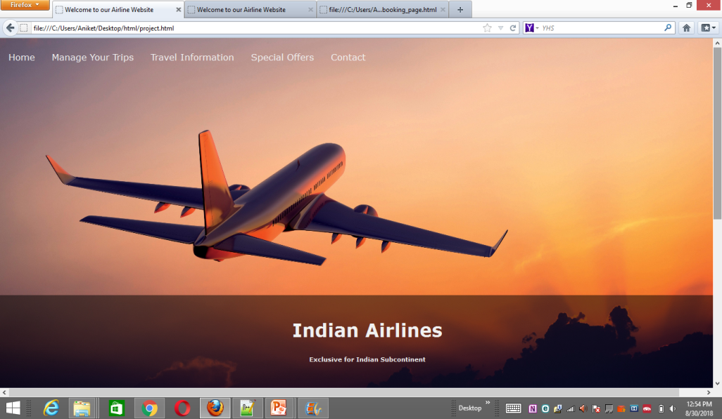
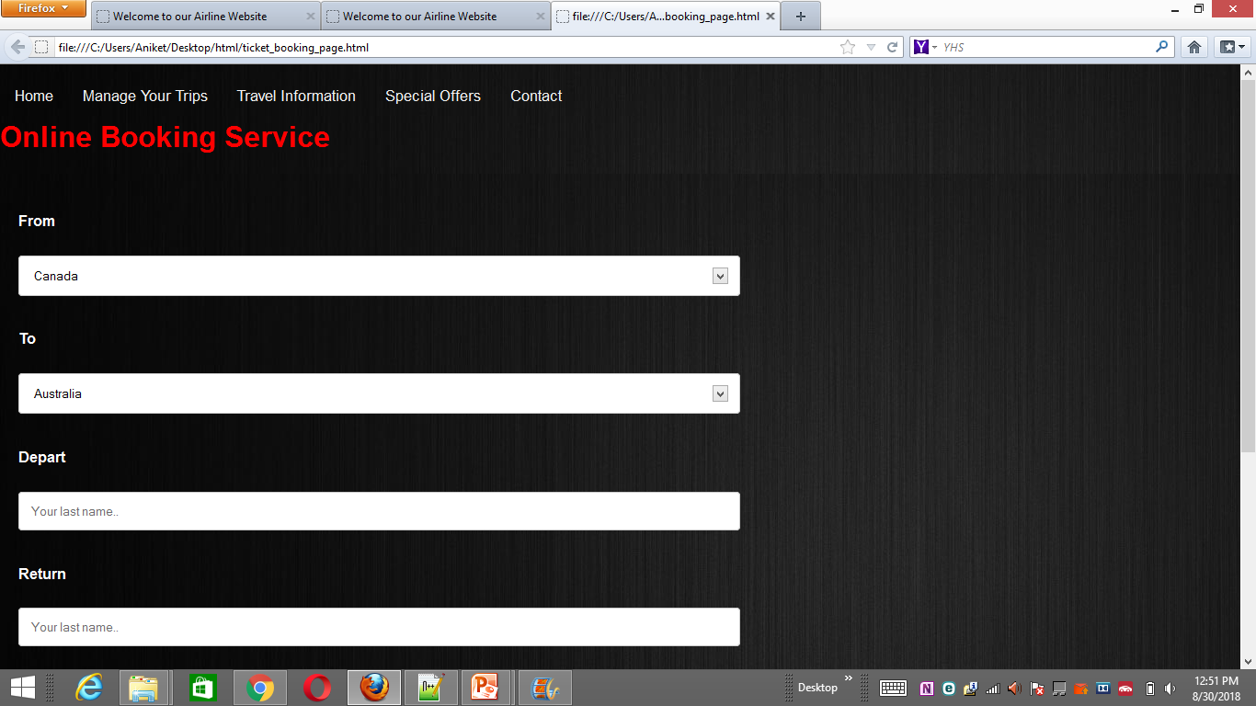
Website Visualization

Slide 9
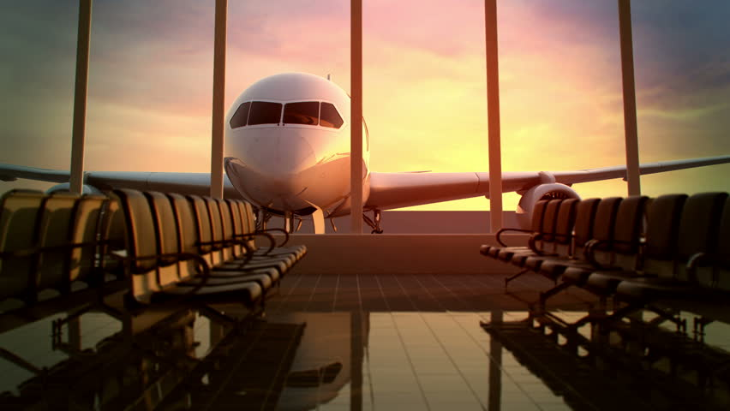
THANK YOU..!!

