Slide 1
Building for Google Assistant

Slide 2

A conversation between you and Google that helps you get more done in your world.

Slide 3
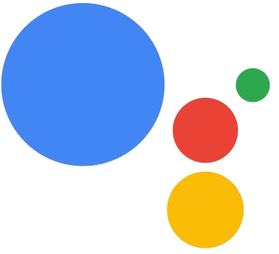
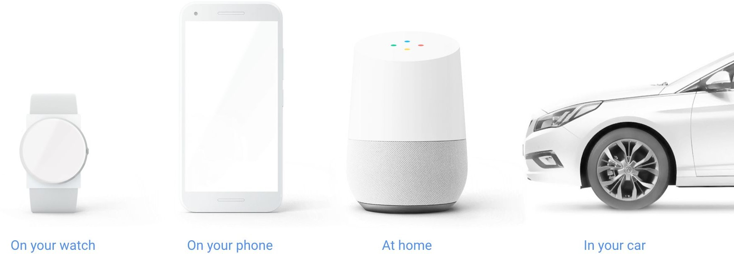

Slide 4

The Mobile Voice Study
55% of teens and 41% of adults
Use voice search more than once a day
http://googleblog.blogspot.com/2014/10/omg-mobile-voice-survey-reveals-teens.html

Slide 5

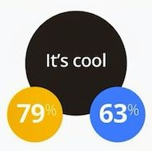
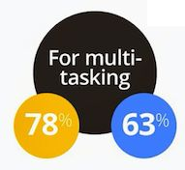
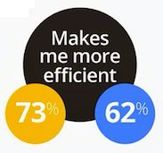
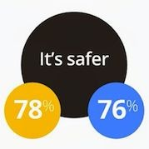

Teens Adults
http://googleblog.blogspot.com/2014/10/omg-mobile-voice-survey-reveals-teens.html

Slide 6
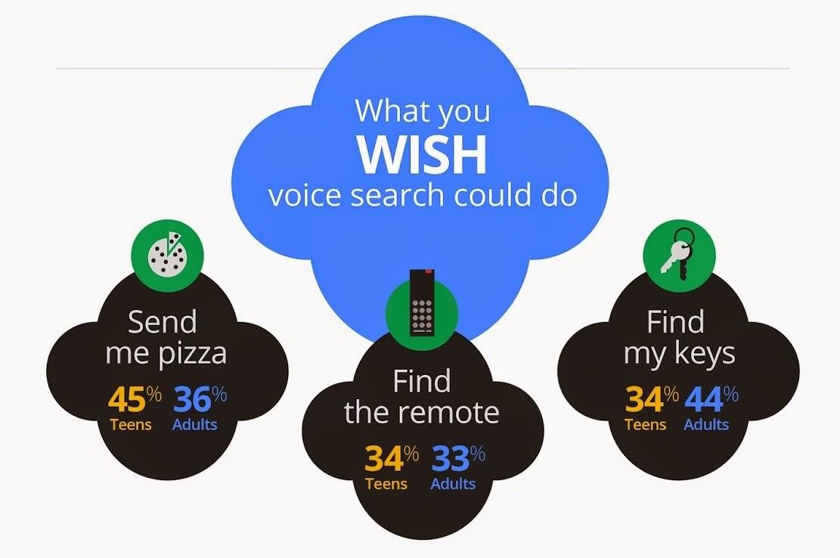
http://googleblog.blogspot.com/2014/10/omg-mobile-voice-survey-reveals-teens.html

Slide 7





When do we use voice search?
Teens Adults
http://googleblog.blogspot.com/2014/10/omg-mobile-voice-survey-reveals-teens.html

Slide 8
Actions on Google
Direct Actions Conversation Actions

Slide 9
Hi, how can I help?
Turn on the living room lights
Sure thing
Play my dinner party playlist on Spotify
Ok, here you go.

Slide 10

Hi, how can I help?
I need an Uber Sure! I’ll connect you to Uber
Hi Scott, where are you headed?
I’m going to the Ferry Building Ok, would you like an UberX again?
No, we’ll need an UberXL this time Ok, Ahmed will arrive in 3 minutes
in a black Toyota Sequoia

Slide 11
Actions on Google
developers.google.com/actions

Slide 12

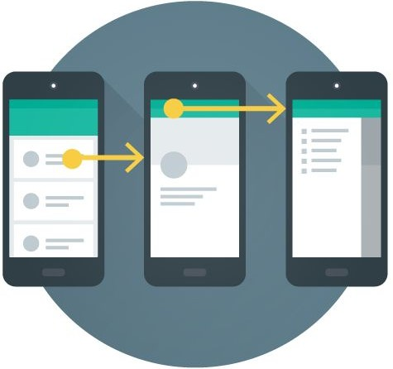
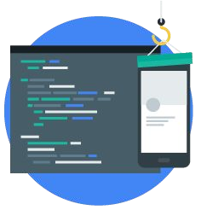
Design
Develop
Deploy

Slide 13
Create Persona
Think out of Actions 03 Context
Speech Errors
Think Big
Design

Slide 14


Develop

Slide 15


Device
Conversation API, Actions SDK
“Ok Google, talk to Hossam”
Speech to Text, NLP, Knowledge
“Sure, here’s Hossam”
Graph, ML, Ranking,
Invoke “Hossam” Action
User Profile, Text to Speech
“Sure, here’s Hossam.
Hi, I am your personal financial advisor. How can I help you today?”
“It’s that time of a year again, I would like some help with ...”
Speech to Text
“What type of tax would you like to save?”
Text to Speech

Slide 16

Device
api.ai
Webhook (optional)
“Ok Google, talk to Hossam”
Speech to Text, NLP, Knowledge
“Sure, here’s your Hossam”
Graph, ML, Ranking,
Invoke “Hossam” Action
User Profile, Text to Speech
“Sure, here’s Hossam.
Hi, I am your personal financial advisor. How can I help you today?”
“It’s that time of a year again, I would like some help with ...”
Speech to Text
“What type of tax would you like to save?”
Text to Speech

Slide 17
Create an API.AI agent
Create intents & entities 03 Define User says phrases
Define Actions & Responses
Test it!
Develop

Slide 18

Deploy

Slide 19
3
Test your actions
4
Register your actions
1
Check for Policy
Violations
2
Follow the brand
guidelines
5
Submit and Deploy
your actions

Slide 20
Create a new cloud project
Register your Conversation Action 3 Deploy your actions
Confirm your deployment
Interact with your Conversation Action
Deploy

Slide 21
Time to build an assistant/bot is NOW.
Understanding Platform, User, Context, Actions is Key!
API.AI makes it easy to get started with Actions.
Augment your service with Assistant/Actions.

Slide 22
thank
you

