Slide 1
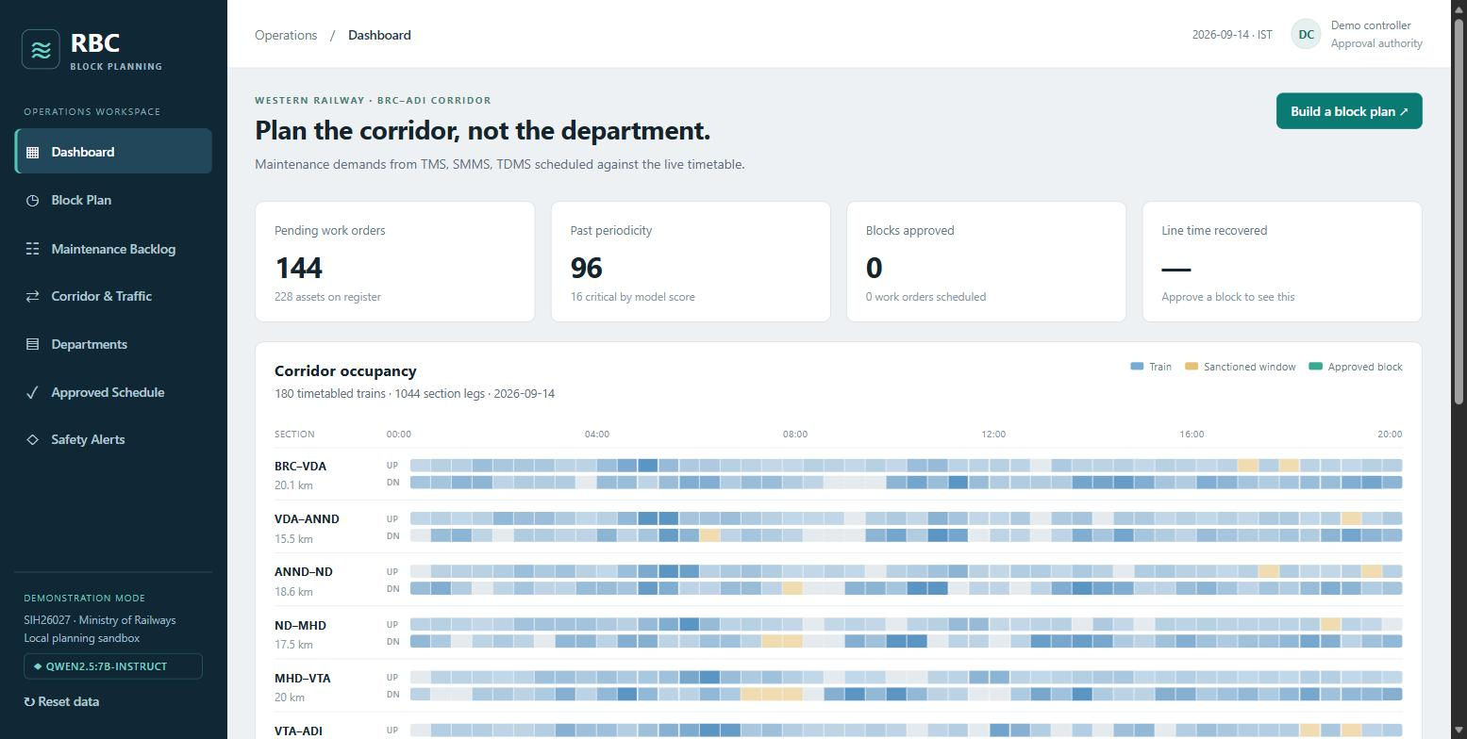
Less track closed. More trains running.
RBC: AI that plans railway maintenance for every team at once
94
105 hours
fewer track closures in one week
of track time given back to trains
• Smart India Hackathon · SIH26027 · Ministry of Railways

Slide 2
The problem: the same track is closed again and again
Three maintenance teams each plan their own work, alone.
3
50 min
teams planning separately: track, signals, overhead power
just to make the power line safe, before any work starts
• Each team asks for its own track closure, often on the same stretch, on the same day
• Every closure repeats the safety setup, and every minute closed is a minute trains cannot run
• Nobody sees the full picture: what is overdue, what might break, which time slot is free

Slide 3
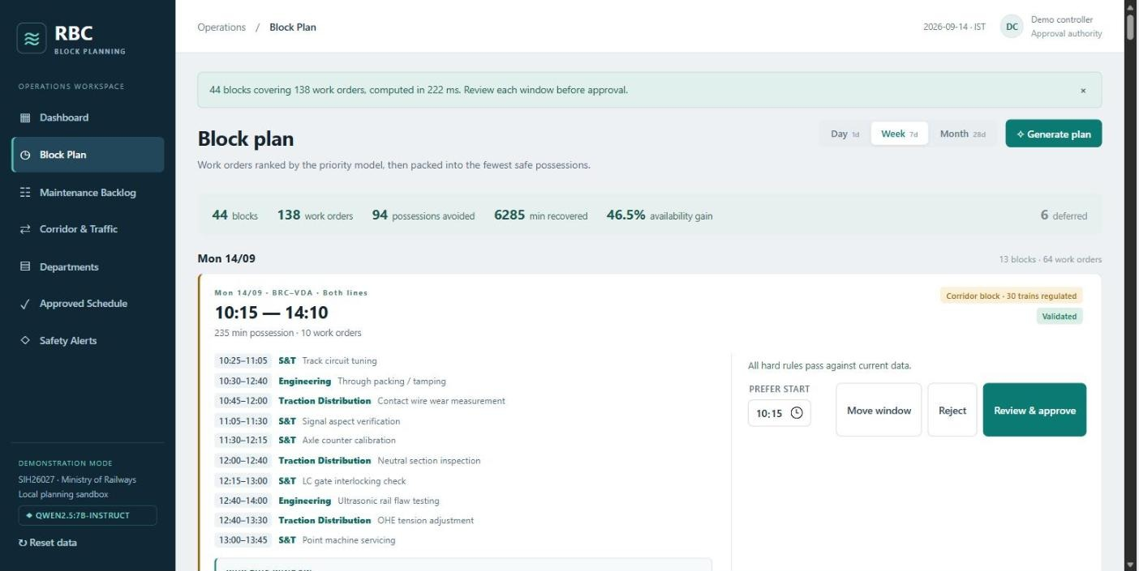
Our idea: one plan for all teams
Put all the work together, then fit it into the fewest closures.
0.25 sec
to plan a full week of work
1. Collect every pending job from all three teams
2. AI ranks them: what is most overdue and most likely to fail goes first
3. Group jobs on the same stretch into one closure, at the time that disturbs the fewest trains

Slide 4
The impact in one week
Compared with planning every job separately, on a real Western Railway line.
94
105 hours
138 of 144
46.5%
fewer track closures
of track time back to trains (6,285 min)
maintenance jobs planned
less track time lost to maintenance
• In a single day, the saving is even bigger: 60% less track time lost

Slide 5
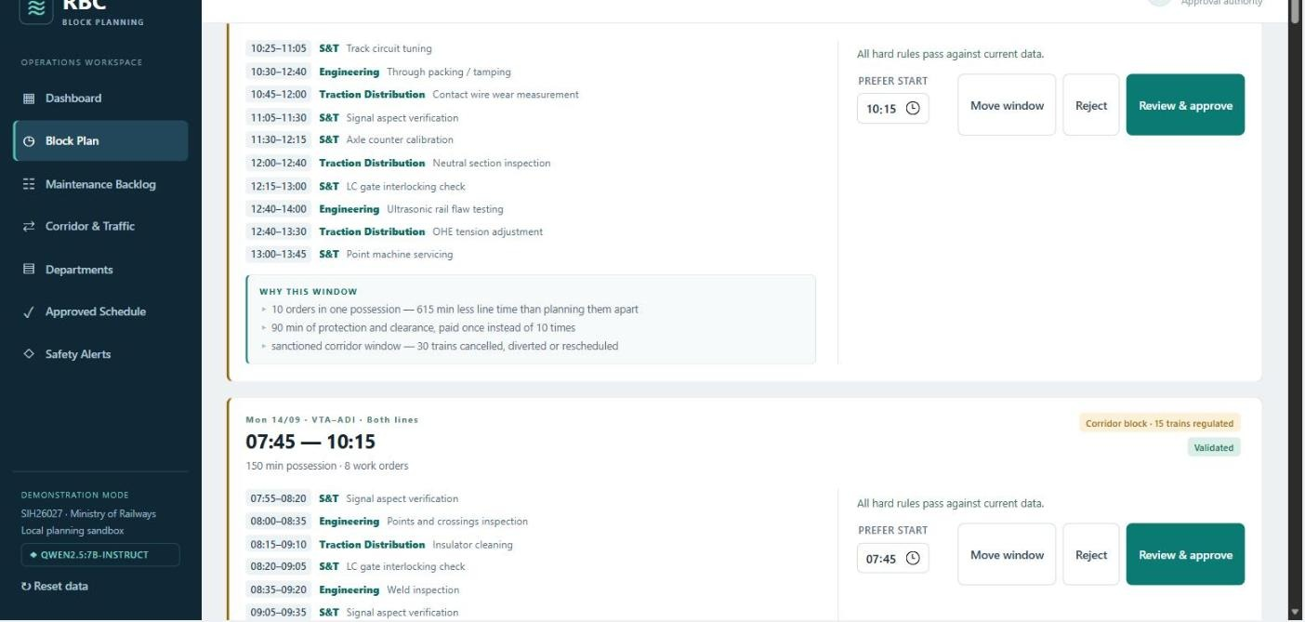
One example: 10 jobs, 3 teams, 1 closure
Instead of 10 separate closures on the same stretch.
615 min
1×
less track closed than doing the jobs separately
safety setup, instead of 10 times
• Teams work side by side in the same time window
• The app shows exactly why it picked this slot, and how many trains it affects

Slide 6
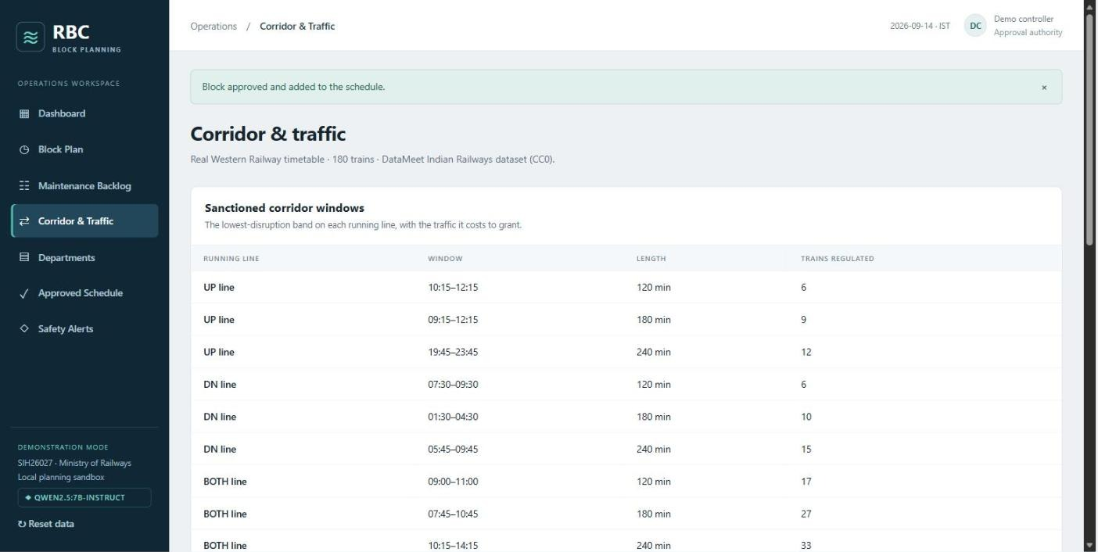
Built on real trains, not made-up data
Vadodara to Ahmedabad: 100 km, 180 real trains every day.
42 min
6 trains
the longest gap between trains when both tracks are closed
the fewest affected by the best planned slot
• The line is so busy that work cannot simply wait for a gap
• So the app finds the time slot that disturbs the fewest trains, and shows that cost up front

Slide 7
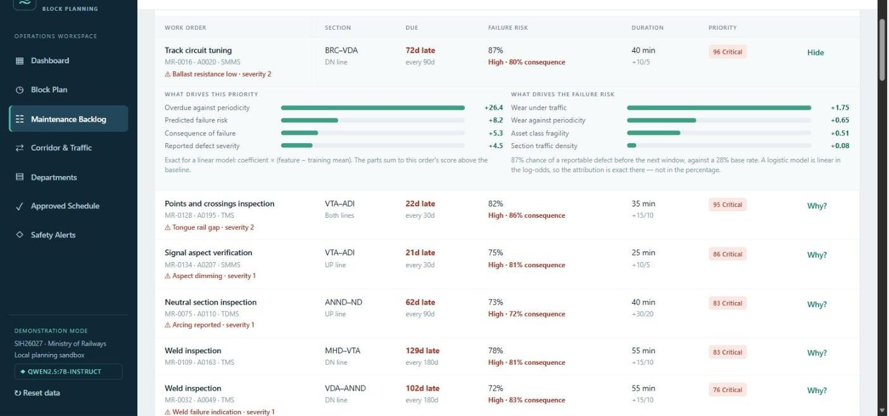
AI you can trust, because it explains itself
Click "Why?" on any job to see exactly what made it urgent.
77%
Almost 3×
of the time the AI picks the same time slot a planner chose
better than just taking the first free slot (28%)
• Predicts which parts are likely to fail before the next check
• Ranks jobs by how late they are, how risky they are, and how bad a failure would be
• No black box: every score is broken down into its reasons

Slide 8
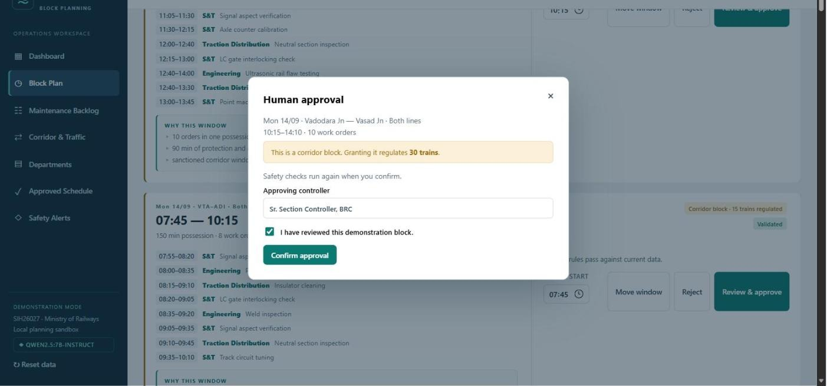
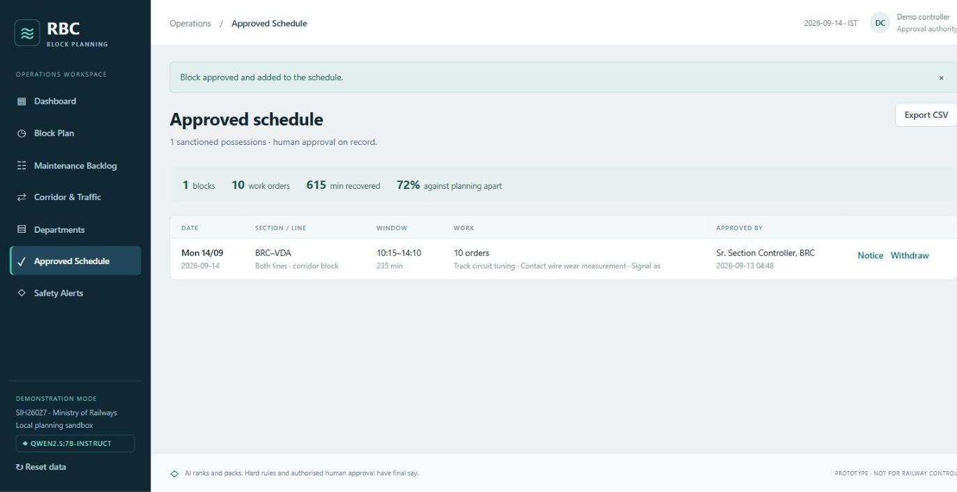
Safety first: AI suggests, people decide
Nothing is scheduled until a named controller approves it.
100%
of approvals re-checked against safety rules first
• Before approval, the app shows the cost clearly, like "this affects 30 trains"
• If a train runs late, an emergency comes in, or a closure is cancelled, the plan is checked again
• Every decision is recorded with who approved it and when

Slide 9
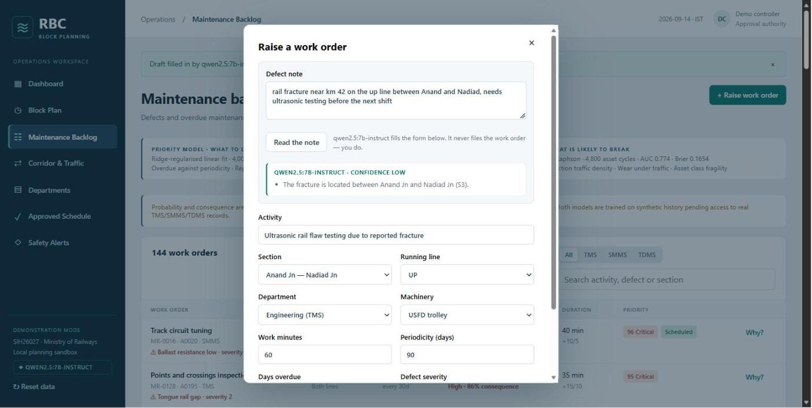
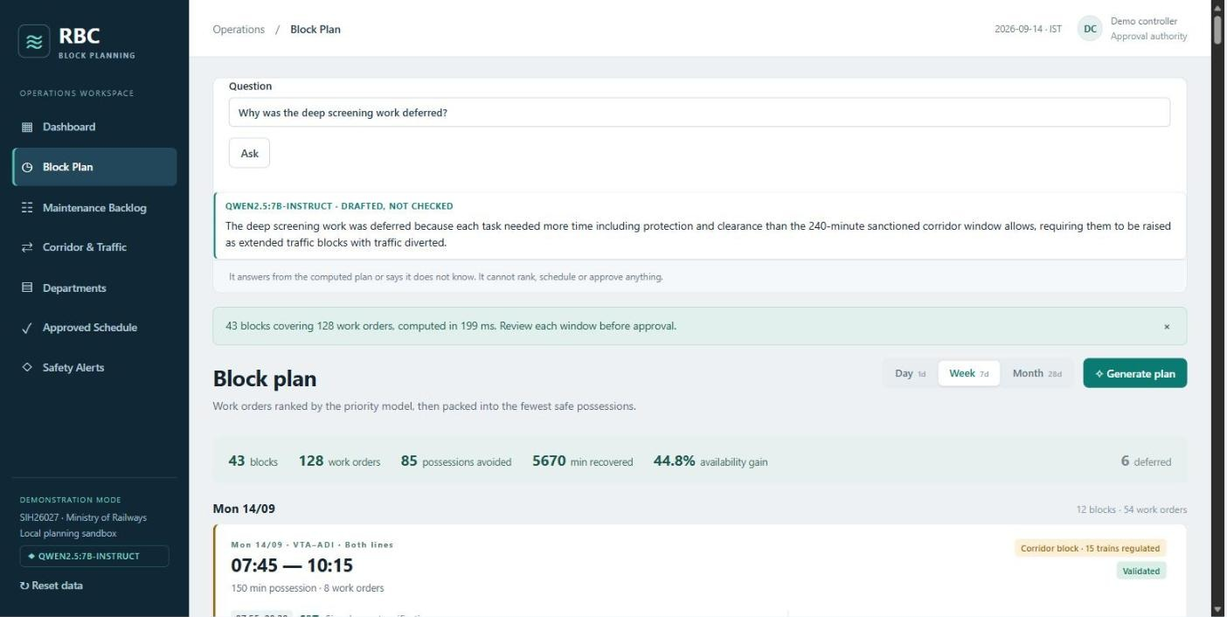
A built-in assistant that speaks plain language
Runs on the laptop itself. No internet needed, and no data leaves the machine.
• Type a note like "rail crack near km 42 on the up line" and it fills in the job form for you
• Ask "why was this job delayed?" and it answers from the plan, or says it does not know
• It only helps with words. Planning and safety decisions stay with the system and people.

Slide 10
Ready for a real railway division
More trains on time, safer tracks, and less wasted time for maintenance teams.
58
0
automated tests passing
internet, logins or paid services needed
• Uses real train timings today. Maintenance records are sample data, because real records are not public.
• Built to plug in real records from one division and retrain automatically
• Next step: a pilot on one real division

