Slide 1
PAYMENT INTEGRITY | PATTERN RECOGNITION
Catching Improper Payments Earlier
From simple rules to explainable machine learning, tested on 558,211 Medicare style claims
Rhutika Patil
Cotiviti Intern Assessment | Technology Solutions Analyst | September 2026
Notes:
Hi, I'm Rhutika. I chose the pattern recognition topic and focused on anomaly detection for payment, since that is the core of Cotiviti's business. I'll cover the problem, the trends, my prototype, and three options for Cotiviti.

Slide 2
The problem: billions paid incorrectly every year
CMS estimates for fiscal year 2025
$28.8B
Anomaly detection across TPO
T
Treatment
Medicare fee for service improper payments (6.55%)
Unusual prescribing or care that departs from guidelines
$23.7B
P
Payment (my focus)
Claims billed at unusual volume, amount, or combination
Medicare Advantage improper payments (6.09%)
O
Operations
Spikes in denials, delays in claim processing
Not all improper payments are fraud. Many are documentation errors. Source: CMS (2026)
Rhutika Patil | Cotiviti Intern Assessment
2
Notes:
CMS estimates almost 29 billion dollars in improper payments in traditional Medicare in fiscal 2025, and another 24 billion in Medicare Advantage. Anomaly detection applies across treatment, payment, and operations. I focused my prototype on payment because it is Cotiviti's core business, and the same method extends to the other two.

Slide 3
Four trends shaping payment integrity
1
Shift to before payment
2
Real time, AI assisted edits
CMS launched WISeR in Jan 2026: AI plus human review for prior authorization and prepayment review in six states.
Cotiviti's Aug 2026 Dental Claim Accuracy added real time processing and AI assisted rule authoring.
3
Rules to learning systems
4
Guardrails are tightening
Machine learning can flag fraudulent providers, but confirmed labels are rare and biased toward overt cases.
California SB 1120 and 2026 laws in states like Illinois and Georgia: AI can flag, a person must decide.
Sources: CMS (2026); Cotiviti (2026); Bauder & Khoshgoftaar (2018); Becker's Payer Issues (2026)
Rhutika Patil | Cotiviti Intern Assessment
3
Notes:
Four trends. First, the industry is moving from recovering money after payment to stopping errors before payment, with CMS's WISeR model as a clear example. Second, vendors including Cotiviti are adding real time and AI assisted tools. Third, machine learning works, but good labels are rare. Fourth, states are passing laws that say AI can flag, but a person must make the final decision. So explainability matters.

Slide 4
My prototype: raw claims to a review list
Kaggle Medicare style data (Gupta, 2019): beneficiary, inpatient, outpatient, and provider labels
558K
SQL
Stats
3
List
claims loaded
▶
provider profiles
▶
EDA and tests
▶
methods compared
▶
for auditors
4 tables, quality checked
5,410 providers, 19 features
Mann Whitney, z scores
Rules, Isolation Forest, Logistic Regression
ranked, with a reason
Why provider level? Fraud labels are given per provider, so each provider's claims are summed into one profile, like turning sequencing reads into a gene count matrix.
Rhutika Patil | Cotiviti Intern Assessment
4
Notes:
Here's the pipeline. I loaded all four Kaggle files, about 558 thousand claims, and checked data quality. Then I used SQL to roll claims up into one profile per provider, because the fraud labels are at the provider level. After exploring the data and running statistical tests, I compared three methods and produced a ranked review list for auditors.

Slide 5
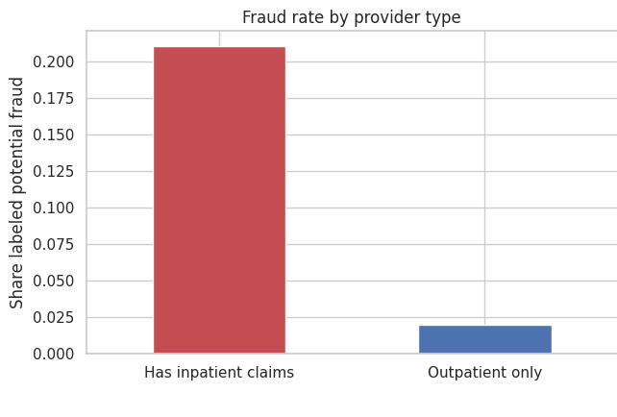
What the data shows
9.4%
of providers are labeled potential fraud...
53%
...yet they billed over half of all dollars
21% vs 2%
fraud rate: providers with inpatient claims vs outpatient only
25x
higher median total billing for fraud labeled providers
All group differences tested with Mann Whitney U (non parametric, suits skewed data).
Rhutika Patil | Cotiviti Intern Assessment
5
Notes:
A few findings from the exploratory analysis. Only 9.4 percent of providers are labeled potential fraud, but they billed 53 percent of all dollars. Providers with hospital claims are ten times more likely to be flagged. I used the Mann Whitney test because the data is very skewed.

Slide 6
Results: Logistic Regression ranks best
Held out test set of 1,082 providers; auditors review the top 10%
71%
of fraud providers caught by Logistic Regression while reviewing only 10% of providers
Random ranking PR AUC: 0.09
Isolation Forest used no labels at all, yet scored over 3x random. That matters where confirmed labels do not exist yet.
Rhutika Patil | Cotiviti Intern Assessment
6
Notes:
On a held out test set, logistic regression did best: reviewing just 10 percent of providers, it caught 71 percent of the fraud labeled ones. Simple rules were a strong baseline. Isolation Forest scored lowest, but it used no labels at all and still beat random by more than three times. In practice you want both: unsupervised to find new patterns, supervised for known ones.

Slide 7
Every flag comes with a reason
Top of the review list (test set), from Logistic Regression
Provider | Fraud probability | Total billed | Claims | Reason | Label
PRV56560 | 1.00 | $3,212,000 | 2,313 | High claim volume; high total reimbursement | Fraud
PRV52340 | 1.00 | $2,540,130 | 1,743 | High claim volume; high total reimbursement | Fraud
PRV56416 | 1.00 | $2,744,870 | 1,592 | High claim volume; high total reimbursement | Fraud
Why it matters
New state laws say AI may flag, but a person decides. Reasons let reviewers and providers check each flag.
Honest caveat
Most reasons are about size. Big honest hospitals can look suspicious too. Fix: compare each provider to peers of similar size and specialty.
Rhutika Patil | Cotiviti Intern Assessment
7
Notes:
An auditor will not act on a score alone, so each flagged provider gets a plain English reason from the model weights. One honest caveat: most reasons are about size. The fix is peer group comparison, which is my first next step.

Slide 8
SWOT: AI driven anomaly detection for payment
Strengths
Weaknesses
Scales to millions of claims
Ranks review queues by risk
Explainable options exist
Unsupervised needs no labels
Labels rare and biased
Unusual is not fraudulent
Size and specialty confound scores
Models drift over time
Opportunities
Threats
Demand for prepayment review
Reviewer decisions become labels
Extend to Treatment, Operations, dental
AI copilots for reviewers
State laws limit automated denials
Political scrutiny of AI in Medicare
Providers adapt to known edits
AI native competitors
Rhutika Patil | Cotiviti Intern Assessment
8
Notes:
Here's the SWOT. The main strength is ranking review work by risk at scale. The main weakness is labels: they are rare and biased. The big opportunity is demand for prepayment review, and the big threat is regulation limiting automated denials.

Slide 9
Options for Cotiviti
Option A | PILOT NOW
Option B | INVEST
Option C | POSITION
Explainable review queue prioritization
Hybrid model with a feedback loop
Compliant by design
Risk score plus reason codes on top of existing edits. 90 day test on one client's historical claims. Metric: improper dollars per reviewer hour.
Unsupervised for new patterns, supervised for known ones. Every reviewer decision becomes a label: a data asset competitors cannot copy.
Human review, reason codes, and audit trails on every AI flag. Turns state regulation into a selling point.
Recommendation: start with A now, design it to capture reviewer decisions for B, and market C across both. Monitor agentic AI reviewer copilots as guardrails settle.
Rhutika Patil | Cotiviti Intern Assessment
9
Notes:
Three options. A: a low risk pilot that adds explainable risk scores to prioritize review queues. B: invest in a hybrid model where every reviewer decision becomes a training label. C: position Cotiviti as compliant by design. My recommendation is to start with A, build it to feed B, and market C.

Slide 10
Next steps
1
Peer groups
Compare providers to others of the same specialty, region, and size
2
Claim level checks
Unbundling, upcoding, and billing after date of death, before payment
3
Real validation
Cross validation, tree models, and a client's confirmed audit outcomes
Thank you
Code, report, and notebook in the GitHub repository
Notes:
For next steps: peer groups to remove the size bias, claim level checks to catch problems before payment, and validation on real client data. Everything is in the GitHub repository. Thank you.

