Slide 1
Crypto-currencies!
What are they, how do they work, who cares?
Rhydian Jenkins
rhj24@aber.ac.uk

Slide 2
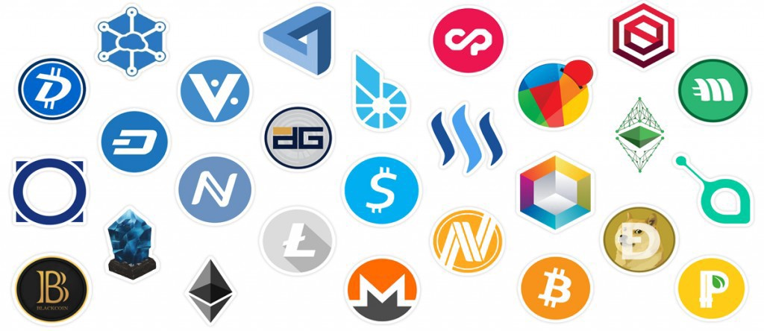

Slide 3
Some words about cryptocurrencies
There are no physical coins, it’s all digital
They are not associated with any governing body, completely decentralised
Meaning their worth is purely subjective
All transactions are public
Conceptually works the same as ‘regular’ money, just relies on very different technologies

Slide 4
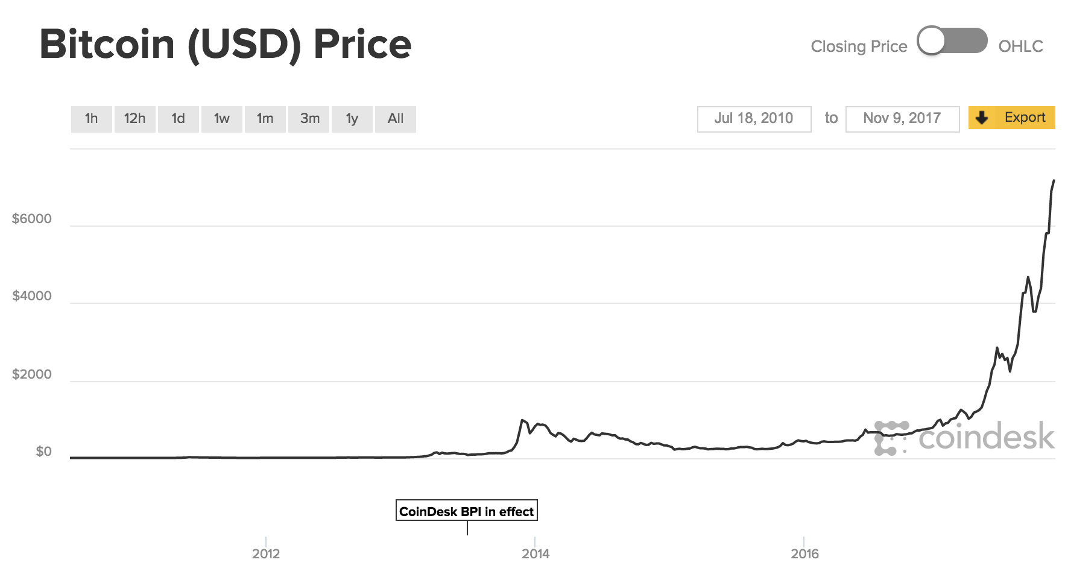
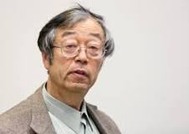
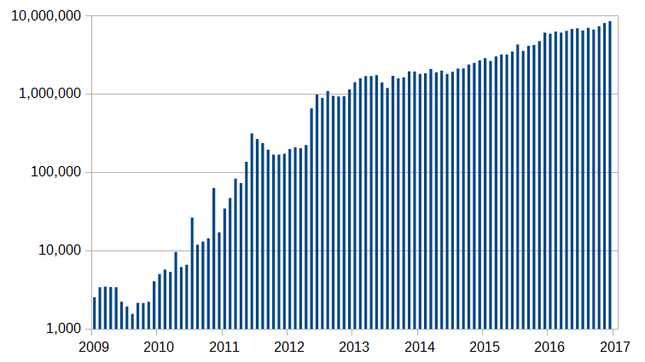
History of bitcoin
Satoshi Nakamoto, 2009

Slide 5

Cryptocurrencies: just the concept

Slide 6
Challenges
(1) All transactions to be immutable
(2) Everyone to agree on a single ledger
(3) A way to add initial funds to the ledger
(4) Be able to confirm the identity of participants to the ledger

Slide 7
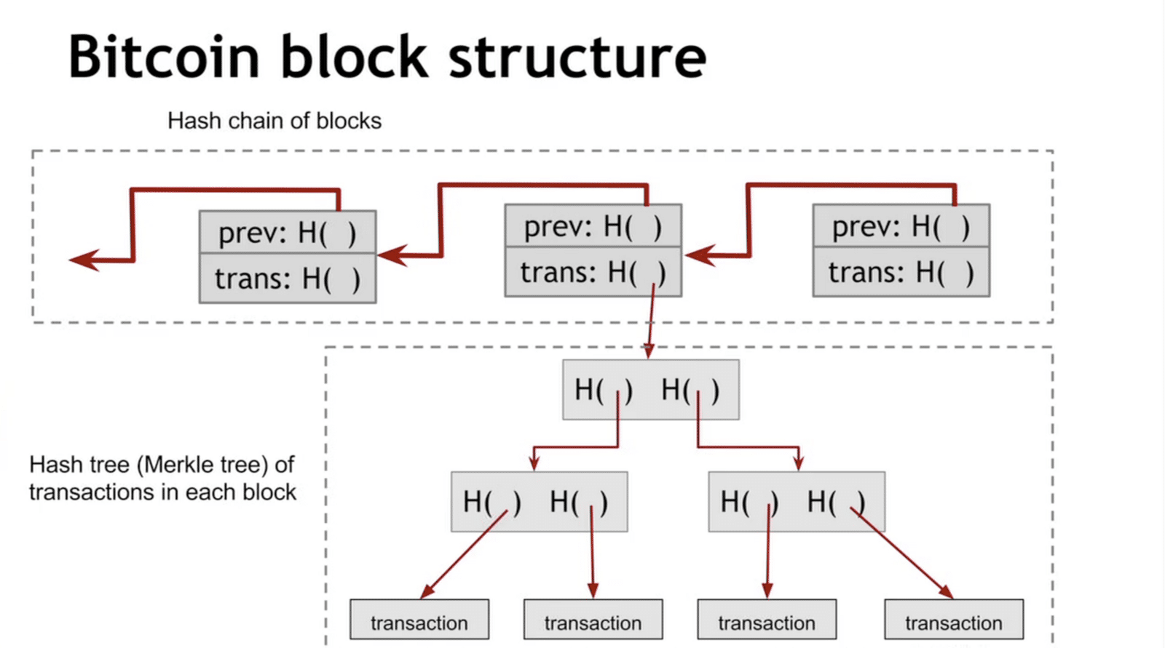
(1) Blockchaining
Lots of business hype at the moment
If you’re familiar with Git, it is similar in concept
https://coincentral.com/merkle-tree-hashing-blockchain/

Slide 8
(2) Proof of work
Hashing, one way algorithms
Takes a long time to find a hash salt that results in the hash of the block to begin with ‘00000000000’
Takes no time to confirm that hash salt
The process of finding this hash salt is called ‘mining’
(3) Those who mine the next hash salt get to add an agreed amount to their wallet

Slide 9
(4) Public / private keys

Slide 10
Further reading / recommended links
3blue1brown “Ever wonder how Bitcoin (and other cryptocurrencies) actually work?” - https://www.youtube.com/watch?v=bBC-nXj3Ng4
Somewhere to view the current latest block - https://blockexplorer.com/

