Slide 1
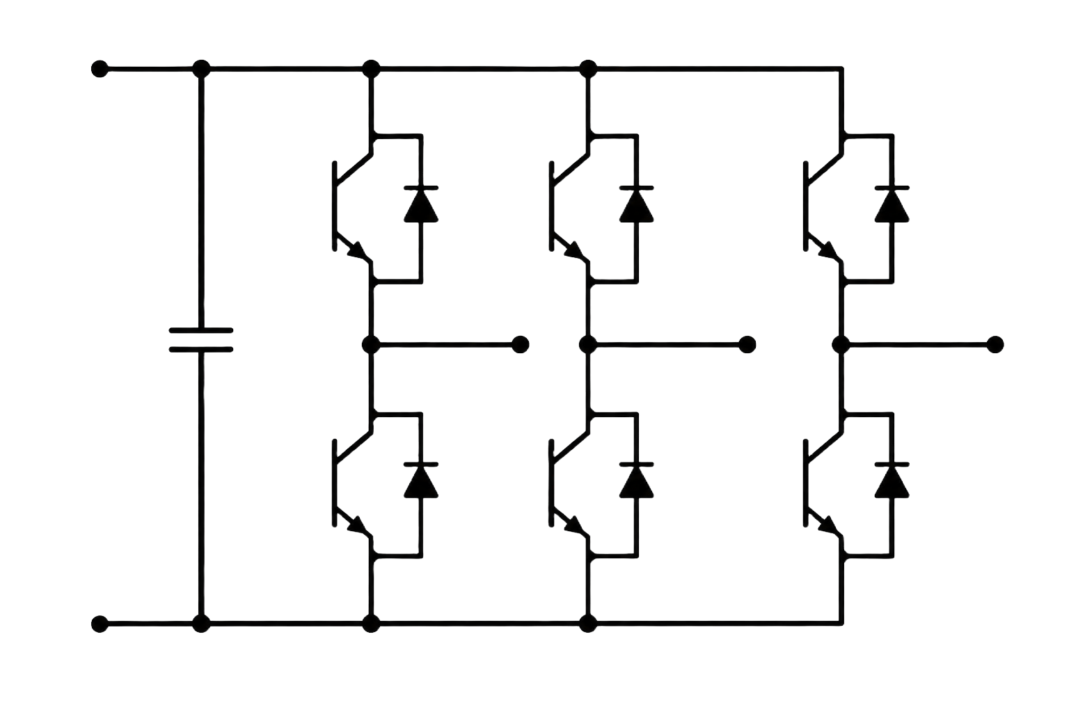

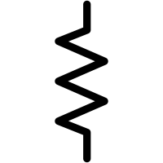
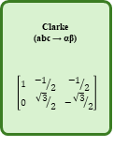

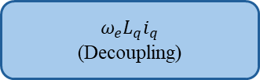

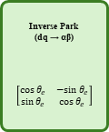
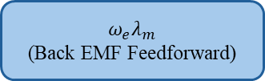

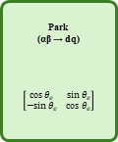
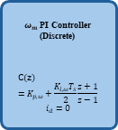
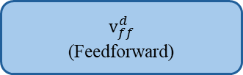

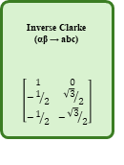

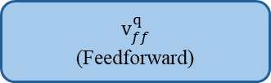




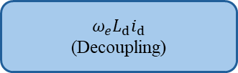

$$ω_{e}L_{q}i_{q}$$
(Decoupling)
_
+
$$v_{ff}^{d}$$
(Feedforward)
$ω_{m}$ PI Controller (Discrete)
$$C(z)=K_{p,ω}+\frac{K_{i,ω}T_{s}}{2}\frac{z+1}{z−1}$$
$$i_{d}=0$$
$$i_{d}^{∗}$$
+
$$e_{d}$$
$i_{d}$PI Controller (Discrete)
$$C(z)=K_{p,d}+\frac{K_{i,d}T_{s}}{2}\frac{z+1}{z−1}$$
$$v_{d,PI}$$
+
$$v_{d}^{∗}$$
Inverse Park
(dq → αβ)
$$\left[\begin{matrix}cos{ θ}_{e} & −sin{ θ}_{e} \\ sin{ θ}_{e} & cos{ θ}_{e}\end{matrix}\right]$$
$$v_{\text{α}}^{∗}$$
Inverse Clarke
(αβ → abc)
$$\left[\begin{matrix}1 & 0 \\ −1/2 & {\sqrt{3}}/2 \\ −1/2 & −{\sqrt{3}}/2\end{matrix}\right]$$
$$v_{\text{a}}^{∗}$$
SVPWM
(Space Vector Modulation)
$$D_{a}^{∗}$$
Inverter Bridge
$$v_{a}$$
-
+
PMSM
$$ω_{m}^{∗}$$
+
$$e_{ω}$$
$$v_{b}^{∗}$$
$$D_{b}^{∗}$$
$$v_{b}$$
-
$$i_{q}^{∗}$$
+
$$e_{q}$$
$i_{q}$PI Controller (Discrete)
$$C(z)=K_{p,q}+\frac{K_{i,q}T_{s}}{2}\frac{z+1}{z−1}$$
$$v_{q,PI}$$
+
$$v_{q}^{∗}$$
$$v_{β}^{∗}$$
$$v_{c}^{∗}$$
$$D_{c}^{∗}$$
$$v_{c}$$
-
+
Position Sensor
(Encoder/Resolver)
$$ω_{m}$$
(Angular Velocity)
$$ω_{e}L_{d}i_{d}$$
(Decoupling)
+
+
$$v_{ff}^{q}$$
(Feedforward)
$$θ_{m}$$
(Mechanical Angle)
+
$$θ_{e}$$
(Electrical Angle)
$$ω_{e}λ_{m}$$
(Back EMF Feedforward)
$$θ_{e}$$
(Electrical Angle)
$$θ_{e}=\frac{θ_{m}}{p}$$
$$ω_{m}$$
(Angular Velocity)
$$\frac{dθ_{m}}{dt}$$
$$i_{a}$$
$$i_{b}$$
$$i_{c}$$
$$i_{\text{d}}$$
Park
(αβ → dq)
$$\left[\begin{matrix}cos{ θ}_{e} & sin{ θ}_{e} \\ −sin{ θ}_{e} & cos{ θ}_{e}\end{matrix}\right]$$
$$i_{\text{α}}$$
Clarke
(abc → αβ)
$$\left[\begin{matrix}1 & {−1}/2 & {−1}/2 \\ 0 & {\sqrt{3}}/2 & −{\sqrt{3}}/2\end{matrix}\right]$$
$$i_{a}$$
Anti Aliasing Filter
(Low Pass Filter)
$$i_{a}$$
Shunt Resistors & Gain Stage
(Current Sense Amplifier)
$$i_{a}$$
ADC
(Sampled at $T_{s})$
$$i_{b}$$
$$i_{b}$$
$$i_{b}$$
$$i_{q}$$
$$i_{β}$$
$$i_{c}$$
$$i_{c}$$
$$i_{c}$$
$$θ_{e}$$
(Electrical Angle)

Slide 2

DQ Model of Permanent Magnet Synchronous Motors (PMSMs)
$$v_{d}=R_{s}i_{d}+L_{d}\frac{di_{d}}{dt}−ω_{e}L_{q}i_{q}$$
$$v_{q}=R_{s}i_{q}+L_{q}\frac{di_{q}}{dt}+ω_{e}L_{d}i_{d}+ω_{e}λ_{m}$$

