Slide 1
PROJECT TOPIC:
DESIGN AND IMPLEMENTATION OF A WEB BASED SOCIAL NETWORKING WEBSITE FOR POLYTECHNICS STUDENTS

Slide 2
ABSTRACT
The polyconnect (polytechnics students social networking system) have low approach to the community’s social networking where by students under the umbrella finds it difficult to identify with fellow polytechnic student in Nigeria, because the system lacks common platform for online social relationship. This research is proposed to solve the problem of social networking among polytechnic students.
Social media has truly aided interaction and even other business services through social networks, forums, blogs, etc. Forums are now been used as tools/ platforms to create discussions, connect to people (mostly of similar interests) and as sources of relevant information. This work intends to make use of forms as tools in helping polytechnic students to connect with one another.

Slide 3
AIM AND OBJECTIVES OF THE STUDY
The aim of this study is to design and develop a web/online platform where students can share different questions or views on various topics under the West African polytechnic interest. This will be achieved through the following objectives:
The objectives of this study are:
To design and implement a web based social networking system for students and staff for the schools.
Create a profiling system in the platform that will capture the full information of users in the polytechnic.
Develop a user-friendly platform for easy use and interaction

Slide 4
DEFINITION OF TERMS
Application: Application software is software designed to perform a group of coordinated functions, tasks, or activities for the benefit of the user
Social Networking: Social media are interactive computer-mediated technologies that facilitate the creation and sharing of information, ideas, career interests and other forms of expression via virtual communities and networks.
Internet: A global computer network providing a variety of information and communication facilities, consisting of interconnected networks using standardized communication protocols.
Computer program: A computer program is a collection of instructions that performs a specific task when executed by a computer. A computer requires programs to function. A computer program is usually written by a computer programmer in a programming language
PHP: Hypertext Pre-processor is a general-purpose programming language originally designed for web development. It was originally created by Rasmus Lerdorf in 1994; the PHP reference implementation is now produced by The PHP Group
Blog: A blog is a discussion or informational website published on the World Wide Web consisting of discrete, often informal diary-style text entries. Posts are typically displayed in reverse chronological order, so that the most recent post appears first, at the top of the web page
Forum: A meeting in which people can talk about a problem or matter especially of public interest.

Slide 5
PAST RELATED WORKS
The Student Room
The world's largest student community, The Student Room have attracted students to the site for help with their studies, advice from their peers and, quite often, just to have a good conversation. It is ranked as one of the first 500 visited websites in the United Kingdom (Alexa, 2014).
Google Groups
Google Groups is a service from Google Inc. that provides discussion groups for people sharing common interests. It became operational in February 2001, following Google’s acquisition of Deja’s Usenet archive. A new and redesigned Google Groups was released in February 2012 with an updated user interface. A Help Center has also been created to cater for users with this new interface (Maluniu, et al., 2013.
Yahoo groups
Yahoo! Groups is one of the world's largest collections of online discussion boards. The term Groups refers to Internet communication which is a hybrid between an electronic mailing list and a threaded Internet forum, in other words, Group messages can be read and posted by email or on the Group's webpage like a web forum.
D groups
Dgroups is a partnership of international development organizations working together towards a common vision: A world where every person is able to contribute to dialogue and decision making for international development and social justice (Wiki, 2019)

Slide 6
METHODOLOGY
Social media is a form of electronic communication which facilitates interaction based on certain interests and characteristics. Social media are media for social interaction, using highly accessible and scalable publishing techniques. Social media use web-based technologies to transform and broadcast media monologues into social dialogues (Idakwo, 2011). A social media network platform is one that provides a medium for interaction by groups of people making it easy to share information (such as lecture materials, pictures and ideas) across a circle of people or groups. Statistics has shown that the use of social network such as Facebook, Twitter and LinkedIn is on the increase most especially among young individuals, the crop of which are students of tertiary institutions (Ikhu-Omoregbe et al., 2012).

Slide 7
INSTRUMENTS USED
Instruments used can be broken down into:
Minimum of 1GB, Random Access Memory (RAM)
Minimum of 32 Bit Video Graphics adapter (VGA)
Modem or Ethernet Card
Keyboard and Mouse
Uninterruptible Power Supply (UPS)
The software for development of the system are:
Programming language: Html/css/javascript, php.
Database used: MySQL database management system
Web servers: Xampp and MySQL server
Operating system: Windows 10
Model design tools: Microsoft office visio 2016
Integrated Development Environment: Brackets and visual studio code

Slide 8
SYSTEM DESIGN
System design can be broken down into the following components:
User interface design
Database design
UML design

Slide 9
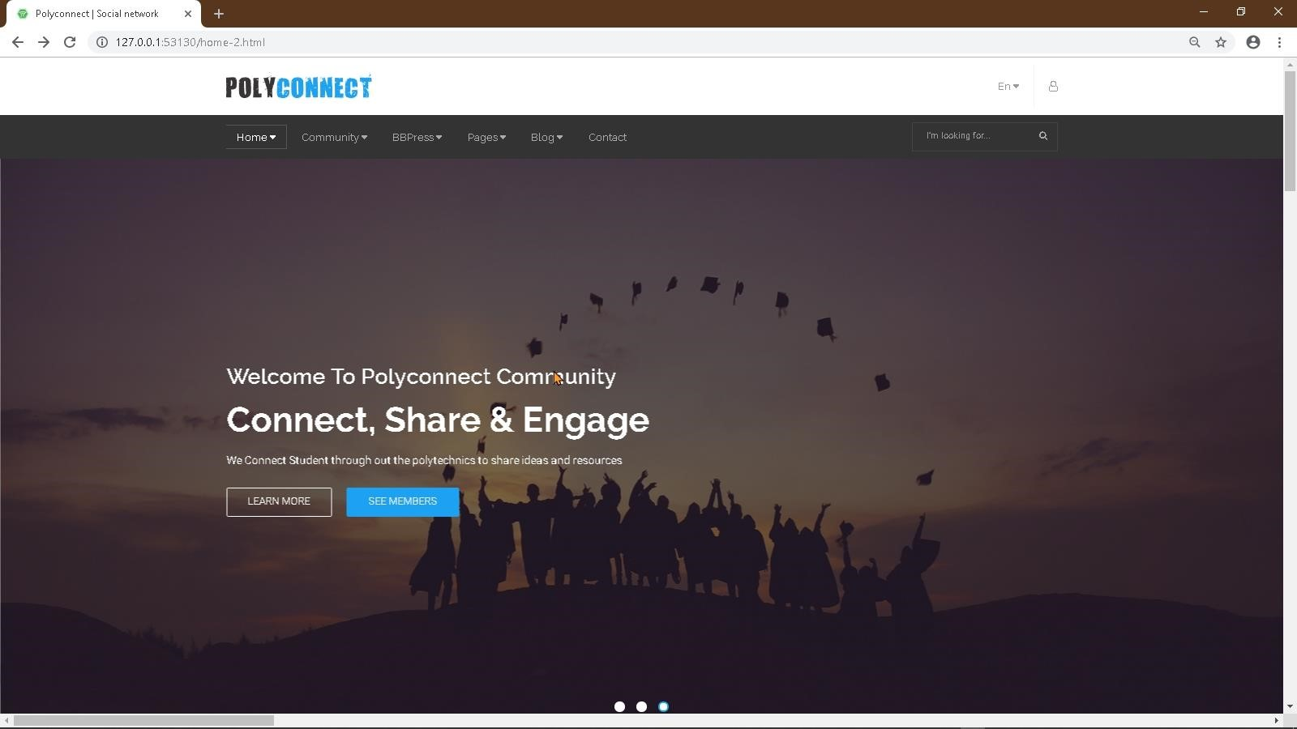
USER INTERFACE DESIGN
Homepage

Slide 10
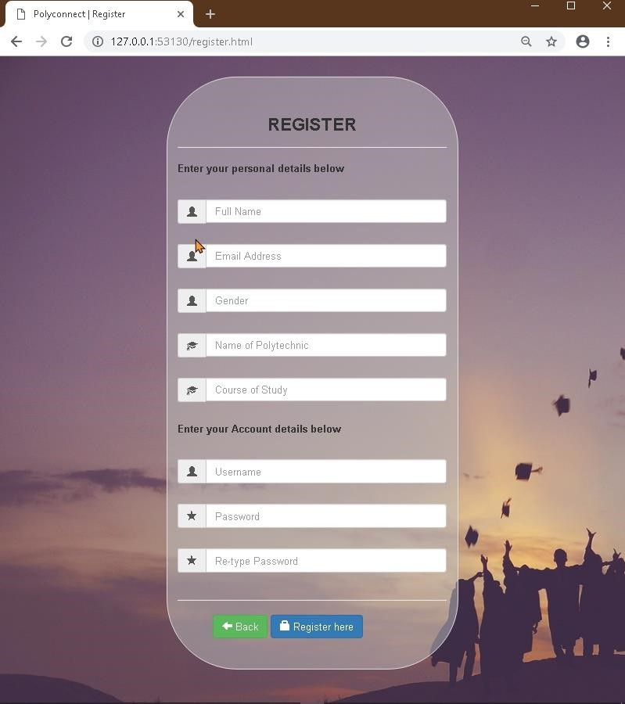
USER INTERFACE DESIGN
Registration interface

Slide 11
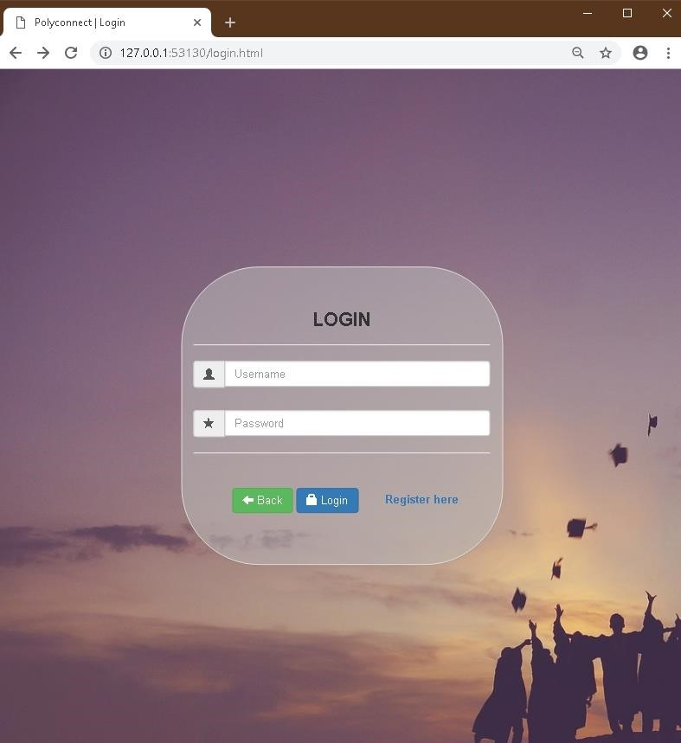
USER INTERFACE DESIGN
Login interface

Slide 12
DATABASE DESIGN
Table Name | Column | Description
Admin | id(PK), username, password | Stores the admin login details
Guest | id(PK), fullname, username, | Stores the guest student’s
 | email, int_course, gender, password | profile details
Moderator | id(PK), fullname, username, | Stores moderator’s profile
 | email, password, postheld | details
News | id(PK), title, news, | Stores and maintains all news
 | date_time | posted by the moderator

Slide 13
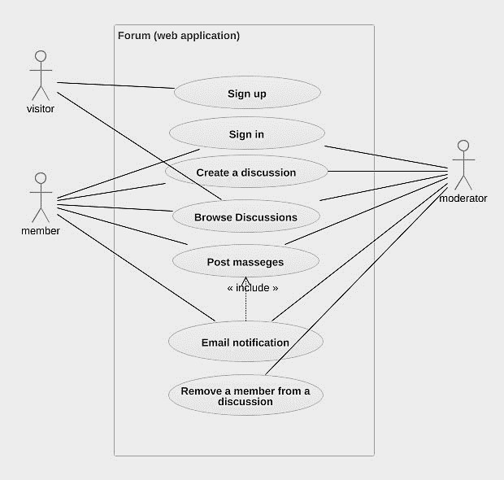

UML DESIGN: CASE DIAGRAM
Figure 8:
The Use
-
Cas
e diagram for the Online Forum
Figure 8:
The Use
-
Cas
e diagram for the Online Forum

Slide 14
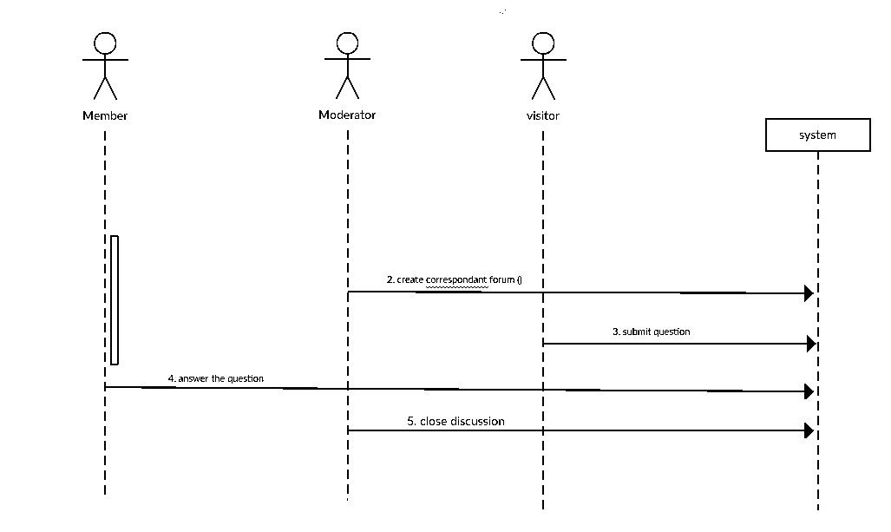
UML DESIGN: SEQUENCE DIAGRAM

Slide 15
CONCLUSION
As the social media grows, online forums like polytechnics students social networking system will be relevant to students in the schools. Even as other versions will be later developed, the activities and features on the site will increase because they will be built to meet the end-user’s requirements.
Online forums have presented students with systems designed for the discussion of topics, with each topic separated into its own area, called a thread. A thread is begun by a user writing a short document, called a post, which introduces the topic or asks a question about the topic (Liu, et al., 2010).

