Slide 1
Climate Model Performance and Overfitting Analysis
Prepared for ClimateWins • Presenter: Rhys Ingalls • Date: Oct 18, 2025

Slide 2
Objectives & Working Hypotheses
Objective: Evaluate ML approaches to classify 'pleasant' weather days by station and compare model performance.
H1: A compact ANN (e.g., two hidden layers) will generalize best across stations for 'pleasant' weather classification.
H2: A single decision tree will achieve very high train accuracy but show signs of overfitting.
H3: Temperature distribution differs by station and helps explain station‑level performance differences.

Slide 3
Data Origin, Coverage, Bias & Accuracy
Data: Historical daily weather features from multiple European weather stations (processed CSVs).
Coverage: 15 stations, multi‑year period; label = 'pleasant' weather (binary).
Potential biases: station sampling, time‑period shifts, label imbalance, localized climate idiosyncrasies.
Data quality: Stations vary in observations; accuracy ultimately measured with held‑out test sets per station.

Slide 4
Optimization Recap: Gradient Descent Findings
Optimization practice: Gradient Descent (α = 0.01, 100 iterations) converged smoothly across stations/years.
Shared linear characteristics allowed the same α and iteration count to work broadly without instability.
Result: Stable convergence and minimal final loss—good foundation for feature scaling and ML preparation.

Slide 5
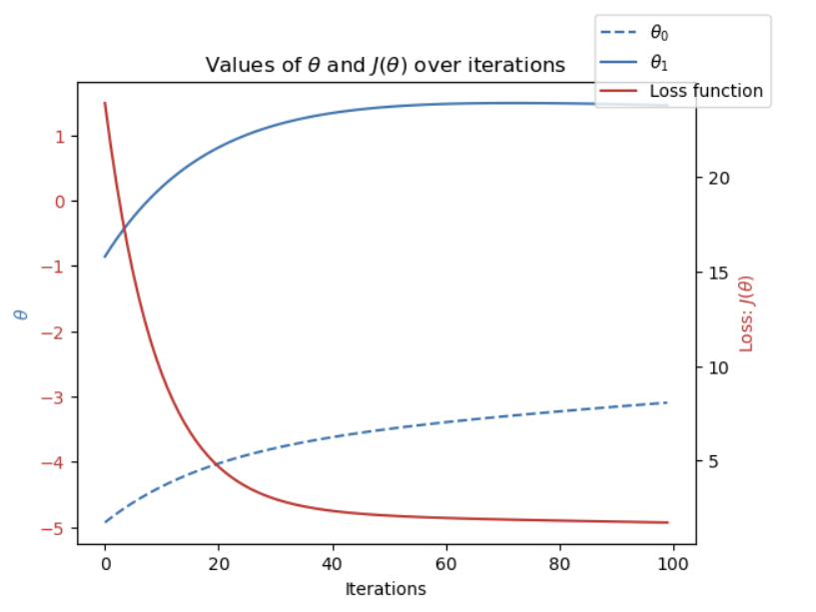
Gradient Descent: Loss vs Iterations

Slide 6
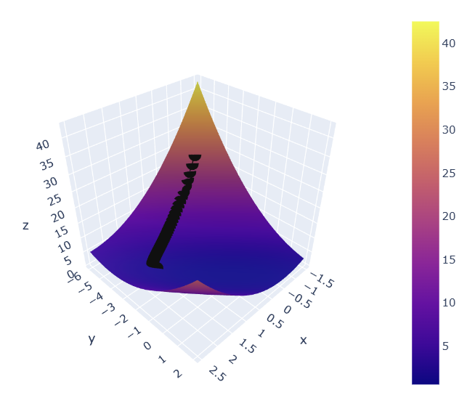
Gradient Descent: 3D Loss Surface

Slide 7
Supervised Learning: Models & Rationale
Compared KNN, Decision Tree, and ANN on scaled features.
Decision Tree (max_depth=6) achieved 1.000 train and 1.000 test accuracy but showed diagonal‑only confusion matrices → classic overfitting risk.
ANN (5,5) on scaled data: Train 0.981, Test 0.975 — best generalization across stations.
Deeper ANNs (10,5) and (20,10,5) did not improve test accuracy; marginally higher false negatives.

Slide 8
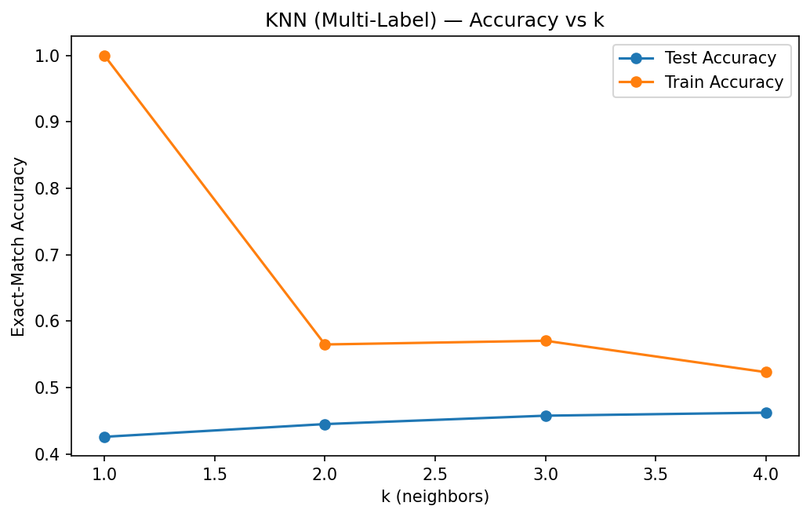
KNN: Accuracy vs k

Slide 9
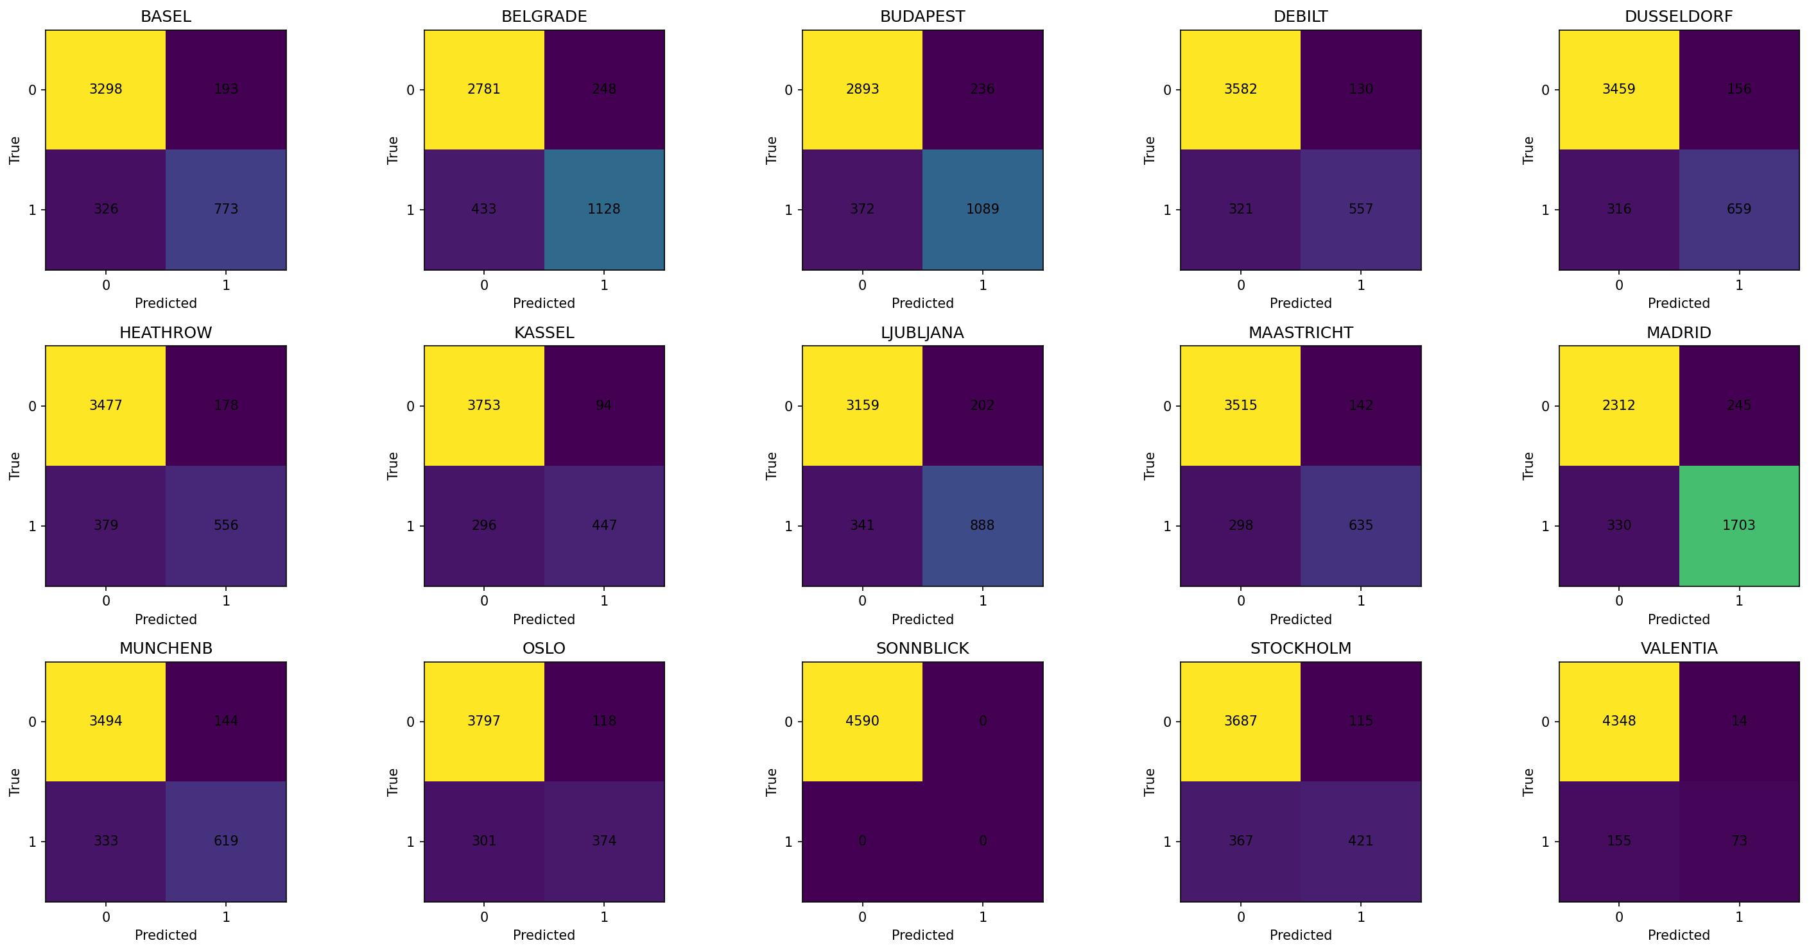
KNN: Confusion Matrices Grid

Slide 10
Results at a Glance
Best overall: ANN (5,5), scaled — strong generalization (≈97–98% test accuracy).
Decision Tree: Perfect scores but likely to fail on new data (memorization).
Station effects: Top performers included Madrid, Belgrade, Budapest; more variability at Sonnblick, Valentia.
Observed overfitting gap example: ~28.9% higher train than test accuracy for ANN in aggregate view.

Slide 11
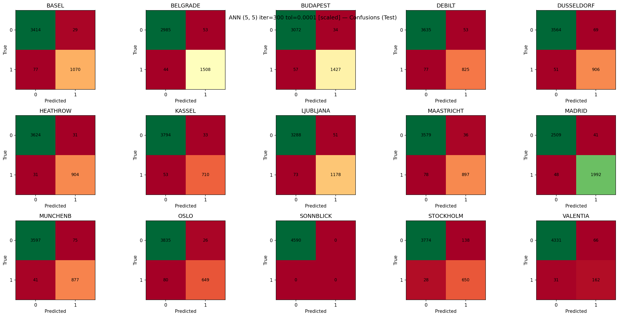
ANN (5-5) Confusion Matrix

Slide 12
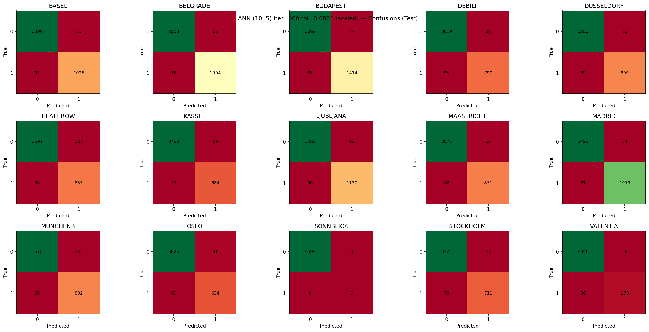
ANN (10-5) Confusion Matrix

Slide 13
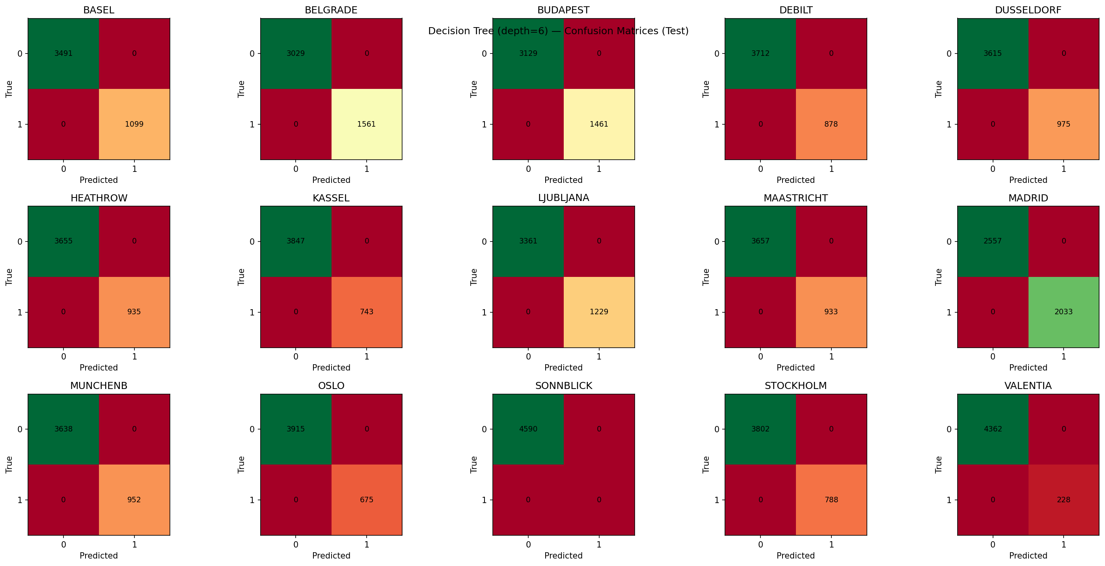
Decision Tree (Depth 6) Confusion Matrix

Slide 14
Dashboard Artifacts (Tableau)
Tableau dashboard includes:
• Temperature Distribution by Station (stacked histogram of counts).
• Model Performance by Station (accuracy bar chart).
• Algorithm Accuracy Comparison (train vs test).
• Overfitting Analysis (train–test gap as %).
Key takeaways are embedded as captions on the dashboard.

Slide 15
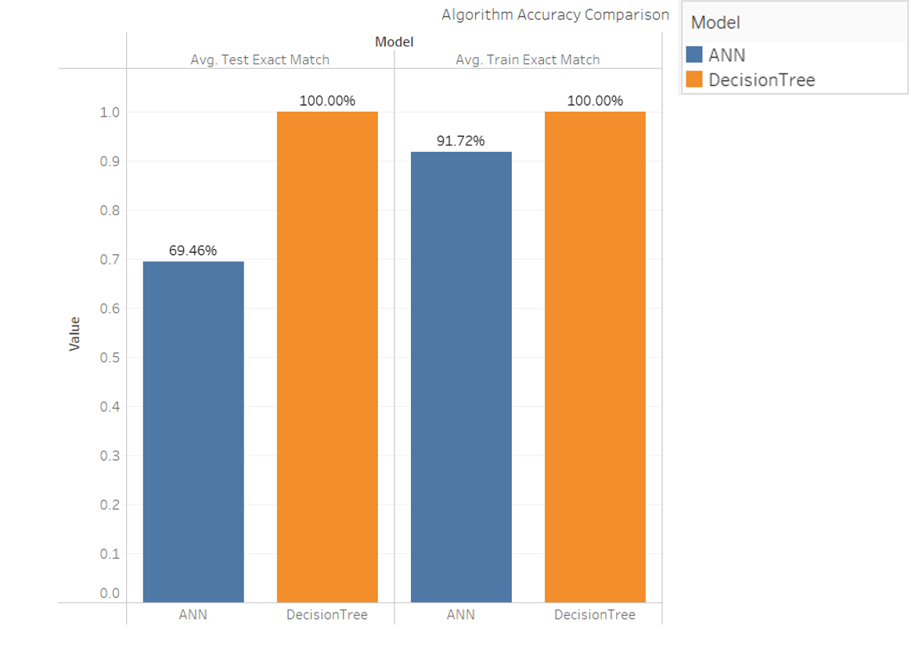
Model Comparison: Train vs Test Accuracy

Slide 16
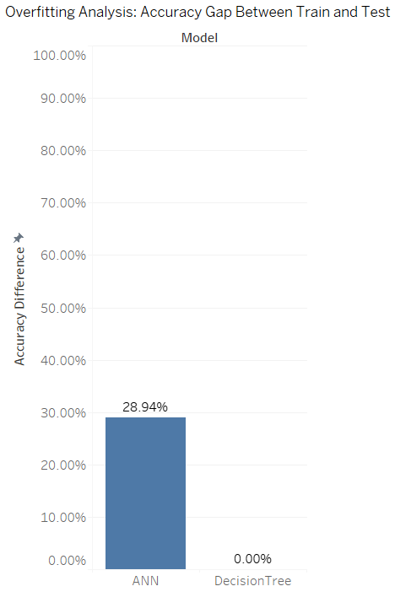
Overfitting Gap by Model

Slide 17
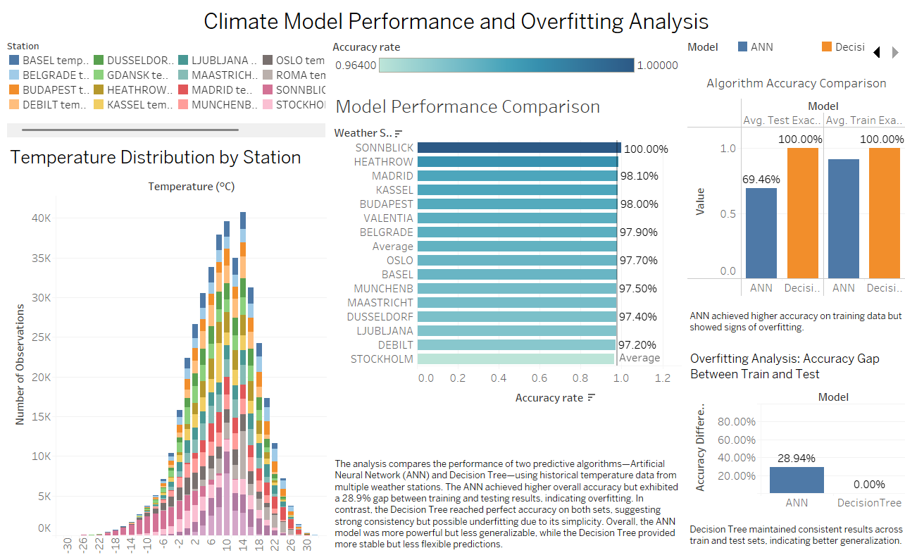
Tableau Dashboard

Slide 18
Next Steps & Future Analysis
Run k‑fold cross‑validation per station to quantify generalization spread.
Address class imbalance (if present) with stratified sampling or calibrated thresholds.
Try regularized tree ensembles (Random Forest, XGBoost) with early stopping.
Tune ANN with dropout and weight decay; evaluate ROC‑AUC and calibration.
Document data provenance & bias checks; set up model monitoring for drift.

Slide 19
Thank You
Questions?
Thank you for your time.
Email: contact@rhysingalls.com

