Slide 1
Tutorial Level

Slide 2
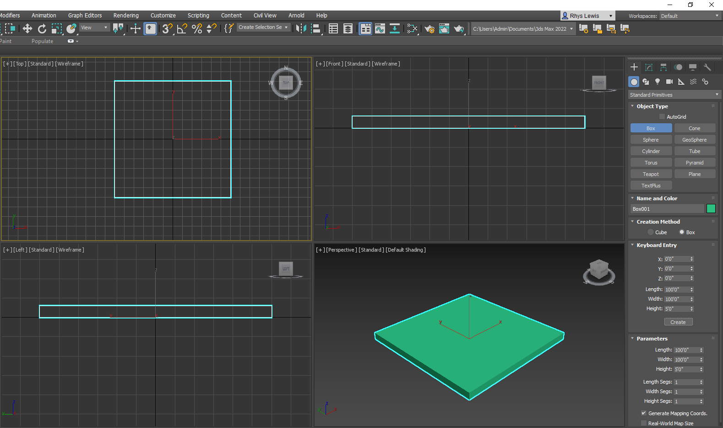
So, we are starting off our tutorial level by adding a base platform. The platform has the length 100”, width 100” and a 5” in height. It is also worth adding the units are American standard which is feet/ inches.

Slide 3
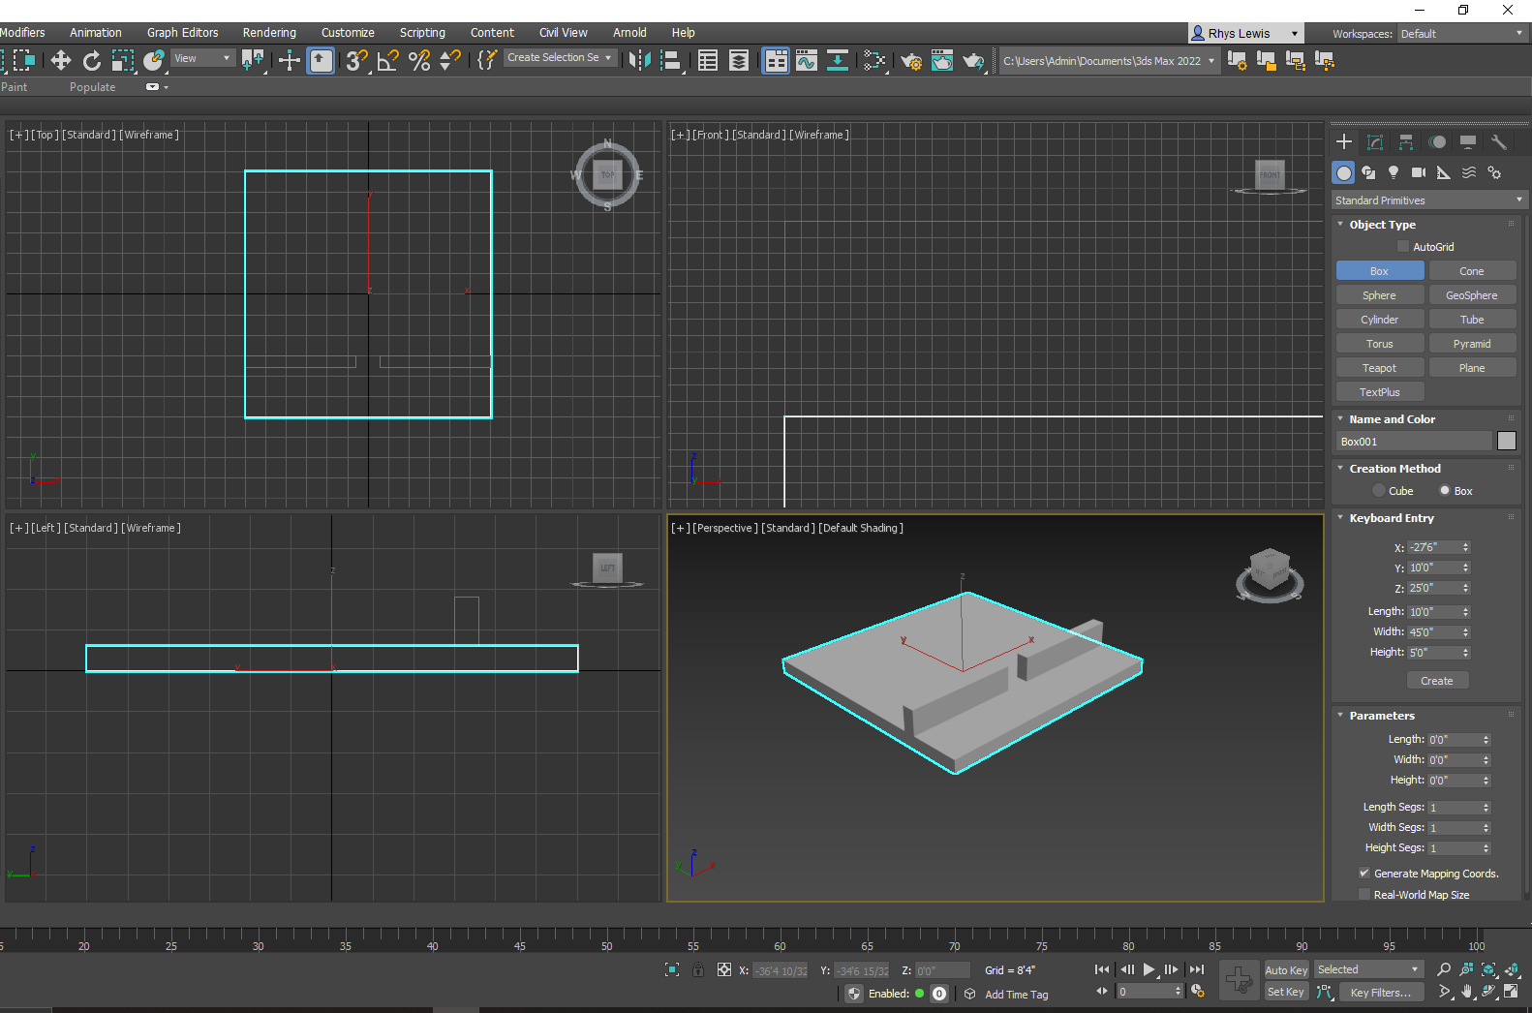
I have decided my base colour for this will be grey this is because I don’t want the player to think this is the actual game, I want them to be able to understand this is just a tutorial and the actual game will be very different. I have also added 2 walls, the player will spawn at the bottom and when making their way through will be able to get a feel for the size of their tank while also learning how to move.

Slide 4
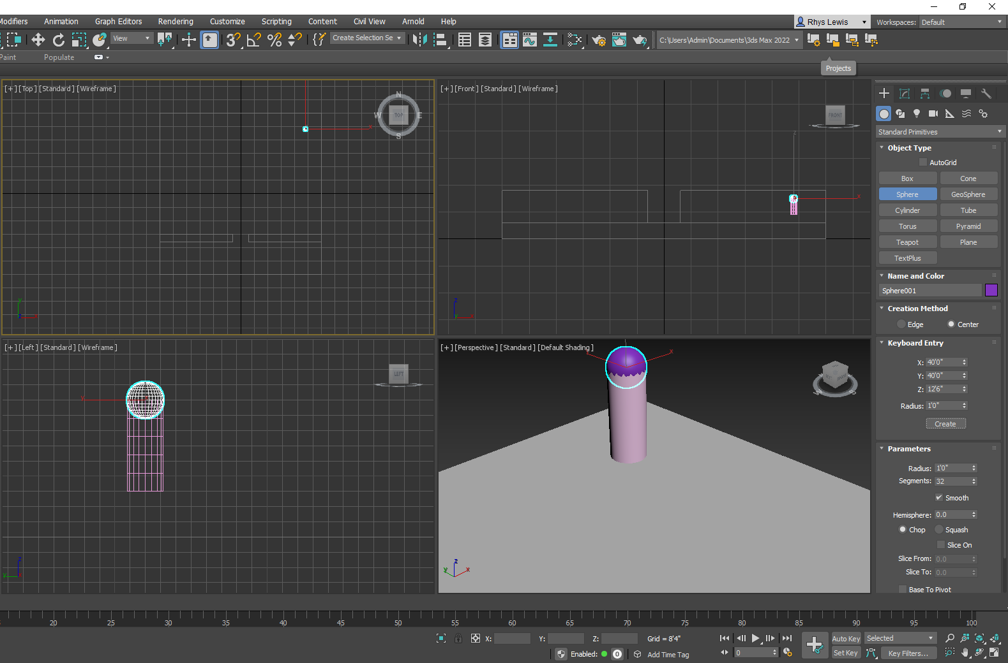
Here I have used a cylinder and a sphere to create this shape which will be used as a prop.

Slide 5
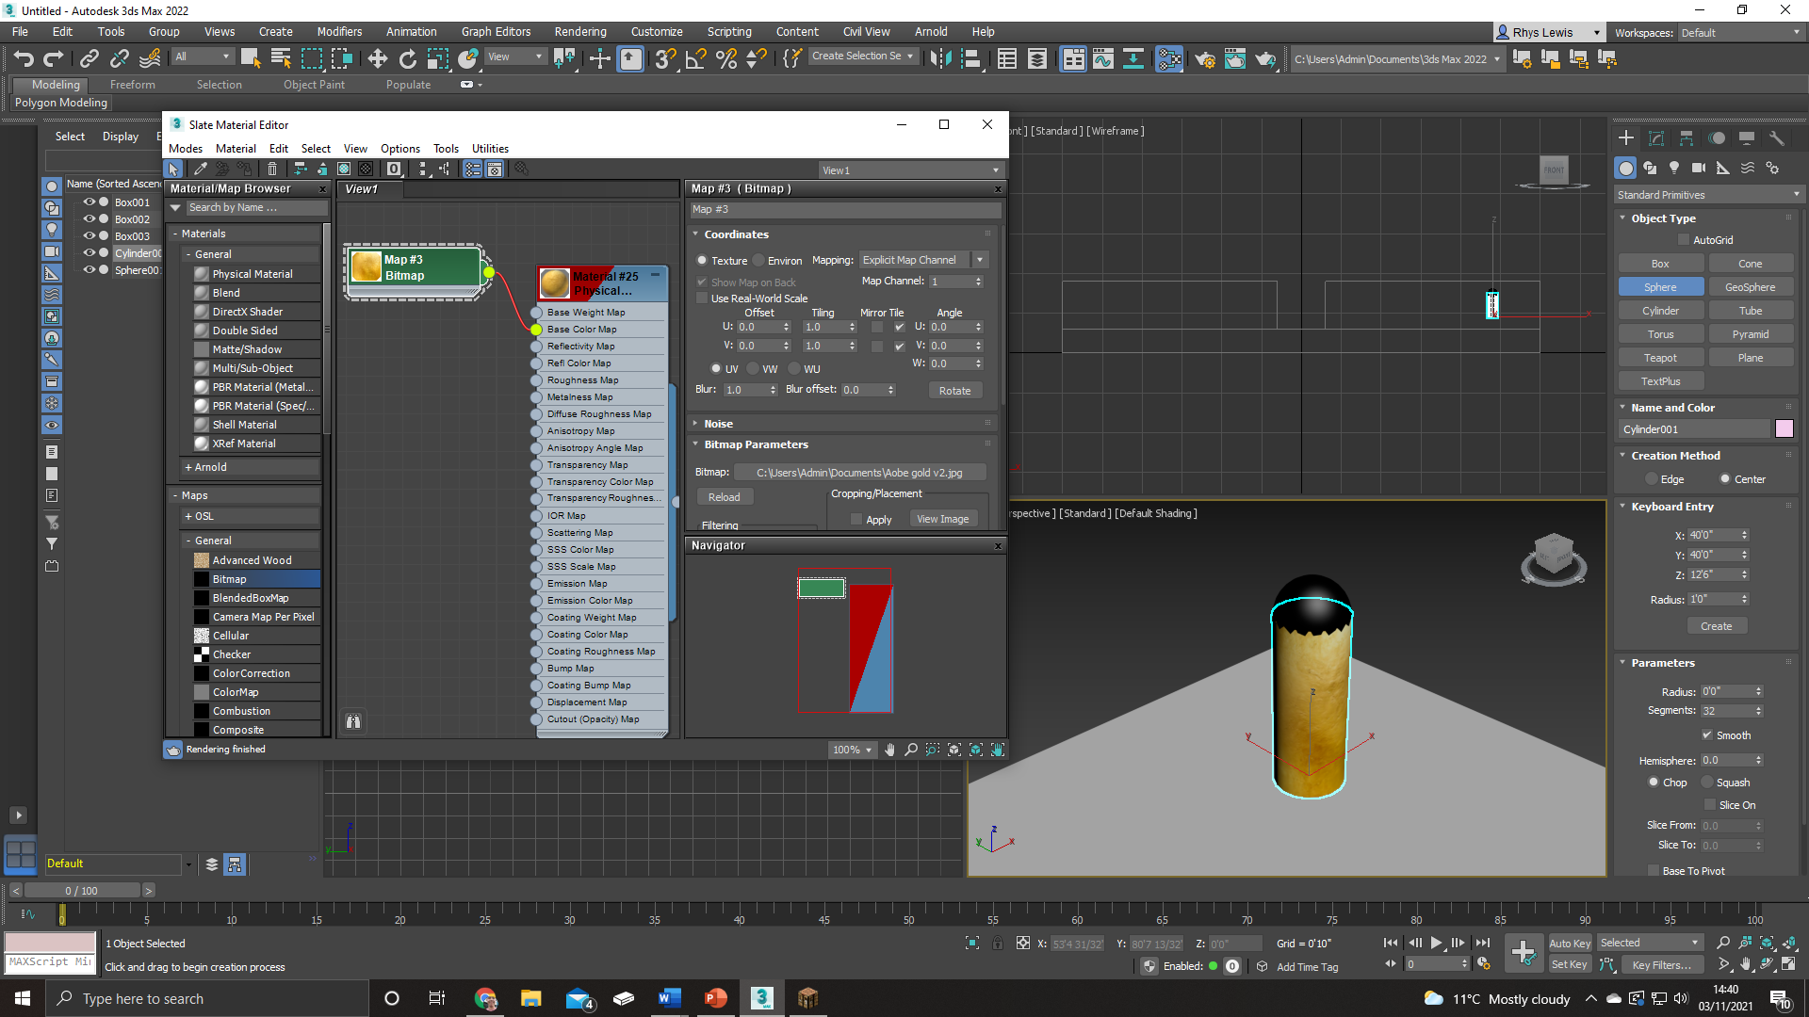
Here I have changed the colour of the sphere to black and then I have textured the cylinder. I textured the cylinder by adding a physical material to it then bitmapping an image to it and adding that to the physical material colour. Every image I have used to bitmap is from adobe stock.

Slide 6
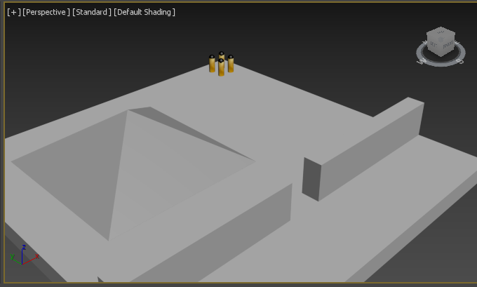
I have then also added a pyramid as a ramp so the player can get a fell for the gravity withing the game and can get use to moving over thing and not always having to go around them.

Slide 7


