Slide 1
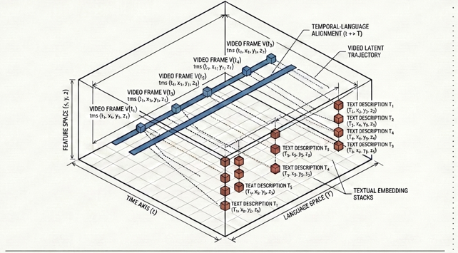
Dynamic Reflections:
Probing Video Representations With Text Alignment
Introduction to Generative Artificial Intelligence
Maria Paul T MDS202424
Raja S – MDS202430
Chennai Mathematical Instituite

Slide 2

Introduction
This work presents the first comprehensive study extending cross-modal representation alignment from static images to dynamic video data.
While prior research has shown that vision and language models develop similar latent spaces for images and text, the temporal nature of videos including motion, causality, and sequential dependencies remains largely unexplored.
The authors investigate whether state of the art video encoders align with text encoders as strongly as image encoders do, and what factors influence this alignment.
Their findings reveal that test-time data richness, including both the number of video frames and the diversity of captions, dramatically improves alignment scores. This research bridges offers new insights into how AI systems perceive dynamic visual content.

Slide 3

Introduction..
The Platonic Representation Hypothesis
The Platonic Representation Hypothesis, introduced by Huh et al. in 2024, posits that as neural networks are scaled up in capacity, data diversity, and task variety, their internal representations converge toward a shared statistical model of reality.
However, this hypothesis has only been tested on static modalities primarily images paired with text. The authors ask a critical follow-up question: does this convergence extend to the temporal domain? Video contains rich information that still images lack, including motion trajectories, causal relationships between events, and complex temporal dependencies such as "before" and "after" relationships.
Understanding whether video and text models align on these dynamic features is essential for developing truly capable multimodal AI systems and embodied agents that must operate in a complex, time-varying world. This paper provides the first systematic investigation of video-text representation alignment.

Slide 4
Introduction & Methodology
Evaluation Metric (Mutual k-NN): The authors utilize the Mutual k-NN (MkNN) alignment metric. Instead of measuring direct cosine distances across different embedding space dimensions, it constructs nearest-neighbor indicator matrices ($M_X$ and $M_Y$) for both the video and text spaces. Alignment is calculated as the mean overlap of these neighbor structures.
Test-Time Multi-Instance Data Aggregation: Visual Scaling ($n_f$): Instead of treating videos as static images, the framework extracts an increasing number of frames ($n_f$) via uniform linear interpolation, processes them, and averages the representations.
  Textual Scaling ($n_c$): Instead of a single short annotation, they concatenate multiple diverse captions ($n_c$) describing the same video into a single string to extract richer linguistic embeddings.
Models and Datasets Studied: The study evaluates 121 modern video and language models (including VideoMAEv2, DINOv2, DINOv3, and the Gemma 2 series) across benchmark datasets like VATEX (which naturally has 10 captions per video) and the Perception Encoder Video Dataset (PVD).

Slide 5
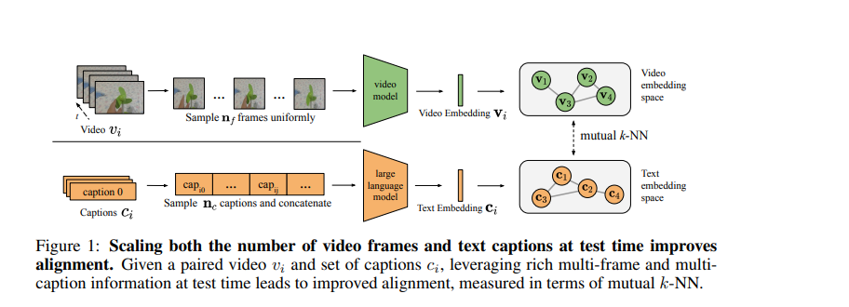
How We Measure Alignment
The Metric: Mutual k-NN
Comparing representations across different modalities is challenging because vision and language encoders typically produce embeddings of different dimensionalities. Direct distance comparison is meaningless.
.

Slide 6
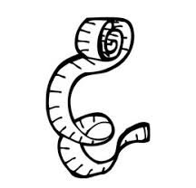
How We Measure Alignment
Title: The Metric: Mutual k-NN
The Mutual k-Nearest Neighbors metric solves this problem by comparing the neighborhood structures rather than the absolute positions. For a dataset of N video-caption pairs, the method first computes k-nearest neighbors for each video in the video embedding space and for each caption in the text embedding space.
Two binary indicator matrices are constructed, where an entry is 1 if item j is among the k-nearest neighbors of item i. The alignment score is then calculated as the mean overlap between these two neighbor sets, normalized by k. A high score indicates that videos and their corresponding captions agree on which items are similar, even if the absolute coordinates differ. This metric is interpretable, ranging from 0 to 1, and requires no parallel training or linear mapping.

Slide 7
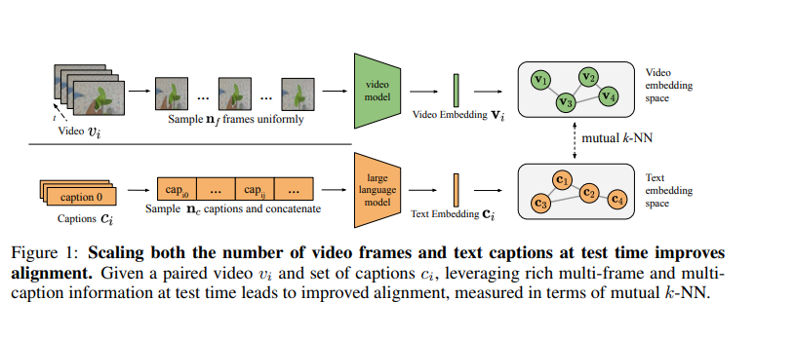

Mutual k-NN (MkNN) Metric
Measures structural agreement between vision and text embedding spaces.
Videos: $n_{f}$ frames sampled uniformly → processed as sub-clips.
Text: $n_{c}$ captions concatenated into a single string
Datasets: VATEX and PVD with randomly sampled video-caption pairs

Slide 8

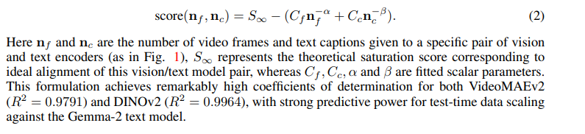
A Predictive Model for Alignment
Building on empirical observations, the authors propose a parametric saturation-based model that predicts alignment scores given the number of frames and captions.
This formulation achieves remarkably high coefficients of determination—0.9791 for VideoMAEv2 and 0.9964 for DINOv2 against the Gemma-2 text model.
The model treats alignment as a saturation process, analogous to how training-time scaling laws model loss as a function of compute and data size.
However, unlike those laws where lower loss is better, this metric is an accuracy score where higher is better, hence the subtractive form.
This predictive power enables researchers to estimate how much alignment improvement they can expect from collecting additional video annotations or using longer video clips.
Notes:
Regression Model – fitting Cf, Cc, alpha & beta

Slide 9

Scaling Visual & Textual Data at Test Time
One of the most striking findings in this paper is that alignment scores improve dramatically simply by providing more data at test time, without any model retraining.
The authors show that increasing the number of video frames from 16 to 80 consistently raises alignment scores across all caption counts. Video models benefit more from additional frames than image models do because they are designed to exploit temporal structure.
On the right side, increasing the number of captions from 1 to 10 yields even larger gains-approximately 60% improvement on average according to a linear fit. This is because multiple captions capture diverse perspectives and cover different visual concepts within the same video
. These results directly complement prior work that focused only on training-time resources like model size and pre-training data volume. The authors demonstrate that test-time annotation richness is equally important for achieving high alignment.

Slide 10

Image vs. Video Models
Why Video Models are Better at Using Time
The fitted parameters from the scaling law reveal fundamental differences between how image and video models process temporal information. VideoMAEv2 has a frame coefficient Cf of 0.15, nearly triple that of DINOv2 at 0.05. This indicates that video models have a much greater capacity to extract useful information from additional frames.
Conversely, DINOv2 has a much higher exponent α of 1.76 compared to VideoMAEv2's 0.75. A higher exponent means faster saturation DINOv2 quickly extracts all useful information from just a few frames and then plateaus because it treats each frame as an independent still image.
VideoMAEv2, designed to model spatiotemporal structure, continues to benefit from additional frames because it can track motion, object persistence, and temporal transitions. The caption coefficients Cc remain comparable between the two models (0.13 vs 0.13), suggesting that both benefit equally from diverse textual descriptions. These parameter differences quantitatively confirm that native video encoders are intrinsically better at leveraging temporal information than static encoders applied frame by frame.

Slide 11
Key Findings
The paper reports four major findings that reshape our understanding of cross-modal alignment. First, alignment quality is highly sensitive to the richness of visual and textual data provided at test time not just during training.
Using multiple video frames and diverse caption sets can double alignment scores compared to using single frames and single captions. Second, self-supervised video models like VideoMAEv2 achieve competitive or superior text alignment compared to top performing image models like DINOv2, demonstrating that native temporal understanding contributes to semantic grounding.
Third, the authors discover predictable "test-time scaling laws" that model alignment as a saturation process, achieving coefficients of determination above 0.98. Fourth, video-text alignment strongly correlates with performance on both semantic tasks like action classification and non-semantic tasks like depth estimation and camera pose prediction, suggesting that alignment can serve as a powerful zero-shot evaluation metric for video foundation models.

Slide 12
Clustering of Video Models
Do they really understand "Before" vs. "After"?
Beyond video-text alignment, the authors also investigate how different video models align with each other. Pairwise alignment analysis reveals two distinct clusters. One cluster contains models that are strongly aligned with language and excel at semantic tasks like action recognition. The other cluster contains models that specialize in geometric and spatial understanding, such as depth estimation and camera pose prediction.
Predictably, text-supervised models and pure self-supervised models separate into these clusters. However, a few models are notable exceptions. DINOv2 and VideoMAEv2 fine-tuned on Kinetics-710 span both clusters, achieving strong alignment with models from both groups. The authors hypothesize that truly general-purpose video foundation models must align across multiple representational types—semantic, geometric, and temporal.
Cross-model alignment could therefore serve as a diagnostic tool for evaluating model versatility, complementing video-text alignment. A complete investigation of this phenomenon remains as interesting future work.

Slide 13
Limitations & Future Work
Despite the impressive results, the authors acknowledge several limitations. First, many native video models are still outperformed by simple frame-averaging of powerful image models like DINOv2 applied to videeos suggesting that current video architectures have not yet fully realized their potential.
Second, generative video models, while promising for synthesis tasks, currently show very weak alignment with text encoders, making them difficult to evaluate with this framework. Third, temporal reasoning remains superficial; models still struggle with fine-grained distinctions between "before" and "after" and are easily confused by temporal reordering.
Future work should explore using cross-modal alignment as a diagnostic tool during training to guide model development. Improving temporal awareness in large language models when used as text encoders is another promising direction. Finally, scaling these analyses to longer-form video understanding and more diverse temporal relationships would significantly advance the field.

Slide 14
Our Implementation
Goal: reproduce the paper's test-time scaling at small scale, then add a video-to-text step
Constraint: free Colab T4, so Gemma-2-2B-it replaces the 9B model; we compare trends, not absolute scores
Mutual k-NN (Eq. 1) reimplemented, checked against the authors' algorithm, with a layer x layer sweep
Frames x captions sweeps and a fit of the scaling law (Eq. 2): S_inf, C_f, C_c, alpha, beta, R^2
Encoders compared: DINOv2-large (image model on frames) vs VideoMAEv2 (video model)
Every score is reported with N, k and the chance level (about k/N)

Slide 15
Video-to-Text Extension
The video and text spaces have different sizes, so a ridge map (or relative representations) is learned from paired training videos
Layers are chosen on the training split only; recall@1/5/10 is measured on held-out videos against chance
Retrieved captions are merged into one description by Gemma-2-2B-it
Needs paired data, so this is not zero-shot
Status: pipeline tested on synthetic data; real Colab results are still to come

Slide 16
Thanks!

