Slide 1
BOOK DONOR

Slide 2
Project Overview
Project Title :
Book Donor
Objective:
People can donate books to needy.
Start Date:
Dec 10,2019
End Date:
Dec 31,2019
Duration:
21 days.
Developed By:
Rhytyhem Nagpal

Slide 3
Technical Information
Back End:
MySql
Front End:
Android and Php

Slide 4
Main Objective
People can donate books to needy.

Slide 5
Our Strengths
User friendly app.
Absolutely free for receiver as well as donor.
User’s data is fully secured
Books can only be donated after verification by admin.
Admin has right to reject book if donor is not verified.

Slide 6
Our Limitations
Only for Indian nationality.

Slide 7
Home Page Contents
Want to Donate
Want to Receive
Admin(Special clicks - click 5 times on home screen)

Slide 8
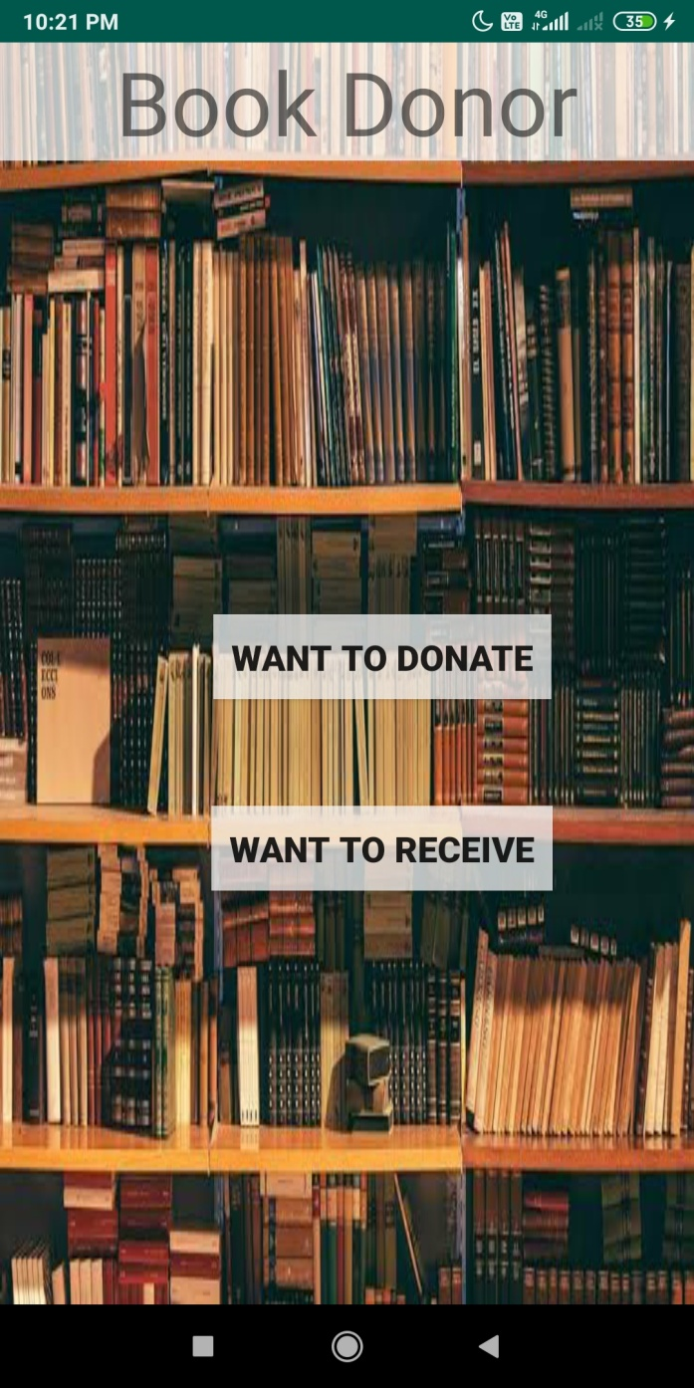
Home page

Slide 9
Donate books
Donor has to register himself/herself firstly.
Details required for registration of donor:
Name
Address
Phone number
After registration donor will fill the details of book that he is going to donate.
Details required for donating book
Name of book
Class
Subject
Edition of book

Slide 10
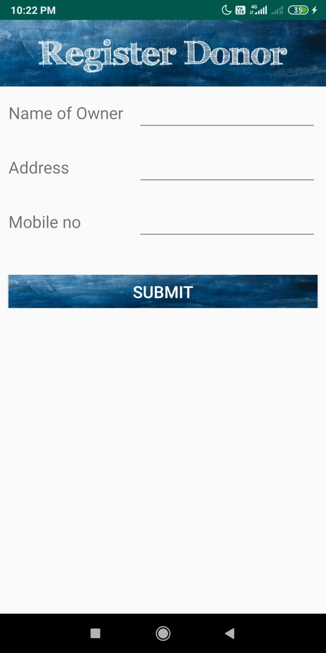
Donor Registration

Slide 11
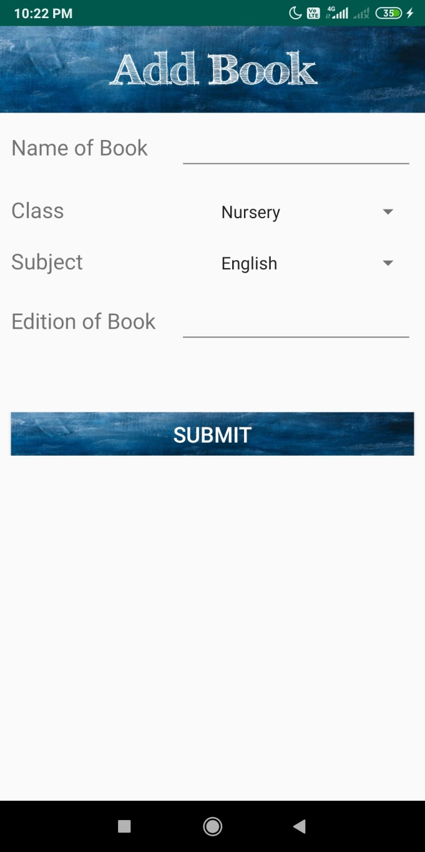
Donate book form

Slide 12
Receive Book
Receiver has to register himself/herself firstly.
Details required for registration of receiver:
Name
Address
Phone number
After registration receiver can view books

Slide 13
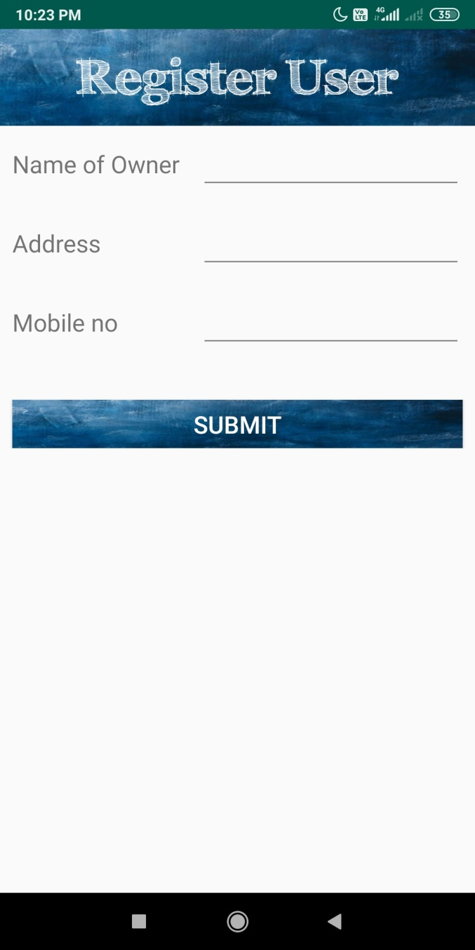
User Registration

Slide 14
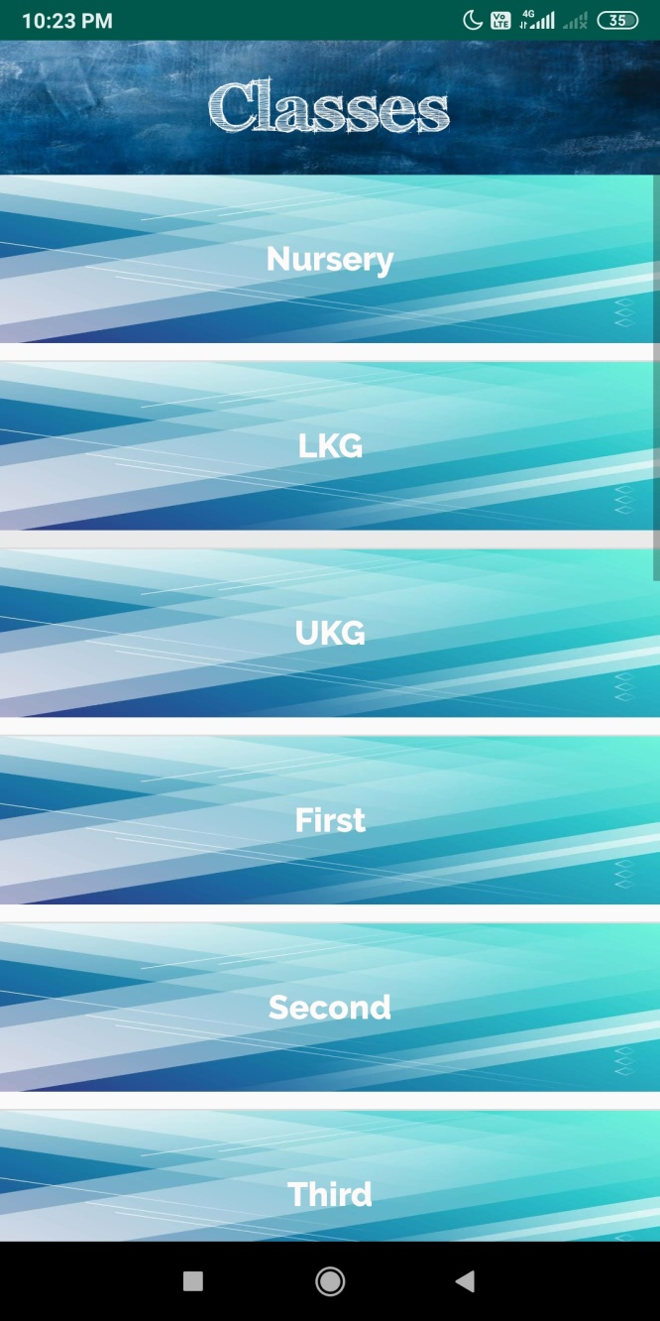
Select class

Slide 15
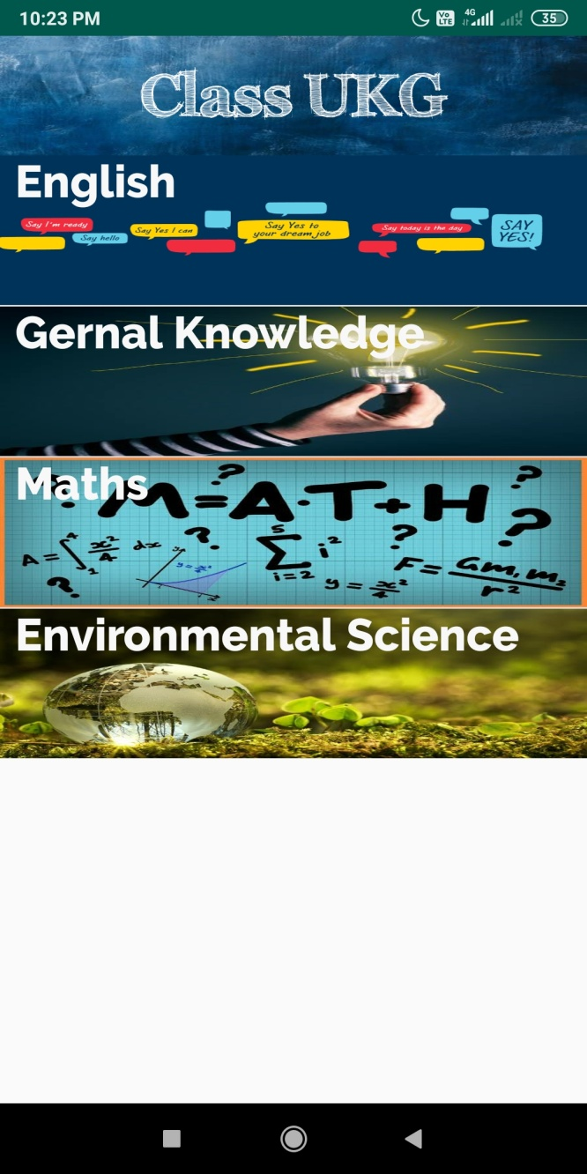
Select Subject

Slide 16
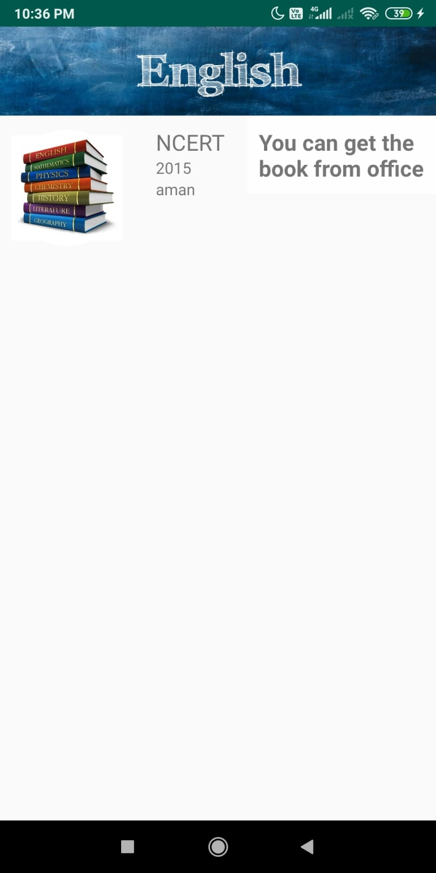
Show books

Slide 17
Admin
Admin has rights to:
Receive books
Donate books
See users(receivers)
See Donors
See all the details of donated books

Slide 18
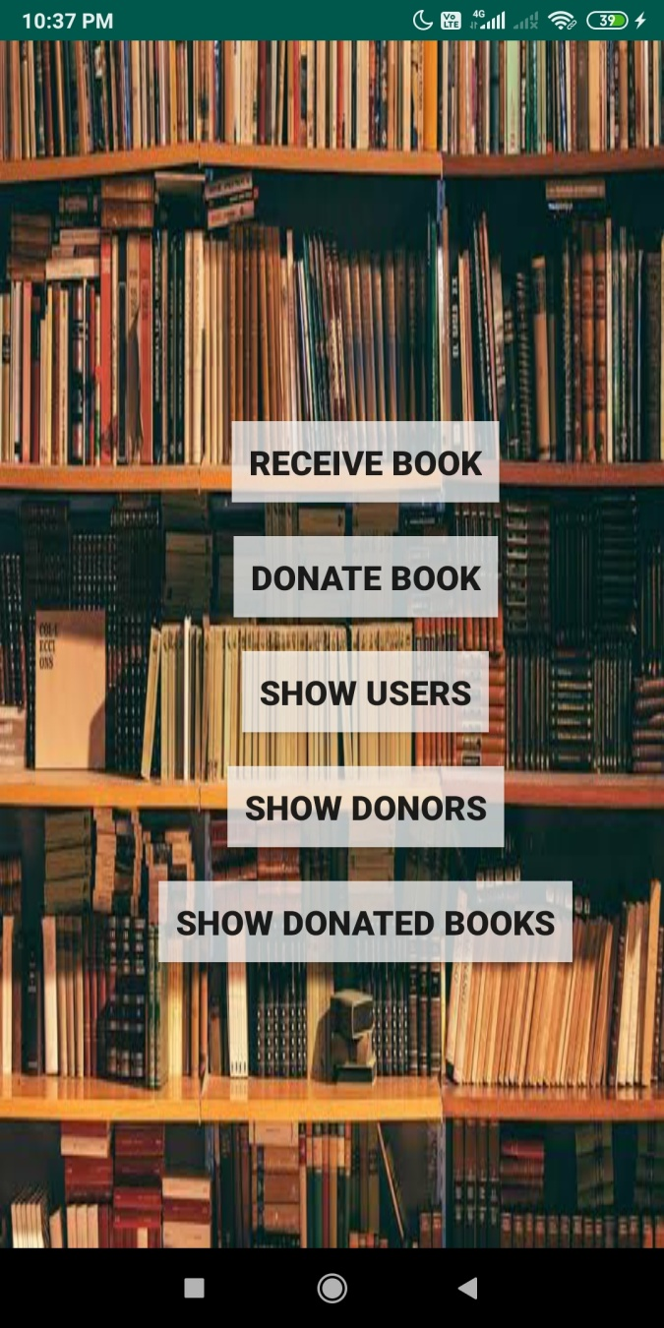
Admin main page

Slide 19
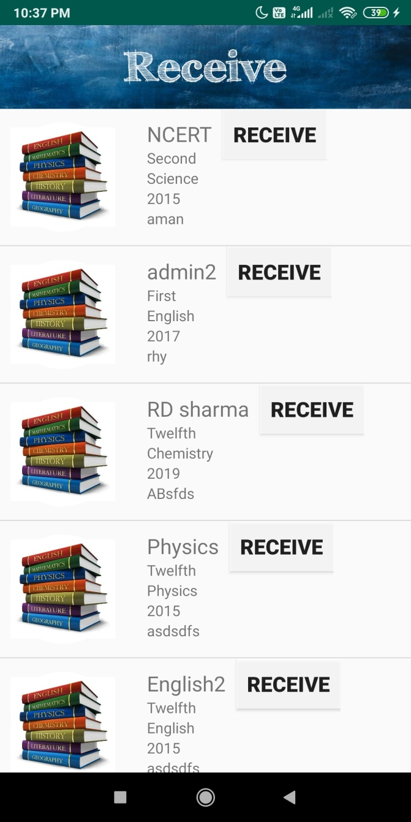
Receive Book(admin)

Slide 20
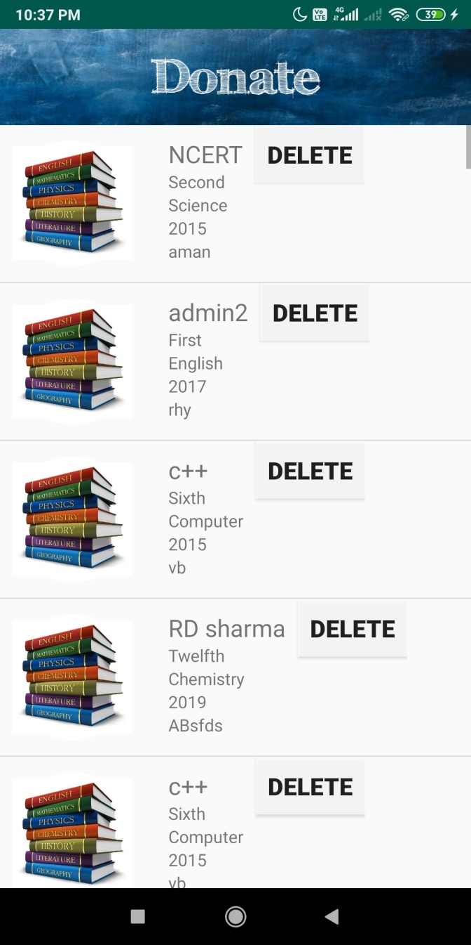
Donate Book(admin)

Slide 21
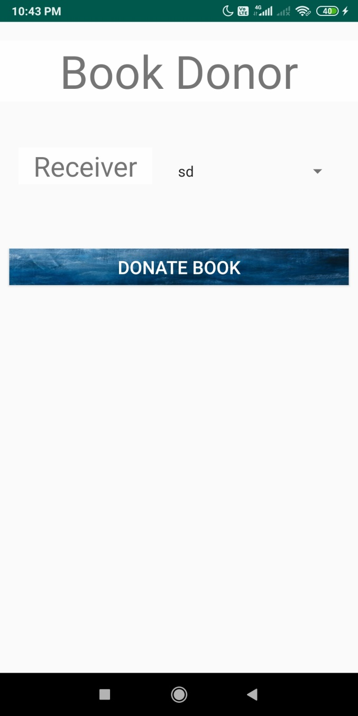
Donate book to receiver(admin)

Slide 22
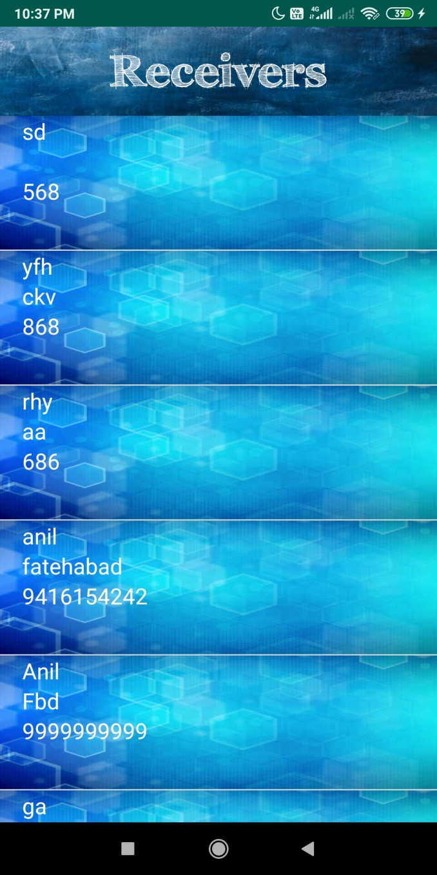
Show receivers(admin)

Slide 23
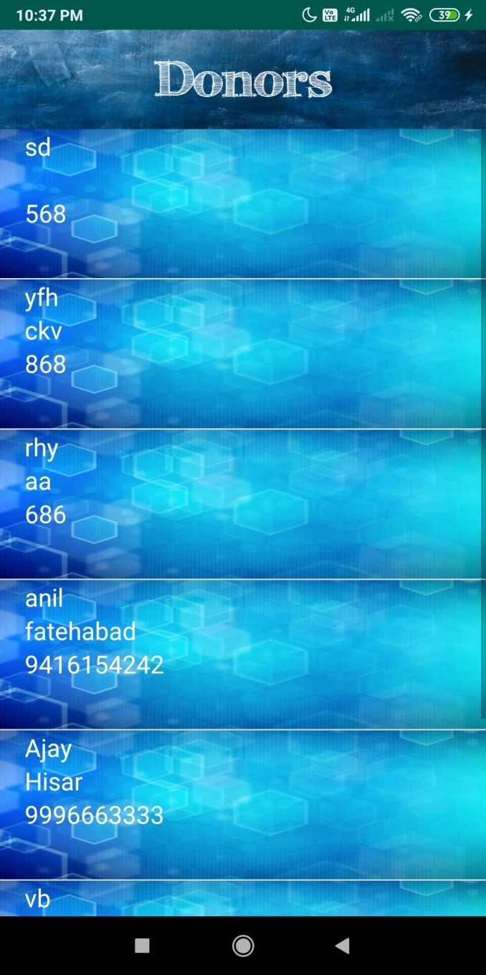
Show Donors(admin)

Slide 24
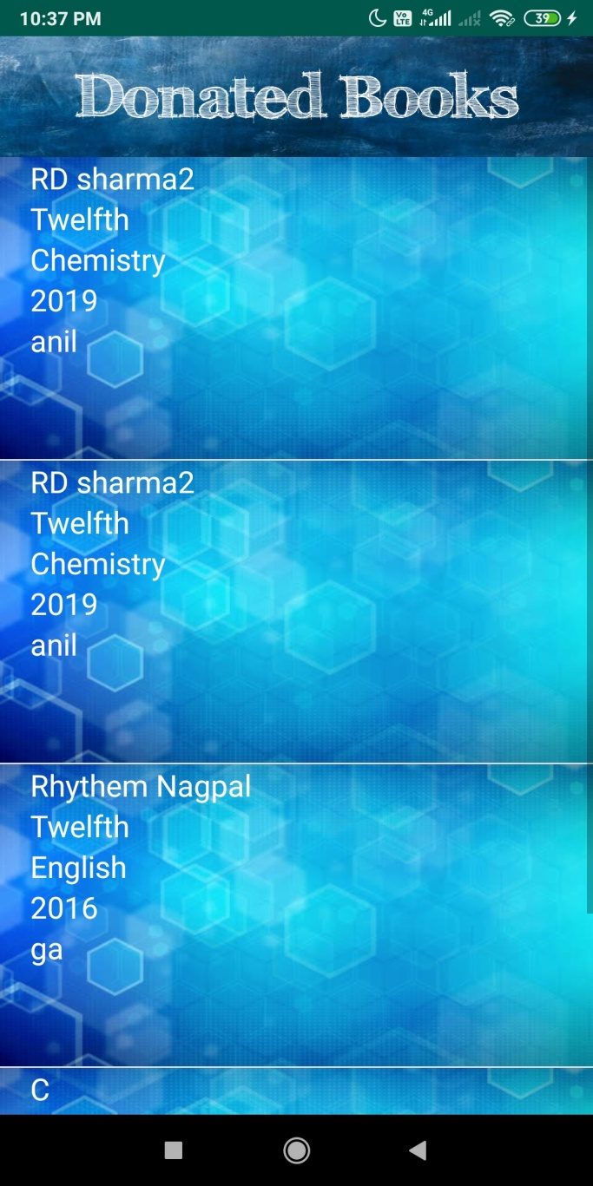
Show donated books(admin)

Slide 25
Search Page
Copyrights Are Reserved By Aptech (Fatehabad) Only.

Slide 26
Search Page
Thank You

