Slide 1
thinc! München 2026 · Reonic challenge
Home energy designer
A first design for PV, battery, heat pump and wallbox that a planner can review, explain and change
Built and measured on real installer data
Notes:
Open with the problem in one sentence: planners spend hours per home before an offer can go out. We built a tool that proposes a first design; the planner keeps the final say. Everything we show is measured on the real Reonic export, on homes the model has never seen.

Slide 2



Planners spend hours designing each home before an offer goes out
Hours per home
Expertise in heads
Slow offers lose deals
Each design is sized by hand: PV, whether a battery pays off, whether a heat pump fits, what the homeowner can afford.
It takes years to learn, is applied inconsistently, and does not scale with demand.
Homeowners compare installers, and the first credible offer often wins.
Source: Reonic hackathon brief
Notes:
These three points are from Reonic's own brief: hours per design, knowledge that sits in experienced planners' heads, and the first credible offer often winning. We did not add numbers here because we do not have Reonic's.

Slide 3




We propose a first design the planner can review and change
Home facts
Learned models
Rules
Design and reasons
Consumption, EV, existing PV and battery, heating. Unknown stays unknown.
Heat pump, then PV, then battery. Each step sees the one before.
Hard limits and the sizes installers actually use.
Similar past homes, rough savings, and where it looks unusual.
The planner stays in control. Override any component and the rest re-plans around it. The wallbox is a fixed rule: a wallbox if the home has an EV. No language model is in the decision path.
Notes:
Walk the flow left to right. Learned models decide whether each component is included and how big it is, in physical order. Rules enforce hard limits such as no battery without PV. The wallbox is a plain rule because a learned model did no better in cross-validation. Mention that nothing here is a language model.

Slide 4
PV and battery size beat a typical design; the whole design is close
Share of homes matching the installer's design (mean of 30 random splits)
Model minus typical design, with 95% interval
Component | Gap | Interval | Reading
PV size | +8.2 | +5.0 to +11.4 | Clear edge
Battery | +8.4 | +6.0 to +11.0 | Clear edge
Whole design | +1.8 | -0.1 to +3.8 | Leans positive, not proven
Wallbox | 0 | n/a | Same fixed rule
On an installer it never saw, the model does not beat a typical design (20.8% vs 31.5% in one direction, 10.5% vs 9.9% in the other): it mostly learns each installer's habits.
Notes:
This is the honest result. A typical design means: ignore the home and propose what most homes got, at the median size. A model trained on scrambled answers already scores about 14.0% on whole design, so beating the rule of thumb (5%) alone proves little. Against the typical design our measurable edge is PV size and battery size, about 8 points each, with intervals from +5 to +11 and +6 to +11. On the whole design the gain is +1.8 points with an interval from -0.1 to +3.8: it leans positive but we do not claim it. The battery gain comes from choosing the size that fits the most plausible expert sizes and snapping to every battery size installers used. The chart is the mean of 30 random 80/20 splits; the table is a bootstrap over all 1,593 projects using out-of-fold predictions. We also checked that customers appearing twice do not inflate the score (grouping by customer: 16.7% vs 16.6%) and that a time split shows no decay. Across installers the model does not beat a typical design, which means it mostly learns each installer's habits.

Slide 5
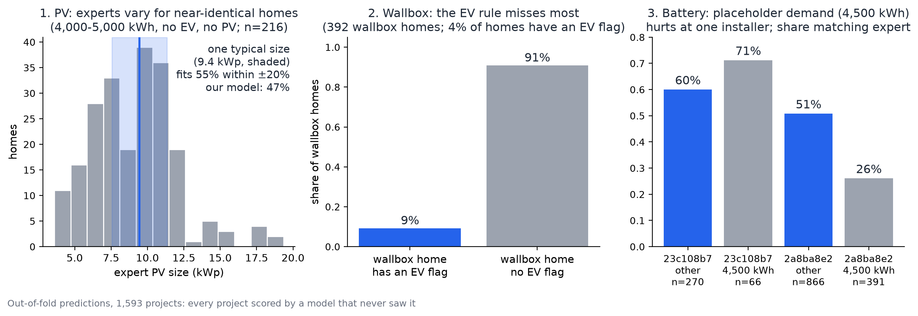
Where we disagree with the installers, and why
Experts differ from each other. For near-identical homes their PV size spans 5.4 to 12.6 kWp. Most wallbox homes have no EV on record. 9 in 10, so a rule cannot see them. A placeholder demand hurts the battery at one installer. 51% falls to 26% when demand is exactly 4,500 kWh.
Notes:
Out-of-fold predictions on all 1,593 projects, so every project was scored by a model that never saw it. Left: for 216 near-identical homes the installer's own PV size varies a lot; one fixed typical size would match within 20% for 55% of them and our model for 47%. Middle: the wallbox rule needs an EV flag, but only 9% of wallbox homes have one. Right: at installer 2a8ba8e2, battery agreement is 26% on homes whose demand is exactly 4,500 kWh, which looks like a default value, against 51% on the rest. Roof area and budget are not in the export, which may explain the PV spread; we have not verified that.

Slide 6
A faster first draft is worth €4,000 to €28,000 per planner per year
Design time saved, € per planner per year (our assumptions)
How it is calculated
Designs per year × (hours today − hours with the tool) × planner cost
Conservative: 8 designs a week, 1 hour today, 45 minutes with the tool
Base: 12 designs a week, 1.5 hours today, 30 minutes with the tool
Hours per design today moves the result most, and only Reonic can give it
The saving comes from a draft with reasons in front of the planner, not from model precision
Not claimed: higher win rates, or what the tool should cost
Notes:
These are the conservative and base cases from docs/business-case.md. Every input is our assumption: Reonic's brief says planners spend hours per design and create several offers a day, but gives no numbers. We left the optimistic case (about 63,000 euro) out of the headline because it has a planner designing 75% of the year and saving 83% of that time. Review time is deliberately not tiny, because only about 14% of designs match on every component. The same hours spent on site are 23 to 207 days per installer per year. We do not claim a win-rate effect: we have no conversion data.

Slide 7



What we know, what we don't, and what comes next
What we know
What we don't know
What comes next
PV and battery size each beat a typical design by about 8 points, within the installers we trained on
On a new installer it does not beat a typical design: it learns each installer's habits
A design is a first draft: a planner still reviews it
Which offer the homeowner signed (we use the first)
Module wattage at one installer (we assume 450 Wp)
Whether 4,500 kWh, in 29% of projects, is a default
Roof area, orientation, location and budget as inputs: they may explain the PV spread
Reonic's time per design, to replace our assumptions
More projects per installer, and more heat pump examples
Notes:
Close on honesty. We know PV and battery size each beat a typical design by about 8 points within the installers we trained on, and that nothing beats it across installers. We do not know three things that Reonic can answer in a minute each: which offer was signed, the module wattage at one installer, and whether the 4,500 kWh values are real. Next steps are roof area and budget as inputs, Reonic's time per design for the business case, and more heat pump examples.

