Slide 1
Human Computer Interaction
BITS F364, Odd semester 2022
Typography and Colour

Slide 2
https://uxplanet.org/typography-in-ui-guide-for-beginners-7ee9bdbc4833
https://uxplanet.org/color-theory-brief-guide-for-designers-76e11c57eaa
https://www.youtube.com/watch?v=yI4shGV1EsM
https://www.youtube.com/watch?v=eZSe4xVXHhI

Slide 3
“typography is the craft of endowing human language with a durable visual form” – Robert Bringhurst, The Elements of Typographic Style
Can we think of presenting information on the web or on mobile phones without copy elements (written communication)? It is very difficult
People are used to receiving a majority of their information in the textual form. Designers need to make this process easy and productive

Slide 4
Font size, width, color, text structure: everything matters
Choosing appropriate fonts and their presentation can transfer moods or messages
Visual performance and readability can impact user experience
Bad legibility can cause problems with navigation and unusable interfaces. Bad user experience is unforgiven on digital products since there are several alternatives that the user can go to
First impression: users don’t read, they scan it. Inappropriate fonts will drive users and customers away

Slide 5
Fonts and typefaces
A typeface is a style of type design which includes a complete scope of characters in all sizes and weight
A font is a graphical representation of text character usually introduced in one particular typeface, size, and weight

Slide 6
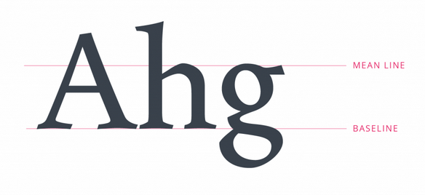
Meanline and Baseline

Slide 7

Height and weight

Slide 8
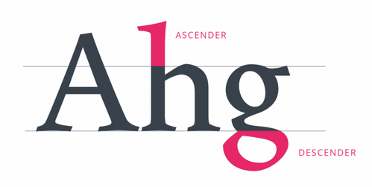
Ascender and Descender

Slide 9
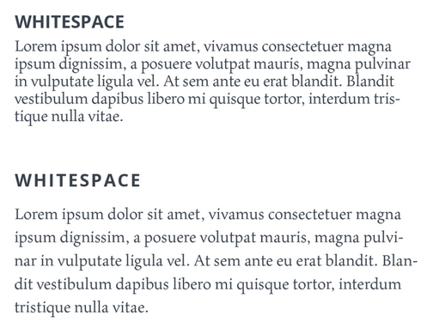
White space or Negative space

Slide 10
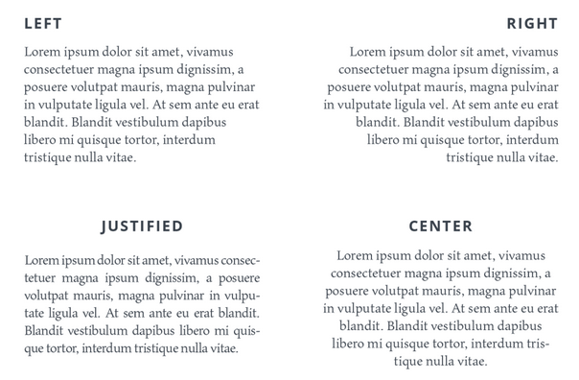
Alignment

Slide 11


Tracking and Kerning

Slide 12
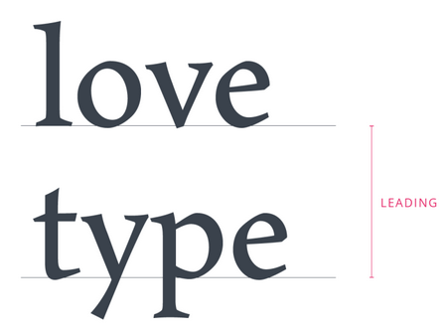
Leading

Slide 13

Hierarchy

Slide 14
Colours
Colorimetry: the science and technology used to quantify and describe physically the human colour perception.
It is similar to spectrophotometry, but is distinguished by its interest in reducing spectra to the physical correlates of colour perception

Slide 15
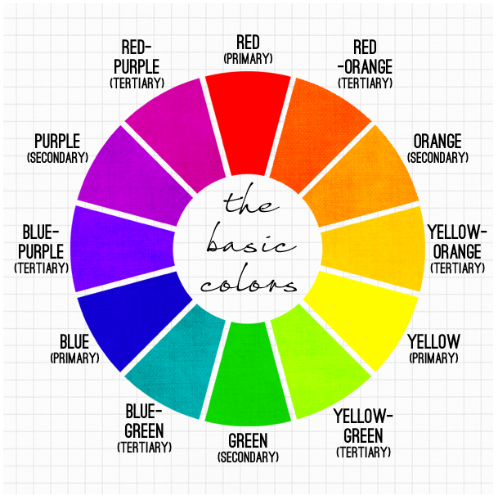
Colours
Newton’s Colour Wheel

Slide 16
Colour Models
Additive colour model:
RGB are primary colours
Model of colour for screens
Combination in equal proportion produces secondary colours cyan, magenta and yellow
Subtractive colour model:
For print media
Colours produced by subtraction of light
Started with RYB, then evolved to CMY, then to CMYK
Cyan (−R+G+B), Magenta(+R−G+B), Yellow (+R+G−B)
What you see on the screen is not what you get in print

Slide 17
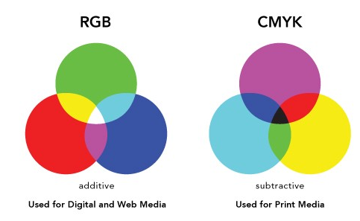
Colour Models

Slide 18
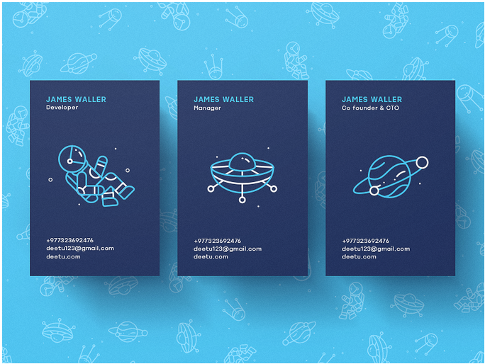
Colour Harmony
Monochromatic: one colour and different tones and shades of it

Slide 19
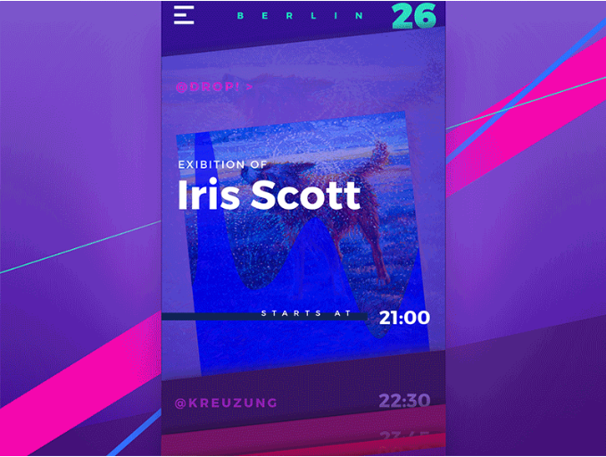
Colour Harmony
Analogous: located right next to each other on the colour wheel

Slide 20

Colour Harmony
Complementary: mix colours placed opposite to each other on the colour wheel
Produces high contrast

Slide 21
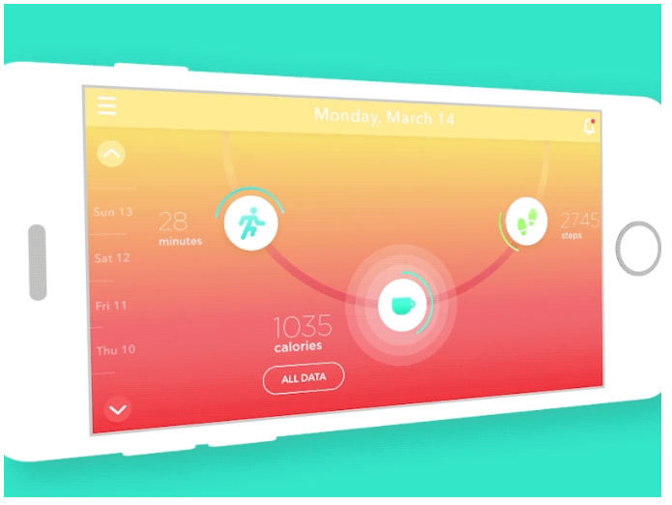
Colour Harmony
Split Complementary: mix more than two colours placed opposite to each other on the colour wheel
Contrast is lower, but allows more than 2 colours

Slide 22

Colour Harmony
Triadic: 3 separate colours equidistant on the colour wheel
One colour is dominant, the others are accents

Slide 23
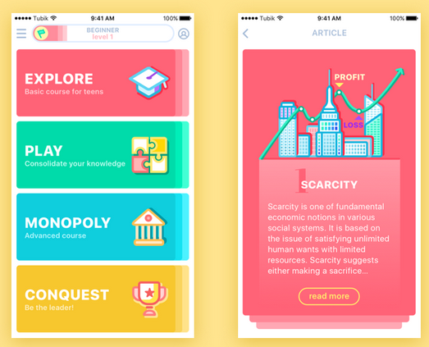
Colour Harmony
Tetradic / Double-Complementary: 4 colours from the wheel which are complementary pairs. They form a rectangle on the colour wheel

Slide 24
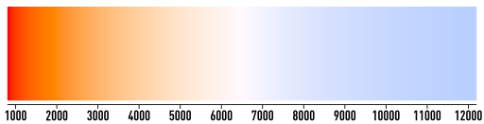
Warm and Cool Colours
The hottest radiating bodies (e.g. stars) have a "cool" colour, while the less hot bodies radiate with a "warm" colour (image in Kelvin scale)

Slide 25
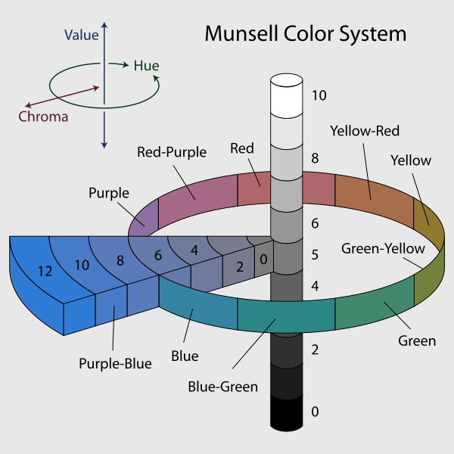
Munsell Colour System
Value, Chroma and Hue
A purple of medium lightness and fairly saturated would be 5P 5/10 with 5P meaning the colour in the middle of the purple hue band, 5/ meaning medium value (lightness), and a chroma of 10.

Slide 26
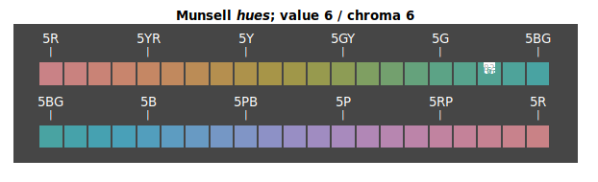
Munsell Colour System
5 principle hues: Red, Yellow, Green, Blue and Purple

Slide 27
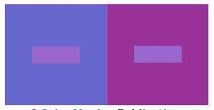
Different Readings of Same Colour

Slide 28
Colour Psychology
Colour psychology: when eyes perceive a colour, they connect with the brain which gives signals to the endocrine system releasing hormones responsible for the shifts in mood and emotions.
Colour preference varies with age, gender, experience, culture, etc.

Slide 29
Colour Psychology
92.6 percent said that they put most importance on visual factors when purchasing products. Only 5.6 percent said that the physical feel via the sense of touch was most important. Hearing and smell each drew 0.9 percent. 84.7 percent of the total respondents think that colour accounts for more than half among the various factors important for choosing products. – Seoul International Colour Expo
People make a subconscious judgment about a person, environment, or product within 90 seconds of initial viewing and that between 62% and 90% of that assessment is based on colour alone. – CCICOLOR - Institute for Color Research

Slide 30
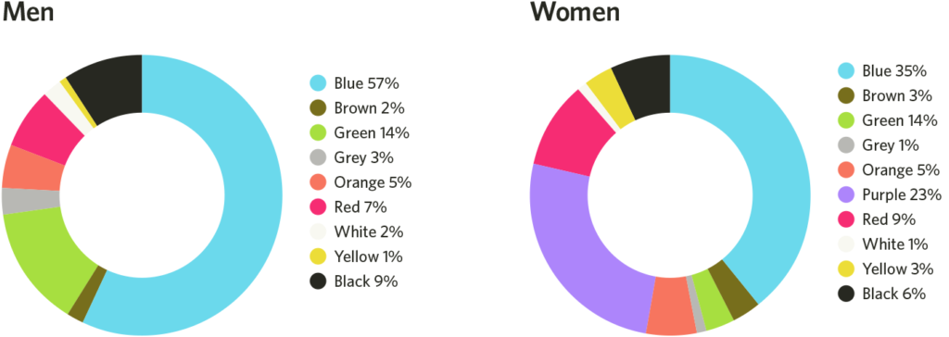
Colour Psychology: Favourite Colours

Slide 31
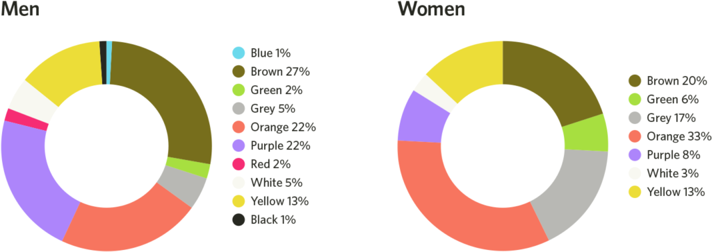
Colour Psychology: Least Favourite Colours

Slide 32
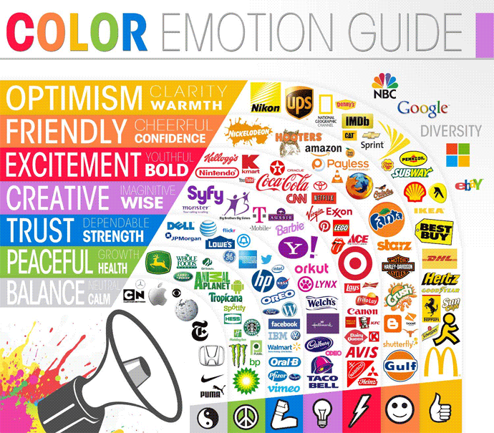
Colour Psychology: Colour Emotion Guide

Slide 33
Colours: Reading and Reference
https://en.wikipedia.org/wiki/Color_theory and links from this page
https://www.colormatters.com/color-and-design/basic-color-theory
https://99designs.com/blog/tips/the-7-step-guide-to-understanding-color-theory/
https://uxplanet.org/color-theory-brief-guide-for-designers-76e11c57eaa
https://tubikstudio.com/color-in-design-influence-on-users-actions/
https://www.helpscout.com/blog/psychology-of-color/
https://www.colorcom.com/research/why-color-matters
https://www.youtube.com/watch?v=gMqZR3pqMjg
https://www.youtube.com/watch?v=KaGSYGhUkvM
https://www.youtube.com/watch?v=Mqaobr6w6_I
https://www.youtube.com/watch?v=hgYnW2ZSQMA

