Slide 1
Human Computer Interaction
Usability
BITS F364, Odd semester 2022

Slide 2
What is Usability?
What do you understand by the term?
How would you measure / test for usability?
How would you do usability engineering?
“79% of users will abandon a website if the usability is poor”

Slide 3
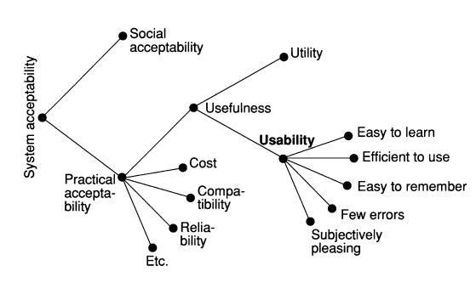
What is Usability?

Slide 4
Attributes of Usability
Learnability: easy to learn, can get started rapidly
Efficiency: efficient to use once a user has learnt the system, high levels of productivity is possible
Memorability: easy to remember, casual users should be able to return after a long time and use the system without learning again
Errors: low error rate, easy recovery from errors, no catastrophic errors
Satisfaction: pleasant to use

Slide 5
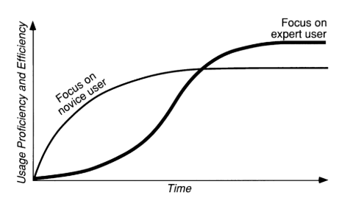
Learnability
Novice users vs Expert users
What is a good time frame for learnability?
What about system upgrades?
How to measure learnability?
  When has a system been ‘learned’?

Slide 6
Efficiency
Users’ steady-state performance when the learning curve has flattened out
Which users to select? Novice or experts? How to identify them?
Where would you put the QWERTY keyboard on the learnability/efficiency spectrum?
How about single handed vs double handed typing on touchpads?

Slide 7
Memorability
Who to measure with? Who is a casual user?
How to measure?

Slide 8
Few and Noncatastrophic Errors
Which errors to measure as a part of usability?
  Trivial errors can be a part of efficiency
  More catastrophic errors should be a part of this attribute

Slide 9
Subjective Satisfaction
Important for systems used on a discretionary basis in non-work environments
How to measure?
  Users likely to remember peak difficulty rather than mean difficulty
  Psychophysiological approaches: EEG, pupil dilation, skin conduction, heart rates

Slide 10
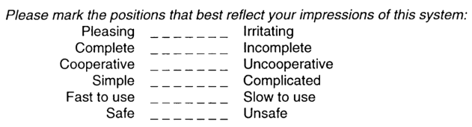
Subjective Satisfaction
Semantic Differential scale

Slide 11
Measuring / Testing for Usability
Define a set of tasks
Observe the user as she/he performs the task
What do you record in the process? How do you record it?

Slide 12
Task Completion
How long does a user take to complete the task
  Comparing two different pathways: through interfaces A and B (A/B testing)
How many users abandon the task? What are the reasons?

Slide 13
Think Aloud
Think-aloud protocols involve participants thinking aloud as they are performing a set of specified tasks.
  Participants are asked to say whatever comes into their mind as they complete the task. This might include what they are looking at, thinking, doing, and feeling.
Observers get insight into the participant's cognitive processes
Observers are asked to take notes of what participants say and do, without attempting to interpret their actions and words, and especially noting places where they encounter difficulty.

Slide 14
How many users to test
Jacob Nielsen: 5 is enough for each test
  More people finding the same difficulty does not add any value
Criticism: 5 can not be representative of all users; not every usability problem is easy to detect

Slide 15
NASA TLX
Developed by Human Performance Group at NASA
Two parts: a user rating on different sub-scales
  Mental Demand
  Physical Demand
  Temporal Demand
  Performance
  Effort
  Frustration

Slide 16
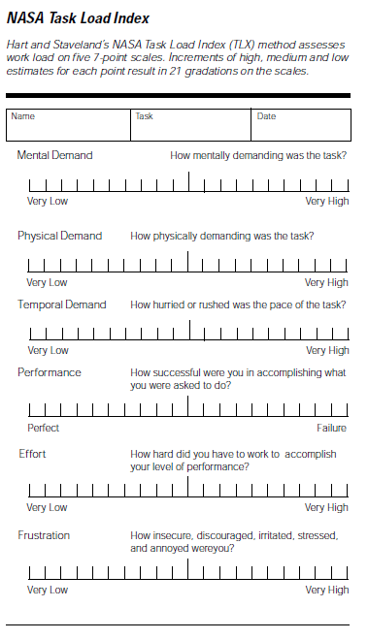
NASA TLX

Slide 17
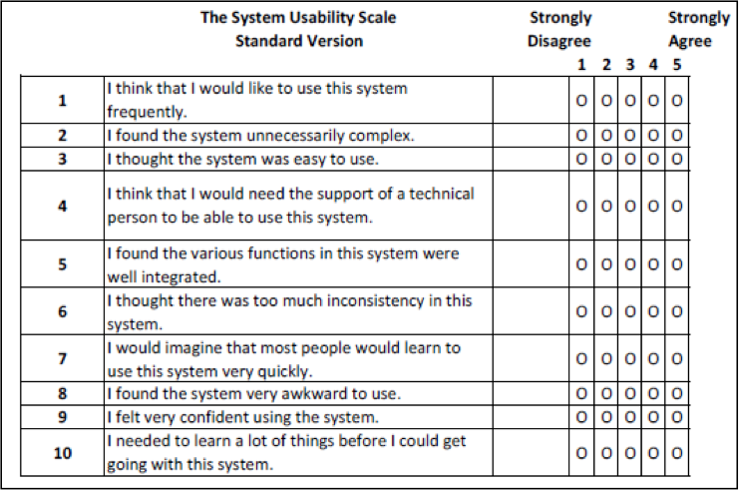
System Usability Scale (SUS)

Slide 18
System Usability Scale (SUS)
Each item's score contribution will range from 0 to 4. For items 1,3,5,7,and 9 the score contribution is the scale position minus 1. For items 2,4,6,8 and 10, the contribution is 5 minus the scale position.
Multiply the sum of the scores by 2.5 to obtain the overall value of SU.
SUS scores have a range of 0 to 100.

Slide 19
Usability Engineering
ISO:9241 - Ergonomics of Human Computer Interaction

