Slide 1
Human Computer Interaction
BITS F364, Odd semester 2022
UX Laws

Slide 2
Fitts’ Law
Quantifies the difficulty in a Target Selection Task
  Time required to move to a target area is a function of the ration between the distance to the target and the size (width) of the target

Slide 3



Fitts’ Law
MT is the average time to complete the movement.
a and b are constants that depend on the choice of input device and are usually determined empirically by regression analysis. a defines the intersection on the y axis and is often interpreted as a delay. The b parameter is a slope and describes an acceleration. Both parameters show the linear dependency in Fitts's law.[10]
ID is the index of difficulty.
D is the distance from the starting point to the center of the target.
W is the width of the target measured along the axis of motion. W can also be thought of as the allowed error tolerance in the final position, since the final point of the motion must fall within ±W⁄2 of the target's center.

Slide 4
Jakob’s Law
Be Familiar
Users prefer your site to be designed the way other sites they use are designed.

Slide 5
Hick’s law
The more choices you present your users with, the longer it will take them to reach a decision.
RT = a + b log₂n
Hick’s law is used to design controls on microwave ovens, restaurant menus, etc.
Sometimes complexity is unavoidable

Slide 6
Miller’s law
An average person can keep only 7 (+/- 2) items in their working memory
Solution: chunking of information
  Phone number: 07700984964 – or – 07700 984 964
  Credit / Debit card numbers

Slide 7
Aesthetic-Usability Effect
Users often perceive aesthetically pleasing design as design that’s more usable.
An aesthetically pleasing design creates a positive response in people’s brains and leads them to believe the design actually works better.
People are more tolerant of minor usability issues when the design of a product or service is aesthetically pleasing.
Visually pleasing design can mask usability problems and prevent issues from being discovered during usability testing.

Slide 8
Goal-Gradient Effect
The tendency to approach a goal increases with proximity to the goal.
The closer users are to completing a task, the faster they work towards reaching it.
Providing artificial progress towards a goal will help to ensure users are more likely to have the motivation to complete that task.
Provide a clear indication of progress in order to motivate users to complete tasks.

Slide 9
Serial Position Effect
Users have a propensity to best remember the first and last items in a series.
Placing the least important items in the middle of lists can be helpful because these items tend to be stored less frequently in long-term and working memory.
Positioning key actions on the far left and right within elements such as navigation can increase memorization.

Slide 10

Law of Prägnanz

Slide 11
Gestalt Principles
Closure
Common Region
Figure / Ground
Proximity
Continuation
Focal Point
Similarity
Notes:
We focus on the part which is different, (which stands out).

Slide 12

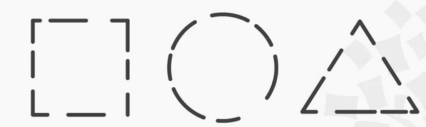
Gestalt Principles: Closure

Slide 13
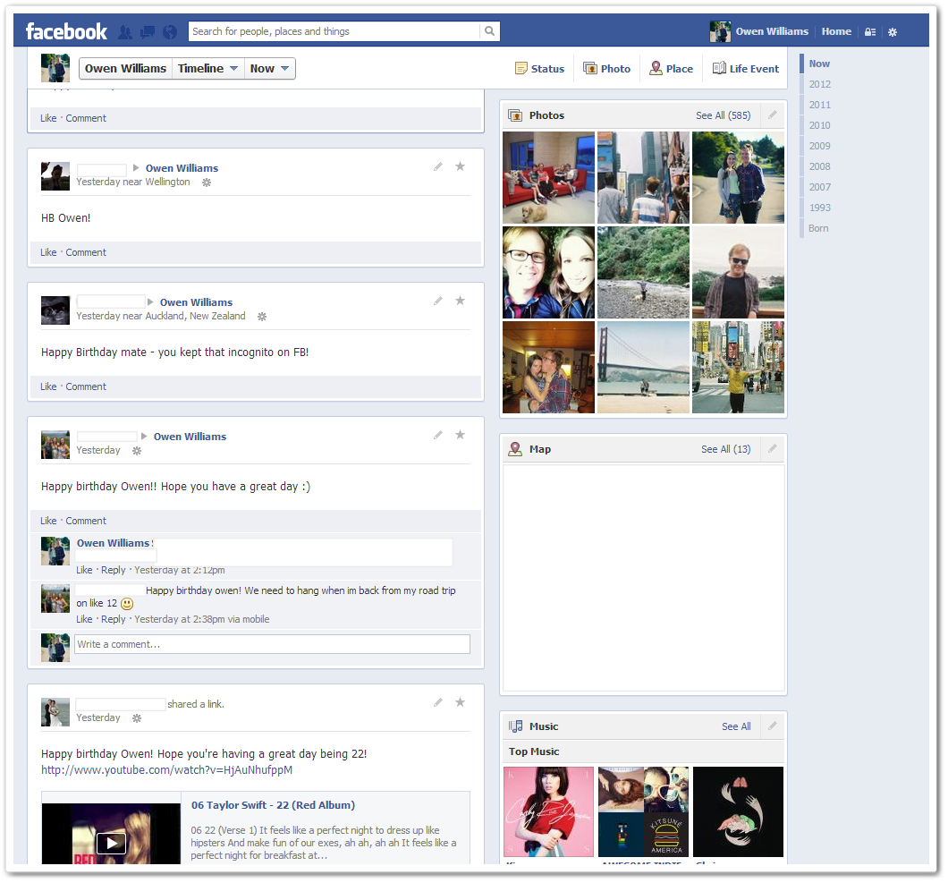
Gestalt Principles: Common Region
Notes:
Items with similar functionality are placed together.

Slide 14
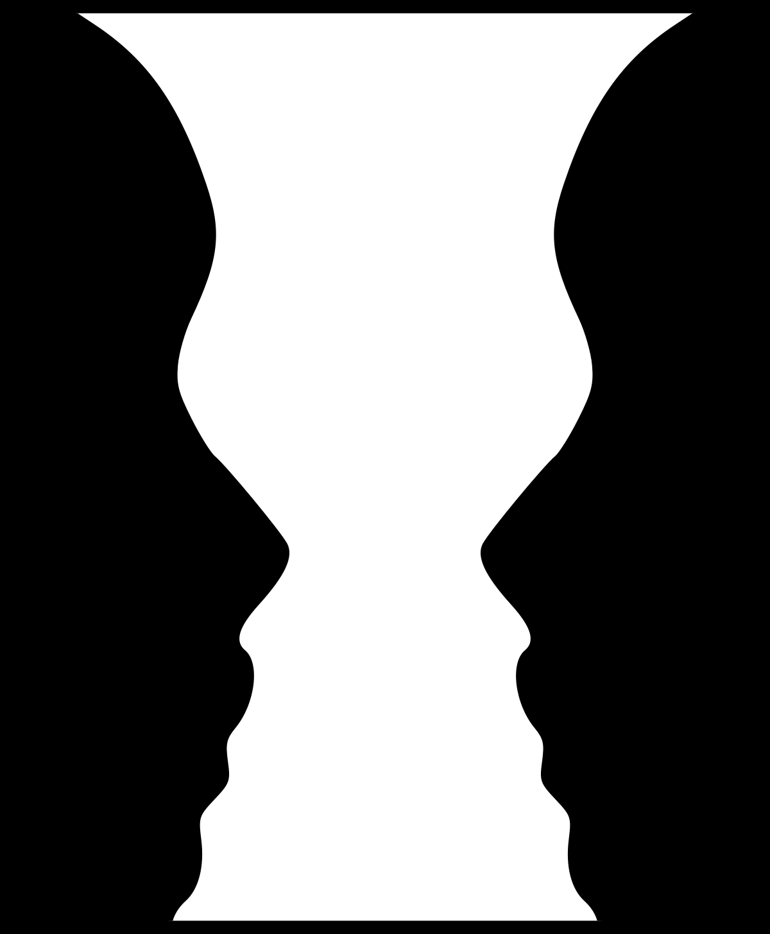
Gestalt Principles: Figure / Ground
Notes:
The one you focus on is figure, other part is ground

Slide 15
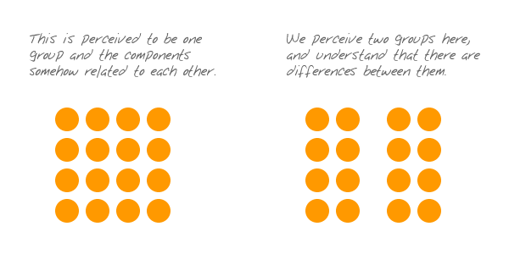
Gestalt Principles: Proximity

Slide 16

Gestalt Principles: Proximity

Slide 17
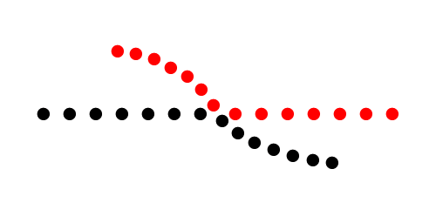
Gestalt Principles: Continuation

Slide 18

Gestalt Principles: Similarity

Slide 19
Von Restorff Effect
When multiple homogeneous stimuli are presented, the stimulus that differs from the rest is more likely to be remembered

Slide 20

Von Restorff Effect

Slide 21
Parkinson’s Law
Any task will inflate until all of the available time is spent.
Features such as autofill to save the user time when providing critical information within forms. This allows for quick completion of purchases, bookings and other such functions while preventing task inflation.

Slide 22
Doherty Threshold
Productivity soars when a computer and its users interact at a pace (<400ms) that ensures that neither has to wait on the other.

