Slide 1
Human Computer Interaction
Constraints
BITS F364, Odd semester 2022

Slide 2
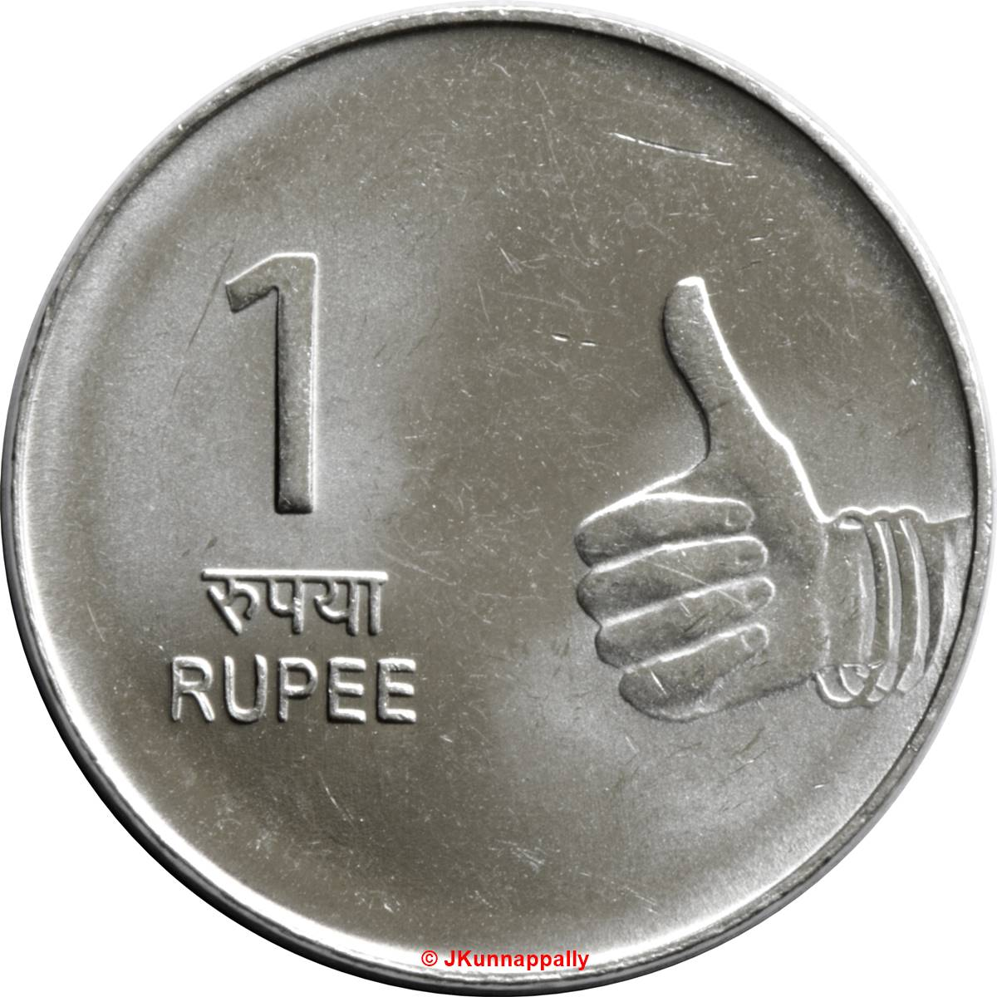
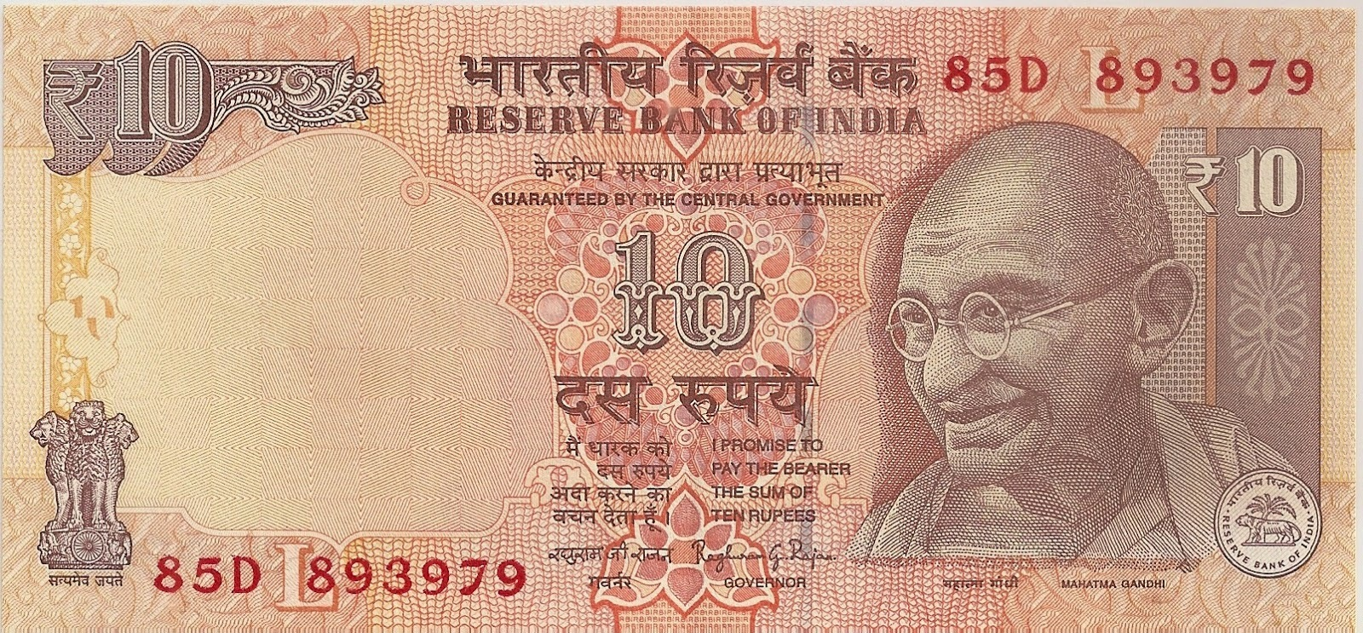
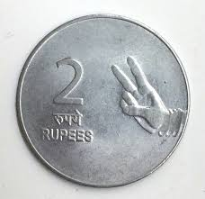
Knowledge

Slide 3
Knowledge

Slide 4
Knowledge
Knowledge in the head: e.g. mapping
Knowledge in the world: e.g. affordances and signifiers
How to provide critical information to enable interaction with unknown devices or situations?

Slide 5
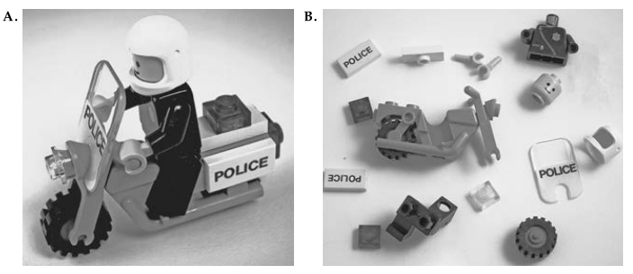
Constraints in Lego Blocks
Physical constraints
Logical, semantic, cultural constraints
Jigsaw puzzles?

Slide 6
Physical Constraint
No special training is necessary
Only limited number of actions possible
Should be easy to see and interpret

Slide 7
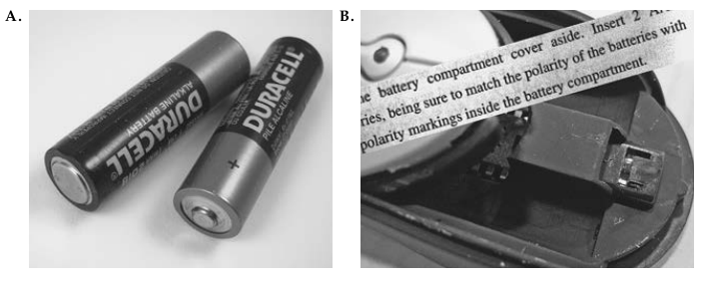
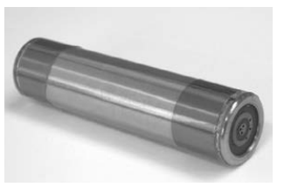
Batteries
Legacy Problems
  Locks and keys, Electric sockets, USB ports
  Superior solutions?

Slide 8
Cultural Constraints
Red is the taillight
Reading is from left to right (or right to left or top to bottom)
Red signal means stop
Anticlockwise opens a tap
Driving on left/right side of the road

Slide 9
Semantic Constraints
Drivers face forwards
Drivers are in the front row of the car

Slide 10
Logical Constraints
Last piece of a hardware goes in the only remaining place
Left switch controls the light on the left, right switch controls the light on the right

Slide 11
Applying Affordances, Signifiers, Constraints
These need to be applied together for good designs
Doors
  Push, pull, rotate, etc.
  Visible colours
Switches
  Lights, airplanes, nuclear power station

Slide 12
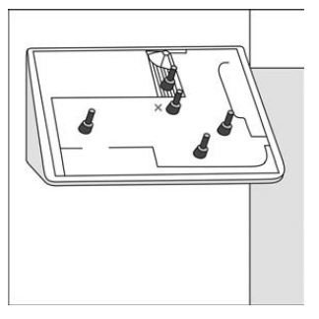
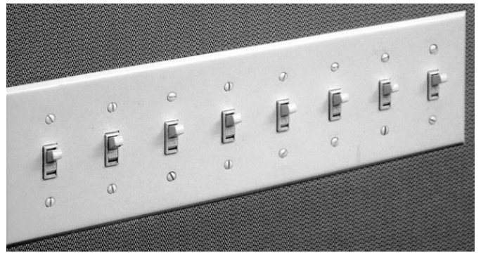

Slide 13
Activity Centred Controls
Paint and image manipulation programs
Audio and video programs
Careful mapping of requirements
Needs to be combined with manual controls

Slide 14
Forcing Functions
When a constraint is forced to prevent untoward incidents from happening
  One can delete files only if one has permissions
  One can start a car only if one has the keys

Slide 15
Forcing Functions: Interlocks
Forcing events to happen in a sequence
  One can’t open the microwave door while it is still operating
  One can’t open the pressure cooker lid while the steam is still in
  Dead man’s handle

Slide 16
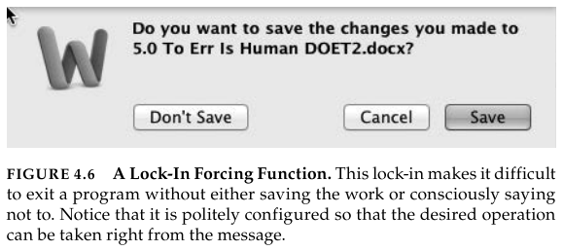
Forcing Functions: Lock-ins
Can’t exit without a conscious decision to save/not save a work
Business strategy to retain customers

Slide 17
Forcing Functions: Lock-outs
Can’t enter a room without a key
Can’t access a computer without a password

Slide 18
Forcing Functions
Users might disable if perceived as a nuisance
Have to minimise nuisance value while retaining the safety features

Slide 19
Conventions
Handle is for grasping: affordance
Handle on a door is to open, handle on a wall is for support: cultural aspects
Metric system vs Imperial system
Standardisation

Slide 20
Sound as Signifier
Click sound added by certain software on mouse clicks
Typing sounds added on Android keyboards
Blind people rely on sounds to cross roads
  Skeuomorphic

Slide 21
Sound as Signifier
Adding sound to hybrid vehicles
  Alerting
  Orientation
  Lack of annoyance
  Standardisation vs individualisation

Slide 22
Solving like a designer: https://www.youtube.com/watch?v=wOrmr5kT-48
Danger symbols: https://www.youtube.com/watch?v=lOEqzt36JEM

