Slide 1
Human Computer Interaction
BITS F364, Odd Semester 2022
Design Thinking

Slide 2
Solve this problem
Infant mortality in India is 44 for every 1000 live births (2016)

Slide 3
The Design Thinking Process
https://www.youtube.com/watch?v=_r0VX-aU_T8

Slide 4
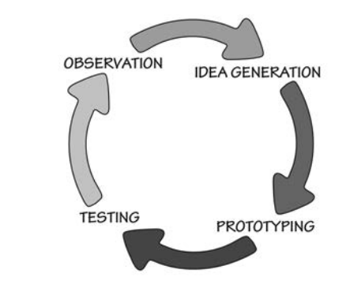
Human Centred Design
Ensuring:
  people’s needs are met
  product is understandable and usable
  accomplishes desired tasks
  Experience is enjoyable and positive

Slide 5
Human Centred Design
Constraints and concerns:
  Shape and form
  Cost and efficiency
  Reliability and effectiveness
  Understandability and usability
  Pleasure of appearance and pride of ownership
  Joy of actual use

Slide 6
Human Centred Design
Address the preceding requirement but emphasis on:
  Solving the right problem
  Meet human needs and capabilities

Slide 7
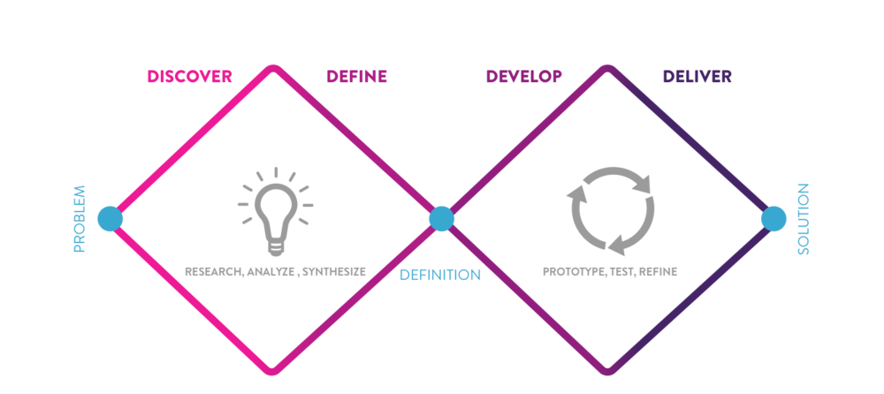
Double Diamond Model of Design / Diverge-Converge Model
Finding the right problem
Finding the right solution

Slide 8
Empathise
Conduct interviews to empathise with the situation
Applied Ethnography and Anthropology
Qualitative (understanding human activities, behaviour and desires, the whys)
Quantitative (understanding the whats)
Requirements made in abstract and by asking people will probably be wrong. The correct way is to observe people in their natural environments

Slide 9
Ideate
Define the problem statement
Are you solving the correct problem?
Generate numerous ideas
Be creative without regard to constraints
Question everything

Slide 10
Prototype
Which idea fits the problem statement?
Build quick prototypes or mockups
  Paper, cardboards, sketches, skits
  Wizard of Oz
Exercise: design a conversational, automated airline reservation system

Slide 11
Test
Test the prototype with actual users
  Single vs in pairs
  In-depth interviews
Don’t defend your idea/prototype
Learn what works and what doesn’t

Slide 12
Iteration
Go back to ideation to apply learning
“Fail frequently, fail fast”

Slide 13
Aside: Defensive Design
https://www.youtube.com/watch?v=WeyLEe1T0yo

Slide 14
Activity-Centred Design
Human-Centred Design: Intense focus on Individuals
What if same product is designed for usage all over the world?
  Automobiles, mobile phones
  Focus on activities, not the person
  Enhancement over HCD, for large, non-homogeneous populations
People are willing to learn things that are essential to an activity

Slide 15
Activity vs Task
Activity
  Go shopping
Task
  Drive to the shop
An activity is a collection of tasks
Focussing on tasks is too limiting, focus on the activity
  e.g. the success of iPods was because the focus was on the activity of music consumption, from purchasing to sharing.

Slide 16
Linear and Iterative Models
The waterfall and iterative models of software development
The double-diamond and HCD Models
They are ideal and expensive
Managements often follow a gated model
The fight between following the ideal design research process and staying on budget and schedule is old
Product management skills required to bring the different disciplines together

Slide 17
Challenges of Design
Design principles remain the same
  Therefore designers are able to design things from automobiles to a camera
Satisfying different requirements
  Engineering
  Cost: financial viability, profitability
  Will people buy it?
  A product is no good if no one buys it or doesn’t lead to profitability

Slide 18
Challenges of Design
Products might have multiple, conflicting requirements
Clients might not be the end-users
  Purchasing departments, building managers, etc.
  They might be interested in the price, not the usability. So what do we optimise?

Slide 19
Challenges of Design
Other teams like engineering, marketing, sales, services, manufacturing are all clients of the design output
  If their perspective is not taken into account the design will be changed piecemeal and weaken the cohesion of the product

Slide 20
Challenges of Design
Designing for special people
  If a product is designed to meet specifications for the 95th percentile of the population, it leaves out 5 percent people (65M people in India)
Some problems can not be solved using averages
  e.g. left handed and right handed users
  Build different versions of the product
  Universal Design

Slide 21
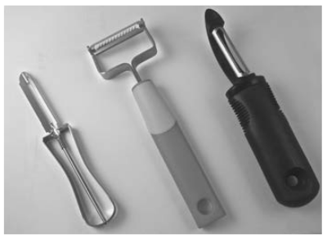
Stigma of special needs: Evolution of vegetable peelers

Slide 22
Stigma of special needs
Make special needs equipments fashion statements?
  Stylised hearing aids and glasses
Universal design make life better for everyone
  Ramp benefits everyone
  Larger fonts benefit everyone
Allow flexibility
  Adjustment of table height, font size, image size, light brightness, etc.

Slide 23

Proper Save Dialog benefits everyone

Slide 24
Complexity vs Confusion
Complexity is inevitable
  Activities in life are complex
Confusion can be avoided
  Mental models

Slide 25

Standardisation
Automobiles
  Pedals, gears, which side of the road to drive
Number of deliveries in an over (cricket)
SI system
Electric plugs and sockets
SDTV, HDTV, UltraHDTV, 3D TV
Digital Time
The hands move anticlockwise

Slide 26
Deliberate difficult designs
Bank vaults
Hazardous Materials

