Slide 1
Human Computer Interaction
BITS F364, Odd semester 2022
Errors in HCI

Slide 2
Why do errors happen?
Nature of task
  Staying alert for long durations
  Providing precise and accurate control specification
  Doing several things at once
  Subjected to multiple interfering activities
  Time stress (e.g. Gig Economy)
Attitude of people towards errors
  Guilty people are punished, but the design is not changed, so the same error might occur again
Design focuses on the requirements of the system and machines, not on the requirements of the the people
  Certain machines require great precision to operate

Slide 3
Root Cause Analysis
Analysing a situation to find the root of the problem
Not enough to attribute an error to human users
The root cause needs to be found the solution redesigned
There might not be one single root cause, but a bunch of reasons

Slide 4
The 5 Whys
Keep asking a series of Whys to understand the root of the problem
  Avoids tendency to stop the analysis when a human error is found
Don’t stop at 5, 5 is just to illustrate
There is no guarantee of success. Different investigators can come up with different reasons. Most complex problems have multiple causes
Examples of root cause analysis
  F-22
  Electricity Company

Slide 5
Deliberate Violations
Organisational and societal errors
Users knowingly take risks
  When outcome is positive, they are often rewarded
Routine violations: non-compliance is so frequent, it is ignored
Sometimes inappropriate rules invite and encourage violations

Slide 6
Types of Errors
Errors: deviance from the generally accepted correct or appropriate behaviour
Slips: person intends to do some action but ends of doing something else
  Action-based: wrong action is performed (e.g. Save instead of Save As)
  Memory-lapse: memory fails, intended action is not done (e.g. forgot to log out of netbanking portal)
Mistakes: wrong goal is established or wrong plan is formed
  Rule-based: diagnosis correct, but erroneous course of action
  Knowledge-based: misdiagnosed because of incomplete/erroneous knowledge
  Memory-lapse: memory-lapse at the stage of goals, plans or evaluation
  https://www.youtube.com/watch?v=snVifFDoAG8

Slide 7
Slips
Most everyday errors are slips
Capture slips
  Clicking buttons
  More experienced users fall prey more often
  Avoid having similar openings and then diverge
Description Similarity Slips
  Acting upon an item similar to the target
  Often result of tiredness, stress or overload
  Design controls to be visibly different

Slide 8
Slips
Memory-lapse Slips
  Primary cause: interruptions
  e.g. leaving the card inside an ATM
  Forcing actions might improve the slips
Mode-error Slips
  Device has several states (modes). Controls have different meanings in different modes
  e.g. Buttons on watches and microwave ovens
  Avoid modes, make modes obvious, compensate for intervening activities

Slide 9
Mistakes
User makes a poor decision, misclassifies a situation, fails to take all relevant factors into account
Vagaries of human thought: reliance upon remembered experiences instead of systematic analysis. Long term memory is a reconstruction, not an actual record and have biases

Slide 10
Mistakes
Skill-based mistakes
  Users are experts, can perform action with little thought or conscious attention
Rule-based mistakes
  User might not be an expert, but there are clear rules on how to act in a given situation (if-then statements)
  Mistakes can occur when situation is interpreted mistakenly, the rules themselves are faulty, or outcome of the implementation of a correct rule is incorrectly evaluated
  Designer should ensure that the current state of things is displayed to the user

Slide 11
Mistakes
Hindsight is superior to foresight
  It is easier to pick out which information was important when the mistake has already happened
  But in a time-stress situation it is not easy to choose among different rules and options

Slide 12
Mistakes
Knowledge-based mistakes
  Unfamiliar situations, when neither skills nor rules apply
  User is consciously problem-solving
  User-manuals or intelligent search engines can mitigate the situation
Memory-lapses
  Memory failure leads to forgetting goal or plan of action
  People will be interrupted. Design so that users are reminded of the current state, the goals and the plan of action. Provide assistance to resume interrupted processes

Slide 13
Societal and Institutional Pressure
Commercial considerations require to keep systems running even when it is not safe
  Airplanes taking off when it is not safe to do so
  Students cheating in exams and assignments
  Consuming pirated software and entertainment
  Drinking and driving
  https://www.youtube.com/watch?v=S3uS_8OyoEI
Pressure makes sensible people do things they know are wrong or dangerous
In hindsight, how does one prove that the safety action was necessary?
Good design might not be enough, we need to reward safety

Slide 14
Checklists
Powerful tools to prevent slips and memory lapses
When there are multiple, complex requirements, when there are interruptions
How to best use a checklist? If at least two persons simultaneously check it, not in series.
How to design a checklist?

Slide 15
Reporting Errors
Catching errors might avoid a lot of problems
Social pressure makes it difficult for users to admit errors or report errors
Reporting and admitting to errors need to be rewarded

Slide 16
Reporting Errors
Toyota: assembly line has special cord. Worker who detects an error pulls the cord to stop the assembly line and alert the experts. The experts use the 5-Whys method to do a root cause analysis. Failure to report an error results in punishment
US Aviation: report anonymously to a neutral third party

Slide 17
Preventing Errors
Poka-Yoke (Error-Proofing): Add simple fixtures to prevent errors
  Memory slots on Computers
  USB ports on Computers

Slide 18
Detecting Errors
Harm can be minimised if errors are detected quickly
Different categories of errors have different ease of detection
  Slips easier to discover, mistakes more difficult
Feedback is essential for error detection

Slide 19
Detecting Errors
Harm can be minimised if errors are detected quickly
Different categories of errors have different ease of detection
  Slips easier to discover, mistakes more difficult
Feedback is essential for error detection
  Memory-lapses are difficult to detect unless some unwanted consequence occurs
  Mistakes are difficult to detect because there is seldom anything to signal wrong plan or goal
  Misdiagnosis is also difficult to detect as the diagnosis was based on symptoms and so the initial results of the actions taken may be effective

Slide 20
Explaining Errors Away
Often, smaller indications of errors are explained away
  Neighbours yelling, car making noise
Distinguishing true anomaly from an apparent one is difficult
Hindsight
  Events seem perfectly logical in hindsight, but are completely unpredictable beforehand
  Fischhoff: Predict the outcome vs likelihood of outcome after the event
  https://www.youtube.com/watch?v=N1fVL4AQEW8&t=1s

Slide 21
Designing for Error
In normal conversations when people detect an error or falsities, they question or debate
Machines can’t question or debate. If the format of the command is correct the machine will do it
  X-Ray and medicine overdoses
  Wrong transactions in banks
Sometimes systems make it easy to err but difficult to discover or recover from the error

Slide 22
Designing for Error
Understand the causes of error and design to minimize those causes.
Do sensibility checks. Does the action pass the “common sense” test?
Make it possible to reverse actions—to “undo” them—or make it harder to do what cannot be reversed.
Make it easier for people to discover the errors that do occur, and make them easier to correct.
Don’t treat the action as an error; rather, try to help the person complete the action properly. Think of the action as an approximation to what is desired.

Slide 23
Designing for Error
Novices are more likely to make mistakes, experts more likely to make slips
Mistakes happen because:
  Current system state is unclear
  Inappropriate procedures
  Lack of good conceptual model
  Poor information provided by the system, poor quality feedback on what has happened: wrong choice of goal/plan, erroneous evaluation and interpretation

Slide 24
Designing for Error
Memory-lapse errors: interruptions
  Necessary to remember the state of the system, the stage in the action cycle
  Most systems make it difficult to resume after interruptions
Multitasking leads to degradation of performance and many more errors
  Using cellphones while driving or walking
  Sterile cockpit configuration

Slide 25
Designing for Error
Warning signs are often not distinct, often annoying and ignored or disabled
Warning signs need to be noticeable but not annoying
Different instruments and manufacturers need to collaborate to come up with standards

Slide 26
Design Lessons
Prevent errors before they occur, detect and correct errors when they occur
Add constraints to block errors
  Poka Yoke (description similarity errors)
  Make it difficult to access controls which lead to errors
  Segregate confusing controls
Undo command, recycle bin to store deleted files
Confirmation and error messages
  Problem: description similarity errors
  Slips vs Mistakes on confirmation dialogues
    Make the object prominent, make the action reversible

Slide 27
Design Lessons
Sensibility Checks
  Medical overdose
  Monetary transactions: transferring $1000 instead of ₹1000
  Intelligent systems would trigger a check

Slide 28
Design Lessons
Minimising slips
  Slips are often caused by distractions
  Should we ensure people are always paying close conscious attention? Bad idea
  Make the actions and the controls as dissimilar as possible: make modes visible and distinct
  Provide perceptible feedback about the action being performed, perceptible feedback about the resulting state and mechanism for it to be undone
  Make initial steps dissimilar

Slide 29
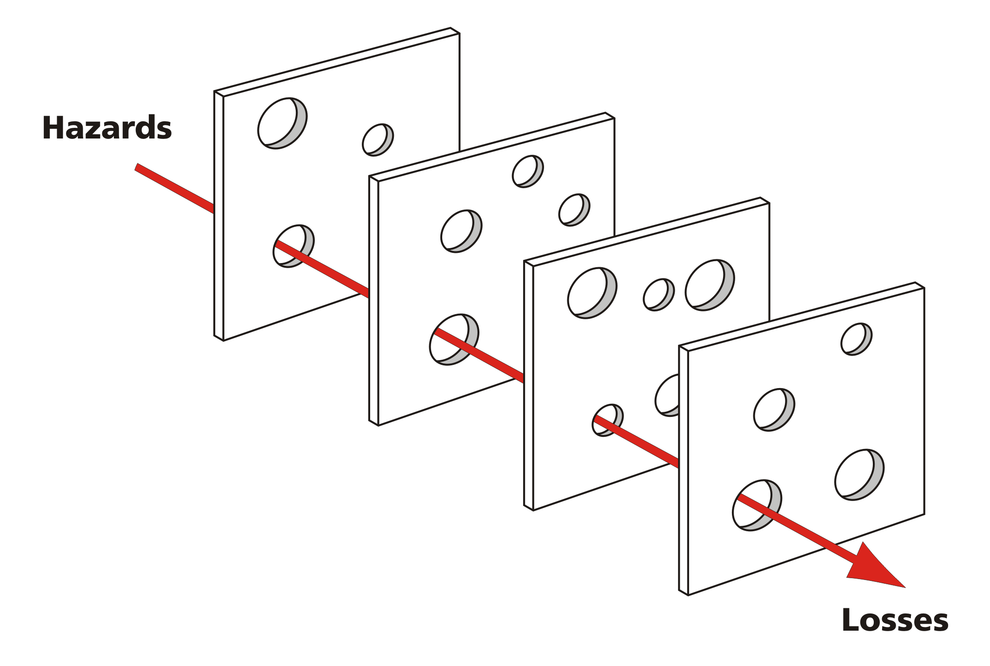
Design Lessons: Swiss Cheese Model

Slide 30
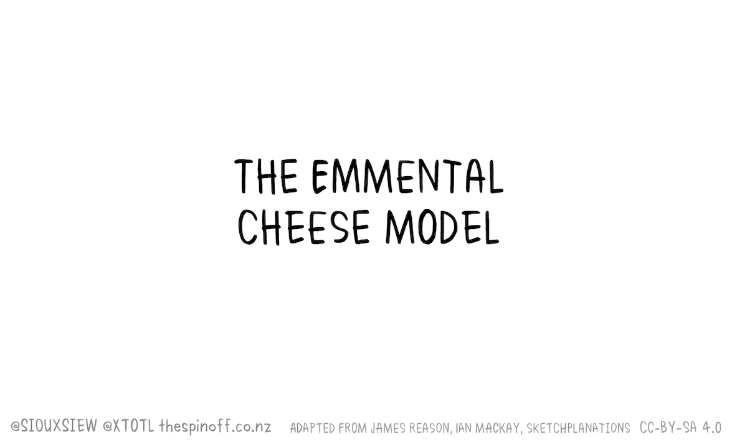
Swiss Cheese Model (New Zealand during COVID 19)

