Slide 1
Human Computer Interaction
BITS F364, Odd semester 2022
Ethics and HCI

Slide 2
Ethical Elements of Design
Contextual
  smart cars that prevent mobile phone use while driving
Emotional
  takes into account the connections people form with the objects they use
Anticipatory
  predict the most useful interaction within a sea of options and make a decision for the user, thus “simplifying” the experience.
  companies may use anticipatory design in unethical ways that trick users into selecting an option that benefits the company.

Slide 3
Is technology shaping our legal systems?
Jaywalking: https://www.youtube.com/watch?v=-AFn7MiJz_s
Aadhaar starvation deaths

Slide 4
If a self-driven car hits a pedestrian
Is the car company to blame?
Is the pedestrian to blame?
Is the Algorithm designer to blame?
…
The trolley problem
  https://www.youtube.com/watch?v=yg16u_bzjPE
https://onezero.medium.com/the-real-moral-dilemma-of-self-driving-cars-ab6bb5f216b
But, humans cause more road accidents than self-driving cars
  Do the ends justify the means?

Slide 5
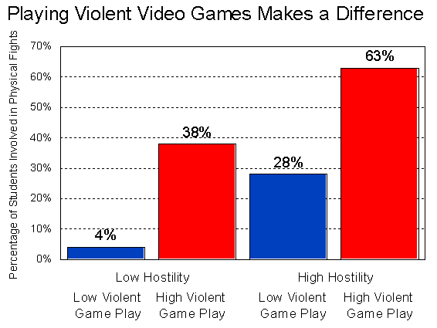
Video Games
First person shooting/fighting games
  How does it affect the psychology of the players?
  Violence, addiction, sexual themes
Microsoft wins Billion Dollar contract to develop AR modules for the US army

Slide 6
Ethics in User Studies
Informed consent and user self-esteem
Anonymity
Data integrity and Presentation
Undue persuasion
  Should not misinform, should not persuade of something they themselves would not consent to
Life and Death

Slide 7
Ethics on Social Media
Addiction
  Algorithms are optimised to increase eye-balls on their platforms
    FOMO, infinite scroll
  “If you aren't paying for the product, then you're the product being sold”
  https://www.youtube.com/watch?v=NUMa0QkPzns
  Filter bubbles
  Echo-chambers
Misinformation
  Influence on elections
Livestreaming violence and crime
Depression in teenagers owing to smartphone use
Twitters blue tick

Slide 8
Ethics on Social Media
User data is big business. Will enterprises give up this revenue stream?
Mastodon
  Decentralised federation, each instance has its own rules, moderation policies and administrators
  Funded through donation, not advertising or venture capital

Slide 9
Ethics on Social Media
Facebook, WhatsApp, etc. are communication platforms
  Should they be public funded like telephones, post, telegram?
Polluting industries are fined. What do we to social media companies leading to physical and mental health hazards?

Slide 10
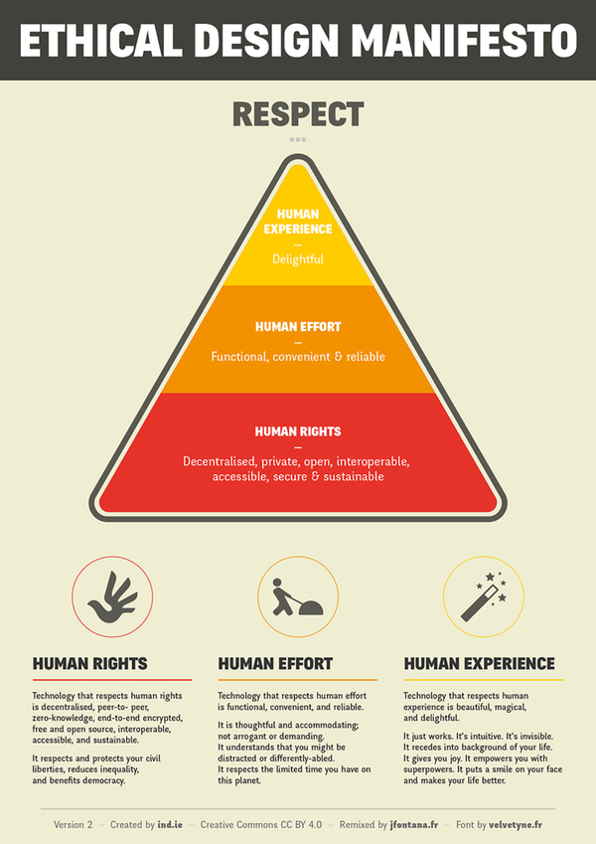

Slide 11
Reading
https://theweek.com/articles/799415/quest-design-ethical-social-media-platform
http://theconversation.com/ethical-design-is-the-answer-to-some-of-social-medias-problems-89531
https://theconversation.com/engineers-philosophers-and-sociologists-release-ethical-design-guidelines-for-future-technology-88696
http://shura.shu.ac.uk/18402
https://theconversation.com/why-its-important-to-understand-social-medias-dark-history-77230
https://futurism.com/the-byte/ethical-design-social-media
https://www.fastcompany.com/90239599/the-future-of-humanity-depends-on-design-ethics-says-tim-wu
http://act4d.iitd.ac.in/act4d/index.php?option=com_content&view=article&id=37&Itemid=45

