Slide 1
Human Computer Interaction
Review of Class Assignment 0
BITS F364, Odd semester 2022
Dipanjan Chakraborty
dipanjan@hyderabad.bits-pilani.ac.in

Slide 2
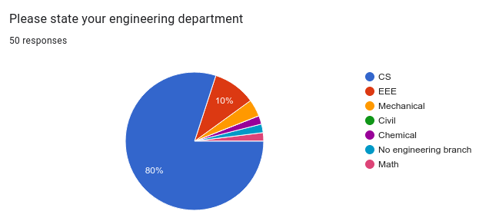
Disciplines

Slide 3
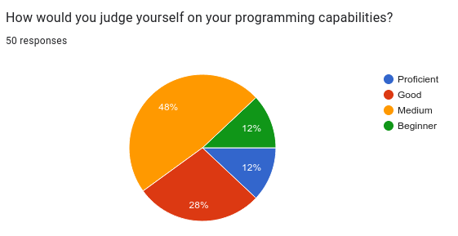
Programming Capabilities

Slide 4
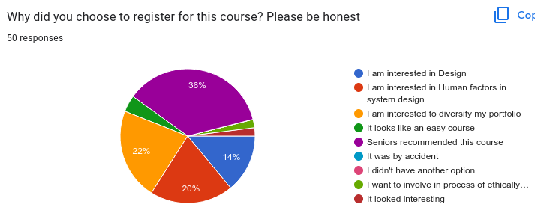
Why did you take this course?

Slide 5
Human Computer Interaction
Class Meeting 2
Evolution of HCI
BITS F364, Odd semester 2022
Dipanjan Chakraborty
dipanjan@hyderabad.bits-pilani.ac.in

Slide 6

Vacuum Tube Machines
ENIAC (1940s): occupied sizes of 3 classrooms, programmed using relays, reprogrammable

Slide 7
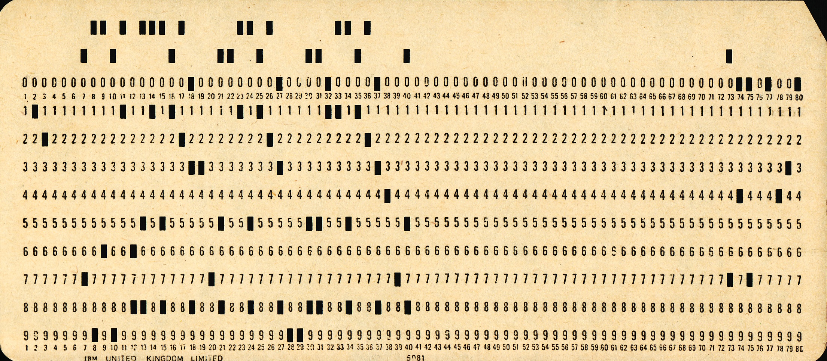
Storing Programs
Punched Cards and Magnetic Tapes

Slide 8
‘Operating’ Computers
Computers were accessed by academicians and big organisations
No concept of operating systems or systems program
Manual computer ‘operators’ programmed the computers

Slide 9
Visual Display Unit
1950s
Realtime Visual cues on the inputs and outputs

Slide 10
Time Sharing (mid 1960s)
Computers still too expensive
Time sharing allowed users to use a single computer from different ‘terminals’
Time sharing gave users the illusion of using individual machines
Allowed development of services like email, file sharing for communicating between terminals

Slide 11
Mother of All Demos
1963: Sutherland’s sketchpad introduced Direct Manipulation of Graphical Objects
1968:https://www.youtube.com/watch?v=B6rKUf9DWRI
  Full video: https://www.youtube.com/watch?v=yJDv-zdhzMY

Slide 12
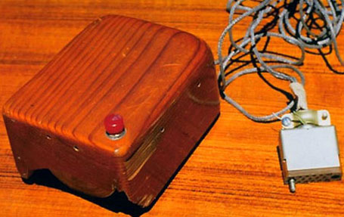
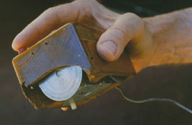
First mouse

Slide 13
Personal Computers
1969 (prototype) – mid 1970s
What computers can do for people, other than for businesses
Local processors, bitmapped display, mouse
Modern GUI (drawing, email, mouse selection, scrollbars, menubars, etc.)
LAN using Ethernet to share resources
Several models by Xerox, IBM and Apple followed
Earlier models were commercially unviable

Slide 14
Mental Models
Initial personal computers were not very intuitive to use
Focus on mapping physical office environment onto computer interfaces
Enter the ‘desktop’ metaphors
  Desktop, wallpaper, recyclebin / trashcan

Slide 15
Mental Models
1980s - 1990s
Focus on usability and users
Focus on task completion
Cognitive walkthroughs, heuristic testing, usability testing developed
These techniques continue to be used today

Slide 16
Collaboration and Communication
1990s – early 2000s
People no longer interact only with the computers, people interact with each other through computers
HCI expanded to include Sociologists, anthropologists, psychologists to study how interfaces influenced behaviour, or if human behaviour models can be used to design interaction and user experiences

Slide 17
Self-expression and Social Change
Mid 2000s -
Complex interactions across people, spaces and technologies
Pleasure, enjoyment, play, exploration
Philosophy, ethics, habit-forming

Slide 18
Multimedia Output
2010+
Not only is a computer able to take multimedia input: keyboard, mouse, voice, gesture, it is also able to provide output in multimedia: conversation agents, book movie tickets, clean the room, etc.

Slide 19
HCI Evolution
Cheaper and available computers / workstations meant people more important than machines
Excellent interface ideas modeled after human needs instead of system needs (user/human centered design)
Evolution of ideas into products through several generations
  pioneer systems developed innovative designs, but often commercially unviable
  settler systems incorporated (many years later) well-researched designs
people no longer willing to accept products with poor interfaces

Slide 20
Where does HCI stand?
Computers, powered by AI and unimaginable amounts of data, are more powerful than ever
Positives: connectivity, information, jobs
Concerns: influencing opinion, influencing elections, polarising society, influencing livelihood
“With great power comes great responsibility”
Responsible Technology Design: as designers and engineers of Human Machine Interfaces, we have a lot of responsibility on our shoulders
https://groups.google.com/u/1/g/responsibletechnologies/

