Slide 1
Human Computer Interaction
BITS F364, Odd Semester 2022
Dipanjan Chakraborty
dipanjan@hyderabad.bits-pilani.ac.in

Slide 2
The Psychopathology of Everyday Things

Slide 3
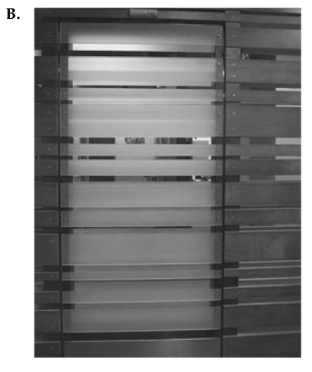

Slide 4
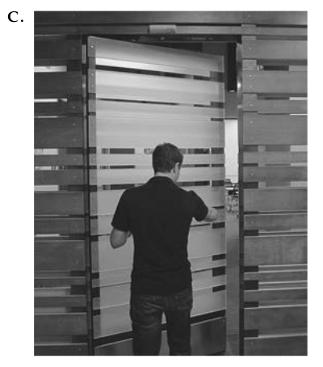

Slide 5
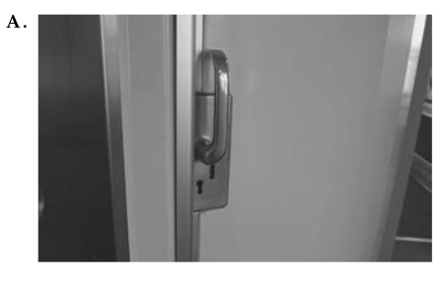

Slide 6
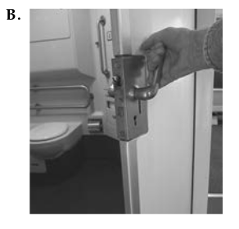

Slide 7
Norman Doors
https://www.youtube.com/watch?v=yY96hTb8WgI

Slide 8
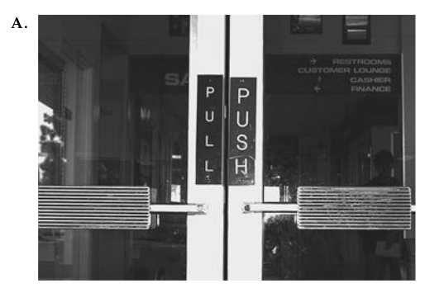
Discoverability
  Is it possible to even figure out what actions are possible and where and how to per- form them?
Understanding
  What does it all mean? How is the product supposed to be used? What do all the different controls and settings mean?

Slide 9
Bad design
Bad design might result in unusable products or usable products which force users to behave in a certain way
Machines can only follow rules. People often have to remember those arbitrary and strict rules to work on a machine
If an operator is not able to remember the rules who is to blame?
It is the duty of machines and those who design them to understand people. It is not the users’ duty to understand the arbitrary, meaningless dictates of machines.

Slide 10
What results in bad design?
Designing often is done by engineers, who are good in technology, but bad in understanding people
Engineers are trained to think logically
Human behaviour is not always logical
  We have to accept human behavior the way it is, not the way we would wish it to be.

Slide 11
Human Centred Design
Puts human needs, capabilities and behaviour first
Understand psychology and technology
Good communication from machine to people regarding what is possible, what is happening, what is about to happen
Designers need to focus their attention on the cases where things go wrong, not just on when things work as planned.

Slide 12
Human Centred Design
HCD is primarily done through observation
People often are unaware of their true needs, unaware of difficulties they are encountering
Rapid, iterative testing of ideas, approaching the problem definition

Slide 13
Principles of Interaction
Discoverability
  Affordances
  Signifiers
  Constraints
  Mapping
  Feedback
Understandability
  Conceptual Model
    Mental Model
  System Image

Slide 14
Affordances
Relationship between a physical object and a person
Chair: sit, food: eat, road: walk, screen: touch, keyboard: type
Anti-affordance:
  Glass affords transparency, but not passing air

Slide 15
Signifiers
Affordances need to be discoverable and perceivable
Signifiers: signals on where to execute the affordance
People need some way of understanding the product or service they wish to use, some sign of what it is for, what is happening, and what the alternative actions are.
Cursor: where to type, button: where to click, zebra crossing: where to walk, door handles: where to push/pull
Affordances: what; signifiers: where

Slide 16
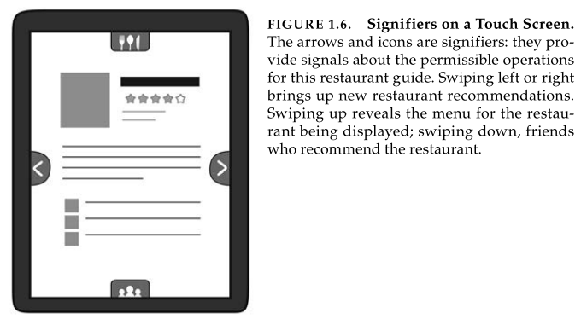
https://www.youtube.com/watch?v=3Va3oY8pfSI

Slide 17
Mapping
Relationship between elements of two sets of things (Mathematics)
  Sets of lights and switches
Turn steering wheel clockwise, car turns right; paddle boat on the left, boat turns right, press up-arrow key, game character moves forward
Natural mapping:
  Scrolling on a mouse vs touch screen
  Raise level to increase volume

Slide 18
Feedback
“Your request is being actioned”
Elevator button
Busy wheel
Acknowledgement email
Clicking a button, moving the mouse, writing on a paper

Slide 19
Feedback
Feedback must be:
  Immediate: delay in feedback can be useless
  Informative: non-informative feedback can be irritating and cause anxiety
  Just the right amount: users may disable feedback if there is too much feedback
Poor feedback might be because of a cost consideration

Slide 20
Feedback
https://www.youtube.com/watch?v=NAYkF04IZHI

Slide 21
Conceptual Models
Files, folders, icons
Desktop, wallpaper, recycle bin
Hand cursor for clicking

Slide 22
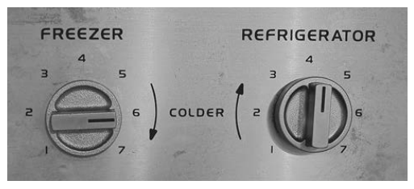
Conceptual Models

Slide 23
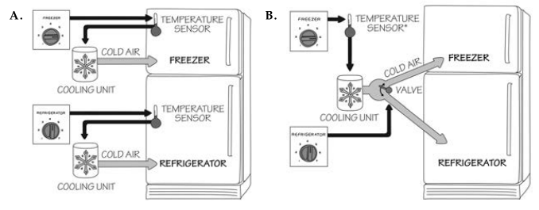
Conceptual Models

Slide 24
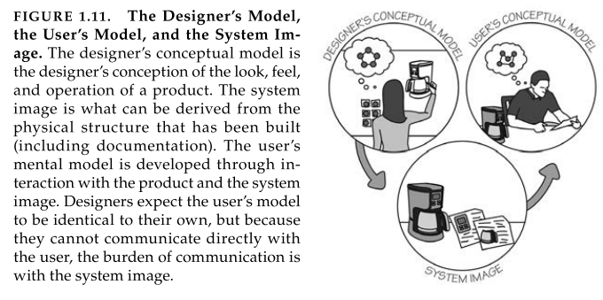
System Image

Slide 25
System Image
Communication is important as the designer and user will probably never come in contact
A product, no matter how brilliant, will fail if people can not use it
Good communication is the key to good conceptual models

Slide 26
The paradox of Technology
The same technology that simplifies life by providing more functions in each device also complicates life by making the device harder to learn, harder to use.
This is the paradox of technology and the challenge for the designer.

Slide 27
The Design Challenge
Different disciplines aim to optimise different aspects
One discipline argues that it must be usable and understandable, another that it must be attractive, yet another that it has to be affordable, another that it must be reliable and serviceable
What do you purchase a device (a car for)?
Design must take into account all the aspects

Slide 28
Flavours of Design
Industrial design: optimise the form and material
Interaction design: positive and enjoyable experience
  Understandability, usability
Experience design: emotional impact

Slide 29
