Slide 1
Human Computer Interaction
Qualitative Research
BITS F364, Odd semester 2022

Slide 2
Introduction
Concerned with the ‘why’ along with the ‘what’
  e.g. quantitative methods might reveal that there is a correlation between gender and the usage of an app. Qualitative methods can reveal the reason behind that

Slide 3
Qualitative Research Approaches
Grounded theory
  Collect data and inductively develop theories
Ethnography
  Immersive research to understand cultures
Action research
  Linking theory and practice to drive social change
Phenomenological research
  Invesitigating a phenomenon or event, interpreting participant’s lived experiences
Narrative research
  Examine how stories are told to understand how participants perceive and make sense of their experiences

Slide 4
Methods
In-depth interview
Focus Group Discussions (FGDs)
Ethnographic research, participant observation
Content analysis
Case study

Slide 5
Outcome
Results are descriptive
Results are easy to interpret

Slide 6
In-depth interviews
Personal interview, conducted one-on-one
Conversational method, unstructured
Follow-up questions can be asked to clarify
Provides the interviewer opportunity to read the body language of the respondent

Slide 7
Focus Group Discussions
Includes a group of respondents (6-10)
Try to find answers to ‘why, what and how’ questions
Give the group a case and see what responses and discussions emerge
Steer the discussion so that you are able to obtain answers to your research questions

Slide 8
Ethnographic Study
Most in-depth observational method
Studies people in naturally occurring environment
Researchers need to adapt to the audiences’ environment: organisation, city, urban slum, rural location
Understand the culture, challenges, motivations, settings
Doesn’t rely on interviews, observations are made first-hand
Can last from a few days to a few years. Requires researchers’ expertise to analyse and infer data

Slide 9
Observation as qualitative research
Does not depend on measurements or numbers (unlike quantitative research) but instead on characteristics
Uses subjective methods
Uses the five senses of sight, smell, touch, taste and hearing

Slide 10
Sampling in Qualitative Research
Sampling choices made to deepen the understanding of the phenomenon being studied
Non-probability sample: don’t know the likelihood of an entity (person, event, etc.) to be selected in the sample
  Cannot be generalised to the population
Goal is in-depth understanding

Slide 11
Non-probability sampling
Purposive sampling
Snowball sampling
Quota sampling
Convenience sampling

Slide 12
Non-probability sampling
Purposive sampling
  With specific purpose in mind.
  e.g. including men and women, different educational strata, etc.
  e.g. building an app on violence against women requires interviewing women victims of violence

Slide 13
Non-probability sampling
Snowball sampling (chain referral sampling)
  Rely on initial participants to identify other participants for the study
  Helpful in studying stigmatised groups

Slide 14
Non-probability sampling
Quota sampling
  Identify what categories are important to study
  Subgroups are created and the number of people to study in each subgroup is decided
  e.g. study 10 male and 10 female participants

Slide 15
Non-probability sampling
Convenience sampling
  Convenience of access
  Exploratory research
  Often used by journalists
  Can not be generalised to the population

Slide 16
Qualitative Data Collection
Collect non-numeric data to provide detailed insight
Data should be holistic, rich, nuanced
Findings to emerge through careful analysis of the data

Slide 17
Qualitative Data Collection
Generates huge amount of data
Data might be in the form of notes, audio recordings and video recordings
Audio and video recordings must be transcribed before analysis

Slide 18
Qualitative Data Analysis
The notes and transcripts are often subjected to text analysis
Researchers decode the words and actions of the respondents

Slide 19
Characteristics
Data is collected in-situ and in the geographic location of participants
Usually multiple sources of data are used: interviews, observations, documents, etc.
Communicative methods, people build trust with the researcher. Data is usually raw and unadulterated

Slide 20
Analysis of Qualitative Data
Methods:
  Content analysis
  Thematic analysis
  Textual analysis
  Discourse analysis

Slide 21
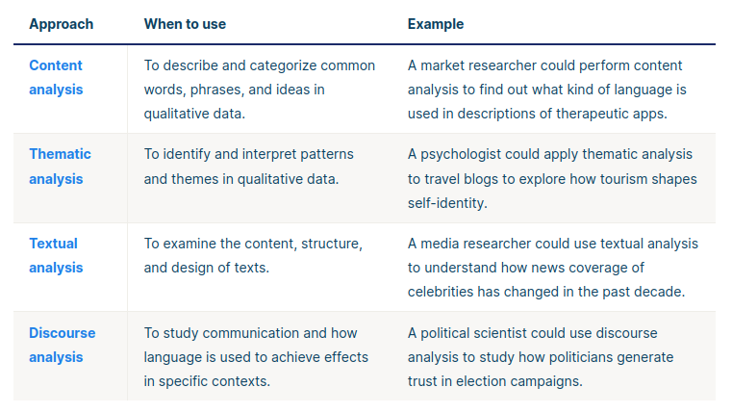
Analysis of Qualitative Data

Slide 22
Advantages of Qualitative Research
Flexibility of data collection and analysis process
Data collection in real-world and natural settings
Obtaining meaningful insights
Generation of new ideas

Slide 23
Disadvantages of Qualitative Research
Uncontrolled factors make it unreliable
Subjective: difficult to replicate
Limited generalizability
Labour-intensive

Slide 24
Human Computer Interaction
Mixed Method Research
BITS F364, Even semester 2021

Slide 25
Mixed methods research
Combines quantitative and qualitative methods
Quantitative and Qualitative studies can feed into each other
e.g. Men own more smartphones than women in India (quantitative finding). This can be explained using qualitative research
Qualitative research can serve as a preliminary (exploratory) phase to quantitative research by identifying what to measure, and to building an exhaustive list of options for a question
e.g. users prefer UIs to be in their native language (qualitative finding). How general is this observation for the entire population can be determined by using quantitative measures

