Slide 1

Alan Bryman
Social Research Methods
Chapter 8: Sampling

Slide 2
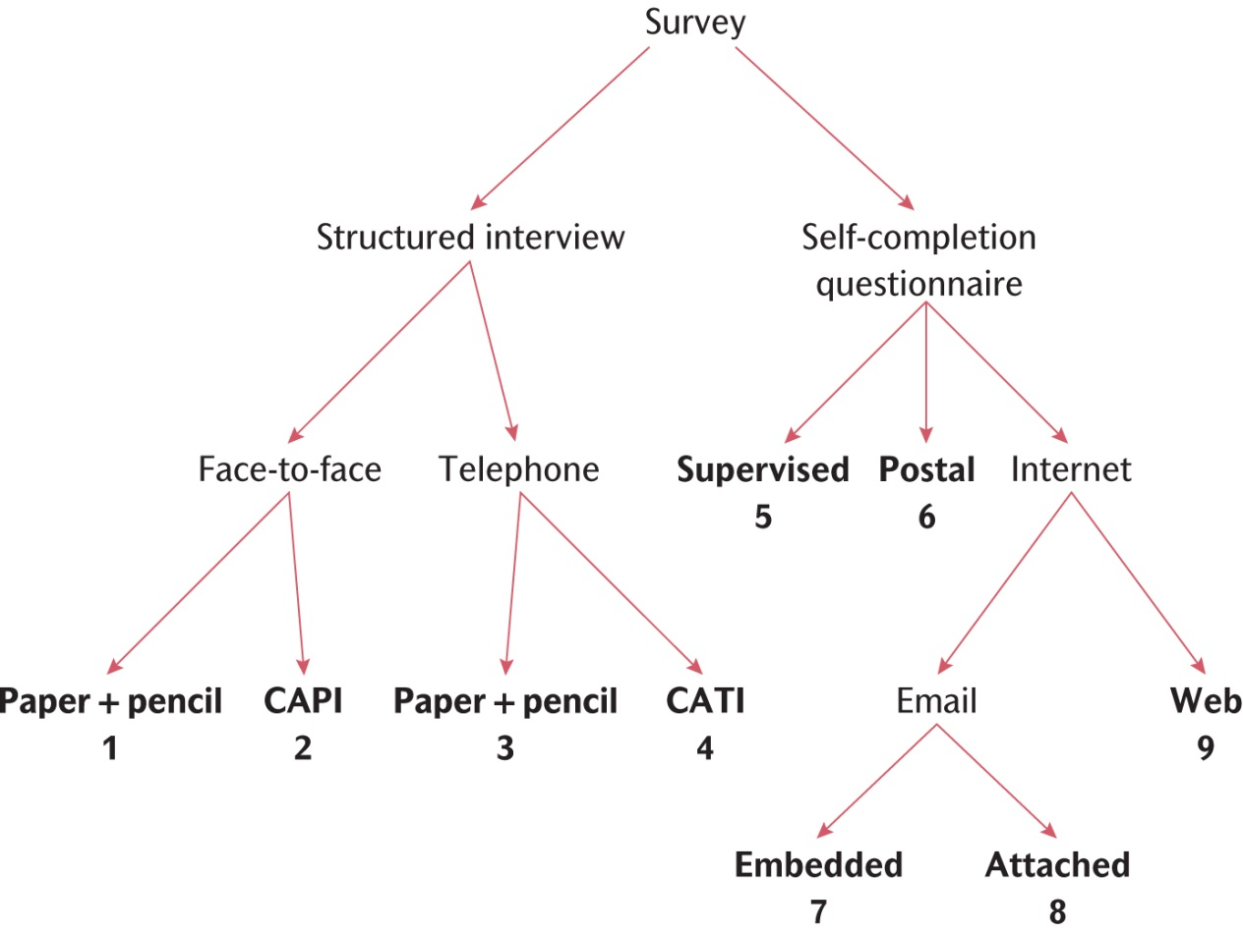
Survey elements
Page 173

Slide 3
Basic terms and concepts: 1
Population: the universe of units from which the sample is to be selected
Sample: the segment of population that is selected for investigation
Sampling frame: list of all units
Representative sample: a sample that reflects the population accurately
Sample bias: distortion in the representativeness of the sample
Key concept 8.1
page 174

Slide 4
Basic terms and concepts: 2
Probability sample: sample selected using random selection
Non-probability sample: sample selected not using random selection method
Sampling error: difference between sample and population
Non-sampling error: findings of research into difference between sample and population
Non-response: when members of sample are unable or refuse to take part
Census: data collected from entire population
Key concept 7.1
page 174

Slide 5
Sampling error
Difference between sample and population
Biased sample does not represent population
  some groups are over-represented; others are under-represented
Sources of bias
  non-probability sampling, inadequate sample frame, non-response
Probability sampling reduces sampling error and allows for inferential statistics
Pages 175 and 176

Slide 6
4 types of probability sample
Simple random sample
Systematic sample
Stratified random sample
Multi-stage cluster sample

Slide 7
Simple random sampling
  Each unit has an equal probability of selection
  Sampling fraction: n/N
  where n = sample size and N = population size
  List all units and number them consecutively
  Use random numbers table to select units
Pages 176 and 177

Slide 8
Systematic sampling
  Select units directly from sampling frame
  From a random starting point, choose every n^{th} unit (e.g. every 4th name)
  Make sure sampling frame has no inherent ordering – if it has, rearrange it to remove bias
Page 178

Slide 9
Stratified random sampling
Starting point is to categorise population into ‘strata’ (relevant divisions, or departments of companies for example)
So the sample can be proportionately representative of each stratum
Then, randomly select within each category as for a simple random sample
Page 178

Slide 10
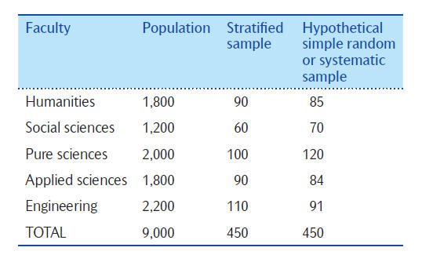
The advantages of stratified sampling – an example
Table 8.1
Page 178

Slide 11
Multi-stage cluster sampling
  Useful for widely dispersed populations
  First, divide population into groups (clusters) of units, like geographic areas, or industries, for example
  Sub-clusters (sub-groups) can then be sampled from these clusters, if appropriate
  Now randomly select units from each (sub)cluster
  Collect data from each cluster of units, consecutively
Pages 179 and 180

Slide 12
Qualities of a probability sample
Representative - allows for generalization from sample to population
Inferential statistical tests
Sample means can be used to estimate population means
Standard error (SE): estimate of discrepancy between sample mean and population mean
95% of sample means fall between +/- 1.96 SE from population mean
Page 181

Slide 13
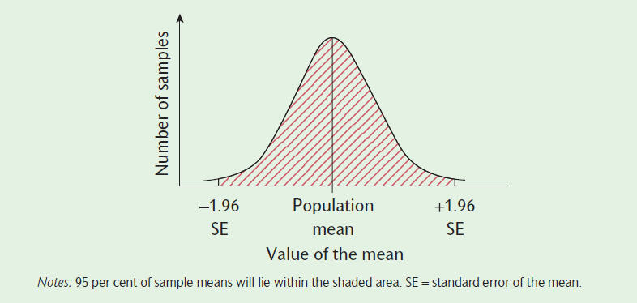
The distribution of sample means
Figure 8.8
Page 182

Slide 14
Sample size
Absolute size matters more than relative size
The larger the sample, the more precise and representative it is likely to be
As sample size increases, sampling error decreases
Important to be honest about the limitations of your sample
Tips and skills
Page 183

Slide 15
Factors affecting sample size: 1
Time and cost
  after a certain point (n=1000), increasing sample size produces less noticeable gains in precision
  very large samples are decreasingly cost-efficient (Hazelrigg, 2004)
Non-response
  response rate = % of sample who agree to participate (or % who provide usable data)
  responders and non-responders may differ on a crucial variable
Pages 184-186

Slide 16
Factors affecting sample size: 2
Heterogeneity of the population
  the more varied the population is, the larger the sample will have to be
Kind of analysis to be carried out
  some techniques require a large sample
Pages 186 and 187

Slide 17
Types of non-probability sampling: 1
1. Convenience sampling
  the most easily accessible individuals
  useful when piloting a research instrument
  may be a chance to collect data that is too good to miss
2. Snowball sampling
  researcher makes initial contact with a small group
  these respondents introduce others in their network
    e.g. Bryman’s (1999) sample of British visitors to Disney theme parks
Pages 187 and 188

Slide 18
Types of non-probability sampling: 2
3. Quota sampling
  often used in market research and opinion polls
  relatively cheap, quick and easy to manage
  proportionately representative of a population’s social categories (strata)
  but non-random sampling of each stratum’s units
  interviewers select people to fit their quota for each category, so the sample may be biased towards those who appear friendly and accessible (e.g. in the street), leading to under-representation of less accessible groups
Pages 188-190

Slide 19
Sampling Issues in online surveys
Not everyone has the internet – bias
But it can be less time consuming than the post
It is often hard to know the size of the population
Non- response rates are generally higher in online surveys (follow them up, potentially contact them first?)
Consider a progress indictor in a questionnaire
Pages 191-193

Slide 20
Limits to generalization
Findings can only be generalized to the population from which the sample was selected
  be wary of over-generalizing in terms of locality
Time, historical events and cohort effects
  results may no longer be relevant and so require updating (replication)
Pages 193 and 194

Slide 21
Error in survey research
Sampling error
  unavoidable difference between sample and population
Sampling-related error
  inadequate sampling frame; non-response
  makes it difficult to generalize findings
Data collection error
  implementation of research instruments
  e.g. poor question wording in surveys
Data processing error
  faulty management of data, e.g. coding errors
Page 194

