Slide 1


Semantic Parsing with Dual Learning
——2019 ACL
Ruisheng Cao*, Su Zhu*, Chen Liu, Jieyu Li and Kai Yu
MoE Key Lab of Artificial Intelligence
SpeechLab, Department of Computer Science and Engineering Shanghai Jiao Tong University, Shanghai, China
Monday 29th July, 2019
Semantic Parsing with Dual Learning

Slide 2
Outline
Introduction and Motivation
Dual Learning Framework for Semantic Parsing
Experimental Results
Conclusion
Semantic Parsing with Dual Learning

Slide 3
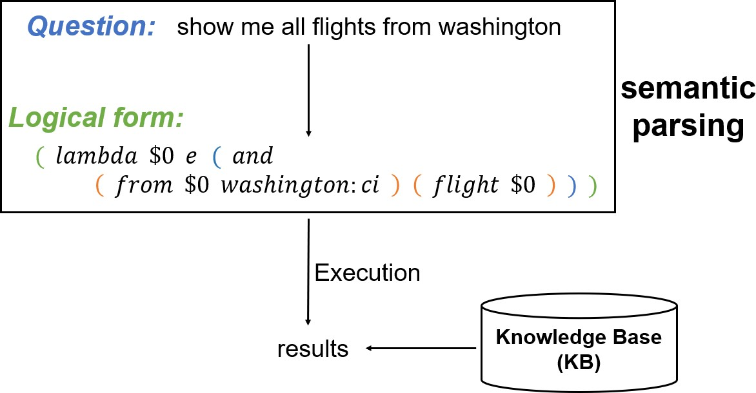
What is Semantic Parsing
Semantic Parsing with Dual Learning
Notes:
As we can see, logical forms are often nested and have a tree or graph structure.

Slide 4
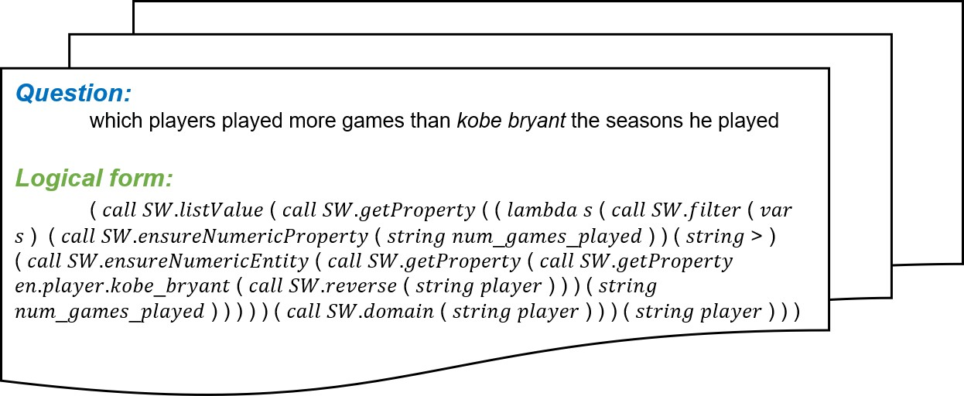
Bottlenecks 1: data hungry
Semantic annotation is labor-intensive and time-consuming
Figure:Training example from dataset Overnight
Semantic Parsing with Dual Learning
Notes:
Here’s an example on the slide, you may find it rather complicated and difficult to understand. Previous work on creating a semantic parsing dataset usually follows this procedure: we first synthesize some logical forms according to some grammar rules. Then workers are employed to paraphrase the canonical query sentences.

Slide 5
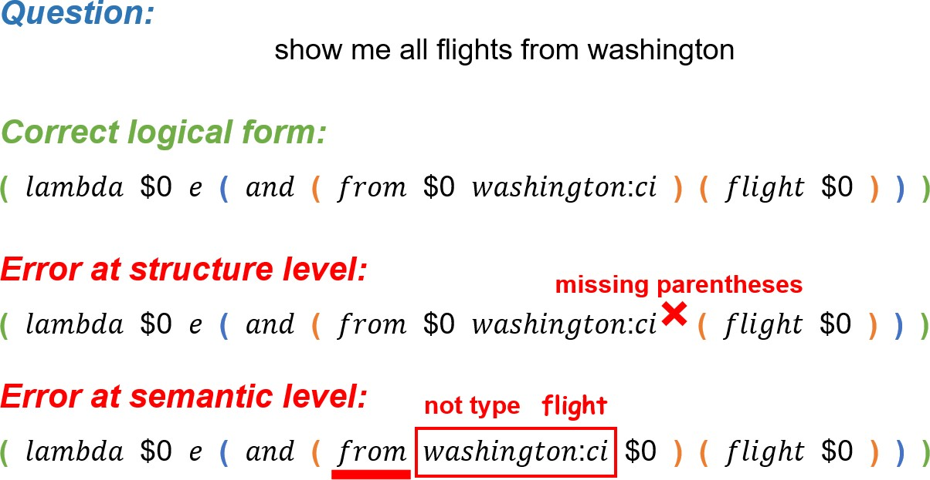
Bottlenecks 2: constrained decoding
Output space should be strictly constrained
Semantic Parsing with Dual Learning
Notes:
Unlike natural language sentences, a logical form is strictly structured. If we make no constraint on decoding process, the generated logical form will be incomplete or invalid at structure and semantic levels.

Slide 6
Outline
Introduction and Motivation
Dual Learning Framework for Semantic Parsing
Experimental Results
Conclusion
Semantic Parsing with Dual Learning

Slide 7
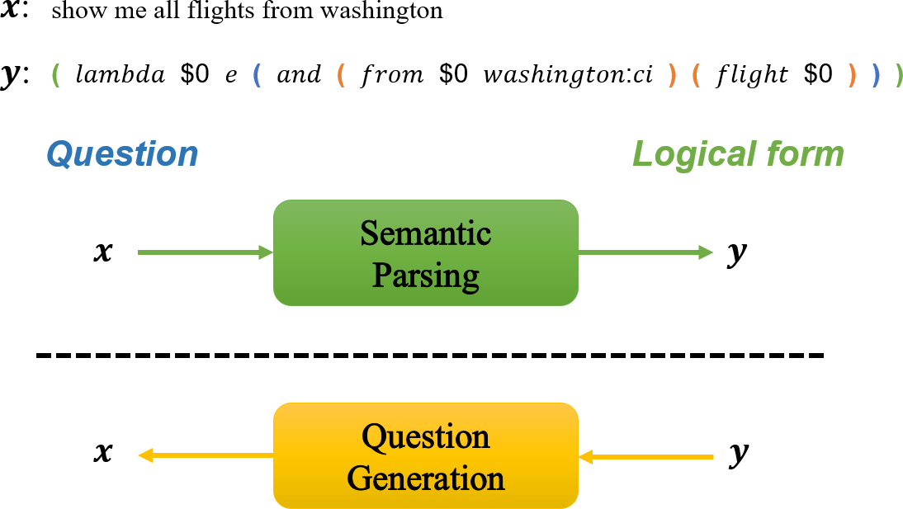
Our method: Overview
Semantic Parsing with Dual Learning
Notes:
The input and output are completely reverse. Furthermore, there is little information loss between the input and output side in both tasks. At this time, these two models are separate.

Slide 8
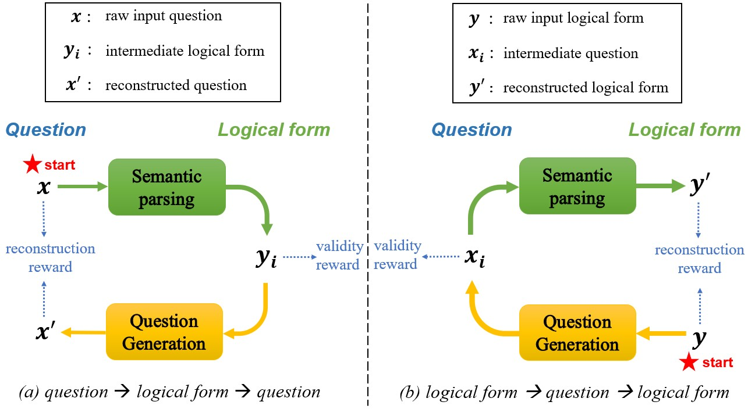
Our method: Overview
Semantic Parsing with Dual Learning
Notes:
By measuring whether these logical forms are valid at structure and semantic levels, we will get some feedback signal, called the validity reward.
By measuring the difference between raw input question and our reconstructed question, we will get another training signal, called reconstruction reward.
Since the closed cycle does not depend on any supervision, unlabeled questions can be effectively utilized, thus alleviating data hungry problem.
With respect to constrained decoding problem, prior knowledge about the structure and semantic constraints can be incorporated into the validity reward for logical form.
Generally speaking, intermediate outputs are produced in one model and then checked in another. Validity reward is used to measure the quality of intermediate results, and reconstruction reward is used to evaluate the performance of the final reconstruction. These two models can teach and regularize each other through this dual learning game.

Slide 9
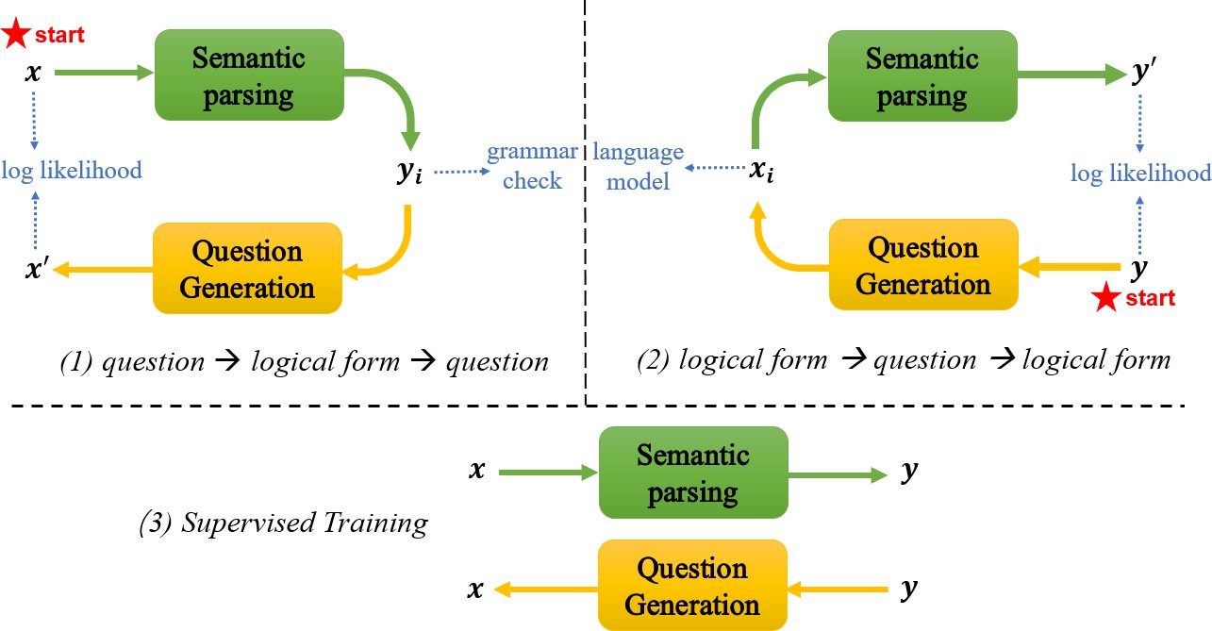
Training Procedure: 3 stages
Semantic Parsing with Dual Learning
Notes:
I wanna give a few more comments on this round-robin scheme. Different from machine translation, which learns phrase mappings in general, semantic parsing has more strict constraints on the output side. If training only contains the first two stages, our algorithm will degenerate into completely unsupervised training. No supervision is provided after pretraining, the two models would be rotten, especially when training data is limited. On the other hand, the first two reinforcement learning stages try to prevent the two models from falling into a local optima due to overfitting. The supervised training tries to exploit data using strong supervision. They achieve a balance between exploration and exploitation, learning from data in both unsupervised and supervised manner. Lastly, the reinforcement learning process may have high variance, and guidance from supervised training may prevent taking a risky step at the end of an iteration.

Slide 10
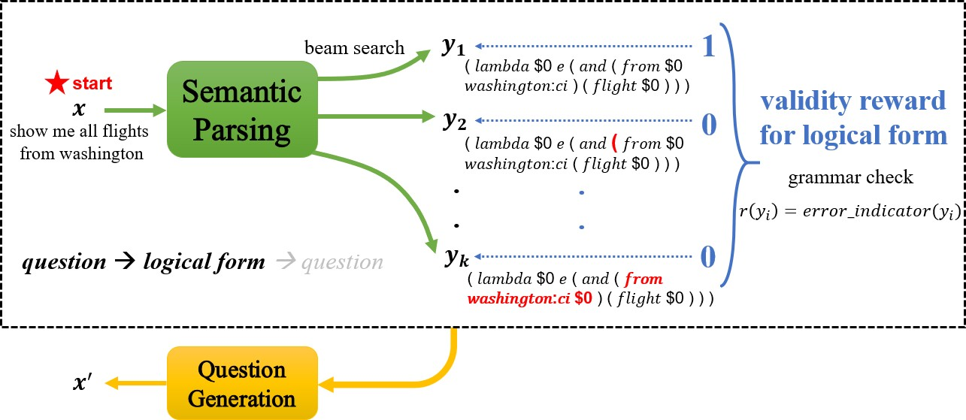
1. loop starts from question
Semantic Parsing with Dual Learning
Notes:
For each LF y subscript i, we evaluate its validity reward according to grammar check result. The validity reward for a logical form checks whether the generated LF is syntactically incorrect or it will cause runtime errors such as type consistency or empty output while execution. With the assistance of an execution engine, we can obtain these binary output signals.

Slide 11
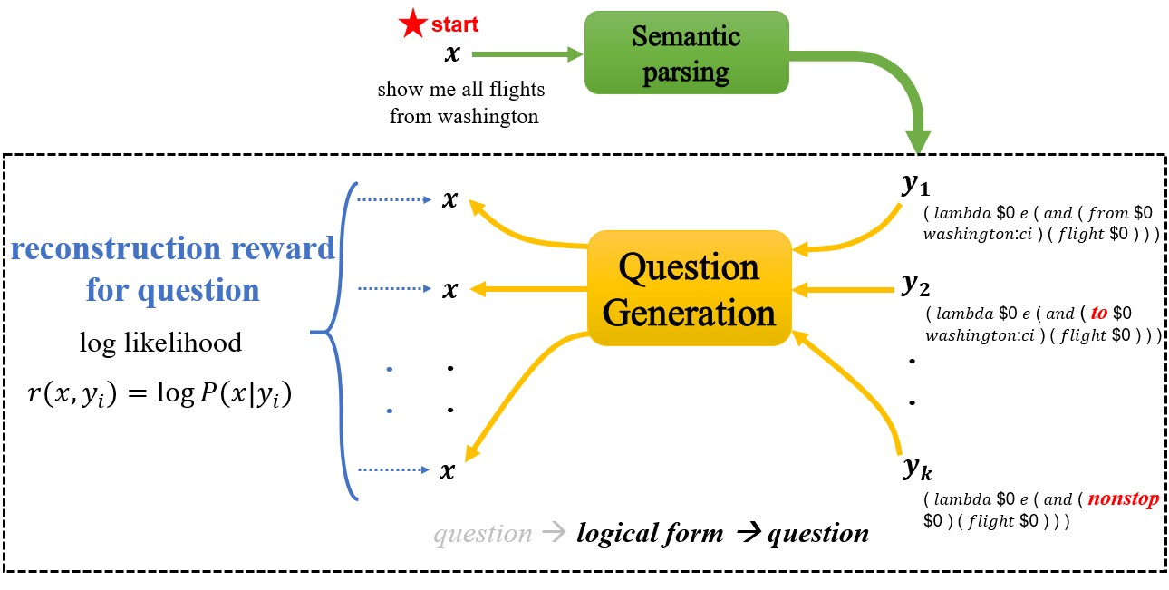
1. loop starts from question
Semantic Parsing with Dual Learning
Notes:
In the reverse path, for each possible logical form, question generation model tries to reconstruct the original question.

Slide 12
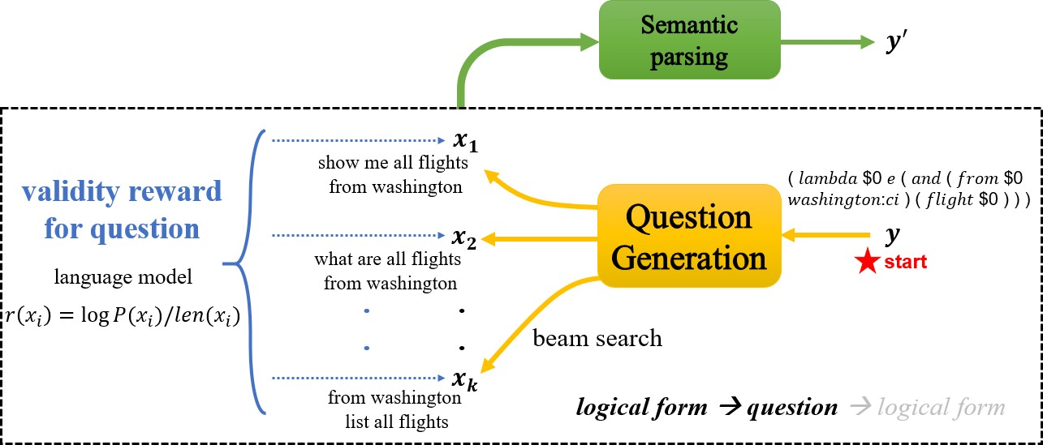
2. loop starts from logical form
Semantic Parsing with Dual Learning
Notes:
To evaluate whether the intermediate question is fluent or natural, we utilize a length normalized language model as the validity reward this time, which allows fair competition between short and long sentences. The language model is pretrained and parameters are fixed since then.

Slide 13
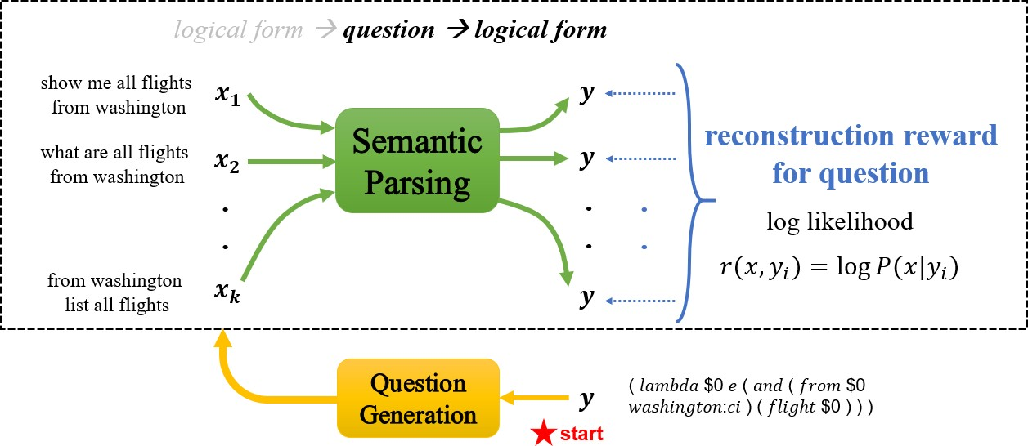
2. loop starts from logical form
Semantic Parsing with Dual Learning

Slide 14
Outline
Introduction and Motivation
Dual Learning Framework for Semantic Parsing
Experimental Results
Conclusion
Semantic Parsing with Dual Learning

Slide 15
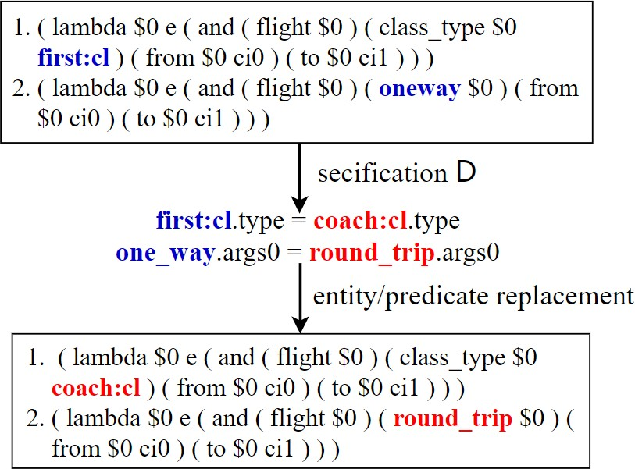
Synthesize more logical forms
Sampling and modification based on ontology (4592 more logical forms for ATIS)
Directly revise grammar rules on Overnight (500 more logical forms on avg)
Semantic Parsing with Dual Learning

Slide 16
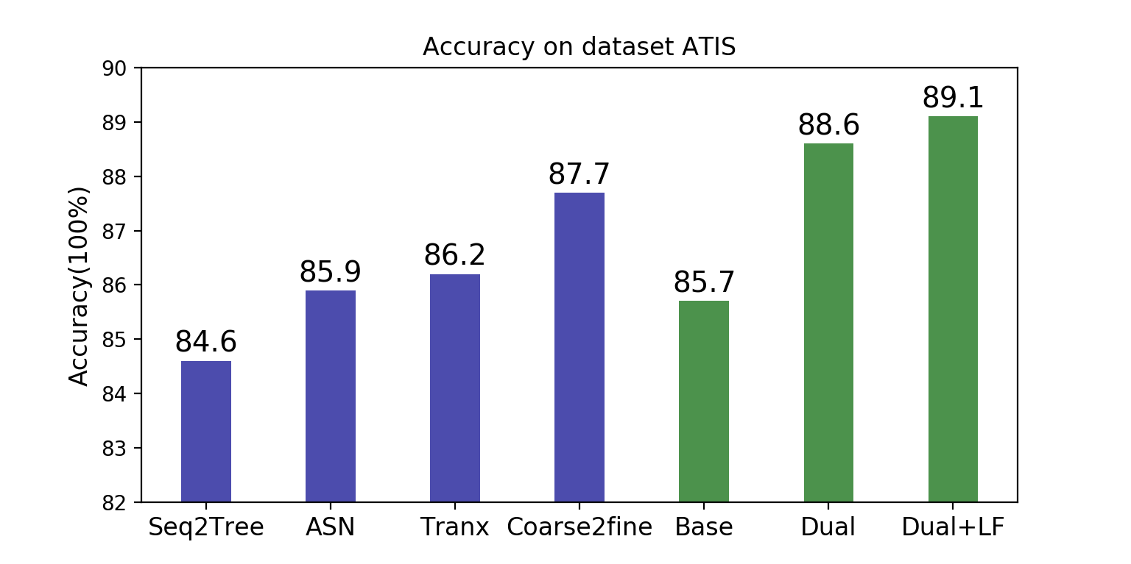
Results: ATIS
Semantic Parsing with Dual Learning
Notes:
The blue bars represents previous work and green bars denote our implementation. Our baseline model is seq2seq with attention and copy mechanism using merely supervised training.
According to the result, even without additional synthesized LFs, our dual learning based semantic parser outperforms our baseline by a large margin.
By involving synthesized logical forms, the performance is improved further, which is SOTA compared with previous best method, coarse2fine, 1.4% absolute improvement.

Slide 17
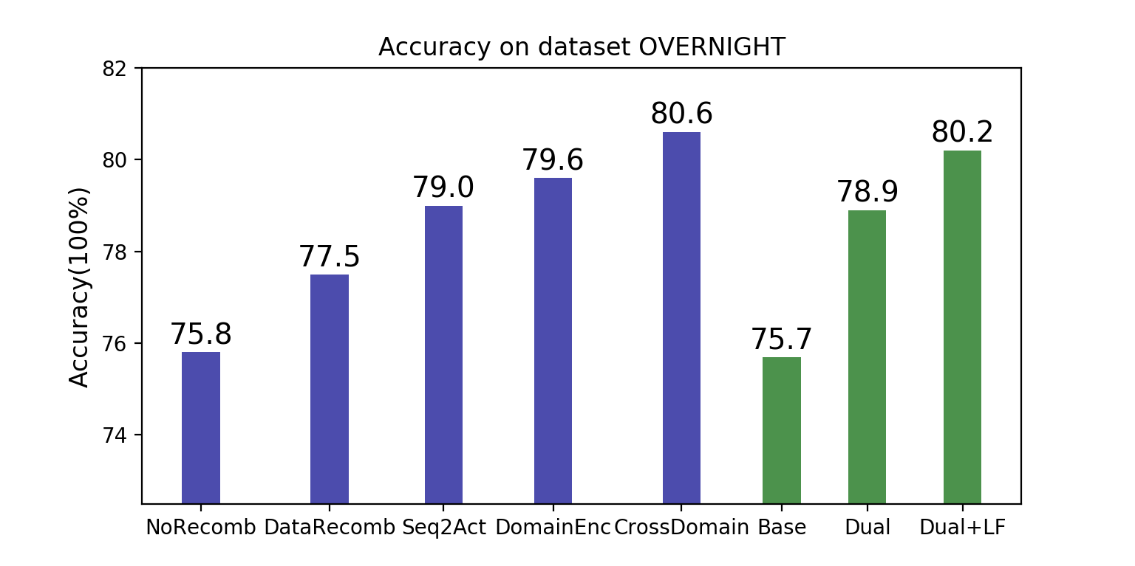
Results: OVERNIGHT
Semantic Parsing with Dual Learning
Notes:
on dataset OVERNIGHT, we average the execution accuracy across eight domains. The improvement is also remarkable compared with our baseline models without dual learning algorithm. We achieve a competitive performance on average. Only a bit lower than cross domain method which apply domain adaptation.

Slide 18
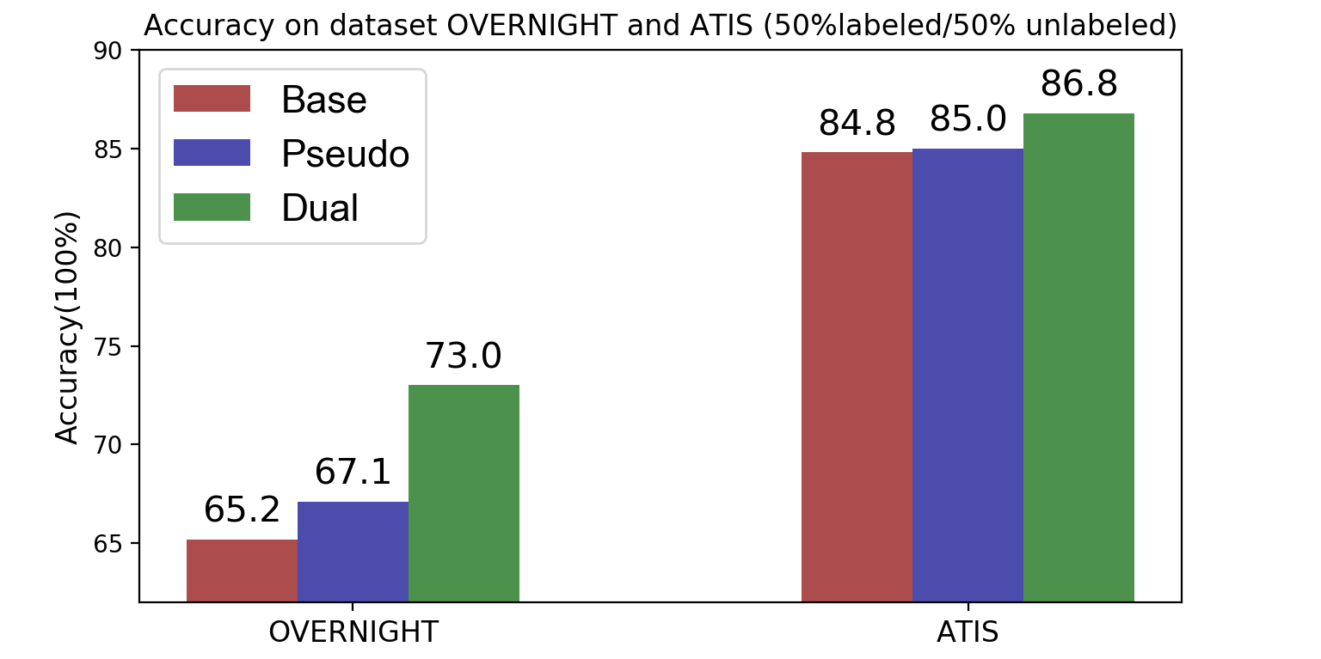
Semi-supervised experiment: 50%labeled/50%unlabeled
Semantic Parsing with Dual Learning
Notes:
On the slide, Pseudo represents a universal semi-supervised method. It means that we use the semantic parsing model plus unlabeled questions as well as question generation model plus unlabeled logical forms to generate pseudo training samples. These pseudo samples are mixed with labeled data to train a semantic parser.

Slide 19
Outline
Introduction and Motivation
Dual Learning Framework for Semantic Parsing
Experimental Results
Conclusion
Semantic Parsing with Dual Learning

Slide 20
Conclusion
Core idea
Leverage query generation model and obtain effective feedback signals to enhance the semantic parsing process.
Semantic parsing framework based on dual learning algorithm
Utilize both labeled and unlabeled samples
Implicit constraint signal incorporated into reward
Semantic Parsing with Dual Learning

Slide 21
Thanks & QA
Q & A
Semantic Parsing with Dual Learning

Slide 22
ReferencesI
Chen, B., Sun, L., and Han, X. (2018).
Sequence-to-action: End-to-end semantic graph generation for semantic parsing.
In Proceedings of the 56th Annual Meeting of the Association for Computational Linguistics (Volume 1: Long Papers), pages 766–777.
Herzig, J. and Berant, J. (2017).
Neural semantic parsing over multiple knowledge-bases.
In Proceedings of the 55th Annual Meeting of the Association for Computational Linguistics (Volume 2: Short Papers), pages 623–628.
Jia, R. and Liang, P. (2016).
Data recombination for neural semantic parsing.
arXiv preprint arXiv:1606.03622.
Su, Y. and Yan, X. (2017).
Cross-domain semantic parsing via paraphrasing.
arXiv preprint arXiv:1704.05974.
Semantic Parsing with Dual Learning

Slide 23
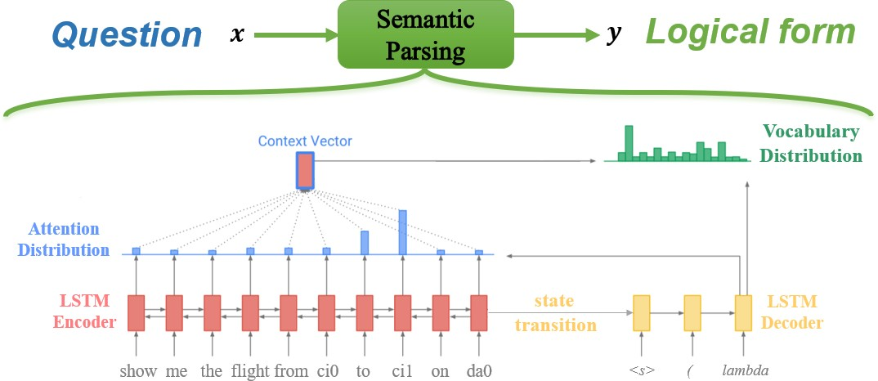
Baseline Model: Att
Semantic Parsing with Dual Learning

Slide 24
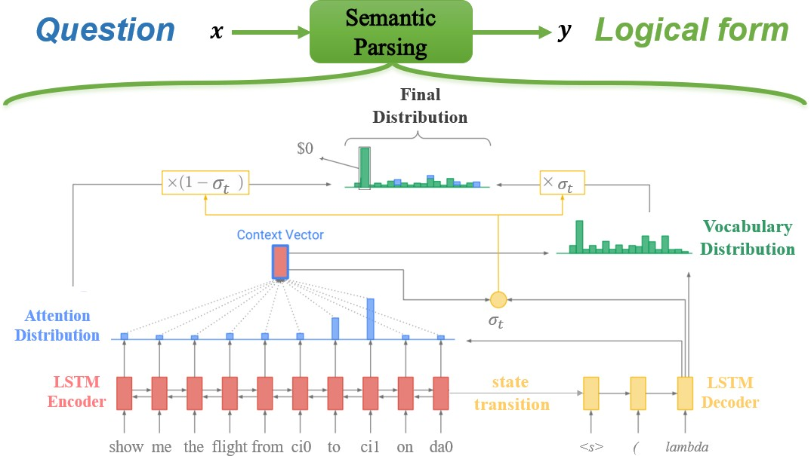
Baseline Model: AttPtr
Semantic Parsing with Dual Learning

Slide 25
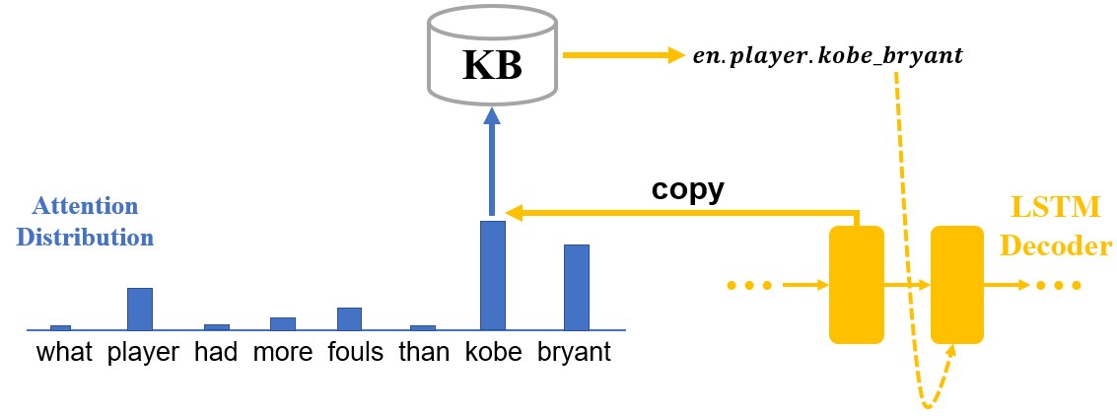
Semantic Parsing (Entity Mapping)
Entities are identified by Universal Resource Identifier(URI) in Knowledge Base(KB)
kobe bryant → en.player .kobe bryant
After copying, map words to corresponding URI
Semantic Parsing with Dual Learning

Slide 26
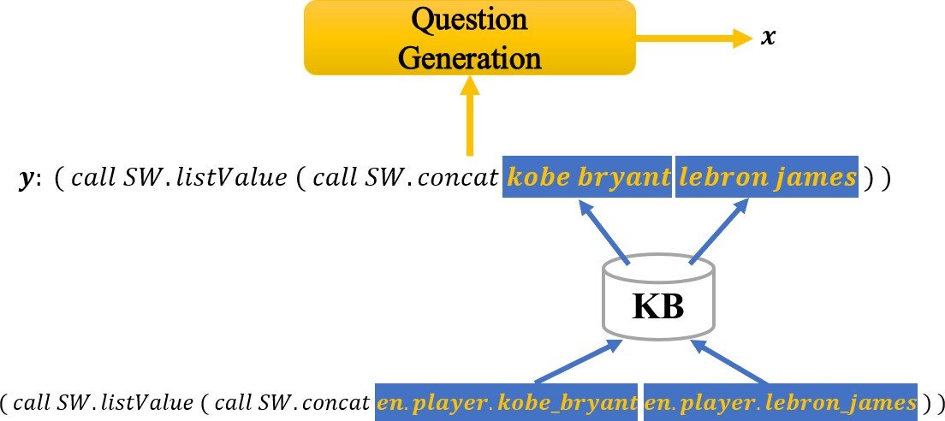
Question Generation (Reverse Entity Mapping)
Reversely map KB entity to possible noun phrase before QG
Semantic Parsing with Dual Learning

Slide 27
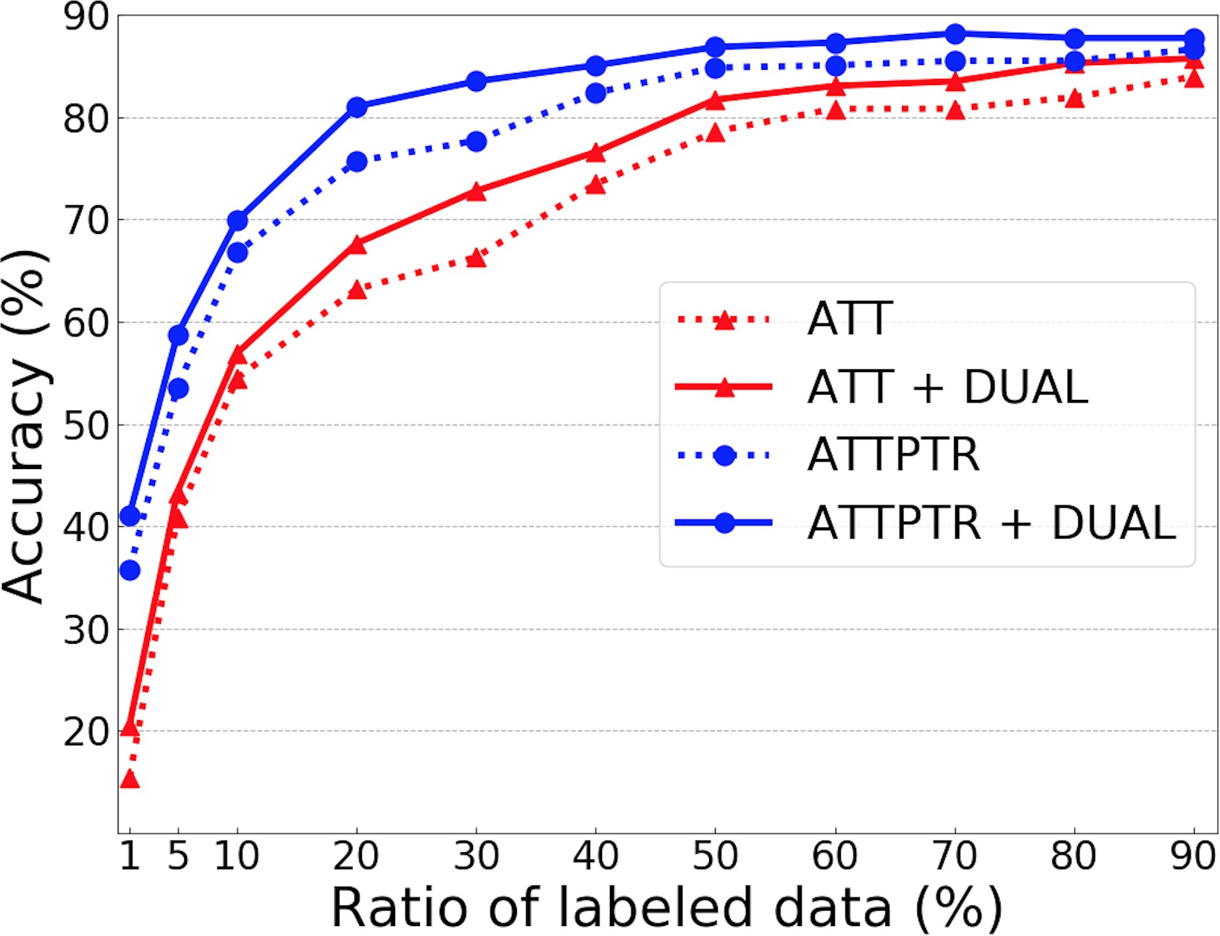
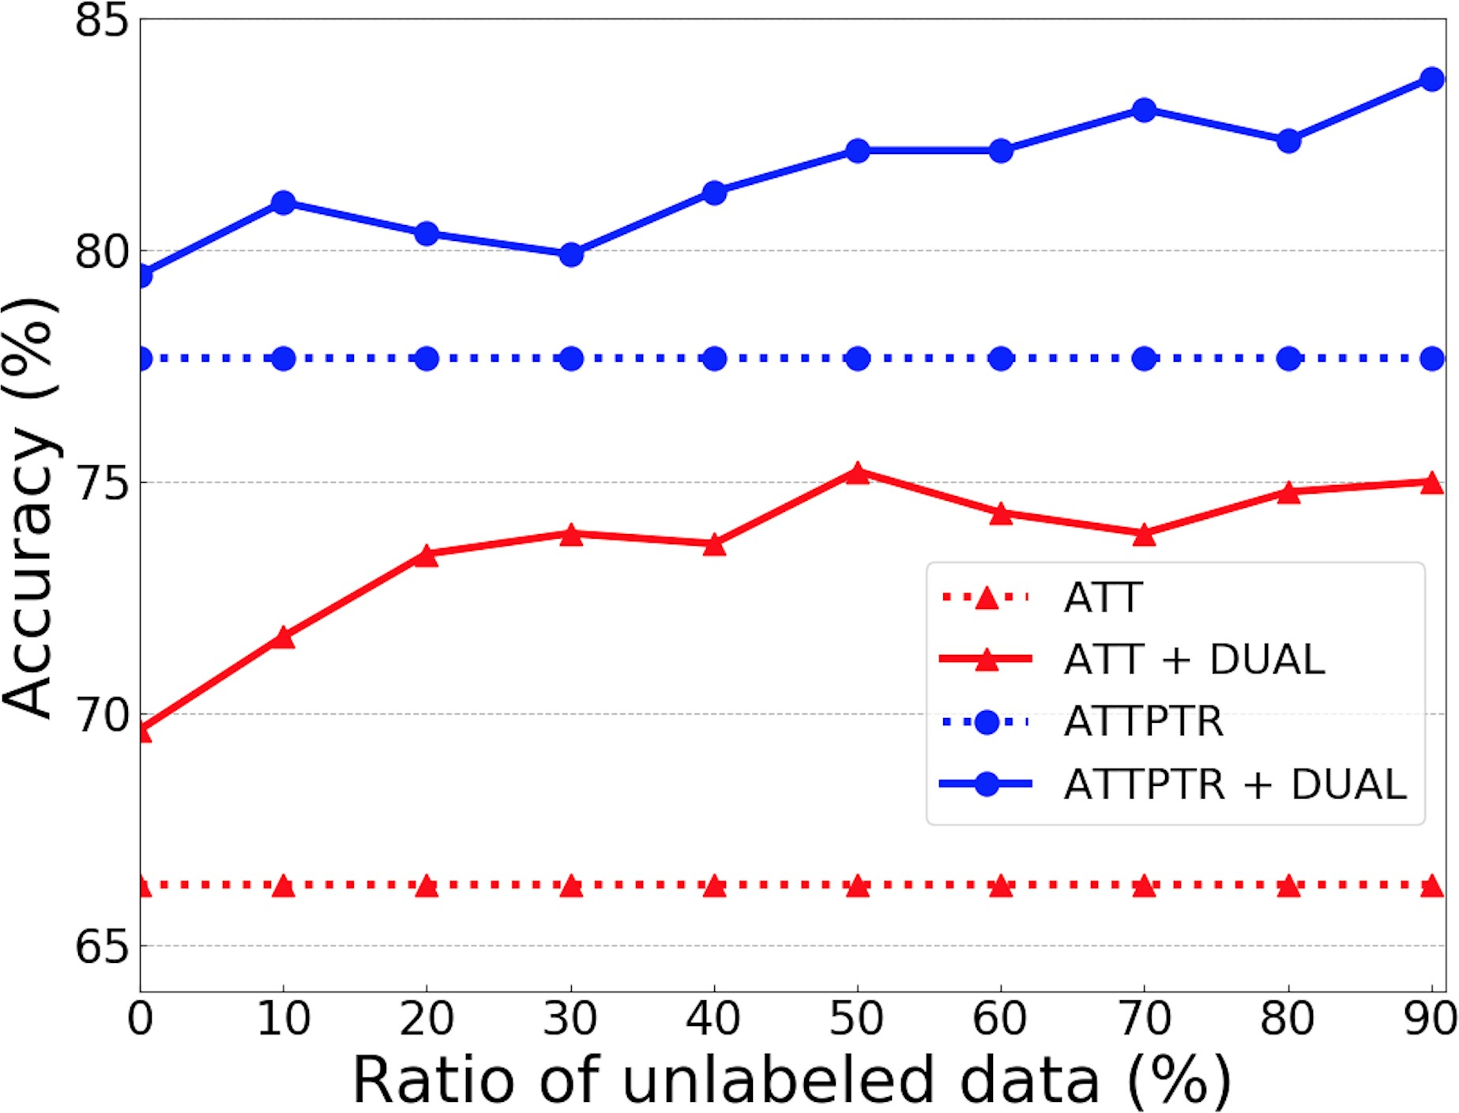
Semi-supervised: vary ratio between labeled and unlabeled data
unlabeled data = train set - labeled data
labeled data = 30%, fixed
Semantic Parsing with Dual Learning

Slide 28
Different choice for logical form validity reward
Method | Validity | ATIS | Overnight
Att + Dual | LM_{lf} | 80.6 | 71.5
 | grammar check | 81.7 | 72.9
AttPtr + Dual | LM_{lf} | 86.2 | 71.4
 | grammar check | 86.8 | 73.0
labeled data = 50%, unlabeled data = 50%
LM_{lf} means using a logical form language model for validity reward
“grammar check” means using the structure and semantic check
Semantic Parsing with Dual Learning

