Slide 1


Unsupervised Dual Paraphrasing for Two-stage Semantic Parsing
——2020 ACL
Ruisheng Cao, Su Zhu, Chenyu Yang, Chen Liu,
Rao Ma, Yanbin Zhao, Chen Lu and Kai Yu
MoE Key Lab of Artificial Intelligence
SpeechLab, Department of Computer Science and Engineering AI Institute, Shanghai Jiao Tong University, Shanghai, China
Wednesday 8th July, 2020
Notes:
Hello, everyone, it’s great honor to give this presentation. My name is Ruisheng Cao, from SpeechLab, Shanghai Jiao Tong University, China. Today, my topic is Unsupervised Dual Paraphrasing for Two-stage Semantic Parsing.

Slide 2
Outline
Introduction and Motivation
Unsupervised Two-stage Framework
Experimental Results
Conclusion

Slide 3


What is semantic parsing
Natural Language Utterance:
$$what is the total number of players$$
Logical form (Lambda DCS):
$$count ( type.player )$$
execution
Knowledge Base
(KB)
result
Notes:
The first question is what is semantic parsing. It aims to convert a natural language utterance into a structured meaning representation, which can be executed in a knowledge base to extract answers. There are various forms of semantic representations, in this talk, we focus on logical forms, particularly Lambda Dependency-Based Compositional Semantics, abbreviated Lambda DCS .

Slide 4
To build a semantic parser from scratch
(1) (canonical utterance, logical form) pairs are automatically generated
player → TypeNP[player]
TypeNP[x] → NP[type.x]
number of NP[X] → NP[count(x)]
… …
1
2
3
NP[count(type.player)]
3
number
of
NP[type.player]
Canonical utterance
Logical form
2
TypeNP[player]
number of player count(type.player)
… … … …
1
player
Notes:
How to construct a semantic parser from scratch if no labeled data is available. A typical procedure proceeds in this way:
First, canonical utterances paired with logical forms are automatically generated by recursively applying grammar rules. Canonical utterances denote pseudo-language utterances, which is generated by rule templates but does not sound natural.

Slide 5

To build a semantic parser from scratch
(2) given (cu, lf) pairs, collect (nl, cf) pairs by crowdsourcing
Paraphrase mode (Wang et al., 2015)
how many players are there
what is the number of players
tell me the total number of players
… …
number of player count(type.player)
… …
… …
Natural language utterances
Canonical utterances
Logical forms
Notes:
Given cu and lf pairs, the researchers collect natural language utterance, logical form pairs by crowdsourcing. There are two paradigms to simplify annotation. We call the first one paraphrase mode. Crowd workers are required to paraphrase those canonical utterances into natural language utterances.

Slide 6
To build a semantic parser from scratch
(2) given (cu, lf) pairs, collect (nl, cf) pairs by crowdsourcing
Detection mode (Herzig and Berant, 2019)
number of points of player kobe bryant
R(num_points).kobe_bryant
what is the number of players
number of player count(type.player)
number of assists of player kobe bryant
R(num_assists).kobe_bryant
… …
… …
… …
Natural language utterances
Canonical utterances
Logical forms
Notes:
The second one is detection mode. Natural language utterances are first accumulated from real world user queries. Next, workers are required to select the correct canonical utterance for each given natural language utterance from some candidate list.

Slide 7
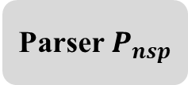
To build a semantic parser from scratch
(3) given (nl, lf) pairs, build a semantic parser upon them
Parser $P_{nsp}$
what is the number of players
count(type.player)
Natural language utterances
Logical forms
Notes:
Finally, given natural language utterance, logical form pairs, we could build a one stage semantic parser upon them.

Slide 8
Drawbacks
heavily rely on nontrivial labor
low utilization of canonical utterances
Natural language utterances
Canonical utterances
Logical forms
what is the number of players
number of player
count(type.player)
Notes:
Obviously, there are two drawbacks through the entire procedure. First, nontrivial human labor is indispensable, no matter paraphrase or detection mode. Next, after dataset construction, the canonical utterances are thrown away, which leads to low utilization.

Slide 9
Outline
Introduction and Motivation
Unsupervised Two-stage Framework
Experimental Results
Conclusion

Slide 10
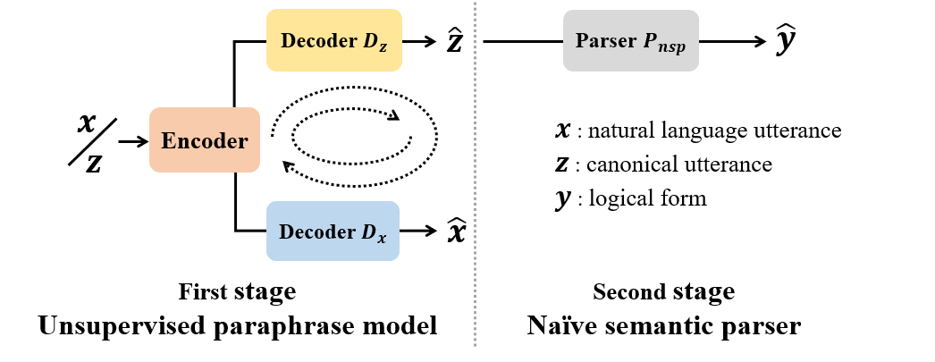
Our method: Overview
Notes:
To this end, we propose an unsupervised two-stage framework for semantic parsing. The entire semantic parser is split into two stages: the first stage aims to paraphrase input natural language utterances into canonical utterances. It performs semantic normalization and reduce diversity in expression. While the second stage expects to accept intermediate canonical utterances and outputs target logical forms. The first stage can be trained in an unsupervised fashion by utilizing the shared encoder and an additional decoder for nl.

Slide 11



Training procedure: pre-training phase
Training naïve semantic parser with (cu, lf) pairs via supervised training
Learn inner mappings embedded in the grammar rules
Saved and fixed for evaluation
$$z$$
Parser $P_{nsp}$
$$y$$
Canonical utterances
Logical forms
Notes:
The entire training process can be split into two phases. The first phase is pre-training. The second stage parser is directly trained with cu, lf pairs via traditional supervised training. It aims to learn the inner mappings embedded in the grammar rules and some structure constraints. This naïve parser is saved and fixed for evaluation.

Slide 12
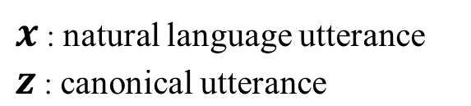












Training procedure: pre-training phase
Initialize the model $E∘D_{x}$ and $E∘D_{z}$ with Denoising Auto-Encoder task
$$𝓛_{DAE}$$
$$𝓝_{x}$$
Encoder
Decoder $D_{x}$
$$x$$
$$\tilde{x}$$
$$\hat{x}$$
Noisy Channel
$$𝓝_{z}$$
Encoder
Decoder $D_{z}$
$$\hat{z}$$
$$z$$
$$\tilde{z}$$
$$𝓛_{DAE}$$
Notes:
In the pre-training phase, we also need to initialize the paraphrase model. We use denoising auto-encoder task in the hope that both models can recover the original input from the corrupted version. The noisy channels will be elaborated later.

Slide 13
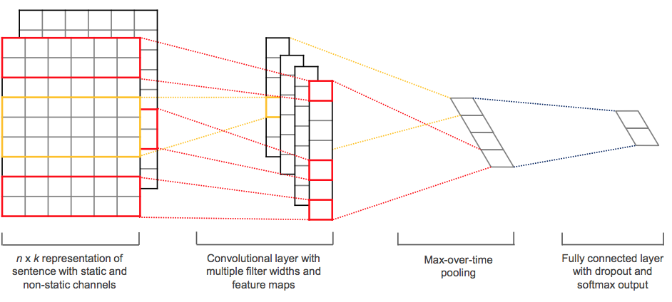
Training procedure: pre-training phase
All auxiliary models are also pre-trained and saved for later usage
LSTM based language models
CNN based text style classifier
what
is
the
…
LSTM
LSTM
LSTM
<s>
what
is
Notes:
Furthermore, some auxiliary models are also pretrained and saved for later usage, including language models for two types of utterances and a sentence classifier for style discrimination.

Slide 14





Training procedure: cycle learning phase
In this phase, two Encoder-Decoder modules teach and regularize each other
Back-Translation (BT): provide pseudo labels
Dual Reinforcement Learning (DRL): provide reward signals
Decoder $D_{z}$
$$\hat{z}$$
$$x$$
$$z$$
Encoder
Decoder $D_{x}$
$$\hat{x}$$
Notes:
After pretraining, the paraphrase model is just a noisy-copying model, we improve upon it by two self-training dual tasks, namely back-translation and dual reinforcement learning. We call this phase cycle learning.

Slide 15









Training procedure: cycle learning phase
Back-Translation (BT): provide pseudo labels
Gradient is blocked in the dashed box
$$𝓛_{BT}$$
Decoder $D_{x}$
Encoder
$$\hat{z}$$
$$x$$
Encoder
Decoder $D_{z}$
Pseudo
Labels
$$z$$
Encoder
Decoder $D_{x}$
$$𝓛_{BT}$$
Decoder $D_{z}$
Encoder
$$\hat{x}$$
Notes:
In back-translation, we utilize the dual model to provide pseudo training samples for each other. This is common practice in unsupervised neural machine translation.

Slide 16










Training procedure: cycle learning phase
Dual Reinforcement Learning (DRL): optimize through policy gradient
$$𝓛_{DRL}$$
$$x$$
Encoder
Decoder $D_{z}$
$$\tilde{z}$$
$$R_{x}$$
sample
Reward
Model
sample
$$R_{z}$$
$$z$$
Encoder
Decoder $D_{x}$
$$\tilde{x}$$
$$𝓛_{DRL}$$
Notes:
To encourage more exploration during cycle learning, we introduce the dual reinforcement learning strategy and optimize the system through policy gradient. Take natural language x as an example, we sample one output canonical utterance z, and evaluate the quality from different aspects. Then the reinforce algorithm is employed to update parameters.

Slide 17












Training procedure: cycle learning phase
Combine the two self-supervised tasks in one iteration
$$𝓛_{BT}$$
Decoder $D_{x}$
Encoder
$$\hat{z}$$
$$𝓛_{DRL}$$
Decoder $D_{z}$
$$x$$
$$\tilde{z}$$
$$R_{x}$$
sample
Starting
Points
Encoder
Reward
Model
$$z$$
sample
$$R_{z}$$
Decoder $D_{x}$
$$\tilde{x}$$
$$𝓛_{BT}$$
Decoder $D_{z}$
Encoder
$$\hat{x}$$
$$𝓛_{DRL}$$
(a) Back-translation
(b) Dual reinforcement learning
Notes:
In each iteration, these two tasks are employed in turn. Now, two remaining questions are how to corrupt the input utterance in DAE task and how to design rewards in cycle learning phase.

Slide 18
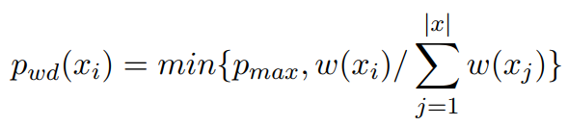
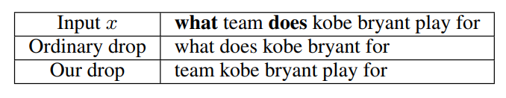
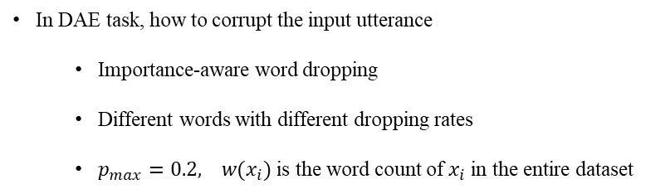
Training Details: noisy channels
In DAE task, how to corrupt the input utterance
Importance-aware word dropping
Different words with different dropping rates
$p_{max}=0.2, w(x_{i})$ is the word count of $x_{i}$ in the entire dataset
Notes:
As for the noisy channel, we propose three strategies. The first one is importance aware dropping. Different words are dropped with different dropping rates. We inject a bias towards dropping more frequent words (such as function words) in the corpus instead of less frequent words (such as content words). The dropping rate is calculated by simple word count.

Slide 19
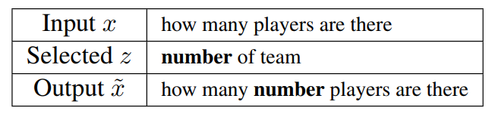
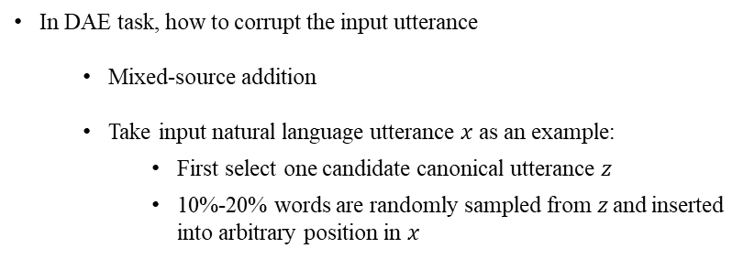
Training Details: noisy channels
In DAE task, how to corrupt the input utterance
Mixed-source addition
Take input natural language utterance $x$ as an example:
First select one candidate canonical utterance $z$
10%-20% words are randomly sampled from$z$and inserted into arbitrary position in $x$
Notes:
The next one is mixed source addition. To encourage shared encoder E to learn a common representation space for different types of utterances, we propose to insert extra words from another source into the input.

Slide 20
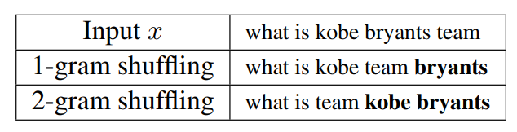
Training Details: noisy channels
In DAE task, how to corrupt the input utterance
Bigram shuffling
Three types of noise are applied successively for each sample
Notes:
The last one is bigram shuffling. Instead of shuffling words, we split the input utterance into bigrams first and shuffle at bigram level. These three types of noise are applied successively for each sample in the minibatch.

Slide 21


Training Details: reward design
In DRL task, how to evaluate the output utterance
Fluency: whether the utterance is fluent
Utilize LSTM-based language models in pre-training phase
what
is
the
…
LSTM
LSTM
LSTM
<s>
what
is
Notes:
About the reward design, we use two separate language models and take the length-normalized log probability to evaluate the fluency of the sampled utterance.

Slide 22


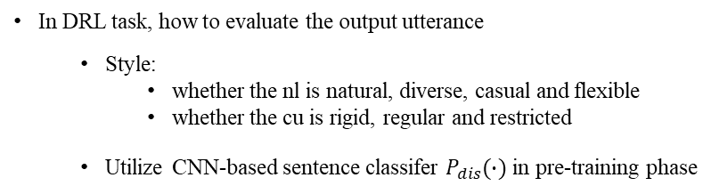
Training Details: reward design
In DRL task, how to evaluate the output utterance
Style:
whether the nl is natural, diverse, casual and flexible
whether the cu is rigid, regular and restricted
Utilize CNN-based sentence classifer $P_{dis}(∙)$ in pre-training phase
Notes:
A sentence classifier is employed to discriminate the characteristics of the generated utterance. Natural language should be diverse, casual and flexible, while the canonical utterance should be rigid and follow some rule patterns.

Slide 23
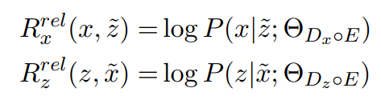
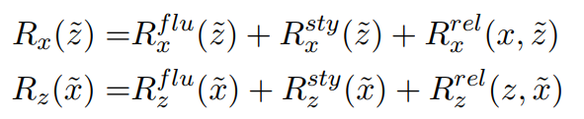
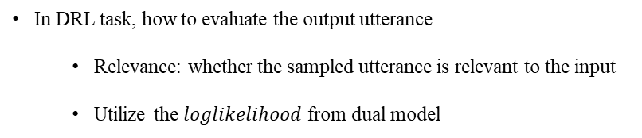
Training Details: reward design
In DRL task, how to evaluate the output utterance
Relevance: whether the sampled utterance is relevant to the input
Utilize the $loglikelihood$ from dual model
In total
Notes:
To measure the relevance between input and output utterances, we also follow the common practice to take the loglikelihood from the dual model. All these rewards are summarized to provide more informative and accurate reward signals.

Slide 24
Outline
Introduction and Motivation
Unsupervised Two-stage Framework
Experimental Results
Conclusion

Slide 25
Datasets
Overnight: contains eight sub-domains, collected in paraphase mode (Wang et al., 2015)
GeoGranno: questions about U.S. geography, collected in detection mode (Herzig and Berant, 2019)
All canonical utterances are generated with tool Sempre, the same as in original papers
Backbone models are traditional Seq2Seq model with attention mechanism (Luong, et al., 2015)
We report denotation level accuracy on test set
Notes:
We conduct experiments on two datasets Overnight and GeoGranno, which are collected in paraphrase and detection mode respectively

Slide 26
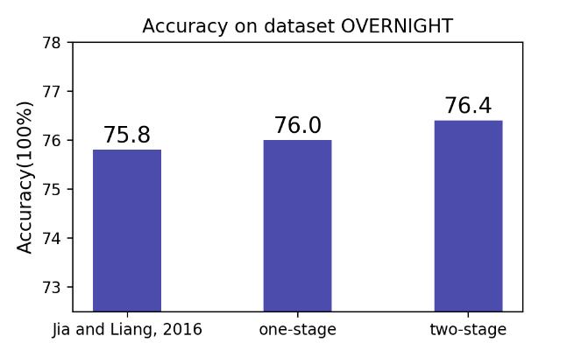
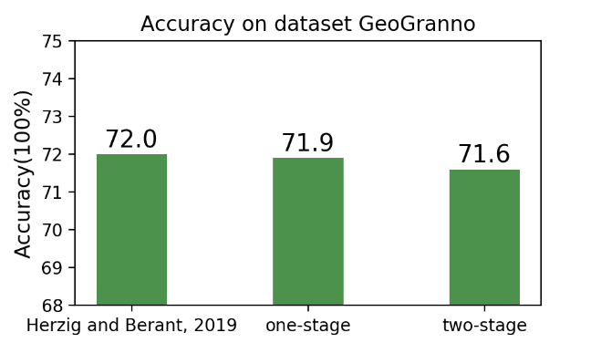
Results: supervised settings
Notes:
In supervised settings, our pipelined two stage parsers are competitive to the one stage parser on two benchmarks. Even a little higher on dataset Overnight.

Slide 27
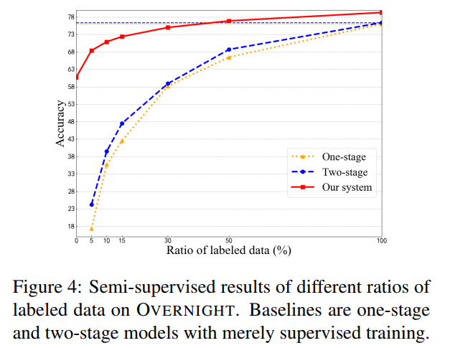
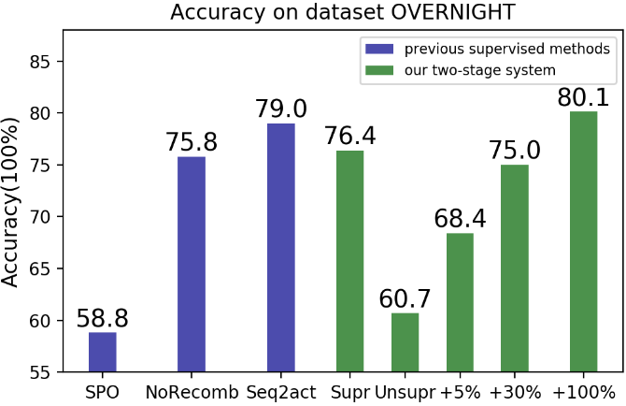
Results: unsupervised and semi-supervised settings
Notes:
As for unsupervised settings, on Overnight, our framework surpasses traditional supervised method in the original paper. With only 5% percent labeled data, the performance improved from 60.7% to 68.4%. With 30% percent labeled data, it is competitive to traditional neural network models with supervised training. With full data, it achieves the best results among previous work, not considering cross domain benefits or extra data sources. The conclusions are almost the same on another dataset.

Slide 28
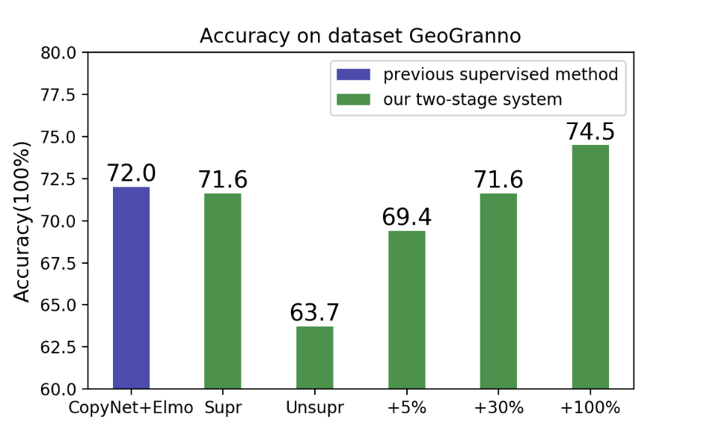
Results: unsupervised and semi-supervised settings
Notes:
The conclusions are almost the same on another dataset.

Slide 29
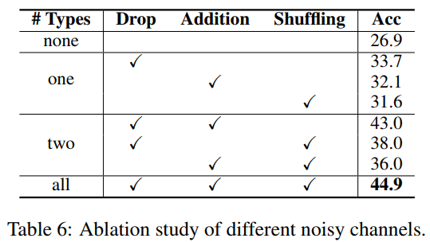
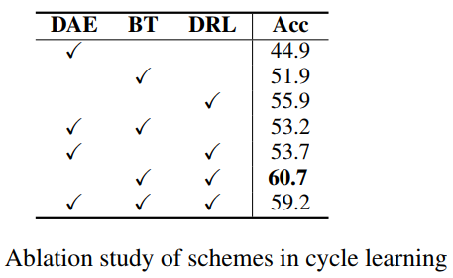
Ablation study: noisy channels and cycle learning tasks
Notes:
In the ablation study, we compare different noise types in DAE and tasks in cycle learning phase. From the table on the left, we can find the more types of noise we introduce, the better the performance. Dropping and addition noise are generally more effective than shuffling in this task.
From the table on the right, dual reinforcement learning seems to perform best among three tasks. Denoising auto-encoder will be a hurdle and make little contribution in cycle learning.

Slide 30
Outline
Introduction and Motivation
Unsupervised Two-stage Framework
Experimental Results
Conclusion

Slide 31
Conclusion
Core idea
Cast semantic parsing into paraphrasing.
The paraphrase stage is trained in an unsupervised way through three self-supervised tasks, namely
Denoising auto-encoder (DAE)
Back-translation (BT)
Dual Reinforcement Learning (DRL)
The second stage leverages automatically generated (canonical utterance, logical form) pairs via supervised training.
Notes:
To sum up, in this work, we cast…

Slide 32
Thanks & QA
Q & A

Slide 33
References
Yushi Wang, Jonathan Berant, and Percy Liang. 2015.
Building a semantic parser overnight.
In Proceedings of the 53rd Annual Meeting of the Association for Computational Linguistics and the 7th International Joint Conference on Natural Language Processing (Volume 1: Long Papers), pages 1332–1342.
Jonathan Herzig and Jonathan Berant. 2019.
Don’t paraphrase, detect! rapid and effective data collection for semantic parsing.
In Proceedings of the 2019 Conference on Empirical Methods in Natural Language Processing and the 9th International Joint Conference on Natural Language Processing (EMNLP-IJCNLP), pages 3810–3820, Hong Kong, China. Association for Computational Linguistics.
Guillaume Lample, Myle Ott, Alexis Conneau, Ludovic Denoyer, and Marc’Aurelio Ranzato. 2018.
Phrase-based & neural unsupervised machine translation.
In Proceedings of the 2018 Conference on Empirical Methods in Natural Language Processing, pages 5039–5049, Brussels, Belgium. Association for Computational Linguistics.
Fuli Luo, Peng Li, Jie Zhou, Pengcheng Yang, Baobao Chang, Xu Sun, and Zhifang Sui. 2019.
A dual reinforcement learning framework for unsupervised text style transfer.
In Proceedings of the Twenty-Eighth International Joint Conference on Artificial Intelligence, IJCAI 2019, Macao, China, August 10-16, 2019, pages 5116–5122. ijcai.org.
Yanbin Zhao, Lu Chen, Zhi Chen, and Kai Yu. 2020.
Semi-supervised text simplification with back-translation and asymmetric denoising autoencoders.
In Proceedings of the AAAI Conference on Artificial Intelligence.

