Slide 1
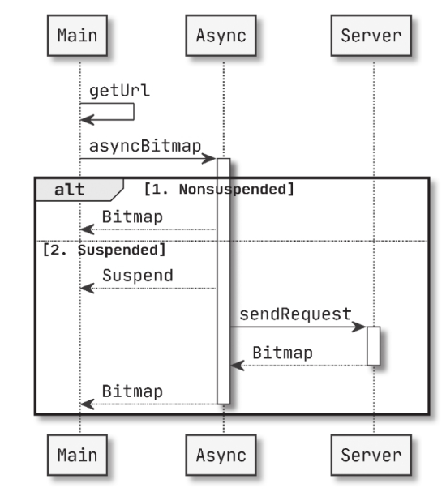
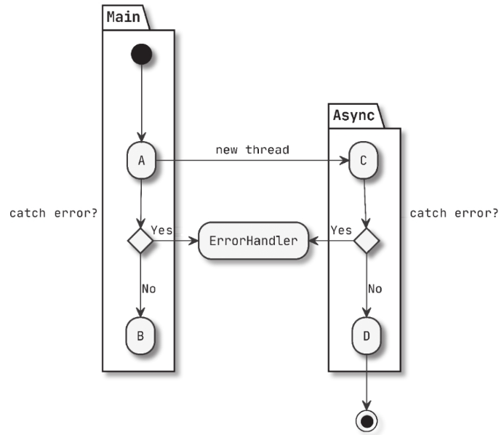
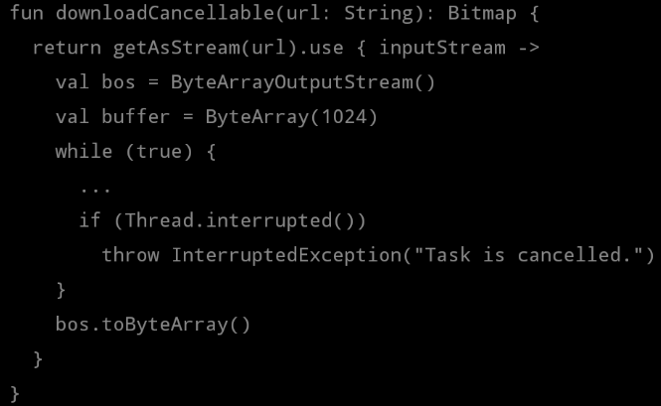
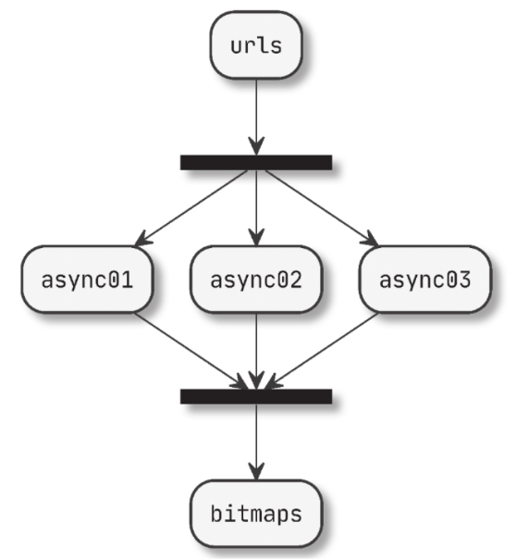
《异步程序的几大特性》
回调
异常
取消
复杂分支

Slide 2


《什么是协程》

Slide 3
suspend fun fetchDocs() {
val result = get("developer.android.com")
show(result)
}
suspend fun get(url: String) =
withContext(Dispatchers.IO) {
...
}
《挂起函数》
2.suspend
4.resume
(handler.post(result))
3. UI Event
Main
1. fetchDocs()
get()
5. get()
fetchDocs()
3. IO、Main、Default
1. 挂起的本质，我们挂起的对象是协程，从当前线程挂起。换句话说，就是这个协程从正在执行它的线程上脱离。
2. suspend ：当线程执行到协程的 suspend 函数的时候，暂时不继续执行协程代码了。

Slide 4


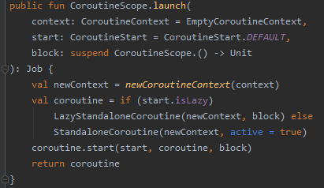
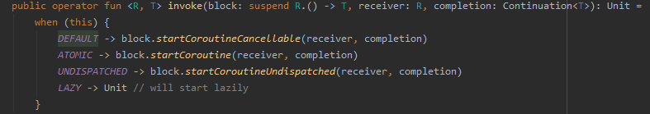


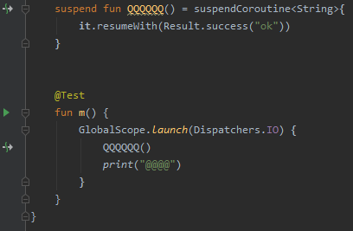
调用resumeWith启动协程
将suspend fun转为Continuation，用来启动协程（这个Continuation在所有子Continuation resumeWith完之后会调用completion的resumeWith）
拦截原始origin Continuation的resumeWith，一般是调度器拦截实现线程切换
public final Object QQQQQQ( Continuation $completion) {
SafeContinuation safeContinuation = new SafeContinuation(IntrinsicsKt.intercepted($completion));
String var9 = "ok";
safeContinuation.resumeWith(Result.constructor-impl(var9));
Object var10000 = safeContinuation.getOrThrow();
if (var10000 == IntrinsicsKt.getCOROUTINE_SUSPENDED()) {
DebugProbesKt.probeCoroutineSuspended($completion);
}
return var10000;
}
public final void m() {
BuildersKt.launch((CoroutineScope) GlobalScope.INSTANCE, (CoroutineContext) Dispatchers.getIO(), (CoroutineStart)null, (Function2)(new Function2((Continuation)null) {
int label;
public final Object invokeSuspend( Object result) {
Object var5 = IntrinsicsKt.getCOROUTINE_SUSPENDED();
switch(this.label) {
case 0:
label = 1;
if (QQQQQQ(this) == var5) {
return var5;
}
break;
case 1:
ResultKt.throwOnFailure(result);
break;
default:
throw new IllegalStateException("call to 'resume' before 'invoke' with coroutine");
}
String var3 = "@@@@";
System.out.print(var3);
return Unit.INSTANCE;
}
public final Continuation create( Object value, Continuation completion) {
Intrinsics.checkParameterIsNotNull(completion, "completion");
Function2 var3 = new <anonymous constructor>(completion);
return var3;
}
public final Object invoke(Object var1, Object var2) {
return ((<undefinedtype>)this.create(var1, (Continuation)var2)).invokeSuspend(Unit.INSTANCE);
}
}));
}
lable=0：初始化并即将执行QQQ
该值表示block （此处是QQQ方法）是suspend func
当QQQ是suspend func，主线程return掉(suspend)；
当QQQ是正常函数，相当于是同步执行
lable=1：QQQ异步执行结束，通过Continuation.resumeWith(Result)返回Result（success/failure）
创建Continuation
CoroutineSope.()->{}初始调用

Slide 5
public final Object QQQQQQ( Continuation $completion) {
SafeContinuation safeContinuation = new SafeContinuation(IntrinsicsKt.intercepted($completion));
String var9 = "ok";
safeContinuation.resumeWith(Result.constructor-impl(var9));
Object var10000 = safeContinuation.getOrThrow();
if (var10000 == IntrinsicsKt.getCOROUTINE_SUSPENDED()) {
DebugProbesKt.probeCoroutineSuspended($completion);
}
return var10000;
}
public final void m() {
BuildersKt.launch((CoroutineScope) GlobalScope.INSTANCE, (CoroutineContext) Dispatchers.getIO(), (CoroutineStart)null, (Function2)(new Function2((Continuation)null) {
int label;
public final Object invokeSuspend( Object result) {
Object var5 = IntrinsicsKt.getCOROUTINE_SUSPENDED();
switch(this.label) {
case 0:
label = 1;
if (QQQQQQ(this) == var5) {
return var5;
}
break;
case 1:
ResultKt.throwOnFailure(result);
break;
default:
throw new IllegalStateException("call to 'resume' before 'invoke' with coroutine");
}
String var3 = "@@@@";
System.out.print(var3);
return Unit.INSTANCE;
}
public final Continuation create( Object value, Continuation completion) {
Intrinsics.checkParameterIsNotNull(completion, "completion");
Function2 var3 = new <anonymous constructor>(completion);
return var3;
}
public final Object invoke(Object var1, Object var2) {
return ((<undefinedtype>)this.create(var1, (Continuation)var2)).invokeSuspend(Unit.INSTANCE);
}
}));
}
lable=0：初始化并即将执行QQQ
该值表示block （此处是QQQ方法）是suspend func
当QQQ是suspend func，主线程return掉(suspend)；
当QQQ是正常函数，相当于是同步执行
lable=1：QQQ异步执行结束，通过Continuation.resumeWith(Result)返回Result（success/failure）
创建Continuation
CoroutineSope.()->{}初始调用

Slide 6
IO-2
SafeContinuation
resumeWith()
IO-1
return
SafeContinuation
resumeWith()
resumeWith()
Main
return
completion
Main

