Slide 1


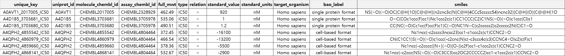
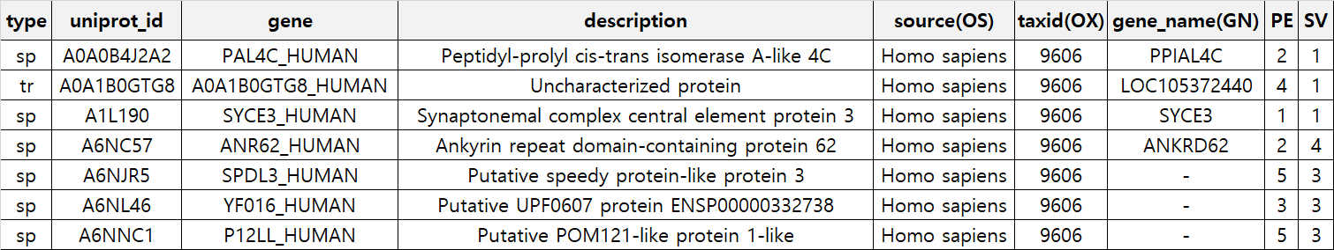
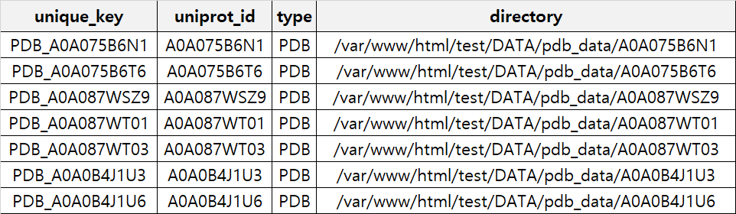
🗂️ Establishing a database
CHEM/BIOINFORMATICS LABORATORY
Constructing a database
To ensure smooth data updates and optimization, a database was established.
There are three tables in total: Ligand for ChEMBL compounds data, Protein for Uniprot provides protein information, and structure_data_info for structural information.
Table 1 : Ligand
Table 2 : Protein
Table 3 : structure_data

Slide 2
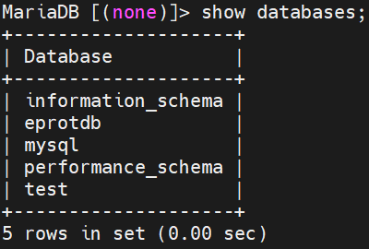
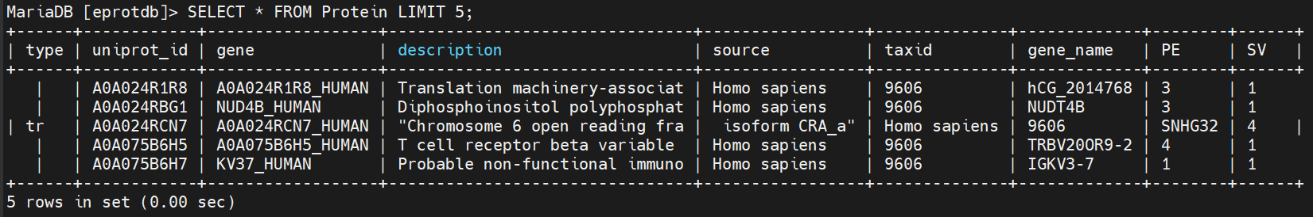
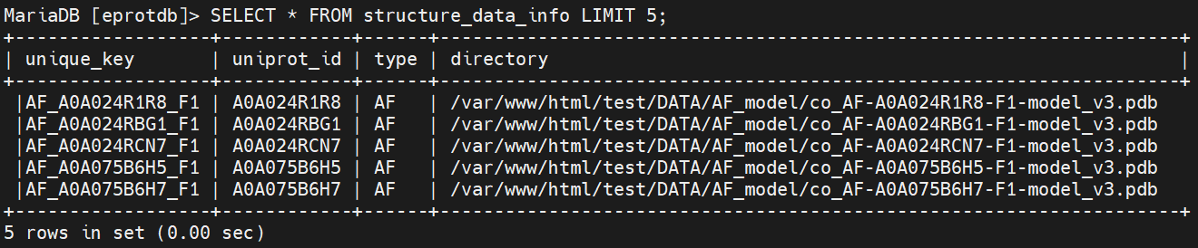
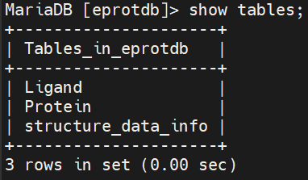
🗂️ Establishing a database
CHEM/BIOINFORMATICS LABORATORY
MariaDB database
MariaDB, which is a relatively recent fork of MySQL, is faster and provides better performance than MySQL on the same hardware.
Additionally, the open-source community around MariaDB is more active compared to the MySQL that was acquired by a corporation, which makes MariaDB more favorable in terms of online resources and community support when searching online.
Databases
Table 1 : Ligand
Table 2 : Protein
Table 3 : structure_data
Tables
To output the top 5 rows of the entire data

