Slide 1
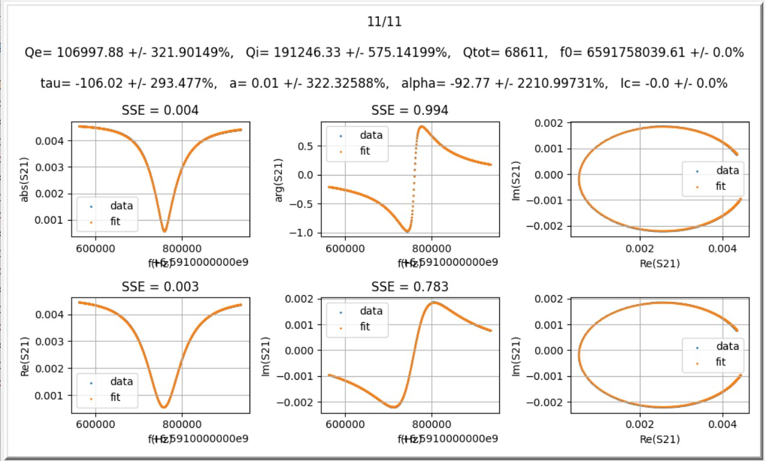
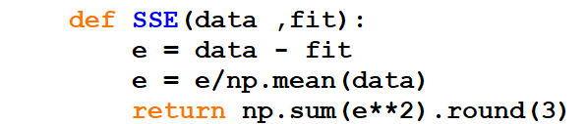
I. Error Measure
SSE & parameter uncertainty range
Uncertainty range expressed as percentage of the estimated parameter value.
Sum of Squared (Normalized) Error

Slide 2
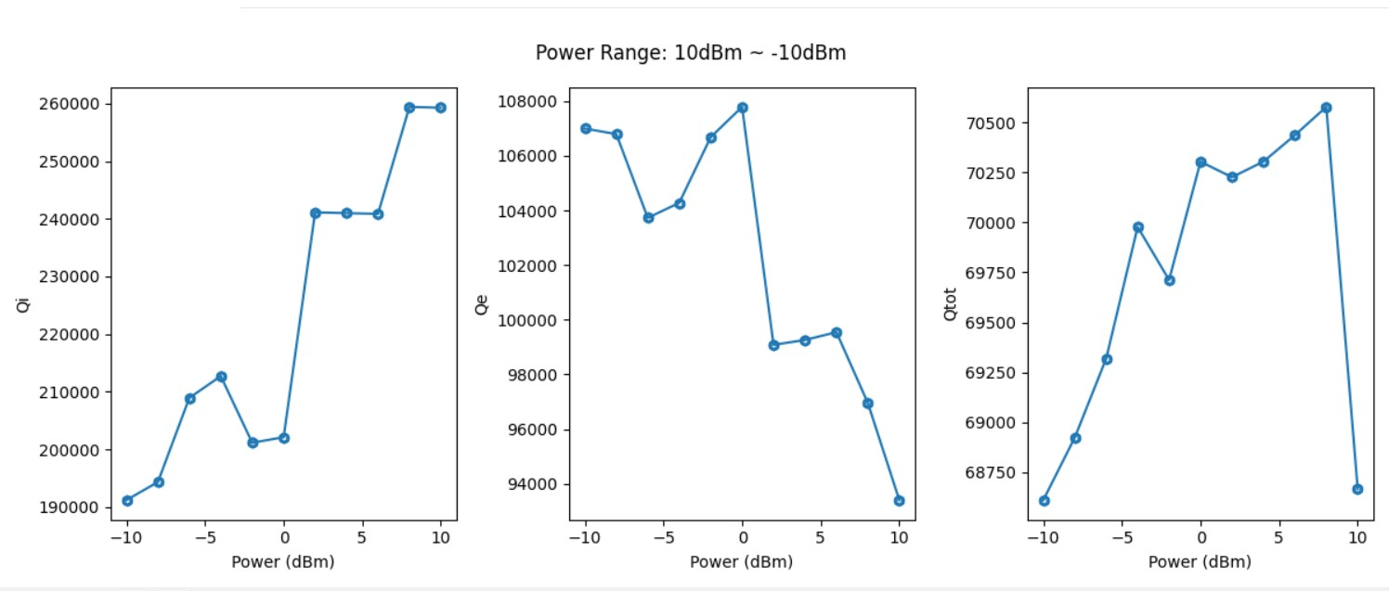
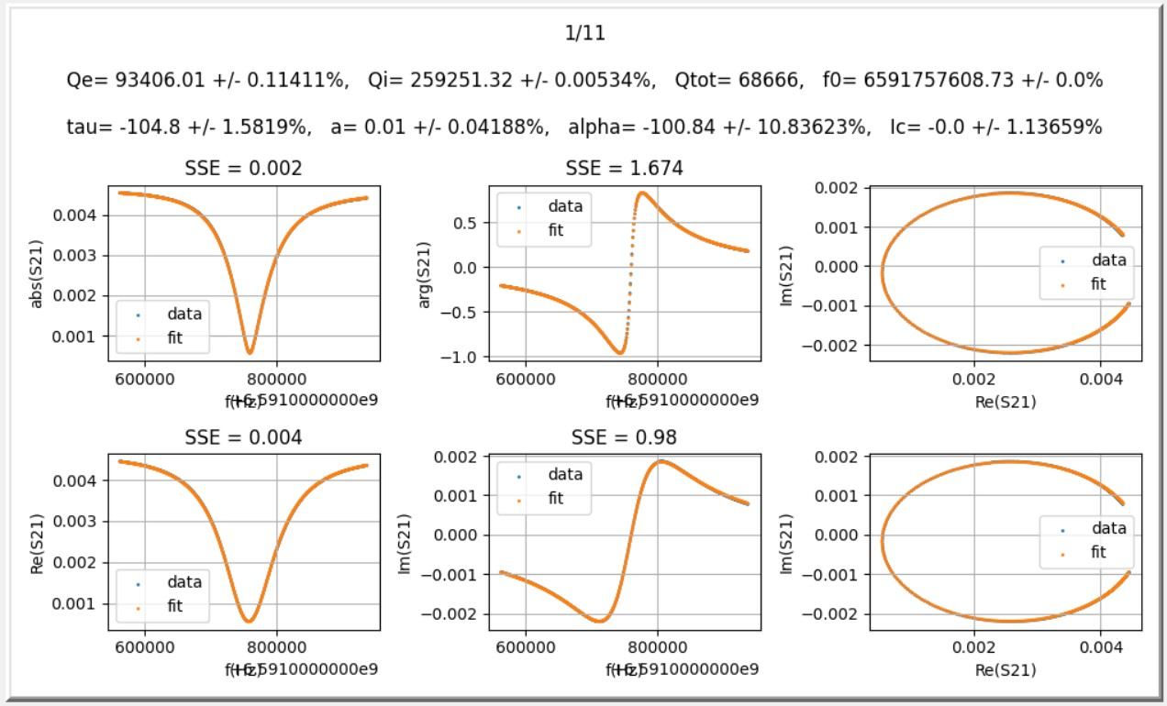
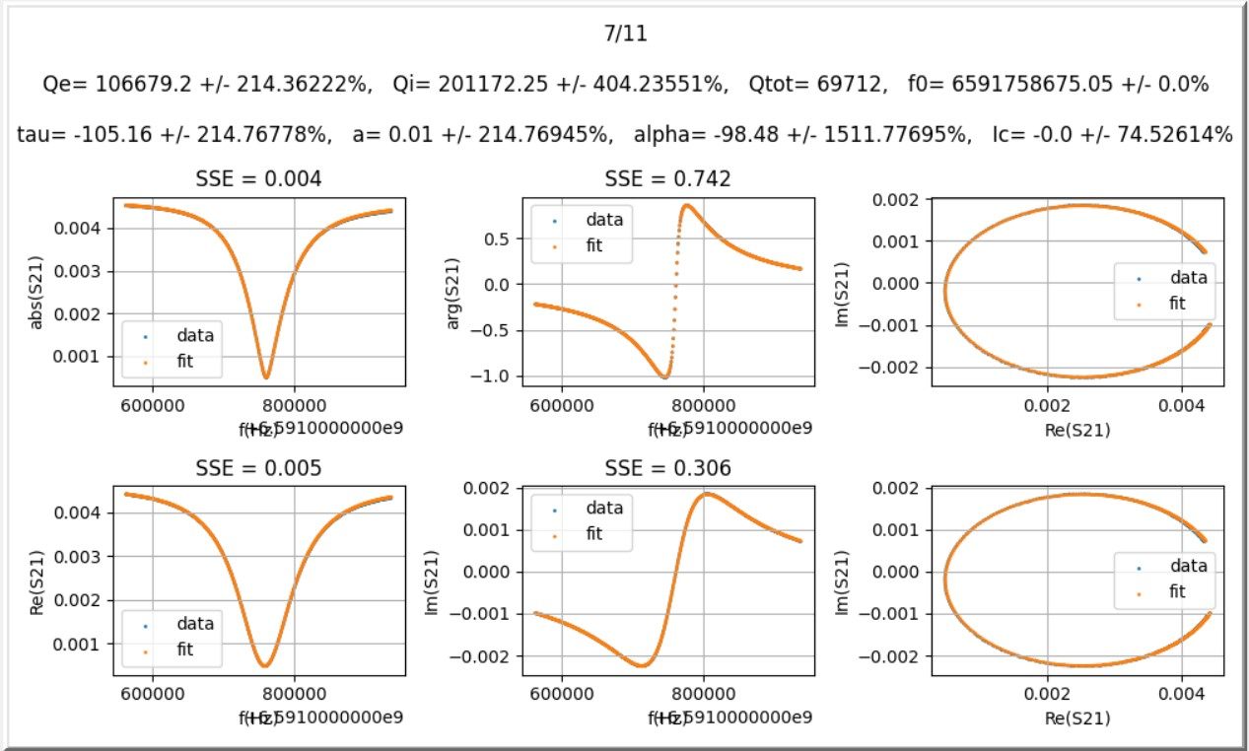
II. Q vs Power (1/4)
6.591GHz ~ 6.9525GHz

Slide 3
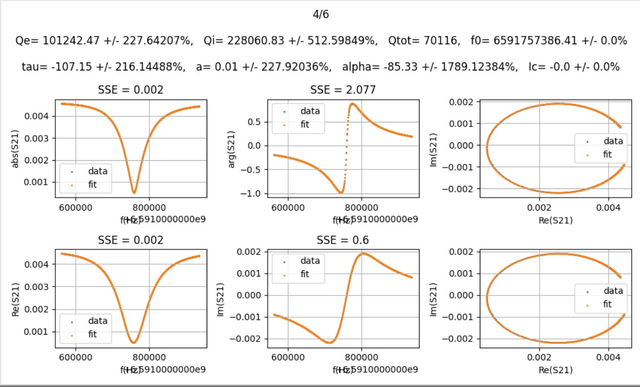
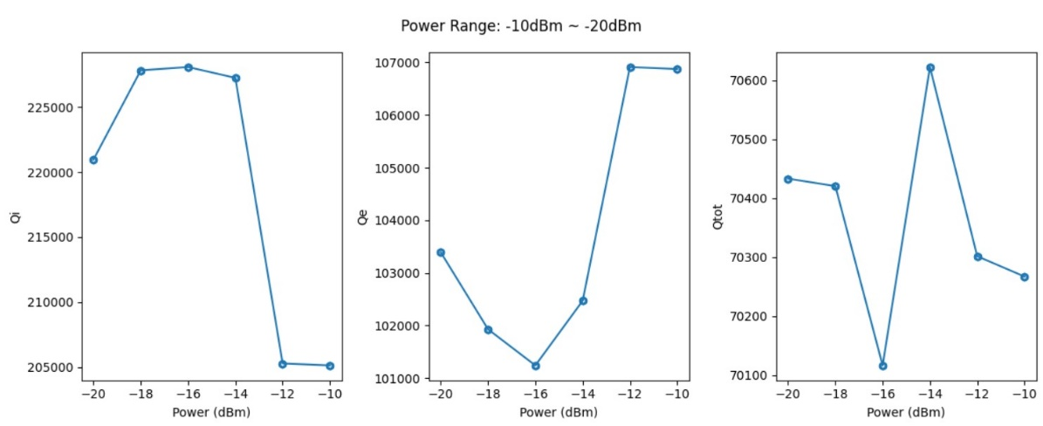
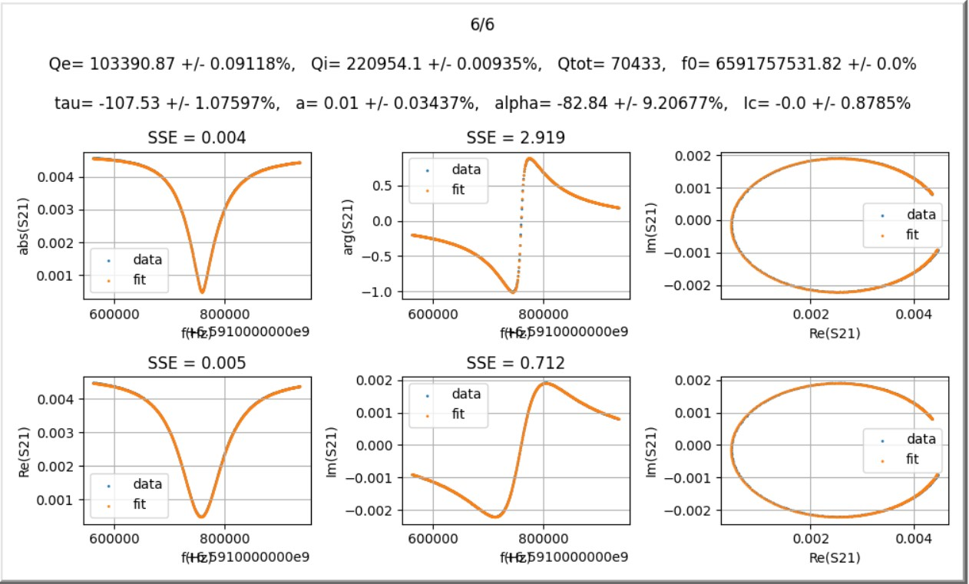
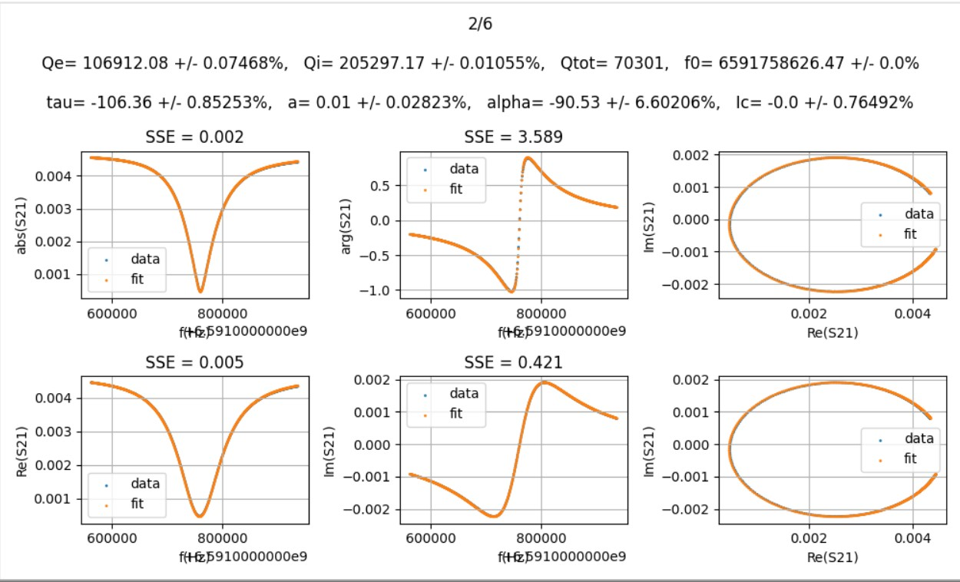
II. Q vs Power (2/4)
6.591GHz ~ 6.9525GHz

Slide 4
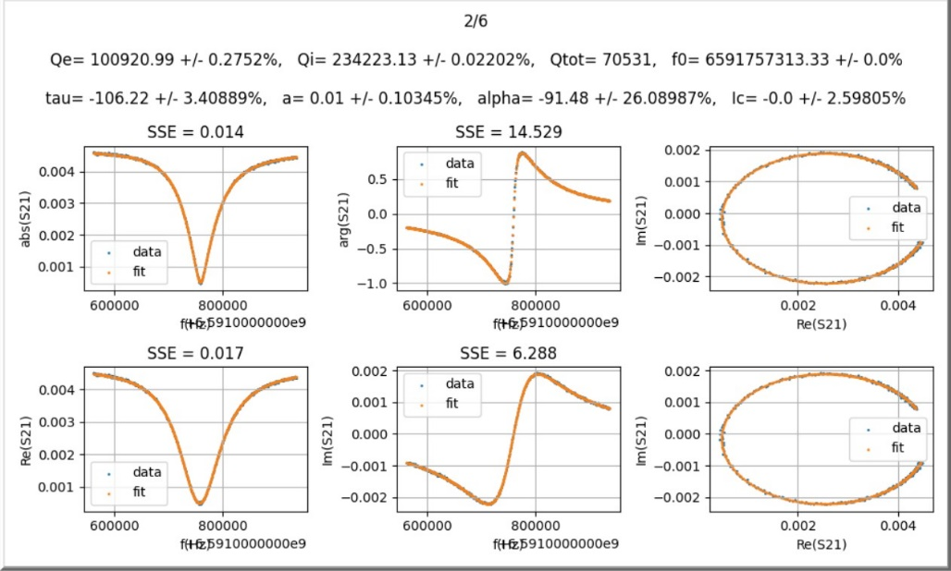
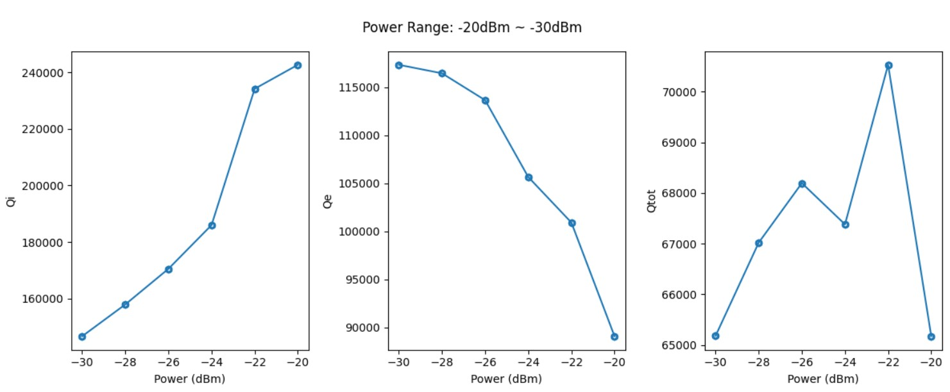
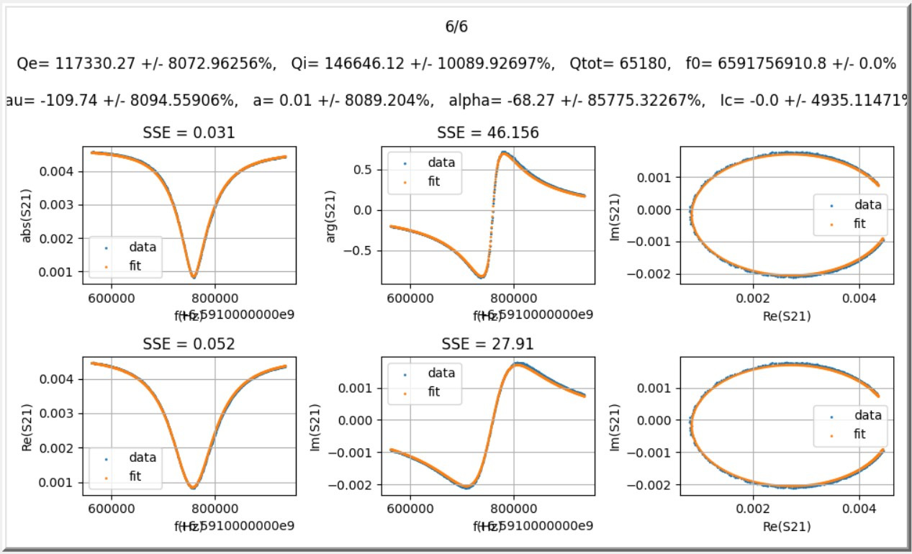
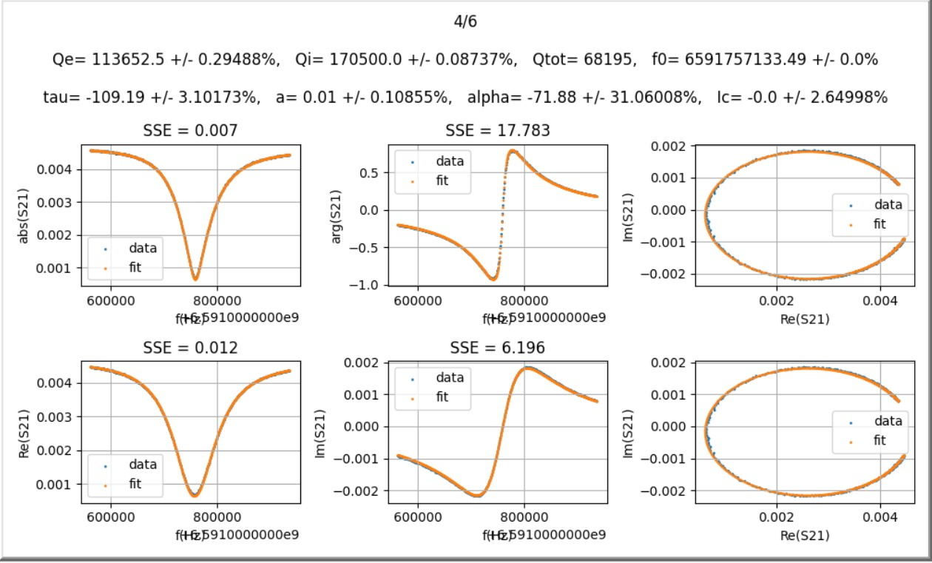
II. Q vs Power (3/4)
6.591GHz ~ 6.9525GHz

Slide 5
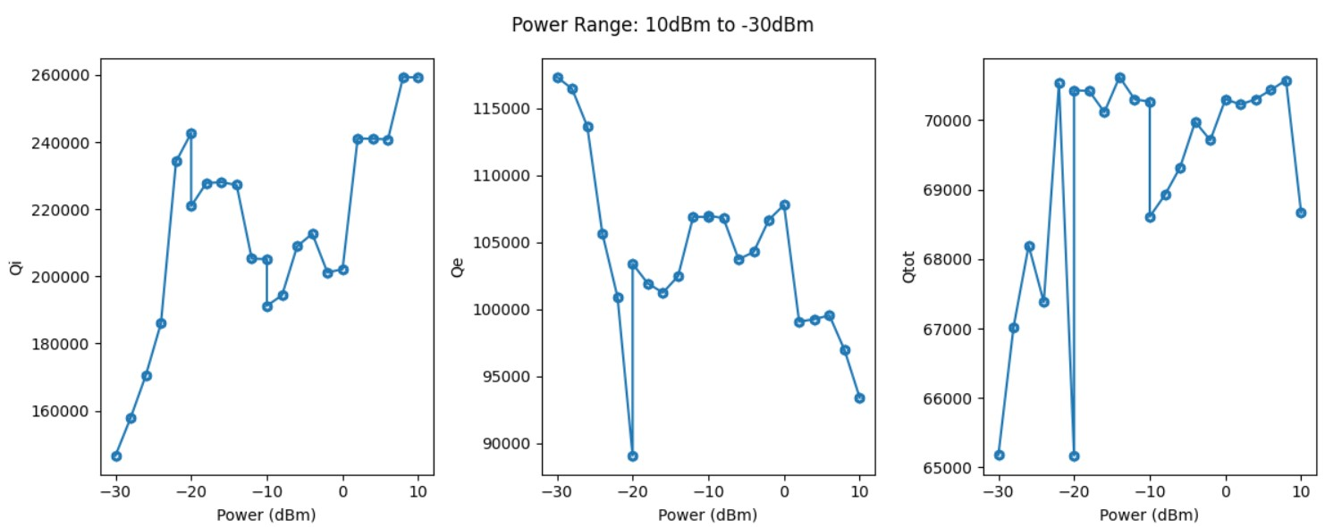
II. Q vs Power (4/4)
6.591GHz ~ 6.9525GHz
Short Conclusion:
After dropping some data points on the two sides, the problem that “multiple sets of combination of parameters giving rise to equally good fitting” never show up again this time.
The resulting Q values is roughly the same the my second trial.

Slide 6
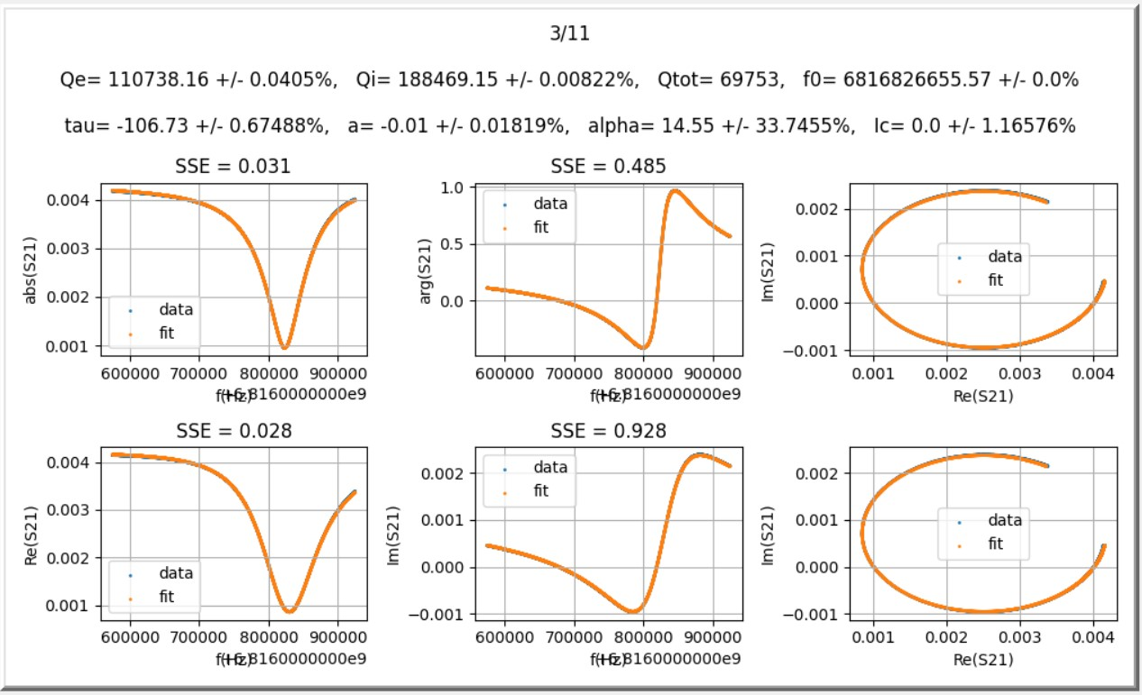
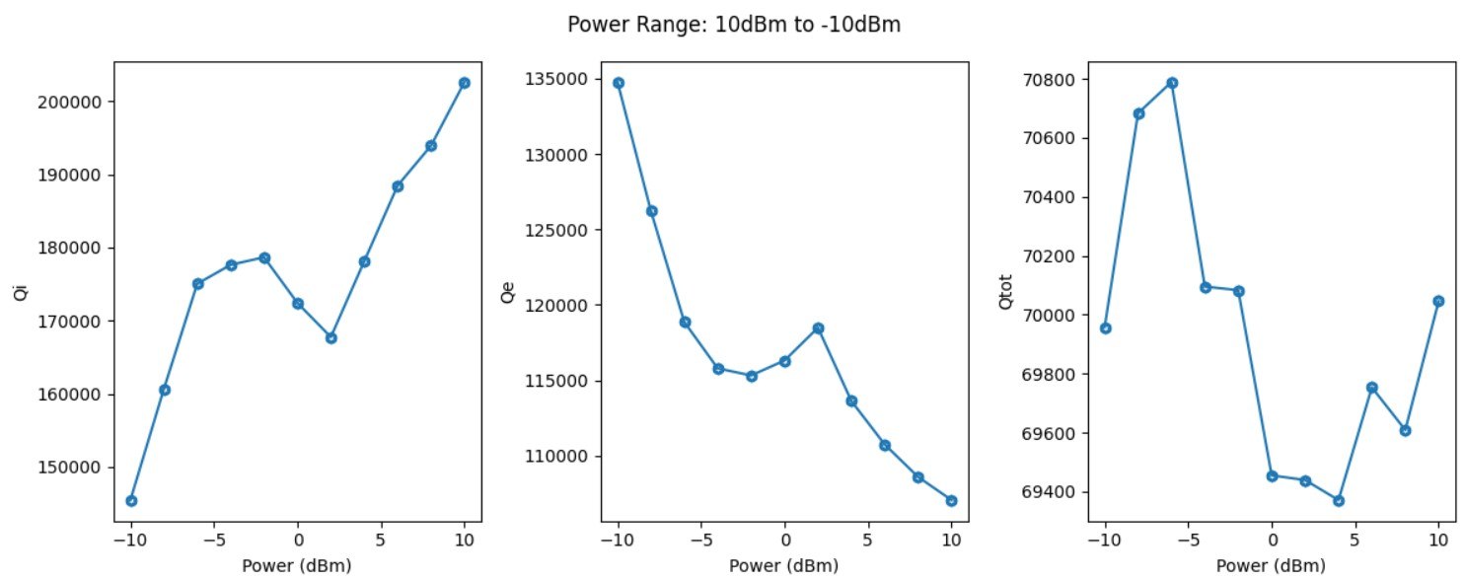
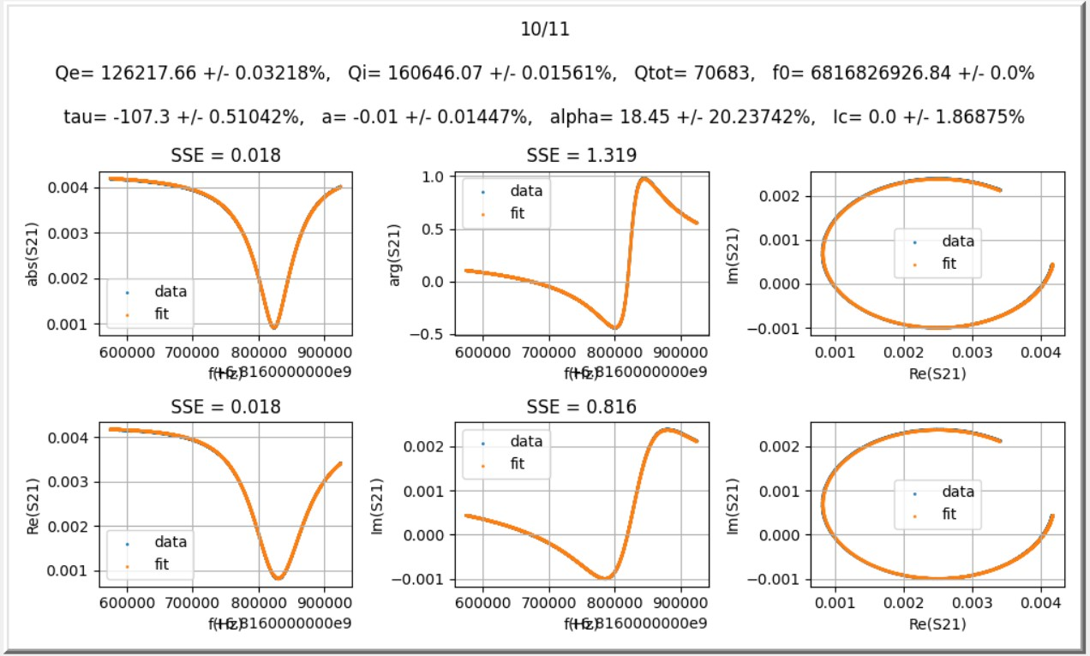
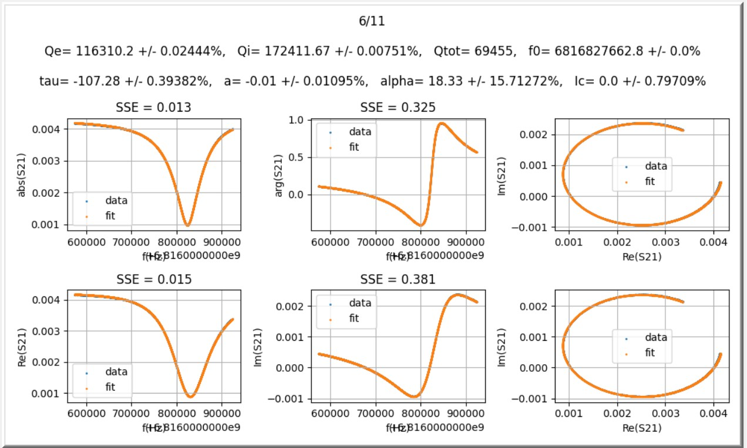
III. Re-plot Q vs Power
For earlier 6.8165GHz ~ 6.187GHz data

Slide 7
IV. Conclusion
Conclusion:
The reason that the earlier fitting for 6.8165GHz ~ 6.187GHz data gives much higher Q values ( ( roughly 350000 for Qi) compared with those Q in this fitting is probably due to different in the fitting models used.
When I use the same model to fit both 6.591GHz ~ 6.9525GHz data and the earlier 6.8165GHz ~ 6.187GHz data, the Q values from the 6.591GHz ~ 6.9525GHz data indeed are higher than those of the earlier 6.8165GHz ~ 6.187GHz data.

