Slide 1
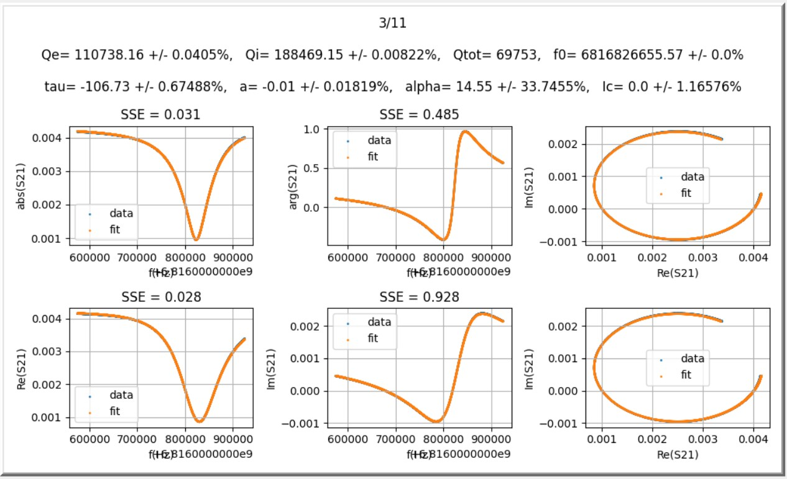
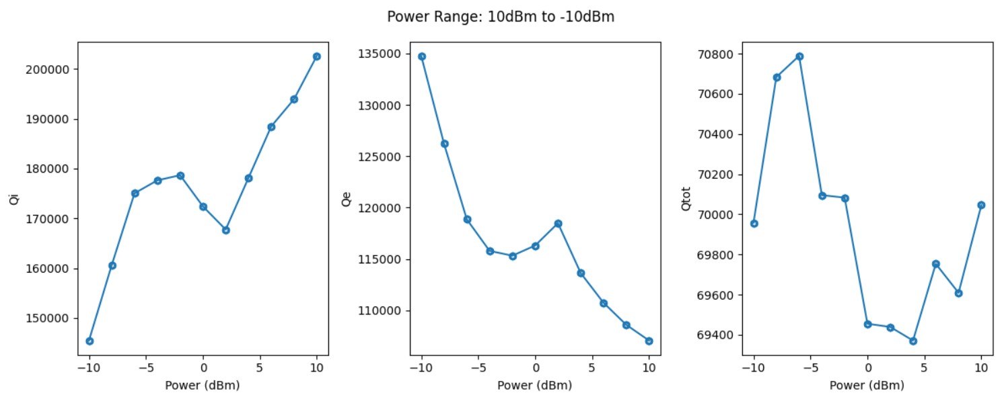
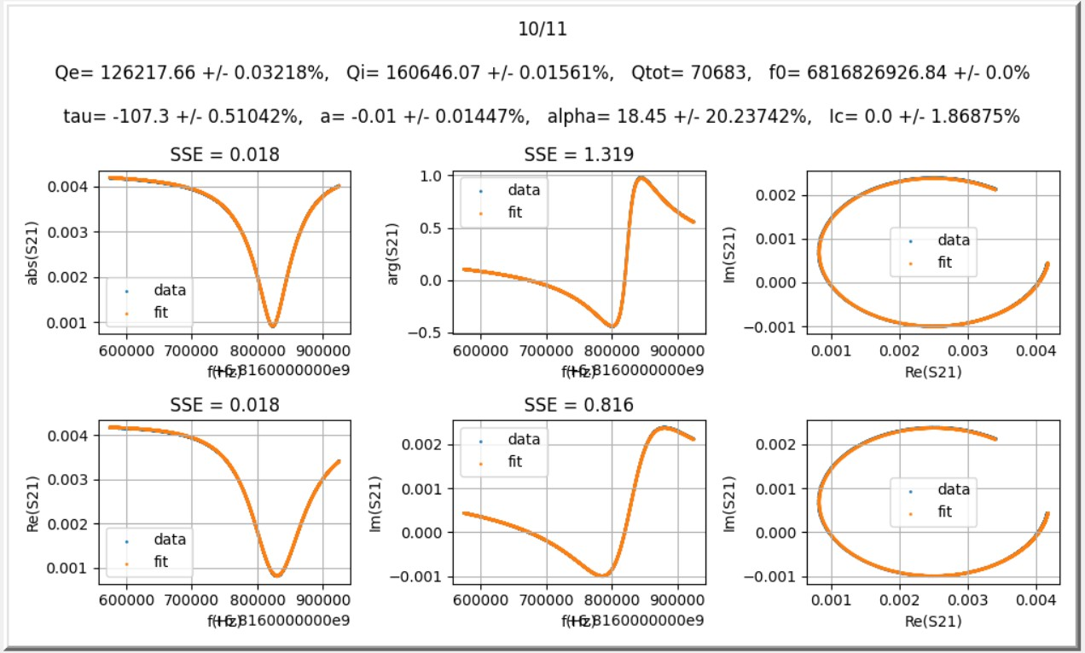
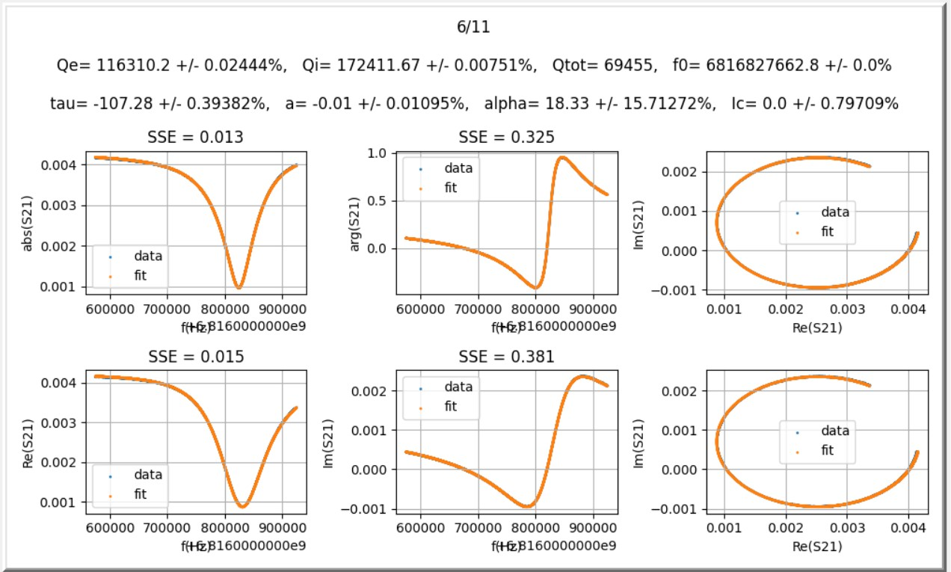
III. Re-plot Q vs Power(1/4)
10dBm to -10dBm

Slide 2
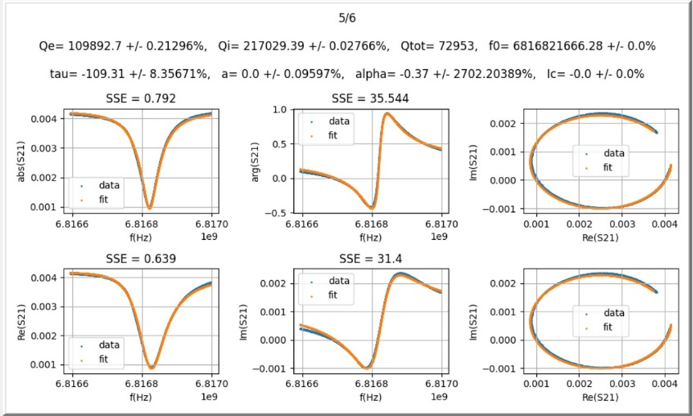
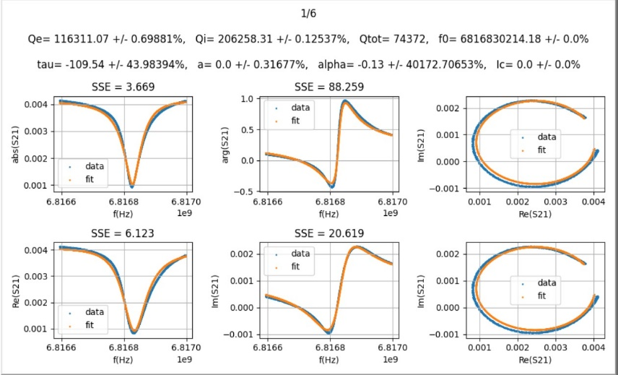
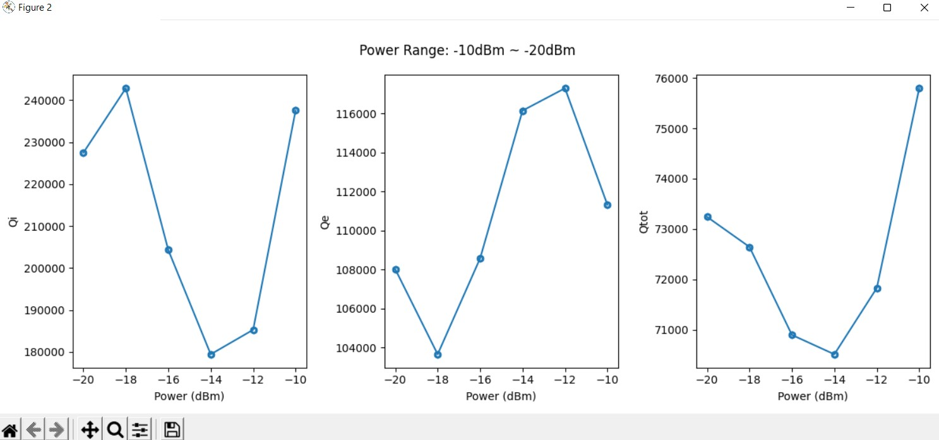
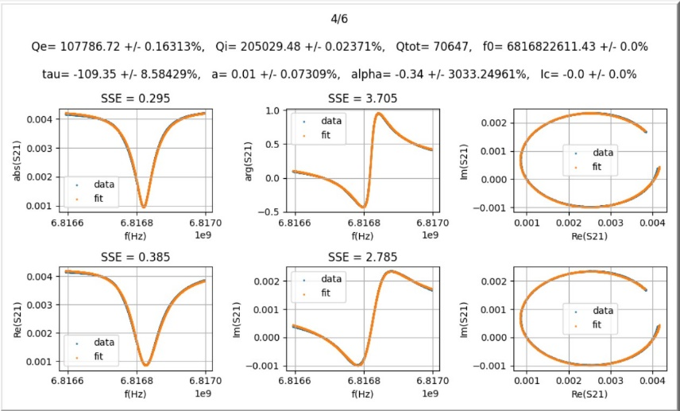
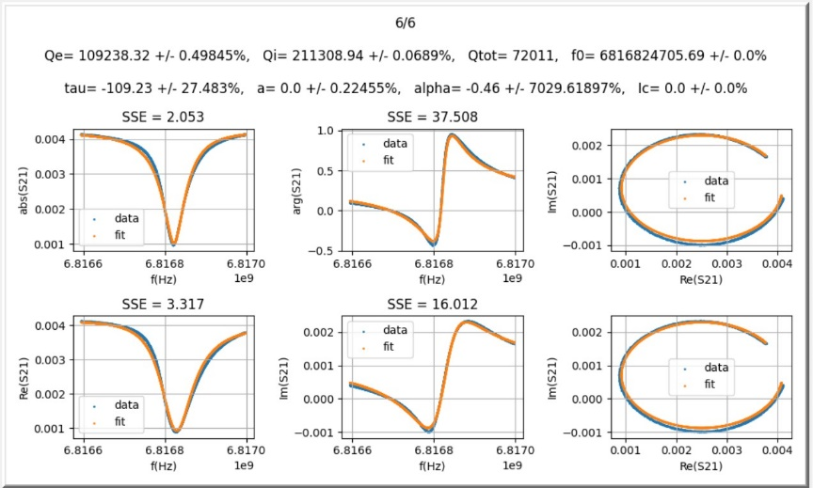
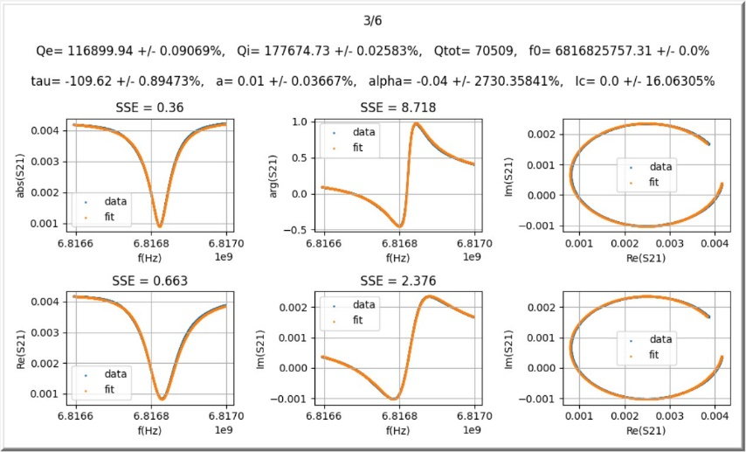
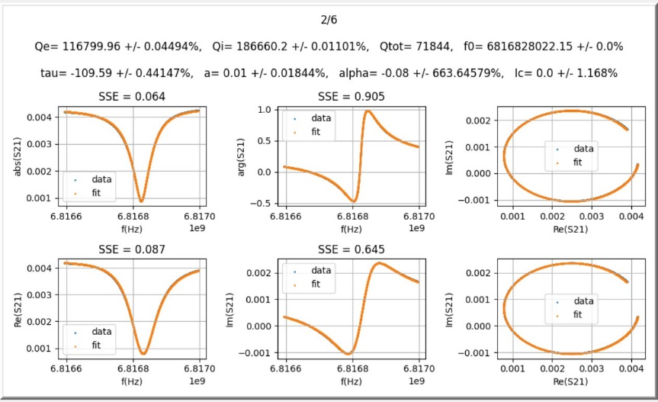
III. Re-plot Q vs Power(2/4)
-10dBm to -20dBm
: Bad Fit (Large SSE)
: Good Fit (Small SSE)

Slide 3
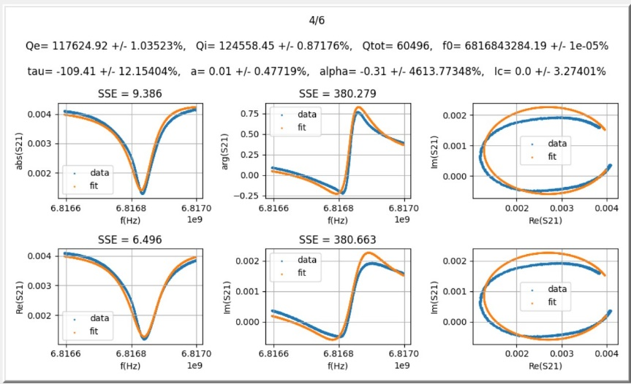
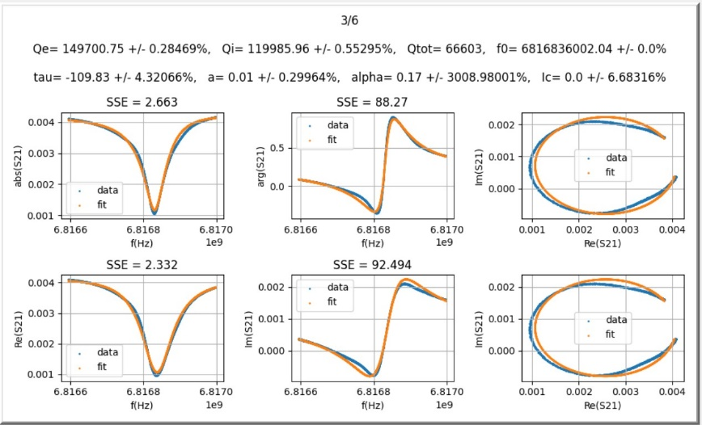
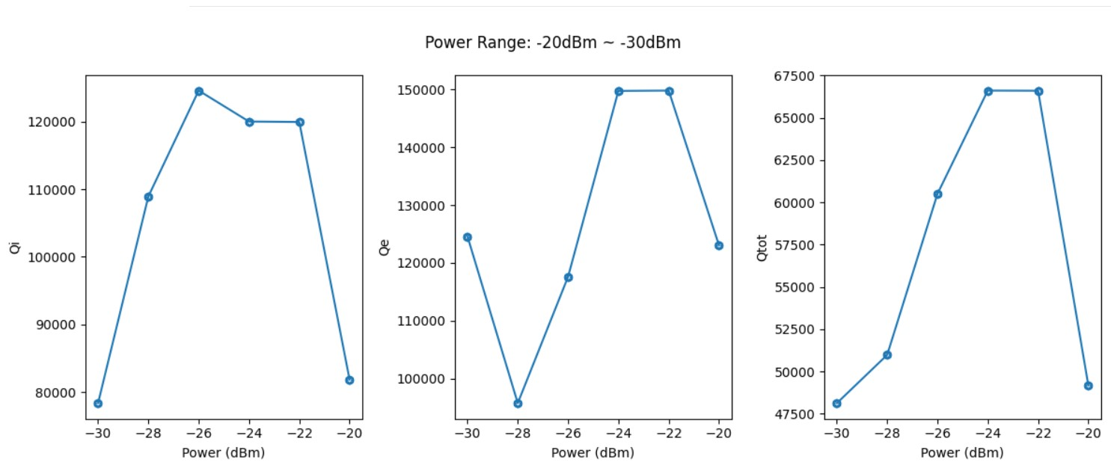
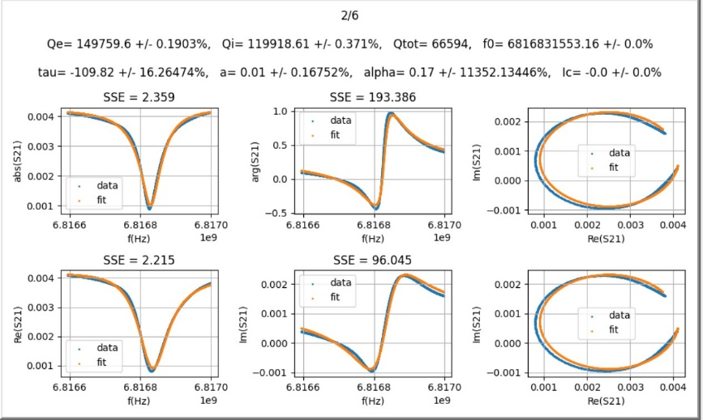
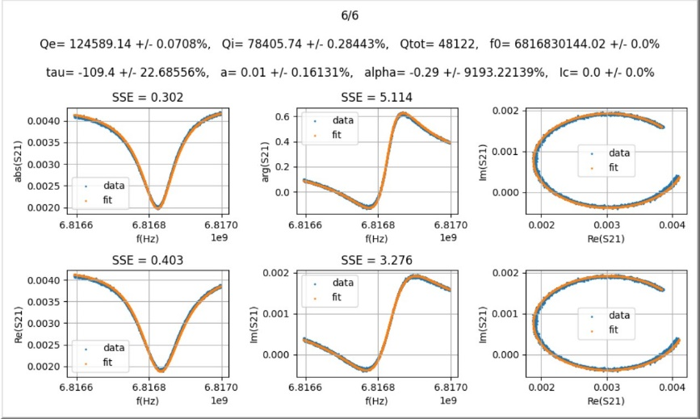
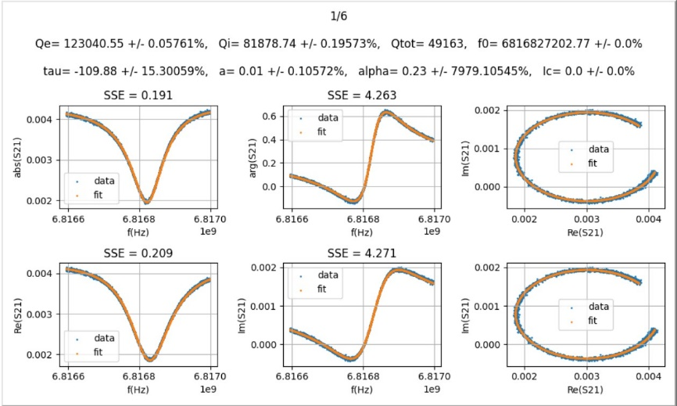
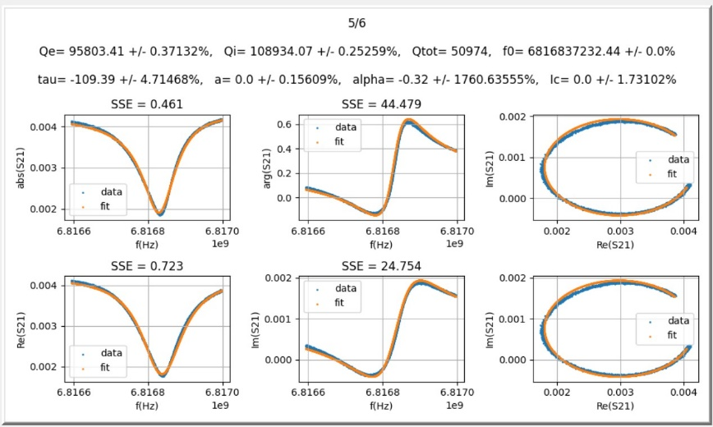
III. Re-plot Q vs Power(3/4)
-20dBm to -30dBm
: Bad Fit (Large SSE)
: Good Fit (Small SSE)

Slide 4
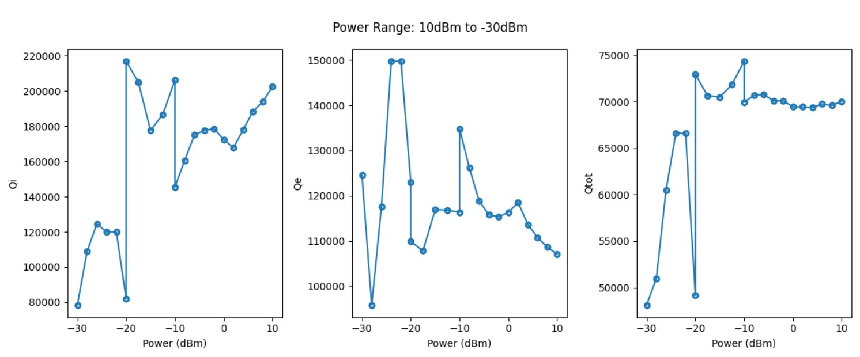
III. Re-plot Q vs Power(4/4)
Overall Q vs Power
Conclusion:
The fitting for 10dBm to -20dBM has lowest SSE ( < 1.5) and lowest standard deviation in Qe and Qi values ( < 0.01%) and therefore this part of the fit is most reliable.
For both the ranges -10dBm to -20dBm and -20dBm to -30dBm, more than half of the datasets have large SSE (the deviation of fit curve from data curve is obvious to naked eye.), so the fit for these ranges is not reliable.

Slide 5
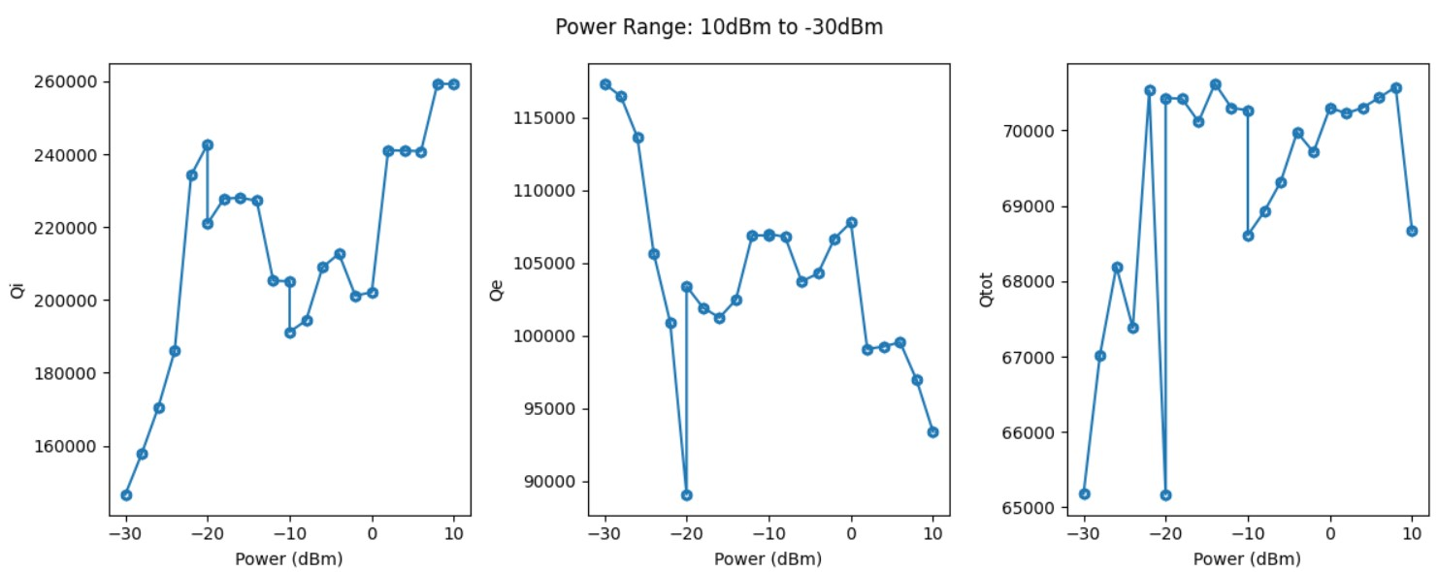
III. Compare 6.591GHz ~ 6.9525GHz and 6.8165GHz ~ 6.187GHz
6.8165GHz ~ 6.187GHz
6.591GHz ~ 6.9525GHz
They both have sudden increase in Qi values in the power range -10dBm to -20dBm, why?

