Slide 1
ANNOY-GPU: Approximate Nearest Neighbor Oh Yeah – GPU
Final Project Presentation
吳永玹

Slide 2
Outline
Goal
Motivation
ANN semantic retrival steps
Build Index Tree (CPU) – Illustration
Build Index Tree (GPU) – Illustration
Performance
Demo

Slide 3
Goal
Use GPU to speed up the Approximate Nearest Neighbor (ANN) algorithm.

Slide 4
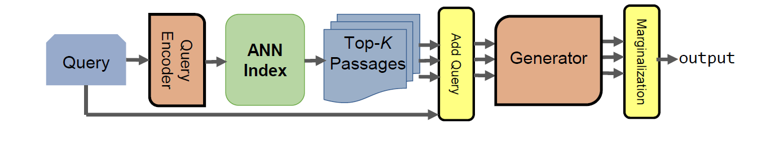
Motivation
In knowledge intensive NLP tasks (e.g. GPT-3), ANN is used to aid in semantic retrival.
ANN is part of the processing pipeline of an knowledge intensive NLP model
Image source: Michael Glass, Gaetano Rossiello, Md Faisal Mahbub Chowdhury, Ankita Rajaram Naik1, Pengshan Cai1, Alfio Gliozzo. Re2G: Retrieve, Rerank, Generate, 2022.

Slide 5
ANN semantic retrival steps
Step 1
Wiki page 1
Encode each wiki page into a M-dimentional vectors
1.023, -0.012,
. . . . . . .
, -2.306
Vector 1
Wiki page 2
0.170, -1.899,
. . . . . . .
, 3.331
Vector 2
Wiki page N
.
.
.
. . . . . . .
0.077, -0.011,
. . . . . . .
, -0.307
Vector N
N x M

Slide 6
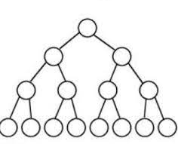
ANN semantic retrival steps
Step 2
1.023, -0.012,
. . . . . . .
, -2.306
Vector 1
0.170, -1.899,
. . . . . . .
, 3.331
Vector 2
Build ANN index tree on disk
. . . . . . .
0.077, -0.011,
. . . . . . .
, -0.307
Vector N
N x M

Slide 7
ANN semantic retrival steps
Step 3
Fast semantic retival using the built ANN index tree.
Encode the query into vectors using same encoder model.
Query
vector
Top K nearest neighbors

Slide 8

ANNOY – Approximation Nearest Neighbor Oh Yeah
Start from an existing project: ANNOY, which is built by an employee from the company Spotify.
ANNOY can only use multi-thread (CPU) to speed up build process.
I will use GPU to speed up build process.

Slide 9
Build Index Tree (CPU) - Illustration
32 data vectors
We want to build index tree for a dataset of 32 vectors.

Slide 10
Build Index Tree (CPU) - Illustration
32 data vectors
. . . . . . .
inner product
inner product
Split vector
Find a split vector that evenly divides the group of vectors (by dot product value > or < 0).

Slide 11
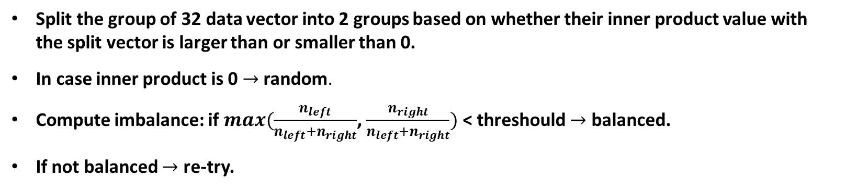
Build Index Tree (CPU) - Illustration
Split vector
Node
14 data vectors
18 data vectors
Inner product < 0 with the split vector
Inner product > 0 with the split vector
Split the group of 32 data vector into 2 groups based on whether their inner product value with the split vector is larger than or smaller than 0.
In case inner product is 0 $→$ random.
Compute imbalance: if $max(\frac{n_{left}}{n_{left}+n_{right}}$, $\frac{n_{right}}{n_{left}+n_{right}})$ < threshould $→$ balanced.
If not balanced $→$ re-try.

Slide 12
Build Index Tree (CPU) - Illustration
14 data vectors
18 data vectors
. . . . .
inner product
inner product
Split vector

Slide 13
Build Index Tree (CPU) - Illustration
Split vector
Node
18 data vectors
9 data vectors
5 data vectors

Slide 14
Build Index Tree (CPU) - Illustration
Split vector
Node
9 data vectors
5 data vectors
9 data vectors
9 data vectors

Slide 15
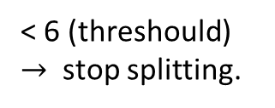
Build Index Tree (CPU) - Illustration
9 data vectors
5 data vectors
9 data vectors
9 data vectors
< 6 (threshould) $→$ stop splitting.
A group will stop splitting when its data vector numbr < a threshould. Assume threshould is 6.
Will create a Node to hold the group of vectors that can no longer be splitted.

Slide 16
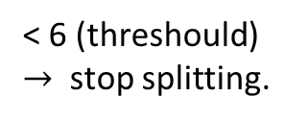
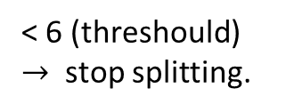
Build Index Tree (CPU) - Illustration
9 data vectors
9 data vectors
5 data vectors
5 data vectors
4 data vectors
< 6 (threshould) $→$ stop splitting.
< 6 (threshould) $→$ stop splitting.

Slide 17
Build Index Tree (CPU) - Illustration
9 data vectors
9 data vectors
5 data vectors
5 data vectors
4 data vectors

Slide 18
Build Index Tree (CPU) - Illustration
Done!
5 data vectors
5 data vectors
4 data vectors
4 data vectors
5 data vectors
5 data vectors
4 data vectors

Slide 19
Build Index Tree (GPU) - Illustration
Split vector
Node
14 data vectors
18 data vectors
In GPU memory
In GPU memory
Data vectors are loaded to GPU before building process begins.
Assume all vectors can fit into GPU memory for now.
Tree is built on host disk not on GPU memory.
Computed split vector by GPU will need to be sent back to host in each iteration to update the tree.

Slide 20
Build Index Tree (GPU) - Illustration
14 data vectors
18 data vectors
. . . . .
. . . . .
inner product
inner product
inner product
inner product
Split vector
Split vector
Done by block 0
Done by block 1
Find split and compute dot product in parallel.
Assign one group to each block.

Slide 21
Build Index Tree (GPU) - Illustration
Find split and compute dot product in parallel.
Assign one group to each block.
inner product
. . .
. . .
. . .
. . .
inner product
inner product
inner product
inner product
inner product
inner product
inner product
Split vector
Split vector
Split vector
Split vector
Done by block 0
Done by block 1
Done by block 2
Done by block 3

Slide 22
Build Index Tree (GPU) - Illustration
Done!
5 data vectors
5 data vectors
4 data vectors
4 data vectors
5 data vectors
5 data vectors
4 data vectors

Slide 23
Build Index Tree (GPU) - Illustration
If initially the data vectors are larger than GPU meomry:
Use CPU to do split when group sizes still larger than GPU memory.
Switch to GPU when group sizes can fit into GPU.

Slide 24
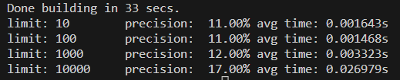
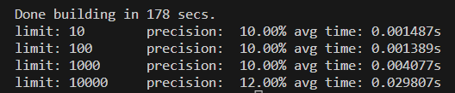
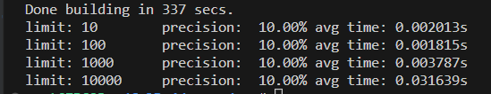
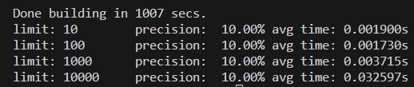
Performance
Build index for 1 x 10⁶ 768-dimensional float vectors (3 GB < GPU memory).
$→$GPU roughly 6 time faster than CPU. Precision are similar.
Build index for 5 x 10⁶ 768-dimensional float vectors (15 GB > GPU memory).
$→$GPU roughly 3 time faster than CPU. Precision are similar.
Speedup factor is 1 - 6, depending on dataset size (size of all vectors).
The speedup factor is larger for dataset that can be fit into GPU memory entirely.
The speedup factor could be almost 1 for dataset which are much larger than GPU memory.

Slide 25

Demo – Test on real-workd data: Wiki pages
There are 1187751 wiki pages in total.
Each wiki page will be encoded into 768-dimensional vector.
Use the transformer model shibing624/text2vec-base-chinese to encode.

Slide 26
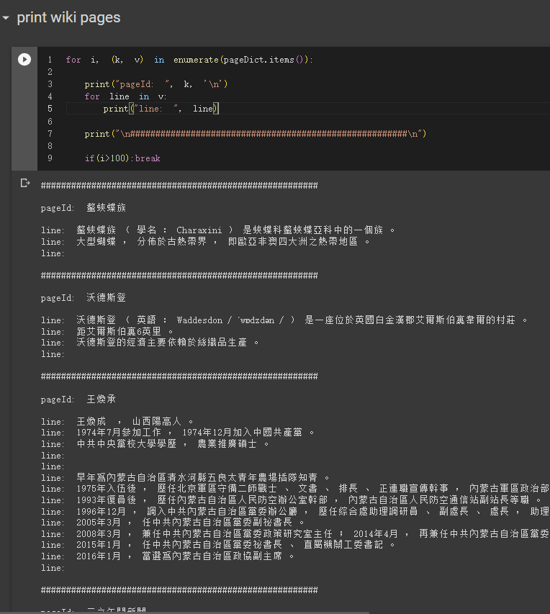
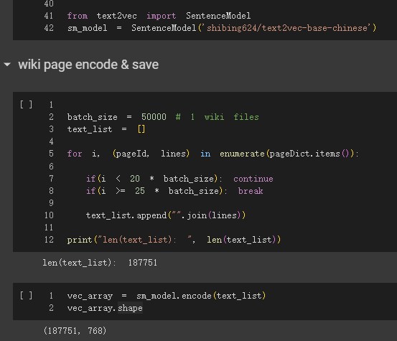
Demo – Test on real-workd data: Wiki pages
Print out wiki page content
Encode each page into 768-dimension vectors.
Page
Page
Page

Slide 27
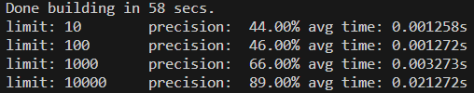
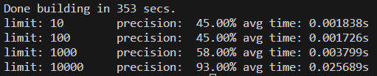
Demo – Test on real-workd data: Wiki pages
Build index for TBrain wiki page data: 1187751, 768-dimensional float vectors (< GPU memory).
$→$GPU roughly 6 time faster than CPU. Precision are similar.
$→W$e are able to obtain much higher precision scores on real world data than we do in synthetic random data

Slide 28
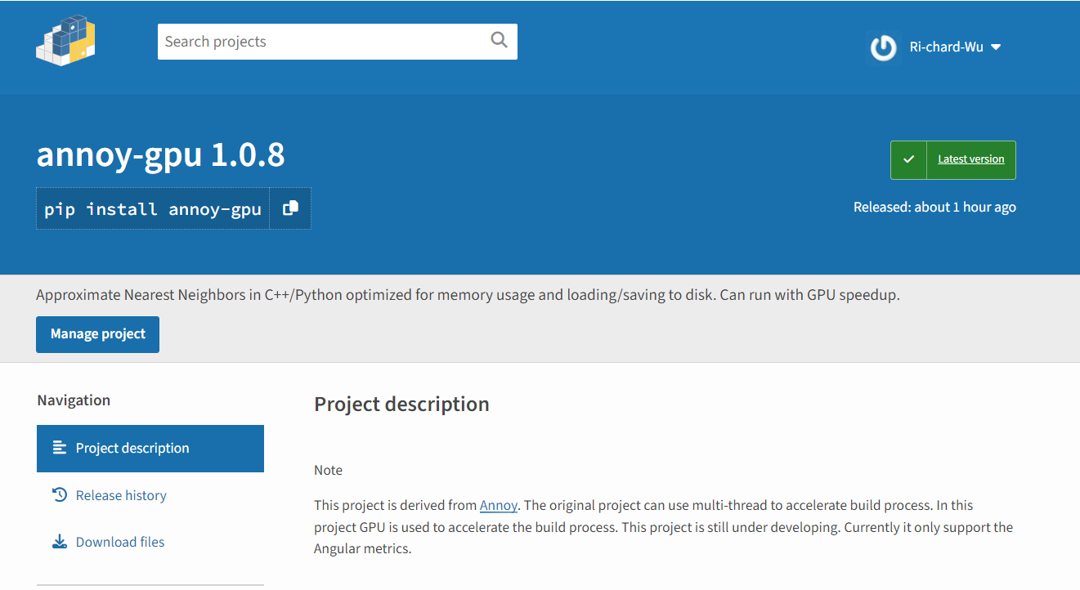
Demo – Pip install and run on colab

Slide 29
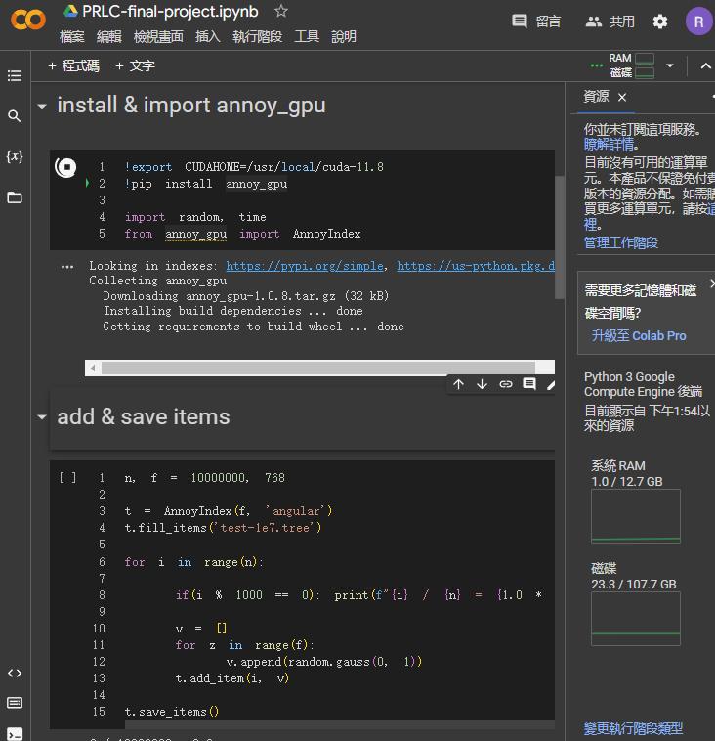
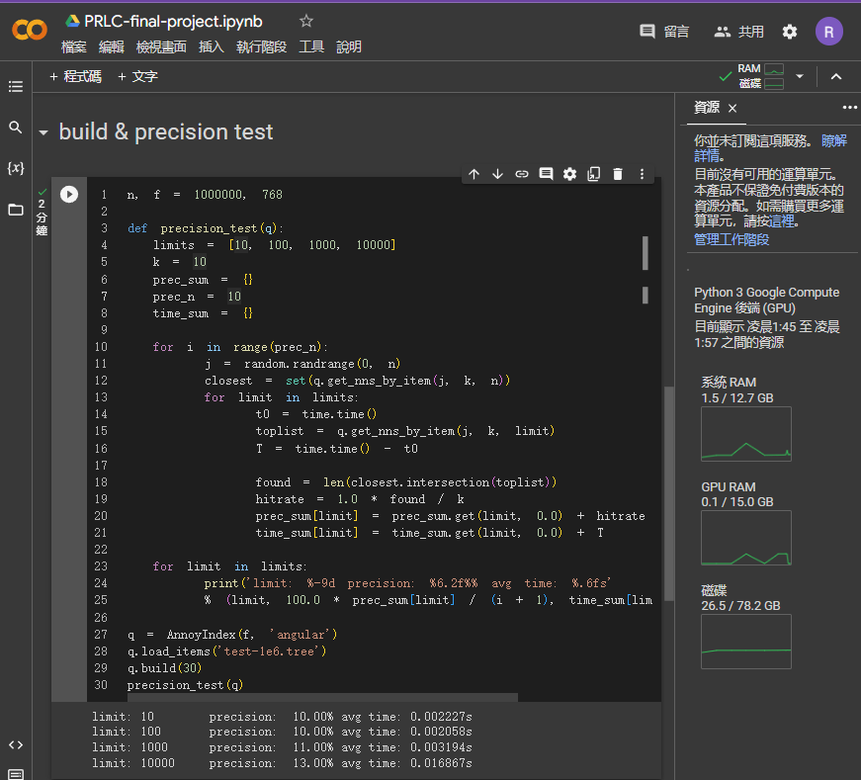
Demo – Pip install and run on colab

Slide 30
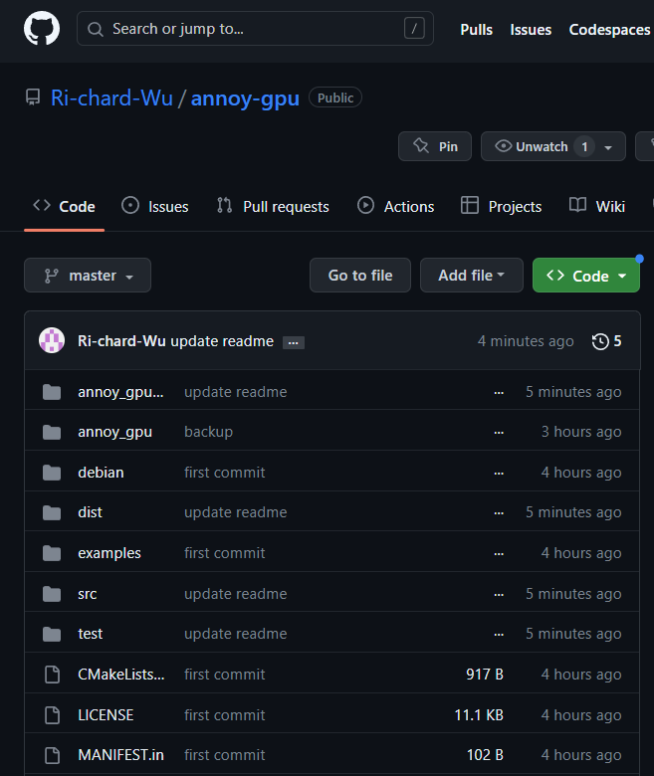
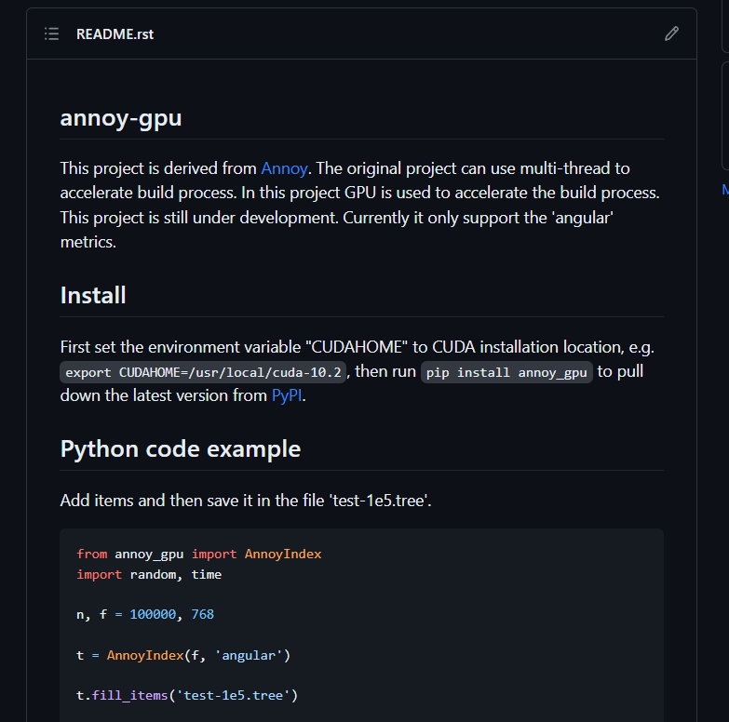
Demo – annoy-gpu Github

Slide 31
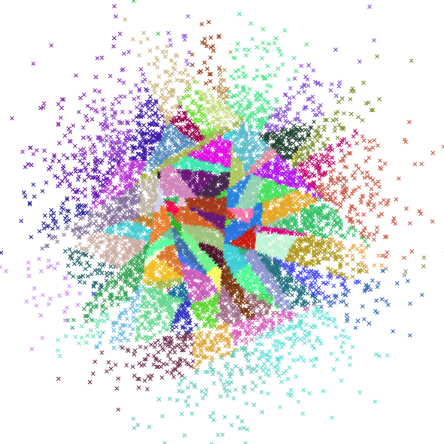
Thanks for your attention
Image source: https://github.com/spotify/annoy

