Slide 1
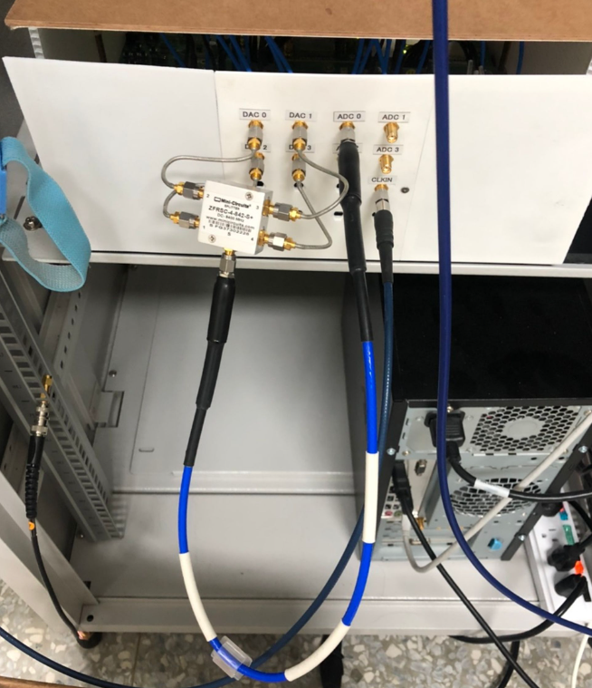

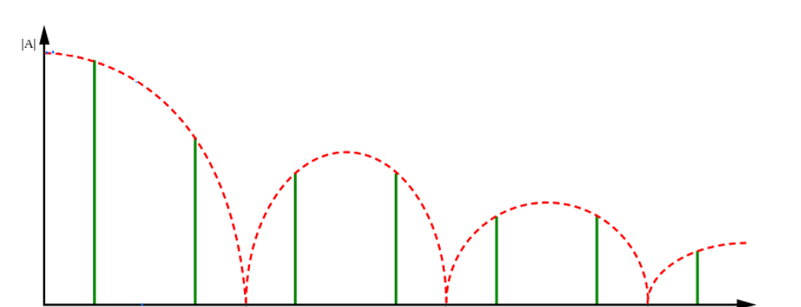
f0

Slide 2
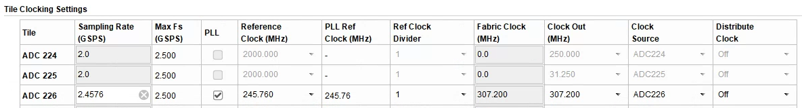
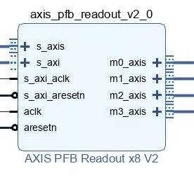
RFDC (e.g. m20_axis)
MPSoC (M_AXI_HPM0_FPD) -> AXI interconnect
axis_avg_buffer 1 (s_axis)
axis_avg_buffer 2 (s_axis)
axis_avg_buffer 3 (s_axis)
axis_avg_buffer 4 (s_axis)

Slide 3
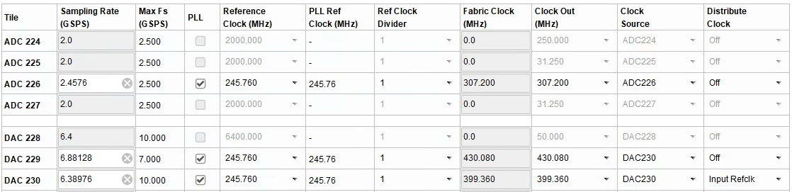
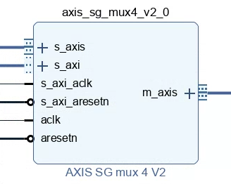
tproc (e.g. m8_axis) -> Clock converter
MPSoC (M_AXI_HPM0_FPD) -> AXI interconnect
RFDC (e.g. s10_axis)

Slide 4
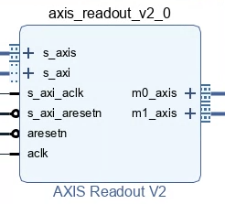
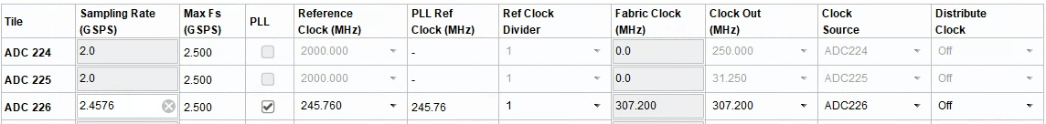
RFDC (e.g. m20_axis) -> axis register slice
MPSoC (M_AXI_HPM0_FPD) -> AXI interconnect
Not used
axis_avg_buffer (s_axis)

Slide 5
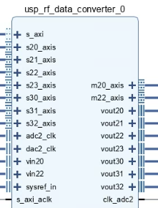



$$f_{\text{clk}\text{_}\text{adc}\text{2}}$$
$$f_{s}$$
$$f_{\text{clk}\text{_}\text{adc}\text{2}}$$

Slide 6
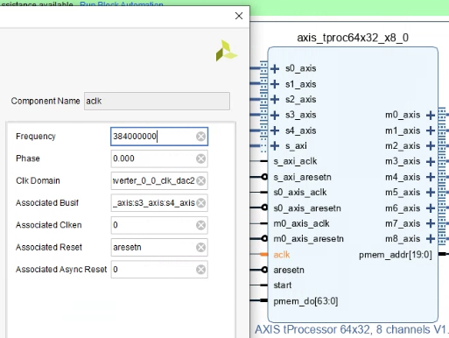
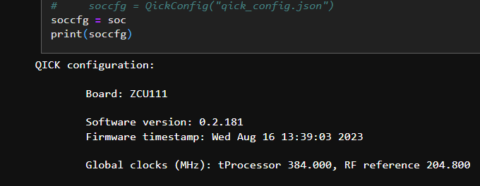

Slide 7
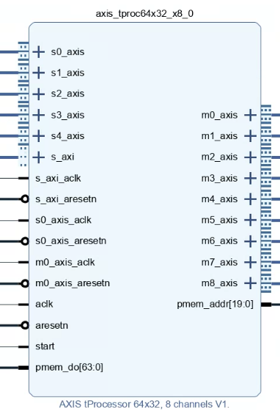
Read accumulated value of the acquired data from axis_avg_buffer ip
Send triggers signals
Control signal generators

Slide 8
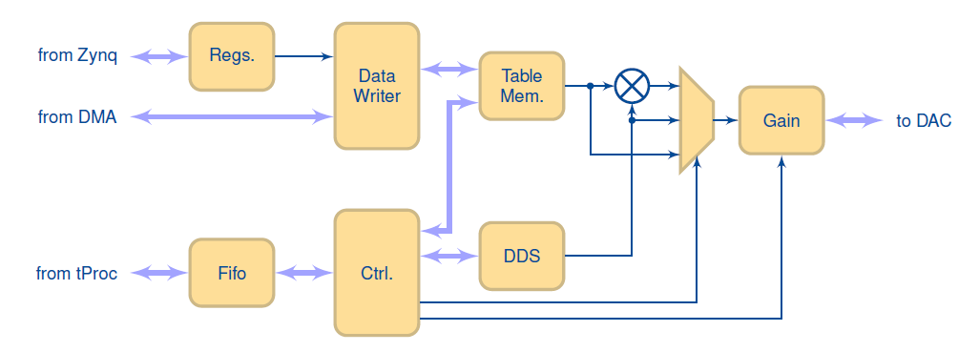
waddr reg,
wlength reg
envelope data
mux
addr, nsamp
outsel, nsamp, gain, addr, phase, freq
freq, phase
outsel
gain

Slide 9
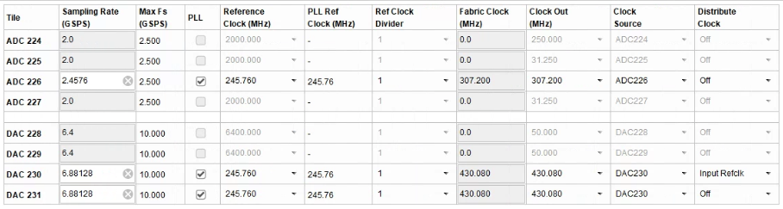
??
??

Slide 10
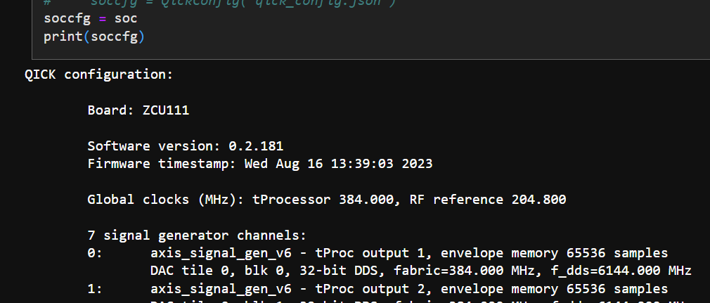
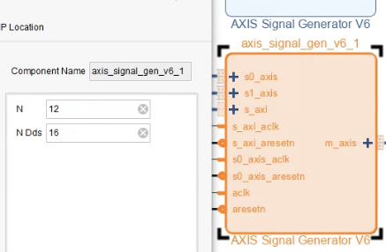
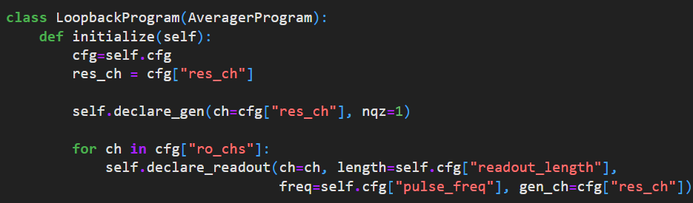

Slide 11
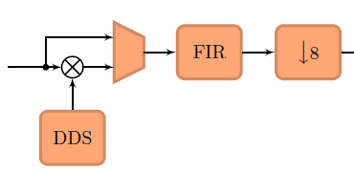
To axis_avg_buf ip
From ADC

Slide 12
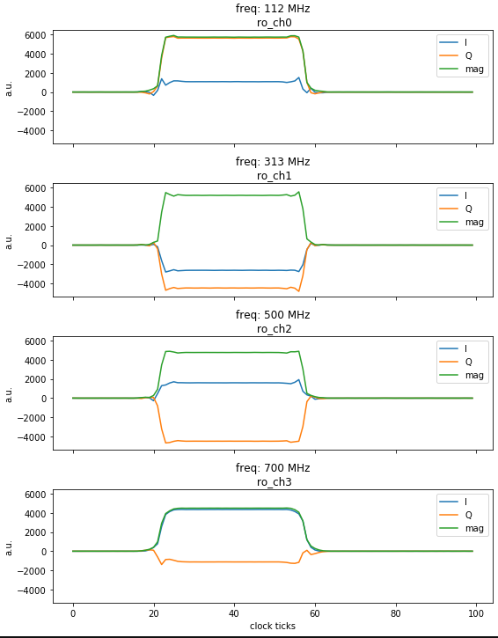
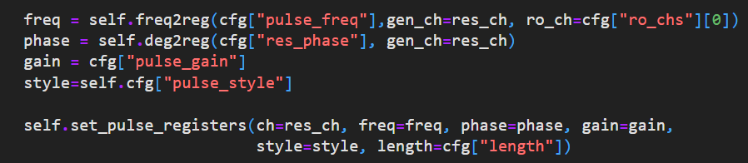

Slide 13
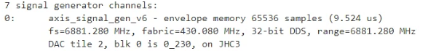
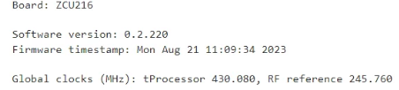
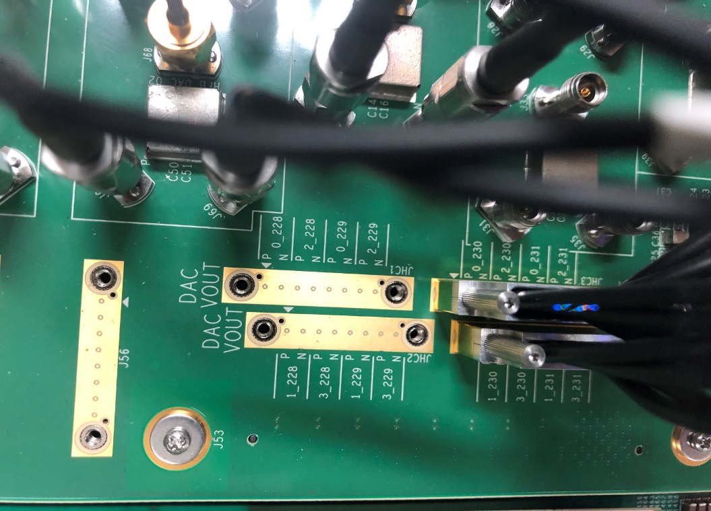

Slide 14
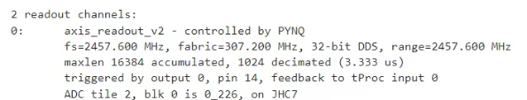

Slide 15
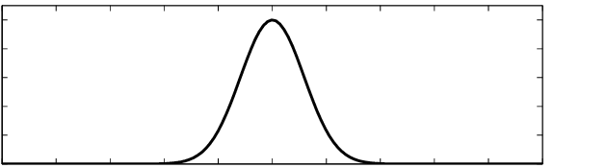
length
sigma
t_{start}
t_{end}
T = 1/f_{s}

Slide 16
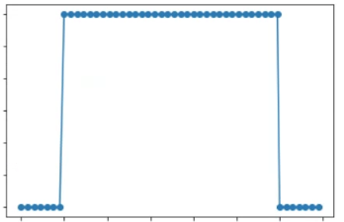
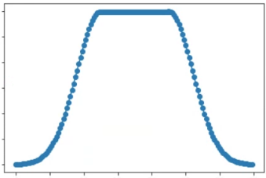
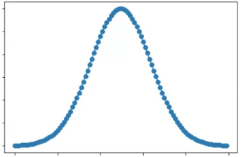
5 * sigma / 2
length
length
sigma / 2
sigma
5 * sigma
T = 1/f_{s}

Slide 17
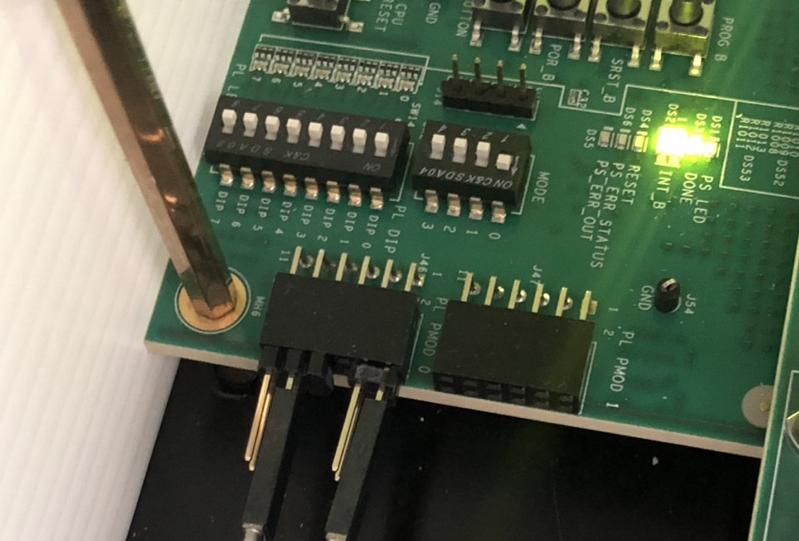
1
PMOD 0
PMOD 1

Slide 18
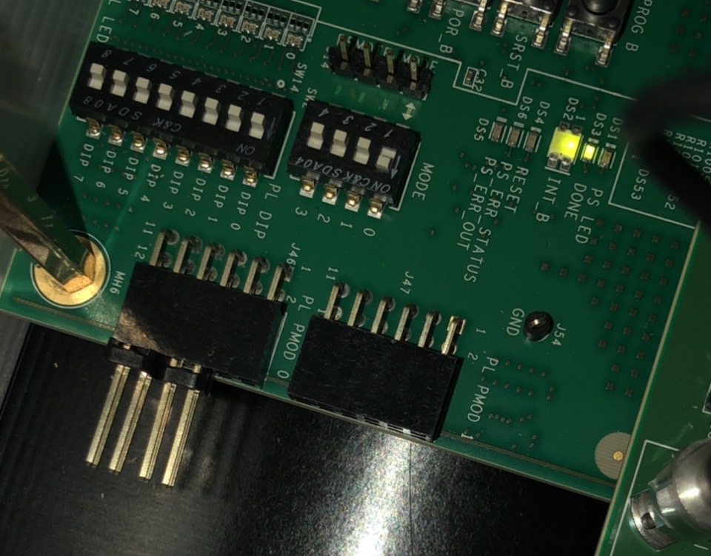
11
9
7
5
12
10
3
8
1
6
4
PMOD 0
2
3
PMOD 1
3

Slide 19
