Slide 1

Dao Xuan Son
Nghiem Tuan Khoi
Truong Dai Duong
Tran Hoang Kien
Elevator Module using Verilog
Performed by: Truong Quoc Anh
1

Slide 2
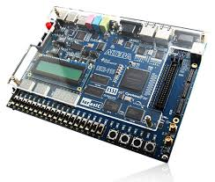

OVERVIEW
Input
Output
Buttons at each floor
- input [5:1] up, down
inside the elevator
- Input Buttons keep_close, keep_open
- Input[5:1] input_floor
output door; // = 1 for open, = 0 for closed
output go_up, go_down; // controls the LED indicating movement direction at each floor
output[5:1] led_up, led_down; // LEDs for the up/down buttons outside each floor
output[2:0] current_floor; // controls the LED displaying the current floor number
output[5:1] led_floor; // LEDs for the floor buttons inside the elevator
Elevator Module
DE2 - 115
2

Slide 3
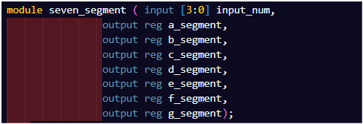
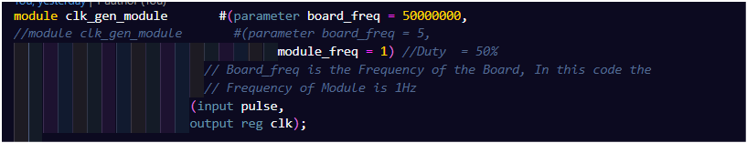
Submodule & Top Module
Frequency divider module from 50MHz to 1Hz.
1
Display number on 7-segment Led
Frequency divider module from 50MHz to 1Hz.
4

Slide 4
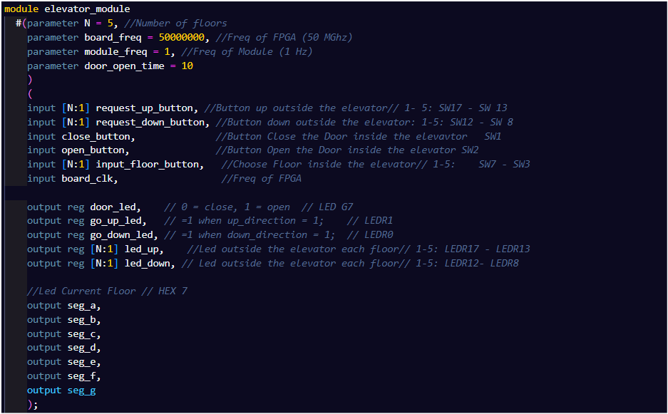
Submodule & Top Module
Frequency divider module from 50MHz to 1Hz.
1
Top Module
4

Slide 5
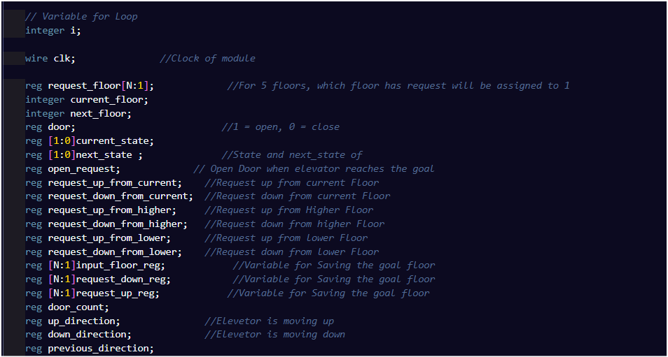
Submodule & Top Module
Frequency divider module from 50MHz to 1Hz.
1
Variables in top module
4

Slide 6
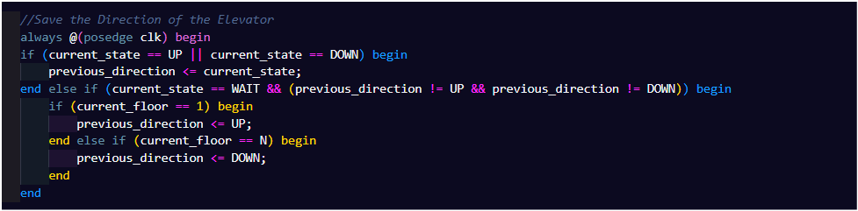
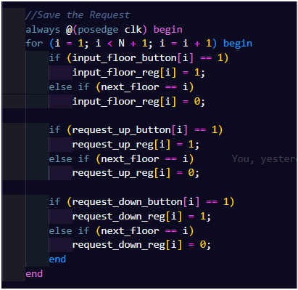
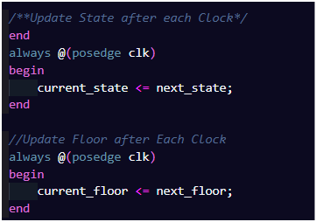
2
Update State and Request after each Clock
5

Slide 7
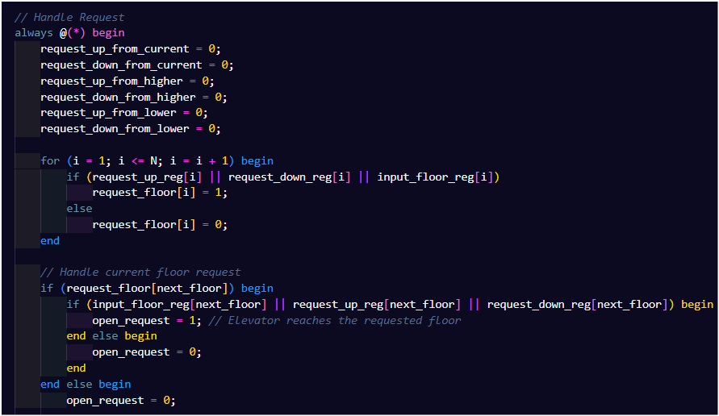
3
Handle Request
When the elevator reach the goal Floor, switch to Open state
Automatically update the request state whenever there is a change signal
5

Slide 8
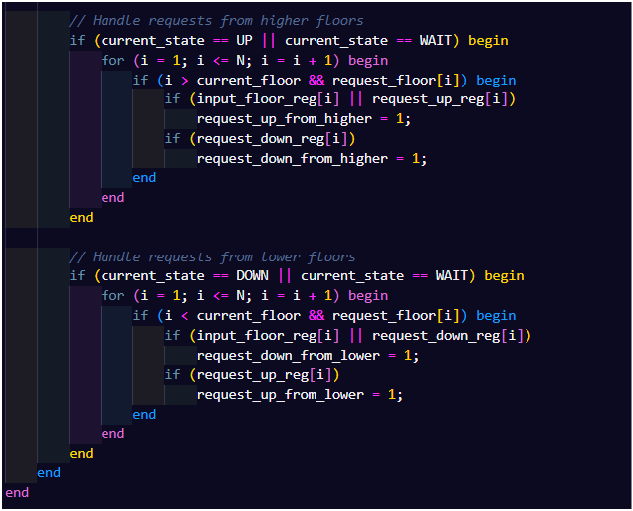
3
Handle Request
Accept request move Up
Accept Request move Down
5

Slide 9
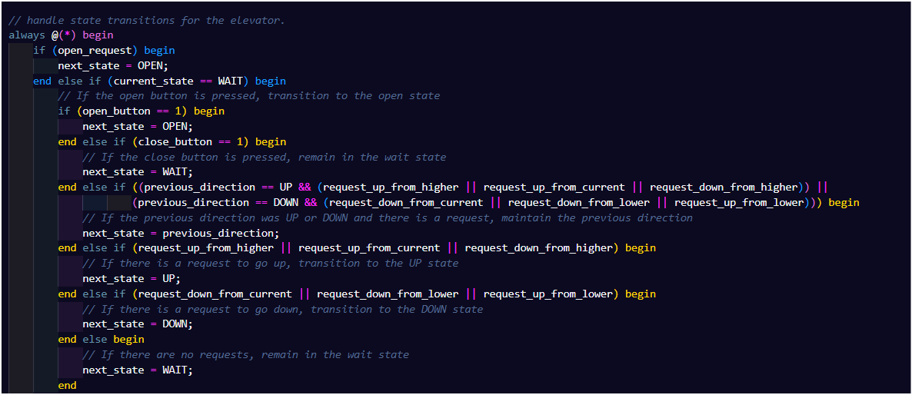
4
Handle State base on Request
Prioritize switching to the door open state.
Continue moving in the same direction if there are still requests in that direction.
Start Moving if elevator is waiting
5

Slide 10
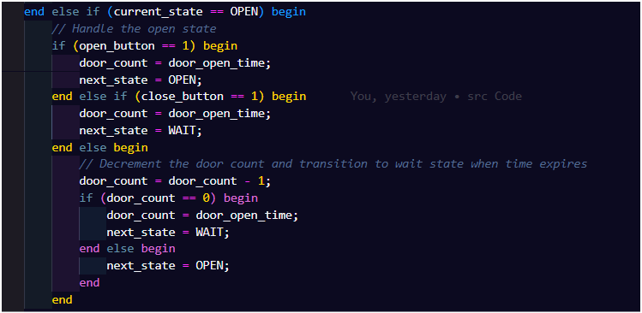
4
Handle State base on Request
Auto Close Door
5

Slide 11
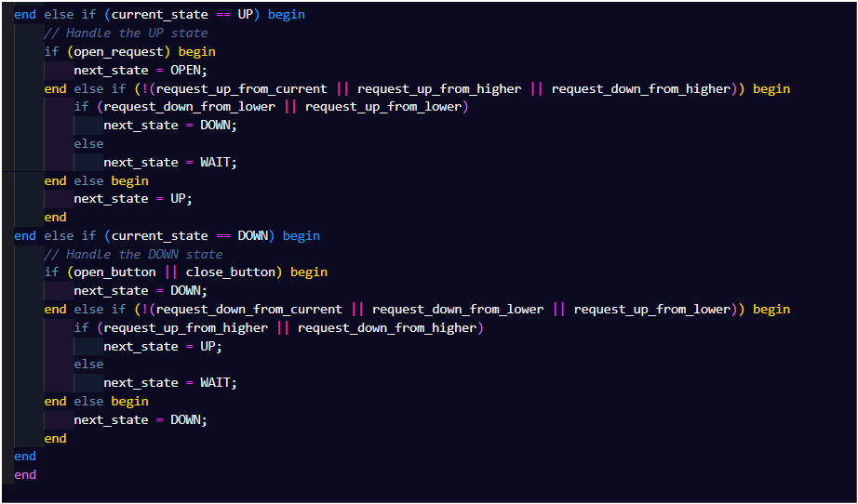
4
Handle State base on Request
Handle Up Request
Handle Down Request
5

Slide 12
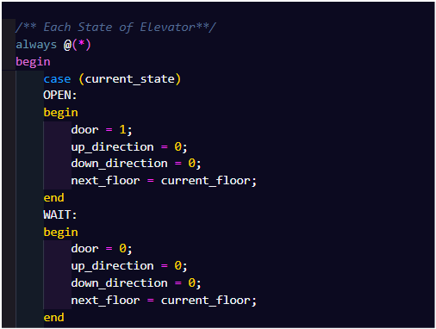
5
Each State of Elevator
5

Slide 13
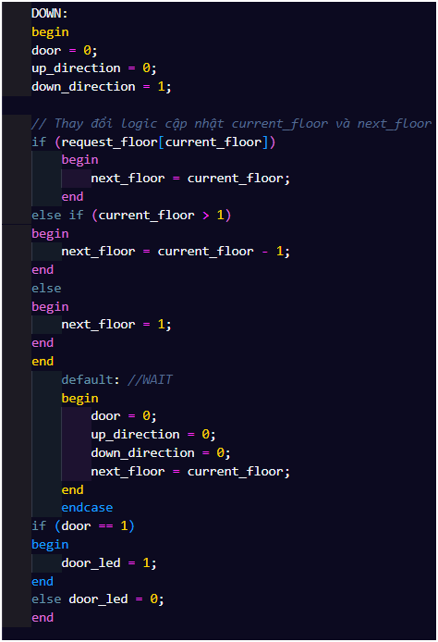
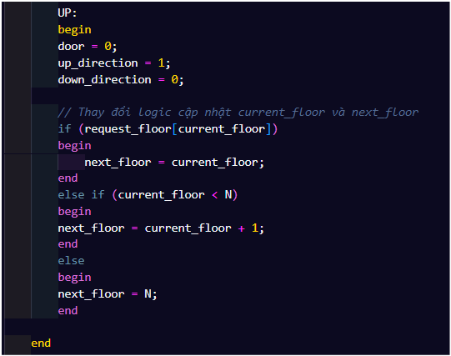
5
Each State of Elevator
Control Door-led
Check and update next floor
5

Slide 14
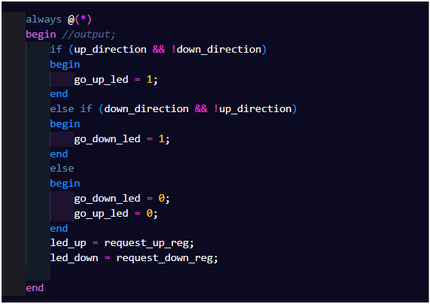
6
Control Output
5

