Slide 1


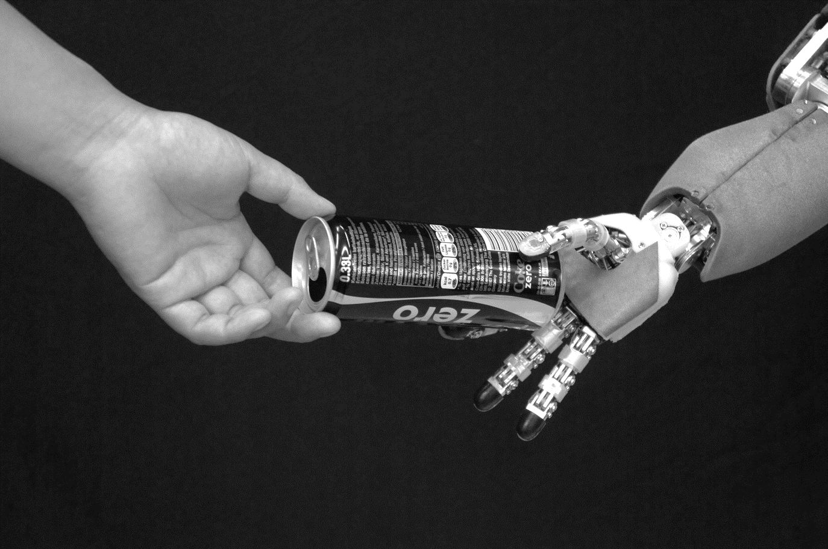

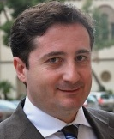
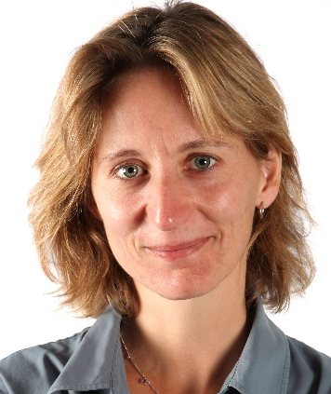
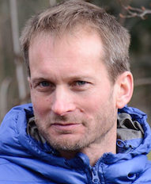
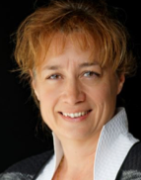




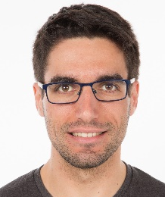



follow us!
@corsmal
CORSMAL
Collaborative Object Recognition, Shared Manipulation And Learning
Scope
Exploring the fusion of multiple sensing modalities (touch, sound, and vision) to accurately and robustly estimate the physical properties of objects in noisy and potentially ambiguous environments
Designing a framework and creating a dataset for recognition and manipulation of objects
Objectives & Challenges
to infer object content by observing the way the human manipulates it
to decide the parameters for grasping (grasping points, stiffness) based on inference of the content
to adapt grip if the object slips
Variability of physical & visual properties of objects
Uncertainty in spatial & temporal context, changes in viewpoint
Perturbations, e.g. sensing & grip uncertainties, object occlusions
Learning from scarce observations
Real-time
re-planning
Partners
Team
Sponsors
A. Cavallaro
A. Billard
P. Frossard
V. Perdereau
K. Althoefer
R. Sanchez-Matilla
A. Modas
K. Chatzilygeroudis
Project start:
February 2019
http://corsmal.eecs.qmul.ac.uk

