Slide 1





CORSMAL Collaborative Object Recognition, Shared Manipulation And Learning Open Science Session CHIST-ERA Projects Seminar 2019
follow us
@corsmal

Slide 2

Scope
reproducibility
data, models, protocols
recognition
manipulation
vision, sound, touch
@corsmal
http://corsmal.eecs.qmul.ac.uk

Slide 3
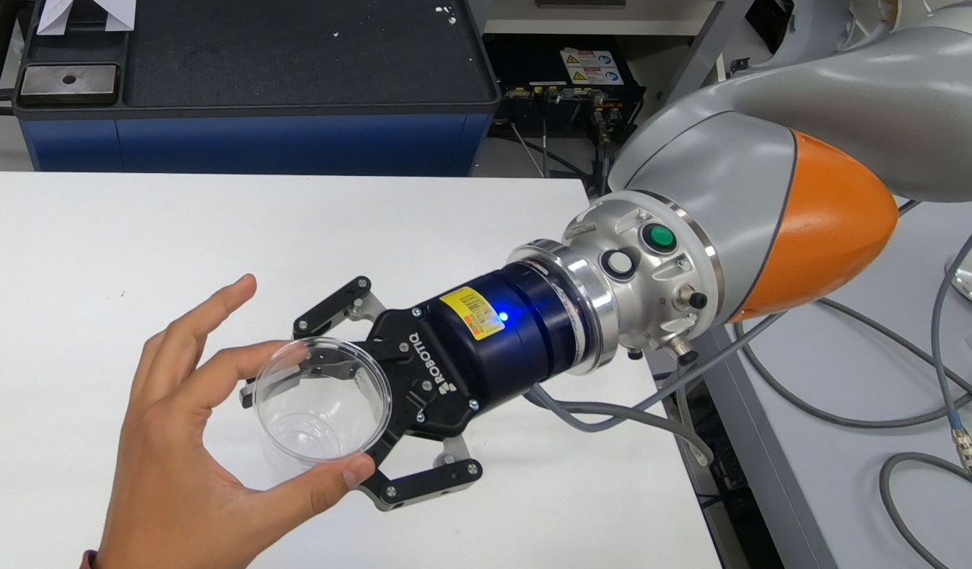
Aims
To create an open dataset and an evaluation protocol for recognition and manipulation of previously unseen objects
To explore the fusion of multiple sensing modalities (touch + sound + vision) to accurately and robustly estimate the physical properties of objects in noisy and potentially ambiguous environments
@corsmal
http://corsmal.eecs.qmul.ac.uk

Slide 4
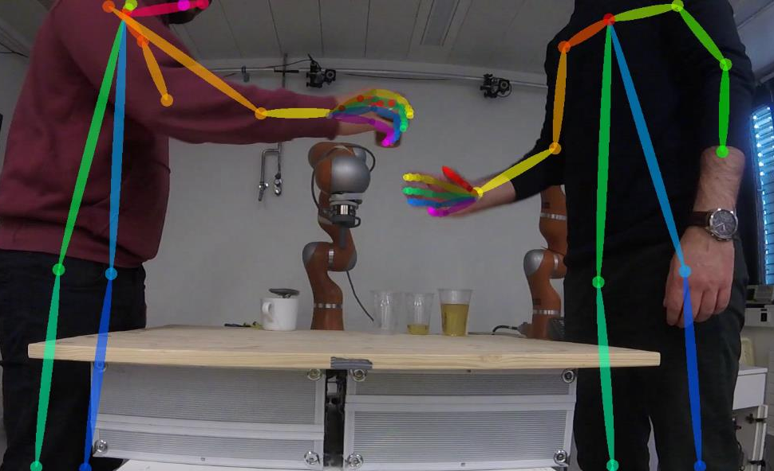
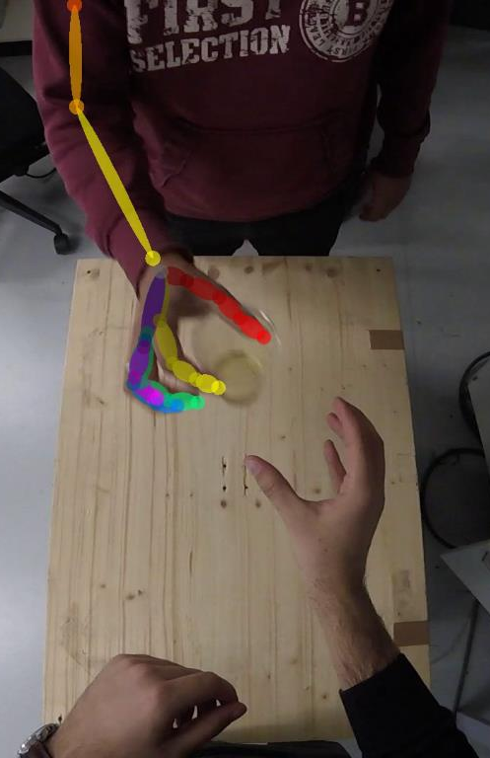
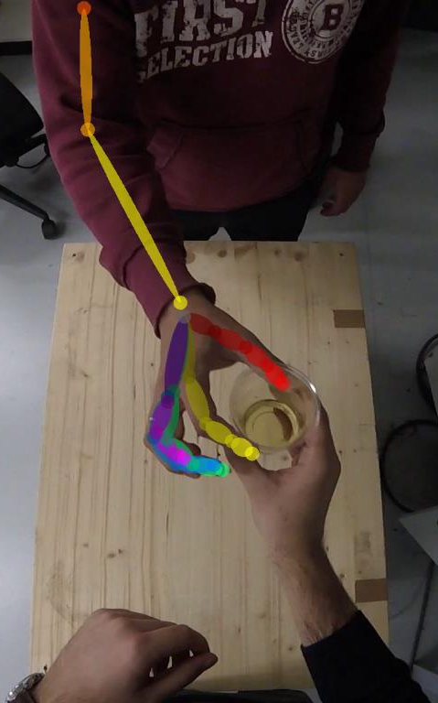
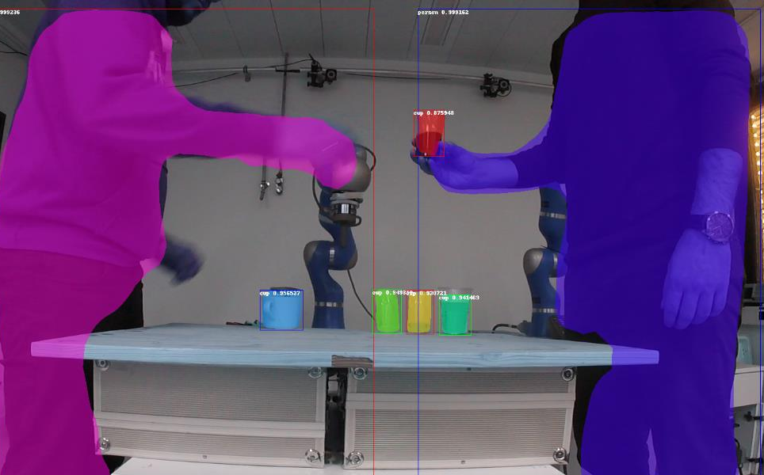
Recognition: examples
@corsmal

Slide 5
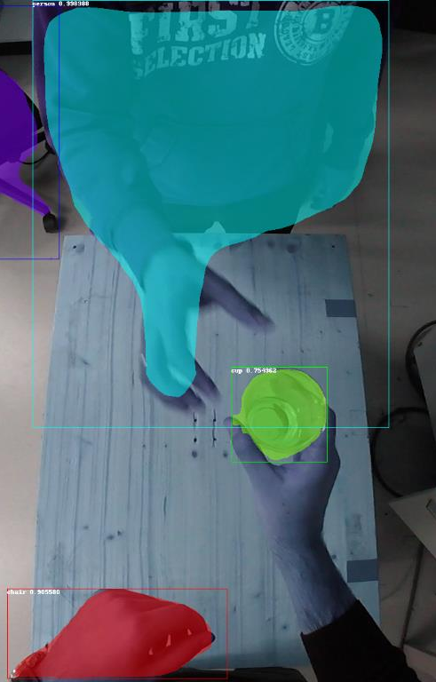
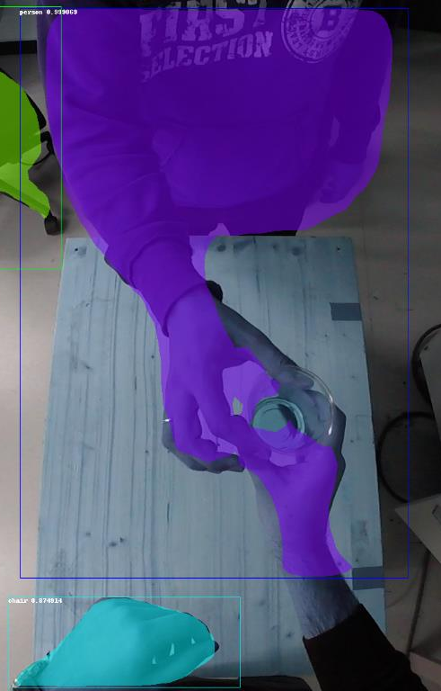
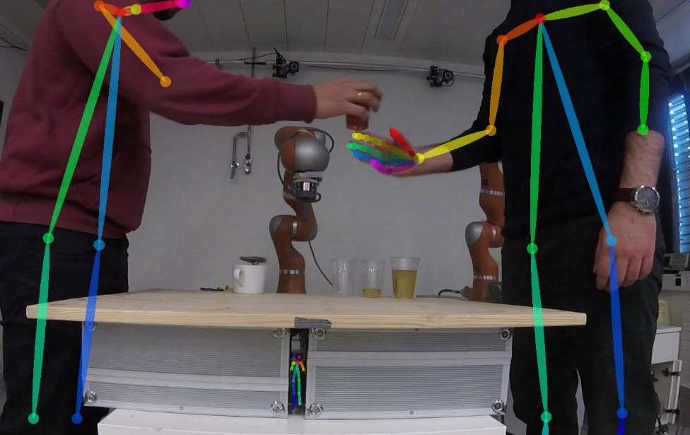
Recognition: challenges
!!
@corsmal

Slide 6
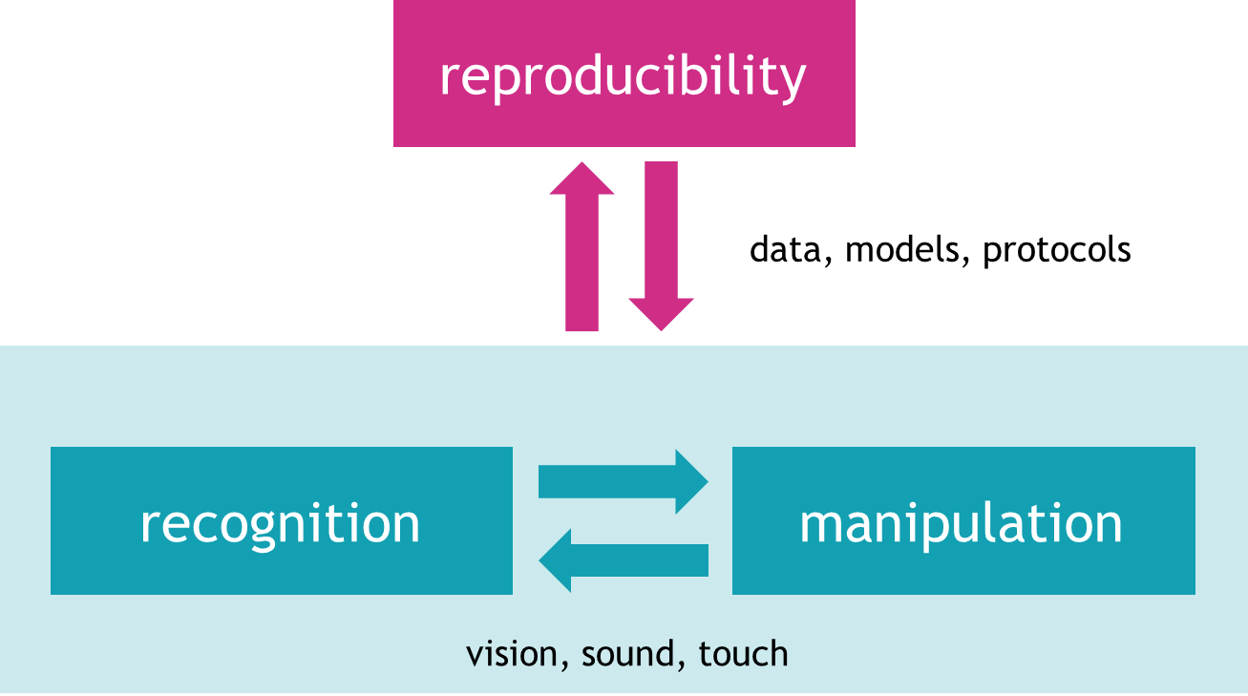
Objectives
To define learning architectures
for multimodal sensory data
for aggregated data from different environments
To learn and adapt across manipulators, tasks, sensing configurations and environments
To continually improve the adaptability and robustness of the learned models
To generalise capabilities across tasks and sites
@corsmal
http://corsmal.eecs.qmul.ac.uk

Slide 7
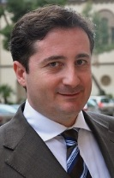
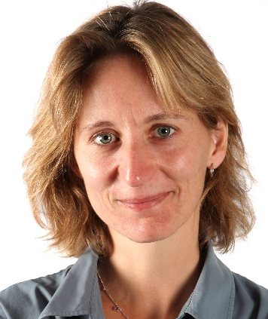
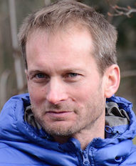
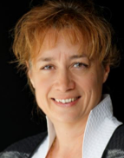


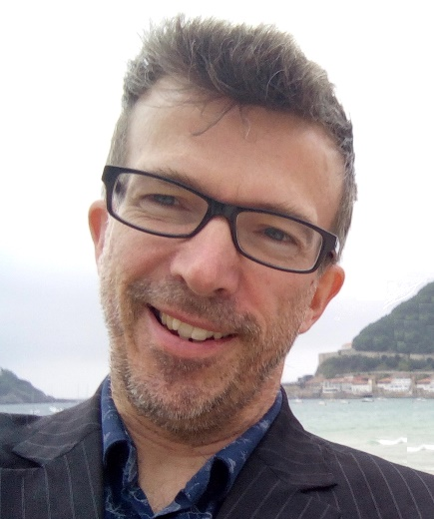
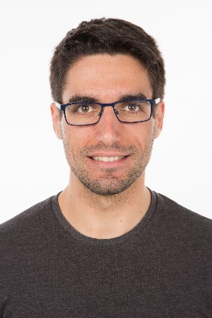

Team
Partners
Sponsors
Andrea
Aude
Pascal
Véronique
Kaspar
Ricardo
Apostolos
Konstantinos
Contact:
a.cavallaro@qmul.ac.uk

