Slide 1
Journey to Net Zero
How Lloyds can support Small and
Medium Enterprises becoming
Net Zero
Ariana Vass

Slide 2


SME Area chosen
Small enterprises (10-49 employees)
Why I chose small enterprises
Small enterprises typically possess enough employees to assign dedicated sustainability responsibilities to one or two staff members. Conversely, micro enterprises often lack the necessary manpower to accommodate such dedicated roles. Furthermore, small enterprises find it comparatively easier to implement significant changes due to the presence of a smaller workforce.
Existing solutions:
Lloyds offers an extensive array of resources designed to assist small and medium enterprises (SMEs) in achieving Net Zero goals. These resources encompass various guides on enhancing sustainability as a business, as well as an SME Net Zero monitor. My objective is to condense this information into easily comprehensible and sector-specific segments.
Notes:
Small enterprises definition: https://assets.publishing.service.gov.uk/government/uploads/system/uploads/attachment_data/file/961722/SME-Action-Plan.pdf pg.5
Existing solutions:
https://www.lloydsbank.com/assets/assets-business-banking/pdfs/from_now_to_net_zero.pdf pg.25-30

Slide 3

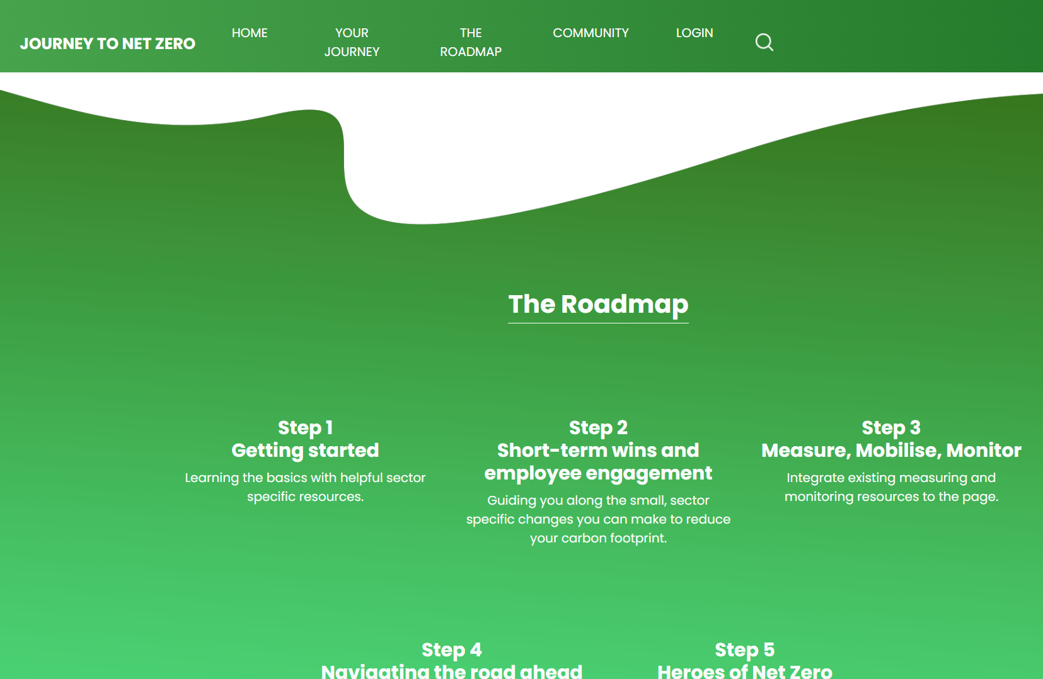
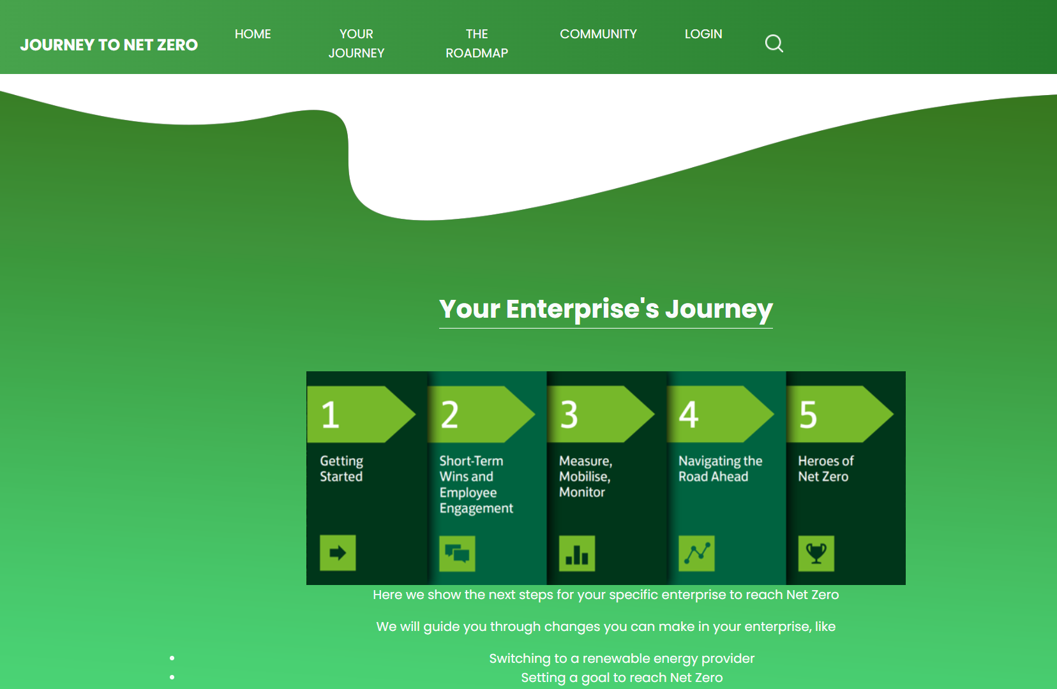

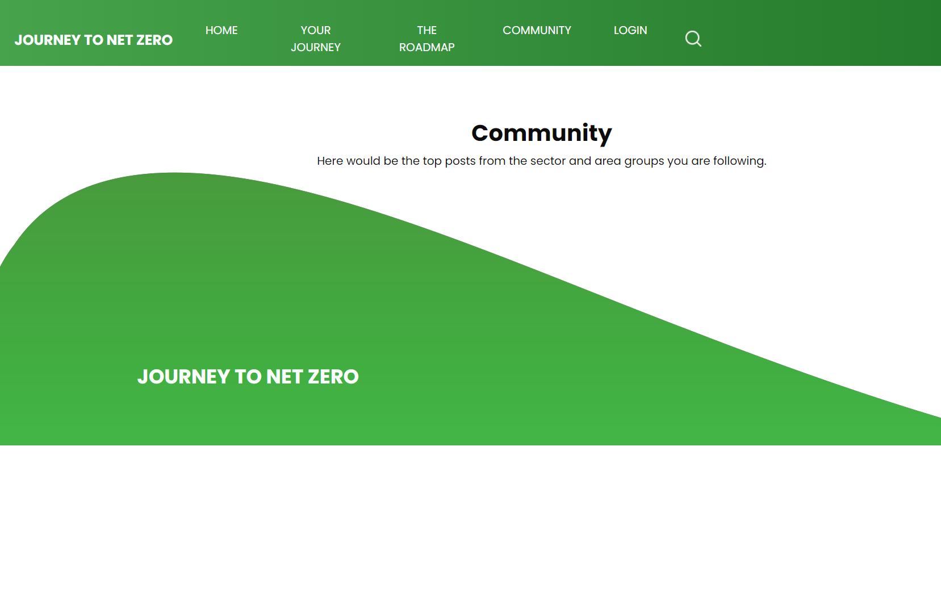
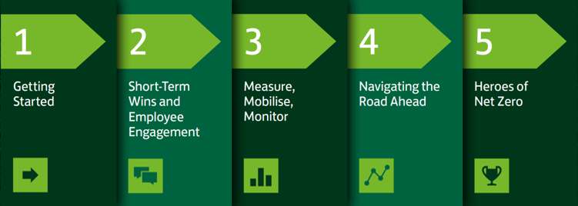
My solution!
To do this, I have created a website that guides enterprises through the existing “Roadmap to SME Net Zero”.
Features:
Learning resources
Goal setter
Monitoring resources
Community board, and sector and area specific groups
Net Zero certification
Lloyds’ Roadmap:
journeytonetzero-arianavass.tiiny.site
Notes:
Small switches you can make:
https://www.herts-iq.co.uk/10-tips-to-help-your-business-reach-carbon-net-zero/
https://www.british-business-bank.co.uk/finance-hub/business-guidance/sustainability/net-zero-how-being-carbon-neutral-can-help-your-business-grow/
https://greenly.earth/en-gb/blog/company-guide/carbon-accounting-all-you-need-to-know-in-2022
Lloyd’s roadmap:
https://www.lloydsbank.com/assets/assets-business-banking/pdfs/from_now_to_net_zero.pdf pg.21

Slide 4

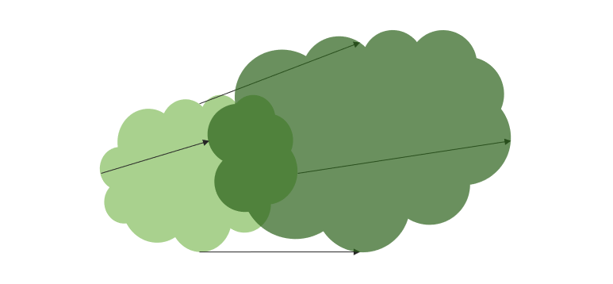
Business Model
Feasibility
Given the abundance of existing resources on the Lloyds website, the task at hand may appear less daunting than initially perceived. The primary effort would involve the organization and condensation of these resources into sector-specific categories. Hence, I believe this endeavour is highly achievable.
Scaling
This solution holds significant potential for scalability and adaptability, particularly for medium-sized enterprises. It is important to consider that the modifications and adjustments they can implement may differ from those applicable to small enterprises. However, extending the scalability to include micro enterprises presents certain challenges, as it necessitates increased automation due to limited human resources available for dedicated implementation.

Slide 5
Thanks !

