Slide 1
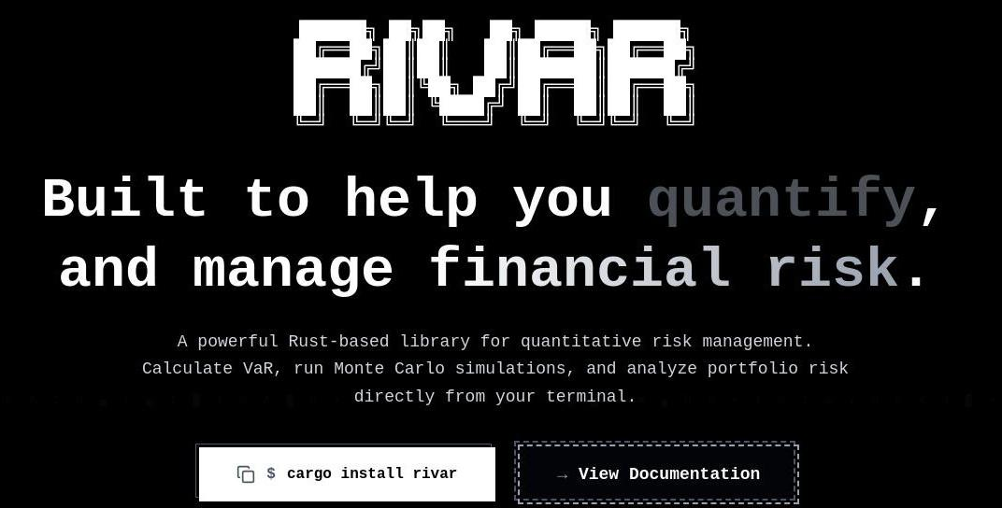

Slide 2
RiVaR
By Anany Mishra,
Asmi Singh,
Harman S. Goodluck,
Tanishq Singh
Guided By - Dr. Juhi Chaudhary
Department of Computer Science and Engineering,
Shri Ram Murti Smarak College of Engineering and Technology.

Slide 3
About RiVaR
RiVaR is a Rust-based quantitative and computational risk management framework designed to model, simulate, and evaluate portfolio risk using mathematically rigorous methods and high-performance numerical computation.

Slide 4
Meaning of all Buzzwords involved

Slide 5
Risk
Market Risk - risk associated with fluctuations in value of traded assets.
Credit Risk - risk associated with uncertainty that debtors will honour their financial obligations.
Operational Risk - risk associated with possibility of human error, IT failure, dishonesty, natural disaster, etc.

Slide 6
Portfolio
In general we consider a portfolio which might be
a collection of stocks and bonds;
a collection of derivatives
a collection of risky loans;
a financial institution’s overall position in risky assets.

Slide 7
Quantitative Risk Management
A finance discipline that uses mathematical models and statistical techniques to measure and manage financial risk.
Value at Risk (VaR)
Market risk analytics
Primary Goal: Model financial risk using mathematical theory.

Slide 8
Computational Risk Management
An implementation-focused approach that applies algorithms, numerical methods, and high-performance computing to solve risk models efficiently.
Performance optimization
Numerical stability
Large-scale portfolio simulation
Primary Goal: Compute risk models efficiently, reliably, and at scale.

Slide 9
Value at Risk (VaR)
If we say: The 95% one-week VaR is ₹50,000
It means: In 95 out of 100 weeks,
The loss will not exceed ₹50,000.
Only 5% of the time will losses be worse than ₹50,000.
It does NOT mean we cannot lose more. It means losing more is statistically rare.
Value at Risk tells us the maximum expected loss over a given time period, with a certain level of confidence.

Slide 10
Monte Carlo
Suppose you want to know: “What could happen to my investment next month?”
But markets are uncertain. Prices move randomly. Instead of predicting one future…
We simulate thousands of possible futures.
Monte Carlo simulation means running thousands (or millions) of possible future scenarios to see what could happen.

Slide 11
VaR vs Monte Carlo
Imagine predicting your total score after rolling a dice 100 times. Instead of solving complex probability equations:
You simulate:
Roll the dice 10,000 times (on a computer)
Record the results
Observe the distribution
And understand:
Most likely outcome
Worst 5% outcomes
Rare extreme cases
That’s Monte Carlo.
In markets:
Prices fluctuate daily
Returns are uncertain
Volatility changes
So instead of guessing one outcome:
We simulate thousands of price paths:
Generate random market movements
Calculate portfolio value in each scenario
Observe worst losses
Then we compute VaR from those simulated losses.

Slide 12
VaR vs Monte Carlo
Now combine both concepts:
VaR tells us “how bad could losses get?”
Monte Carlo helps us estimate that when reality is too complex.
So: Monte Carlo is the method. VaR is the result.
Value at Risk estimates the worst loss we expect within a certain confidence level
Monte Carlo simulation helps us estimate that loss by simulating thousands of possible future market scenarios.

Slide 13
The Problem
Most quantitative risk models:
Are developed in academic environments
Assume ideal conditions
Ignore computational scalability
Are implemented in slow prototyping environments
Strong theory, weak systems integration.
Theoretical Models ≠ Practical Systems

Slide 14
The Problem
Modern financial risk analysis requires:
Large portfolio simulations
Monte Carlo with millions of paths
Backtesting over years of historical data
Python/R-based systems often:
Struggle with memory efficiency
Require heavy optimization
Lack low-level control
Depend on external C/C++ bindings
Performance Bottlenecks in Risk Computation

Slide 15
The Problem
Quant libraries focus on models
Systems languages focus on performance
Few libraries integrate both natively
There is no unified, Rust-native framework that:
Implements rigorous risk theory
Ensures memory safety
Provides high-performance computation
Is production-ready
Fragmented Tooling

Slide 16
The Solution
Rivar introduces a **layered architecture** that separates:
Mathematical model definitions
Numerical computation engine
Interface & integration layer
This ensures:
Mathematical rigor is preserved
Computational execution is optimized
Models are deployable in production systems
Quantitative models remain theoretical or prototype-level.

Slide 17
The Solution
Rivar implements:
Parallel Monte Carlo simulation
Memory-efficient data structures
Quantile-based VaR computation using selection algorithms
Configurable simulation scale NNN
Result:
Scalable simulation for large portfolios
Reduced computational overhead
Real-time or near-real-time risk recalculation
Monte Carlo and portfolio simulations are computationally expensive.

Slide 18
The Solution
Financial systems demand:
Deterministic behavior
No memory leaks
Safe concurrency
Numerical precision
Rivar leverages Rust’s:
Ownership model
Compile-time safety guarantees
Absence of garbage collection pauses
Strong type system
Result: Reduced runtime risk in financial software infrastructure.
Reliability & Systemic Safety

Slide 19
Unified Quantitative + Computational Framework
Rivar Integrates
Quantitative Layer | Computational Layer
VaR definitions | Parallel simulation engine
CVaR estimation | Efficient quantile selection
Historical models | Memory-safe data pipelines
Stochastic processes | Multi-threaded execution

Slide 20
Vision Behind
Rivar can evolve into:
A full risk analytics framework
A research platform for financial modeling
A backend engine for financial institutions
An open-source computational finance ecosystem in Rust
Rivar is not just an academic project. It is a structured attempt to transform financial risk theory into a scalable, production-ready computational system. By combining mathematical modeling with modern systems engineering, it aims to bridge research and real-world deployment.

Slide 21
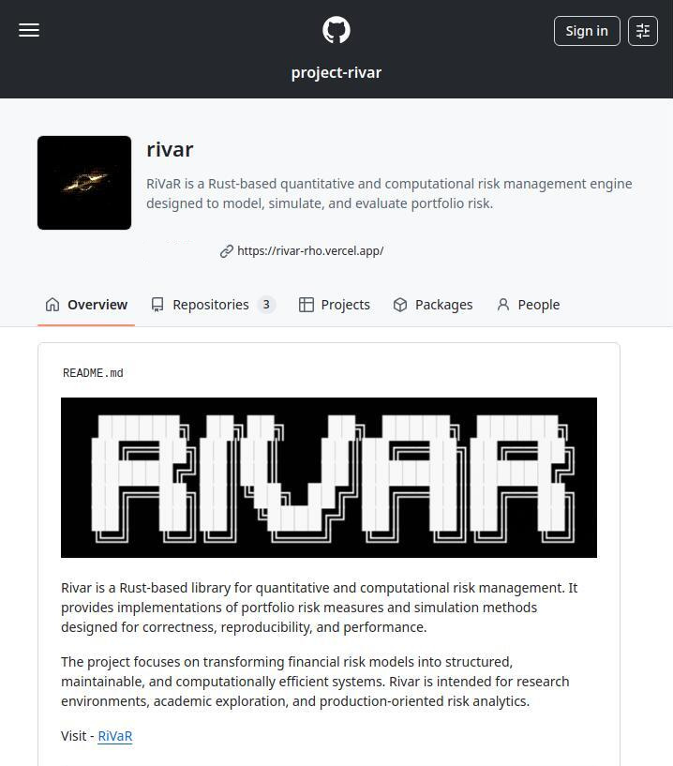
Documentation
Rivar is being developed as an open-source project. View
The intention is to make the framework transparent, reviewable, and open to academic and community contributions. As the project evolves, documentation, examples, and implementation details will be publicly available.
You are welcome to:
Review the documentation
Explore the source code
Suggest improvements
Contribute ideas or extensions
Use it for research or experimentation
Feedback, discussion, and collaboration are encouraged.

