Slide 1
NutritionSense
Data-Driven Analysis of Dietary Patterns and Health Risks
Submitted by
Ria Varsha N – RA2311026050033
Priyaavarshiny M – RA2311026050081
Course: Data Science
Department: CSE with AIML
Class: III AIML B
Year: 2026

Slide 2
Introduction
Rise in lifestyle diseases such as obesity and diabetes has become a major global health concern due to changes in modern living conditions and daily habits
Caused by poor diet and lack of physical activity
Need for analyzing dietary patterns
Data analytics helps identify hidden trends
Traditional methods are not sufficient to capture complex relationships between lifestyle factors and health risks
It enables better understanding of how different factors such as diet, activity, and behavior contribute to overall health

Slide 3
Problem Statement
Unhealthy eating habits are increasing
Difficulty in identifying health risks manually
Need for automated and data-driven analysis
Goal: Predict health risks using lifestyle data
Unhealthy eating habits are increasing rapidly due to changing lifestyles and greater dependence on processed and fast foods, which significantly impacts overall health. Identifying health risks manually is often difficult and inefficient, as it fails to capture complex relationships between multiple lifestyle factors. Therefore, there is a strong need for automated and data-driven analysis methods that can process large datasets and uncover meaningful patterns. This project aims to address this gap by predicting health risks using lifestyle and dietary data, enabling more accurate and efficient health assessment.

Slide 4
Objectives
Analyze dietary and lifestyle data
Identify patterns affecting health
Visualize relationships between features
Build a predictive machine learning mode
The project focuses on analyzing dietary and lifestyle data to gain a comprehensive understanding of factors influencing individual health outcomes. By examining this data, it aims to identify key patterns and trends that contribute to health risks such as obesity. l

Slide 5
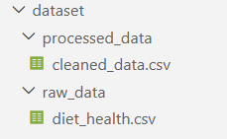
Dataset Description
Dataset contains dietary and lifestyle features
Key features include:
Age
Eating habits
Physical activity
Water intake
Target variable:
Obesity level (NObeyesdad)

Slide 6
Data Preprocessing
Data preprocessing was carried out to ensure the quality and reliability of the dataset before analysis. Missing values were identified and removed to prevent inconsistencies and inaccuracies in the results, while duplicate records were eliminated to maintain data integrity. Categorical variables were converted into numerical form using appropriate encoding techniques, enabling effective processing by machine learning algorithms. Finally, the cleaned and transformed dataset was prepared for further analysis and model development, ensuring improved performance and accuracy
Removed missing values
Removed duplicate records
Converted categorical data to numerical
Prepared dataset for analysis

Slide 7
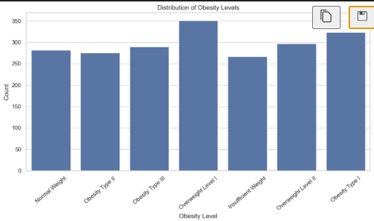
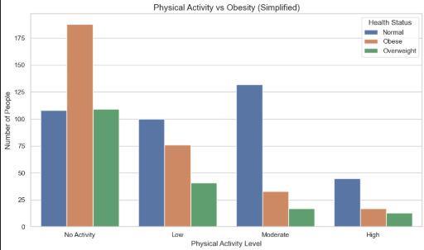
Data Visualization

Slide 8
Model Building
Algorithm: Random Forest Classifier
Data split into training and testing sets
Model trained on the prepared dataset
Suitable for complex, multi-feature data
The project utilizes the Random Forest Classifier as the primary machine learning algorithm due to its ability to handle complex and high-dimensional data effectively. The dataset is divided into training and testing sets to ensure proper evaluation of the model’s performance. The model is trained using the prepared dataset, allowing it to learn patterns and relationships between features. Due to its ensemble nature, the Random Forest algorithm is highly suitable for handling multi-feature data and provides robust and accurate predictions.

Slide 9
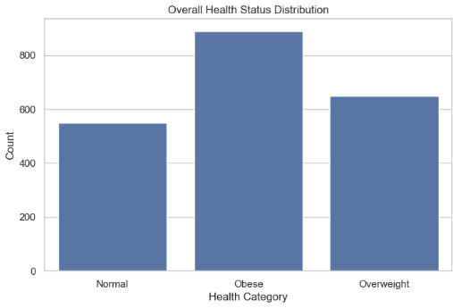
Results
~96%
Model Accuracy
Predictions match actual values
Model performs effectively on test data
Random Forest classifier proved highly reliable

Slide 10
Key Insights
The analysis indicates that lower levels of physical activity are strongly associated with higher obesity rates, highlighting the importance of regular exercise. Poor dietary habits, including high consumption of unhealthy and processed foods, significantly increase the risk of various health issues. Adequate water intake plays a crucial role in maintaining proper body functions and overall health. Overall, lifestyle choices, including diet, physical activity, and daily habits, have a significant influence on determining long-term health outcomes.
Low physical activity → higher obesity rates
Poor diet → increased health risks
Water intake significantly impacts overall health
Lifestyle strongly influences health outcomes

Slide 11
Conclusion
Dietary habits play a crucial role in determining overall health, as consistent consumption of unhealthy foods can lead to serious lifestyle-related diseases. Machine learning techniques provide an effective approach for accurately predicting health risks by analyzing complex relationships within the data. By leveraging these technologies, it becomes possible to identify potential issues at an early stage. Furthermore, data-driven analysis enhances public health awareness by offering meaningful insights, enabling individuals to make informed decisions and adopt healthier lifestyle practices

Slide 12
Future Work
Use larger and more diverse datasets
Add more health parameters for better prediction
Build a real-time health risk prediction system
Develop a mobile or web application for end users
The development of a real-time health risk prediction system would enable continuous monitoring and early detection of potential health issues. Additionally, creating a user-friendly mobile or web application can make the system accessible to end users, promoting better health management and awareness.

