Slide 1

THE BIG LEAGUE
Hackathon 2026
OPEN PAYMENTS

Slide 2
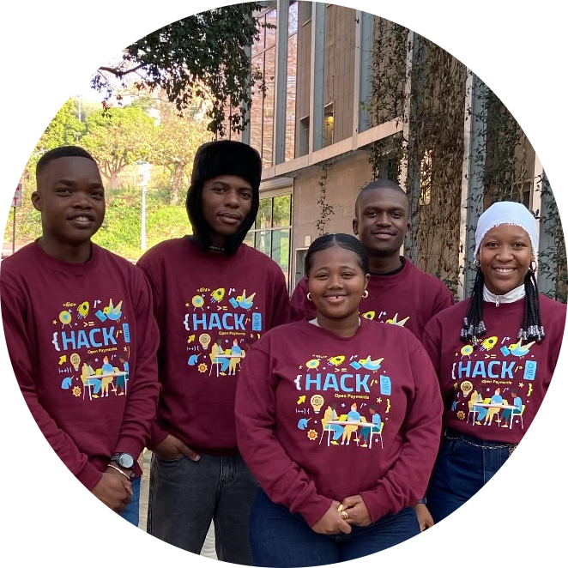
Meet the team
Voucher2
Buqwana Xolisile
Mathiane Karabo
Ndwandwa Lisakhanya
Khakhu Rialivhuwa
Mbhokane Kwazi

Slide 3
Problem statement
Voucher shortfalls trigger checkout failures.
Legacy infrastructure blocks instant top-ups.
Merchants lose critical sales conversion.
Open Payments Interledger streams unified payment sources.

Slide 4


Solution
`
Check for eligible Vouchers
`
Yes
Purchase X
from A
Check for eligible voucher funds
Deduct from
voucher balance
Merchant
No
Redeem entire voucher amount.
Top-up paid from customer wallet.

Slide 5
Solution
Uses Interledger to compose funds in the user's wallet.
Merchants keep existing systems unchanged.

Slide 6
Conclusion
Deliver a seamless, interoperable voucher payment system for all users.

Slide 7
Thank you.

