Slide 1
Python From Scratch
By
Ria Umahiya

Slide 2
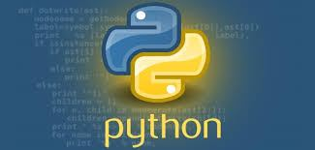
Discovery
Python was discovered in the late 1980’s and in 1990’s early.
The Founder of Python is Guido Van Rossum and he first released it in 1991.
It was found at the Centrum Wiskunde & Informatica(CWI) in Netherlands.
Python is a Interpreted and Dynamically Typed Programming language.
Its language constructs and object oriented approach help write clear, logical code for small and large-scale projects.
The Python Language is indicated by the below logo :

Slide 3

Introduction
Keywords are the predefined words that are designed to do a specific task. There are 35 such keywords in python. Ex: for,from,if…etc.
Variable is a named memory location where the value is stored and the name is called a variable name which is given to identify the memory location.
Ex: varname = value
Identifiers is a name to identify the memory location. It starts with alphabet or an underscore.
Datatypes specify what is the type of data that is present inside the variable. These are categorized into two types :
Single valued type
Collection type

Slide 4
Single Valued Type
Integer or int can store only numeric data(+ve or –ve) with no decimal part.
Float is used to store numeric value with decimal part and it can be (+ve or –ve).
Complex datatype is used to store equations like a+bj where a is real part and bj is imaginary part.
Boolean or bool is used to store the Boolean values of True and False.

Slide 5
Collection
String is a collection of data items and are enclosed between the pair of ‘ ’, “ ”.
Ex: var = ‘val1,val2,val3….valn’
List is a collection of homogeneous and heterogeneous data items and is enclosed in [ ].
Ex: var = [1, 4, ‘hello’, 2.4]
Tuple can also store homogeneous and heterogeneous data items but is enclosed in ( ).
Ex: var = (val1,val2,val3….valn)
Set is a homogeneous and heterogeneous collection of non-repetative data item enclosed in { }.
Ex: var = {val1,val2,val3….valn}
Dictionary is a collection of key value pair and enclosed in { }. The key and value are separated by : .
Ex: var = {k1:v1, k2:v2,………..kn:vn}

Slide 6
Typecasting And Operators
Typecasting is the phenomenal of converting the data from one type to another type.
The present type is the source type and the converted type is the destination type.
To covert the data from one type to another type we use the syntax:
Var = datatype (data/var)
Operators are the special symbol that are predefined with an operation.
Based on the Operation Operators are classified into five different types.

Slide 7
Types of Operators
Arithmetic operators are used to perform the arithmetic operations such as +, -, *, /.
Logical operators perform the operations on the Boolean values and these are AND, OR, NOT operators.
Relational operator is used to check the relation between the values and these operators are <,>,==,!=,>=,<=.
Bitwise operator is used to work on the binary bits of given number and these are |(bitwise or), ~(bitwise not), ^(bitwise XOR)
Membership Operator is used to check whether the value is Present in the collection or not. There are two membership operator
IN
NOT IN

Slide 8
Control Statements
Generally the flow of execution of program will happen in the top to bottom approach by deafault. If ever we want to change that we go for control Statements.
There are two types of control statements :
Decisional Statements
Looping Statements

Slide 9
Decisional Statements
Decisional statements are the control statements which are used to change the flow of execution of the program based on the decision taken at a particular condition.
There are four Types of decisional statements in python :
if statement
if else statement
elif statement
nested if statement

Slide 10
Looping Statements
Looping statements are the set of statements that are used to repeat the set of instructions again and again until the given condition is satisfied.
Condition is the entry as well as the exit point of a loop
There are two types of looping statements :
for loop
while loop

Slide 11
Functions/Methods
Functions are the named blocked of instructions that are created and designed to do the specific task.
Functions helps in reducing code redundancy problem. “Def” is a keyword to create the named block.
The function are created by using the syntax :
Syntax : def name_of_function(arguments):
block of instructions
return()
There are four types of functions

Slide 12
Types Of Function
Function without argument without return type.
Function without argument with return type.
Function with argument without return type.
Function with argument and with return type.

Slide 13
Local, global And Non Local Variables
Local variables are those variables whose scope is restricted only to the block where it is created.
Usually all the variables and arguments that are present or created inside the function are called as local variable.
Global variables are stored in the mainspace and can be accesed from any part of the program by using keyword caleed global.
Before using the variable we should specify the variable as global variable.
The non local variable are created in the outer function and will be created in the inner function.
To create variable of such type we use a keyword called non-local.

Slide 14
Decorators
Decorators are the set of functions which gives additional feature to the function.
Whenever there is a need to perform some set of operations before the execution of the function and after the execution of the function we use decorators to a function.
There are two types of decorators :
Built-in Decorators
User defined Decorators

Slide 15
Recursive Function
A function calling itself until the given condition is satisfies is called as recursion.
And the function following this is called is called recursive function.
For every execution the value that are their in the function keeps on getting modified.

Slide 16
Packing And Unpacking
Packing and unpacking is used while sending and receiving the data.
Packing is the process of grouping the collection of data items into single data item. This can be done by using any collection datatype but the most suitable is tuple.So packing is done in the form of tuple.
Unpacking is the process of extracting the data present in the collection and giving individual priority to each and every data item present in the collection.
If we pack the pair of data packing will be done in the form of dictionary and while unpacking first the keys will be unpacked and then the values.

Slide 17
Generic Arguements
Generic arguments is a combination of packing and double packing so the application will have the ability to accept n no of arguments which are in the form of tuple and dictionary.
The mandatory arguments are stored as tuple and the non mandatory as dictionary.
At the receiving end we will be getting the mandatory arguements as *args and non mandatory as **kwargs.

Slide 18
Terminologies Used For Ide
Import : Import in python is similar to #include header file in C/C++. Python modules can get access to code from another module by importing the file/function using import. The import statement is the most common way of invoking the import machinery
example : import pandas import matplotlib.pyplot as plt ,
package package name for function

Slide 19
Object Oriented Programming
The Programming that deal with real world’s entities data to perform some action is known as Object Oriented Programming.
The language use for the process is called as object oriented programming language.
The OOP concepts approaches the problem solving by creating classes and objects.

Slide 20
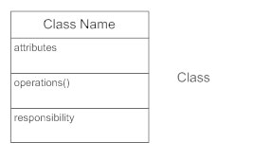
Class
Class is a user defined datatype with the states and behaviours of real world entity.
States are the properties and behaviours are the functionalities.
Class is a blueprint of the object.
Class tells us about what to do and what to store.
The class is represented by a diagram called as class diagram:

Slide 21
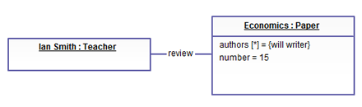
Object
Object is a real world entity that stores all the information which is specified by a real world entities
Object stores the information about the real world entities.
An object is created with the syntax :
Syntax : objectname = classname(arguments)
The object diagram is as follows:

Slide 22
Constructor
Constructor is used to do the initialization of the specific variables.
Constructor does not return any value and is used for the initialization proxess.
The constructor should have atleast one argument to store the address of an object where the insertion need to be done.
The constructors are called automatically during the object creation.

Slide 23
Object Oriented Principles
Inheritance is the phenomenon of deriving the properties of one class to another class.
The class from which properties is inherited is called parent class or base class or super class.
The class to which properties is inherited is called as child class or derived class or sub class.
All the members of super class will be inherited in the sub class.
Syntax : class Parentname1:
class Parentname2:
class Parentname n:

Slide 24
Constructor Chaining
Constructor chaining is the phenomenon of invoking the constructor of parent class from the constructor of child class.
The constructor chaining can be done in two ways :
By using classname
parentclassname.__init__(self,arguments)
By using super
super().__init__(arguments)

Slide 25
Types Of Inheritace
There are five types of inheritance in python
They are as follows :
Single Inheritance
Multiple Inheritance
Multilevel Inheritance
Hybrid Inheritance
Hierarchical Inheritence

Slide 26
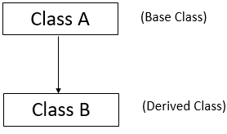
Single Inheritance
The phenomenon where one class gets derived to another class is called as single inheritance.
The syntax is as follows :
class parent :
class child(parent):
The diagram of single inheritance is as follows :

Slide 27
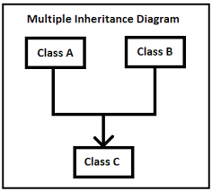
Multiple Inheritance
A type of inheritance where multiple classes will get inherited to a single class.
In multiple inheritance we can have n number of parent classes but only 0ne child class.
The syntax is as follows :
class child(parent1, parent2,……parent n)
The diagram of multiple inheritance is as follows :

Slide 28
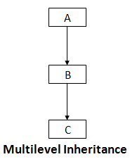
Multilevel Inheritance
Multilevel inheritance is a type of inheritance which happens in the forms of level.
In this we can find child, parent, grandparents and great grandparents etc.
The syntax is as follows:
The diagram of multilevel inheritance is as follows:
Level 1
Level 2
Level 3

Slide 29
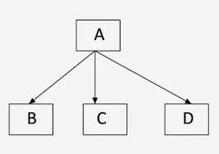
Hierarchical Inheritance
Hierarchical inheritance is a type of inheritance where a single class is derived to multiple classes.
In this inheritance for one parent there will be n no of child.
The syntax is as follows :
The diagram of hierarchical inheritance is as follows:
Parent
Child 1
Child 2
Child 2

Slide 30
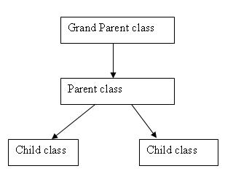
Hybrid Inheritance
It is a type of inheritance where all types of inheritances are grouped together and become one.
Hybrid inheritance is a combination of all type of inheritances that are present.
The diagram of hybrid inheritance is as follows:

Slide 31
Access Specifiers
As the name says access specifiers are going to specify where the data can be accessed and where it cannot.
There are three different access specifiers in python :
Public is an access specifier where the members can be accessed from any part of the program such as public methods ,functions and variables are known as public members.
Protected members can be accessed and modified within the same package where it is created. The name of these members must start with ‘_’(underscore). These members work similarly as public members.
Private members can be accessed only within the class where it is created. Private members must start with “__”(double underscore).

Slide 32
Method Overloading
The phenomenon of invoking the method with the same name but difference in nature is known as method overloading.
In other words, if their exists method with same name but difference in no. of arguments and types of argument such method will be invoked and the phenomenon is called method overloading.
Ex. : def add(a,b):
return a+b
Ex. : def add(a,b,c):
return a+b+c

Slide 33
Method Overiding
The phenomenon of overiding the address present in the method variable with address of the method which is in the same name.
This occurs when multiple methods has the same name but different signatures.
The address of the older method is overided by the newly created method.
Ex. : def display():
print(“older display is called”)
print(display)
def display():
print(“newer display is called”)
print(display)
display()

Slide 34
Operator Overloading
Operator overloading is the phenomenon of changing the behaviour of an operator to make operators work on custom data type.

Slide 35
Iterators
Iterators are used to traverse through the sequence and produce the values one after the other from the collection.
Two main functions responsible for traversing is iter[ ] and next[ ].
Iter is responsible for initialization of a variable to the initial value.
Next is responsible for traversing through the sequence.
Ex. : var = iter(collection)
next(var)

Slide 36
Generators
Generators are the functions that are used to create a sequence by giving the element one after the other by using yield keyword.
Iterators are used to traverse through the sequence and generators are used to create the sequence.
Yield keyword is used to hold the current state of execution.
Ex. :def fn( ):
print(“before yield 1”)
yield1
print(“before yield 2”)
yield2
var=fn( )
i=iter(var)
print(next(i))

Slide 37
Exception Handling
An exception is an interruption in the flow of the program.
Exceptions stops the flow of execution of the program.
In python, exception handling has three blocks :
The block where you identify or suspect the excepton is known as try block.
The block where you give a solution when an exception is arised is written inside except block
There will be some statements that will get executed either an exception is arised or not they are writtem inside finally.

Slide 38
File handling
File is a storage location where we can store the data permanently.
We can store data in different format like .txt, .pdf, .doc etc.
To interact with the file we can perform operations like read, write and append on the file.
The read can perform the read(r), read and write(r+), read binary (rb)operations.
The write can perform the write(w), write and read(w+), write binary (wb)operations.
The append can perform the append(a), append and read(a+), append binary (ab)operations.

Slide 39
Regular expression
Regular expression are the generalised form of representing the data.
Regular expression is string made of set of special symbols.
These symbols have predefined value or predefined meaning.
Regular Expression is mainly used to do the pattern matching and pattern is a string.
Whenever we want to fetch the required data from the collection of data we go for Regular expression.
It is a concept in every programming language to do apttern matching.

Slide 40
JSON
The transfer of data from one source to another without changing the actual format is done in JSON format.
JSON format is represented as key and value pair within { }.
The key should be in the form of string.
In JSON dump convert and stores the data and dumps converts the data.
Similarly, load is used to convert the data which is read from JSON file and loads takes file obj as a argument and directly reads the data from JSON file and converts the data.

Slide 41
Pickle And Unpickling
To encrypt and decrypt the data python provides a buil-in module pickle and unpickling.
The process of converting the data into encrypted format is known as pickling process.
The process of converting the encrypted data into decrypted format is known as unpickling process.

Slide 42
Assertion
Assertion is the process of compairing and throwing and exception.
Whenever we perform unit testing operation and if it is not matched with the expected result we throw an assertion error.
Assertion error is generally thrown while doing unit testing if the result is not matched with the specified result.
Assertion can be done by the keyword called ‘assert’.

Slide 43
About ides
IDLE
Sublime Text 3
Atom
PyCharm
Spyder
Vim

Slide 44
Python Extended in Fields
Web and Internet Development
Desktop GUI Applications
Scientific and Numeric Applications
Software Development Application
Python Applications in Business
Database Access
Network Programming
Games and 3D Graphics

Slide 45
Thank You!

