Slide 1
TABLE OF CONTENTS
Outline.
I
Physical setup & dataset
Brushed DC motor + vertical rod load; excitation & sensor-noise design.
II
ML1 — Motor identification
[Friend's section] Identification of motor dynamics.
III
ML2 — Speed filtering
Neural filter (GRU / CNN / TCN) vs EMA & Kalman; nonlinear-plant gain.
IV
Conclusion
Key numbers, takeaways, and future directions.

Slide 2
03 ML2 — SPEED FILTER: TASK & DATA
Denoise the speed of a nonlinear plant.
Recover the true motor speed from a noisy speed sensor and the known command voltage. The vertical rod adds a gravity torque ∝ sin θ, making the mechanics nonlinear and state-dependent — the property a learned filter can exploit.
(J + I_rod)·dω/dt = Kt·i − B·ω − m·g·l_cm·sin(θ) ← gravity = nonlinearity
input x = [ omega_noisy , voltage ] target y = omega_true
— 210 trajectories, 6 s @ 1 ms, split 70/15/15 by trajectory — no time-step leaks between train and test.
— Excitation cycles step / ramp / random / mixed bipolar voltage; motor R, J, B jittered ±12% per run.
— Sensor noise std 2–4 rad/s on a 21 rad/s swing → SNR ≈ 7× (14% noise).
— A chirp excitation is held out entirely for an out-of-distribution generalisation test.

Slide 3
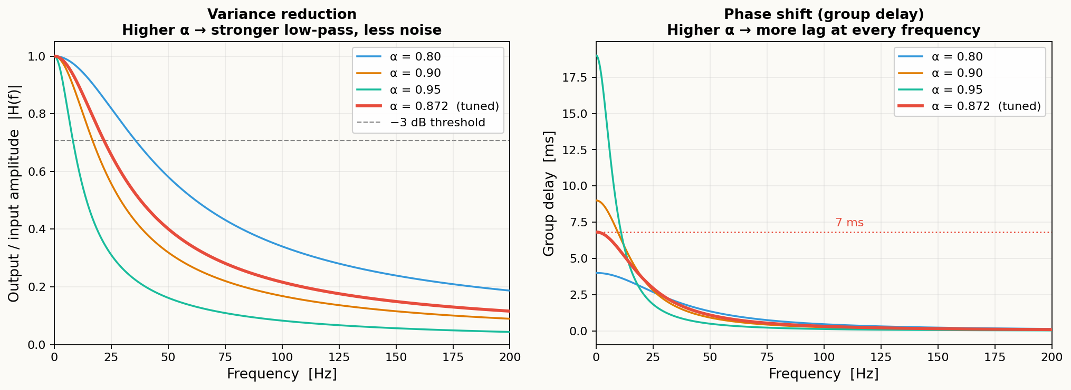
04 ML2 — EMA BASELINE: VARIANCE VS DELAY
Smoothing always costs delay.
The EMA is a causal first-order IIR low-pass filter with a single knob α. Higher α smooths more aggressively (lower output variance) but also pushes the filter's phase lag higher — the two effects are inseparable.
y[t] = (1 − α)·x[t] + α·y[t−1] H(z) = (1−α) / (1 − αz⁻¹)
Var(y)/Var(x) = (1−α)/(1+α) DC delay = α/(1−α)·dt
Tuned α = 0.872. Noise std cut to ~26% of raw (variance × 0.068) — but at 7 ms DC lag. Both figures share the same α axis: you cannot get one without paying for the other.
Left: amplitude response |H(f)| — higher α narrows the passband (less noise). Right: group delay τ(f) — same α inflates lag at every frequency.

Slide 4
04 ML2 — METHODS
Classical baselines vs learned filters.
Baselines tuned on validation, evaluated on test: EMA (α tuned) and a steady-state Kalman filter on the nominal linear [i, ω] model — whose model omits the gravity term. Three learned filters share the same causal 64 ms window over [omega_noisy, voltage].
GRU
GRU (3 489 params)
Recurrent hidden state accumulates 64 ms of context. hidden = 32, 1 layer.
CNN
CNN (8 801 params)
Stacked causal 1-D convolutions. channels = 32, k = 8, depth = 2.
TCN
TCN (33 153 params)
Dilated causal convolutions. Receptive field = 91 ms. channels = 32, k = 4, 4 levels.
all learned filters: x = (B, 64, 2) → scalar omega_true
loss = MSE optimiser = Adam (lr 1e-3) early stop on val

Slide 5
05 ML2 — RESULTS (IN-DISTRIBUTION TEST SET)
Learned filters cut error 51% below Kalman.
Raw — no filter | RMSE 2.97 rad/s (28.3 RPM) — reference
MA — window 64 | RMSE 3.00 rad/s (28.6 RPM) −1 % (just lag)
Kalman — tuned, linear model | RMSE 1.32 rad/s (12.6 RPM) +56 %
EMA — tuned α | RMSE 1.07 rad/s (10.2 RPM) +64 %
CNN | RMSE 0.80 rad/s ( 7.6 RPM) +73 %
GRU / TCN 🏆 | RMSE 0.65 rad/s ( 6.2 RPM) +78 %
Model-based ≠ better. The tuned linear Kalman (1.32) actually loses to a plain tuned EMA (1.07): its linear model can't represent the rod's gravity torque, so its model-mismatch outweighs its model-based advantage.

Slide 6
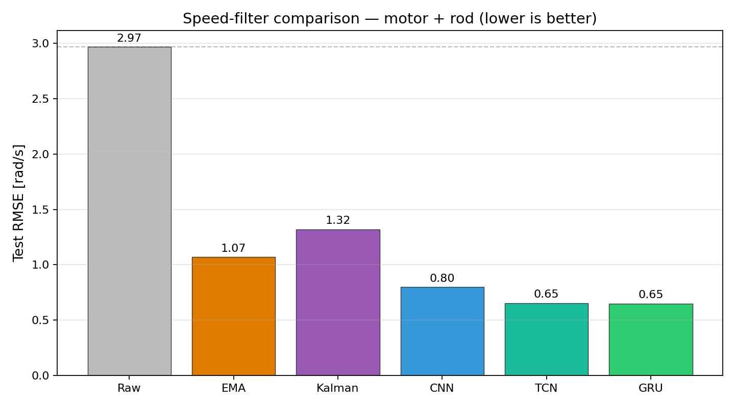
06 ML2 — COMPARISON
Every neural filter beats every classical one.
— A 64-sample moving average barely helps — the rod swings fast enough that its lag cancels its smoothing.
— EMA and Kalman land at 1.1–1.3 rad/s — a useful but limited linear fit.
— GRU / TCN reach 0.65 rad/s — a 78% cut from the raw sensor and 51% below the tuned Kalman.
Fig. 1 — test-set RMSE by method (motor + rod, lower is better).

Slide 7
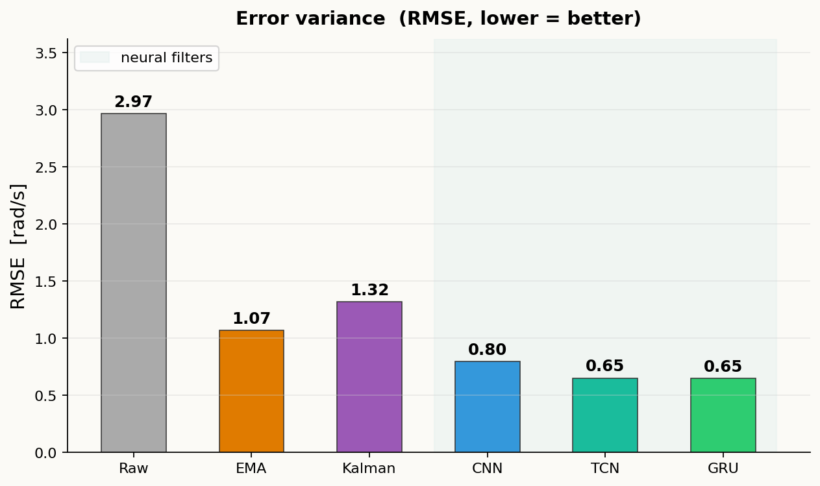
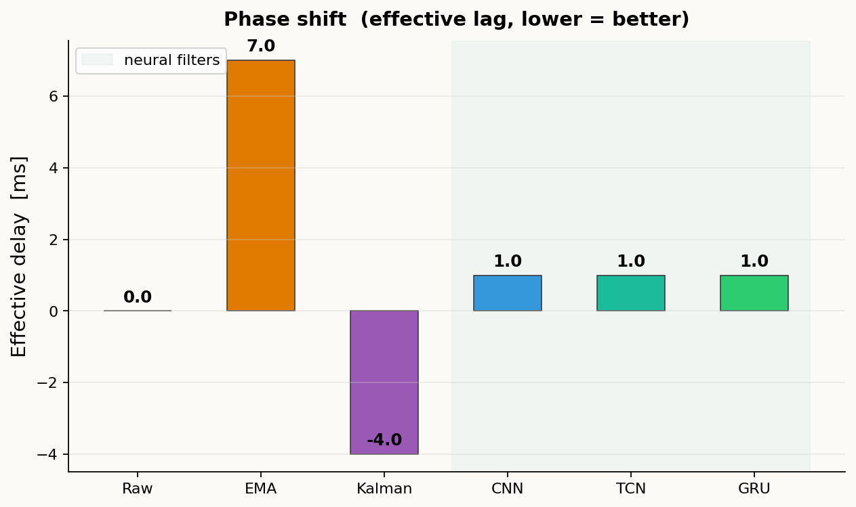
06b ML2 — RESULTS: VARIANCE & DELAY
Neural filters win on both axes.
Variance (RMSE) and phase lag (effective delay) are independent failure modes. A good filter must minimize both — not just one.
Error std (RMSE, rad/s) — lower is better
Effective phase lag (ms) — lower is better
EMA: 7 ms lag, GRU/TCN: 1 ms. EMA halves RMSE vs raw but costs 7 ms of lag at α = 0.872. Neural filters cut RMSE a further 39 % AND reduce lag to one sample — faster response, less noise.

Slide 8
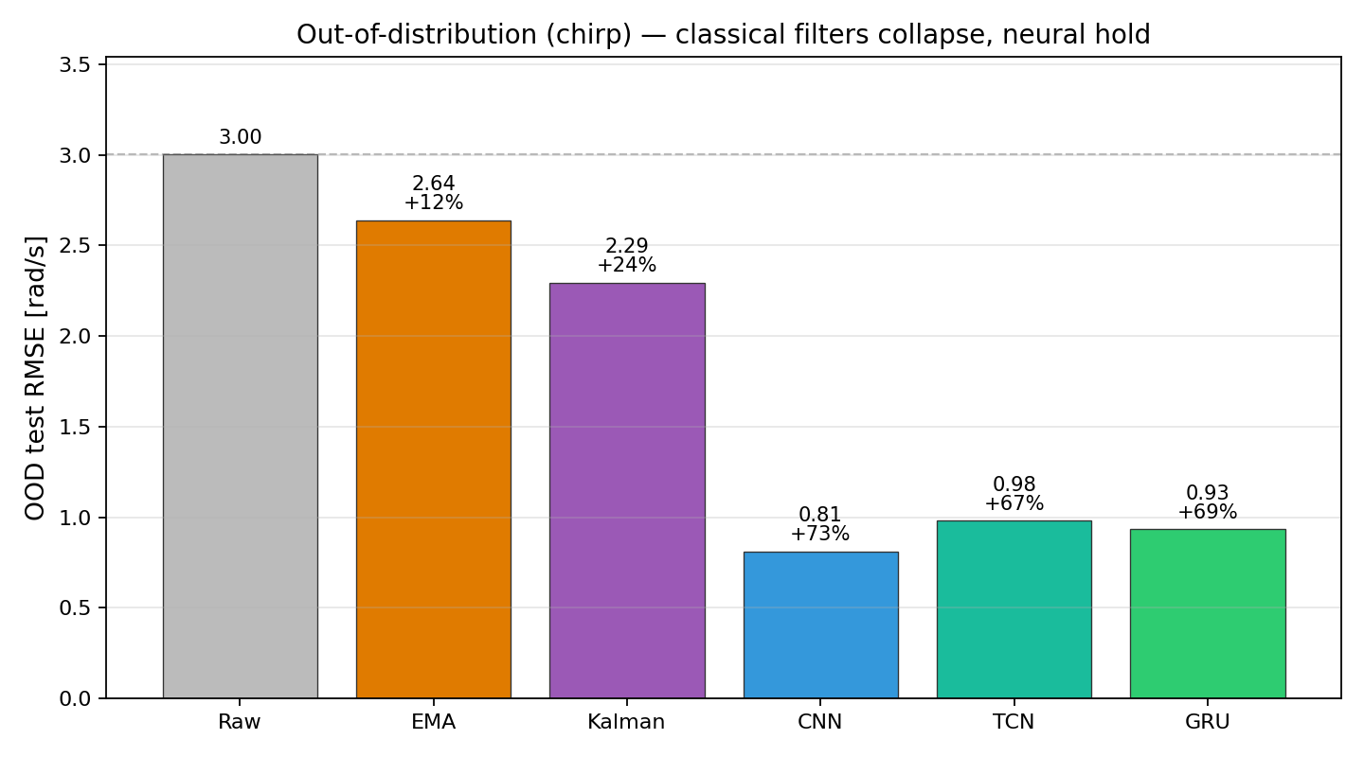
07 ML2 — GENERALISATION (UNSEEN EXCITATION)
Classical filters break on unseen inputs.
Raw — no filter | 3.00 rad/s — reference
EMA — tuned | 2.64 rad/s +12 % (was +64 %)
Kalman — tuned | 2.29 rad/s +24 % (was +56 %)
TCN | 0.98 rad/s +67 % holds
GRU | 0.93 rad/s +69 % holds
CNN 🏆 | 0.81 rad/s +73 % holds
Generalisation gap. On a chirp sweep never seen in training, EMA and Kalman collapse — implicitly tuned to the training spectrum — while neural filters hold +67–73 %, having learned the dynamics, not the excitation.
Fig. 2 — OOD (chirp) RMSE: classical filters collapse, neural hold.

