Slide 1
AI IN ELECTRICAL ENGINEERING | Group 14 | 30 June 2026 |
Motor Estimation and Control
Professor Mohamad A. Houran | Course: AI for Electrical Engineering
Members
Alessandro Carlino | 3125999080
Riad Mohamed Attou | 3125999081
Phanpasorn Laor-iam | 3125999087
Paweekorn Buasakorn | 3125999096
Vladimir Serezhin | 3126999010

Slide 2
TABLE OF CONTENTS
Contents
I
II
Problem Formulation
Machine Learning Replaced Reference Feedforward
III
IV
Residual Reinforcement Learning for Speed Control
SAC-RL Controller Design
V
Denoise the speed of a nonlinear plant

Slide 3
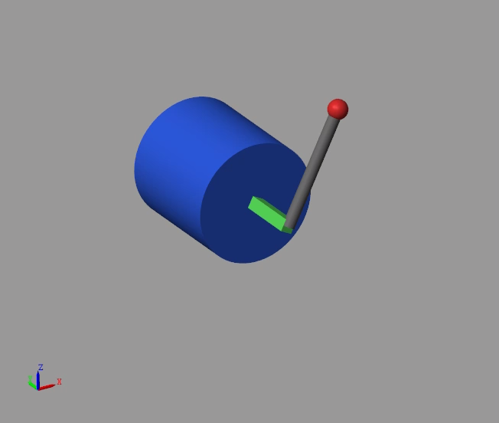
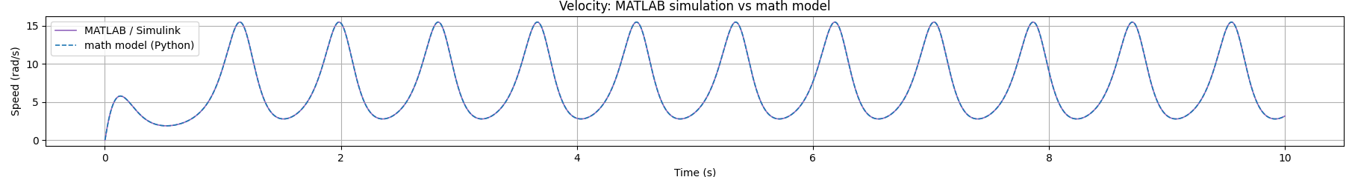

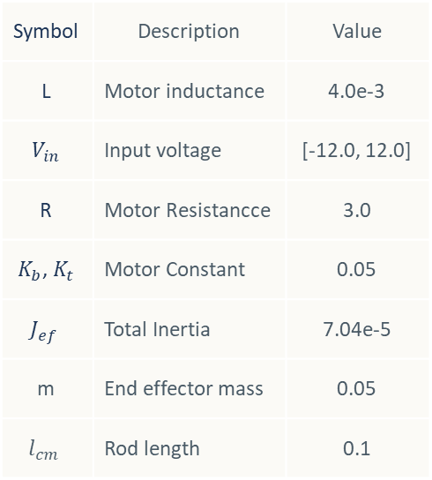

A1 Vertical Pendulum Control - Introduction
Problem Formulation
Our work focused on the speed control of a brushed DC motor with a vertical pendulum using several control techniques. To make the project accessible and easy to understand, we used Python to derive the system dynamics by modeling the mathematical equations and validated the correctness of the mathematical model using Simulink Multibody.
Symbol | Description | Value
L | Motor inductance | 4.0e-3
$$V_{in}$$ | Input voltage | [-12.0, 12.0]
R | Motor Resistancce | 3.0
$K_{b}$, $K_{t}$ | Motor Constant | 0.05
$$J_{ef}$$ | Total Inertia | 7.04e-5
m | End effector mass | 0.05
$$l_{cm}$$ | Rod length | 0.1
Motor with vertical pendulum dynamic
Applying Kirchhoff's voltage law to the armature circuit:
The net torque balance on the motor shaft with an attached rod of mass
$$3.5 V$$
Math model plant
Simulink

Slide 4
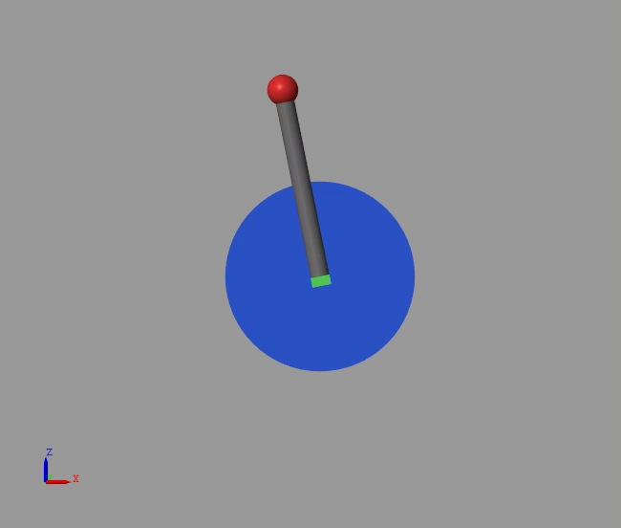
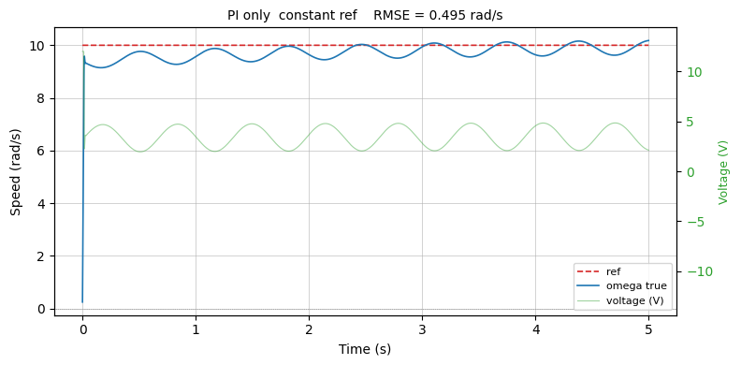
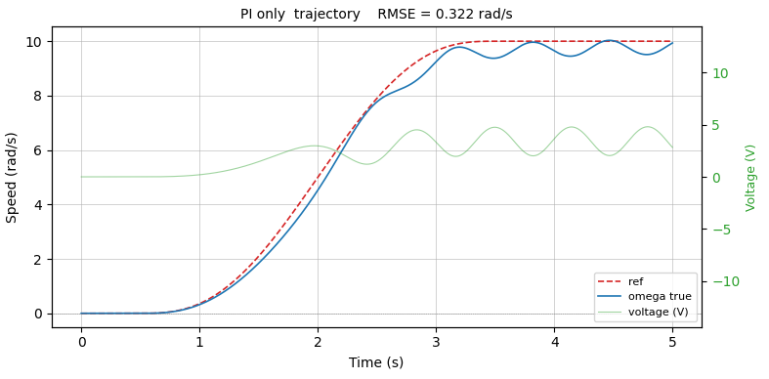






A2 Vertical Pendulum Control - Introduction
Classical Control
The classical method commonly used for speed control is the PI controller. One of its advantages is that it can provide satisfactory performance even without a complete understanding of the plant model. However, this approach works well only for linear systems. In our case, the presence of the vertical pendulum introduces gravitational effects, making the system highly nonlinear.
As a result, the performance of a conventional PI controller can be significantly degraded.
$$ω^{∗}$$
PI
$$V_{base}$$
+
$$V$$
Clip to $±12V$
Plant
(Motor+Rod)
$$ω$$
$$±$$
RMSE = 0.322

Slide 5
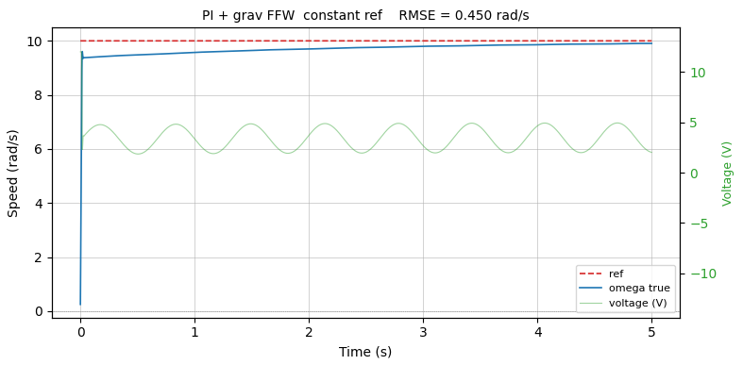
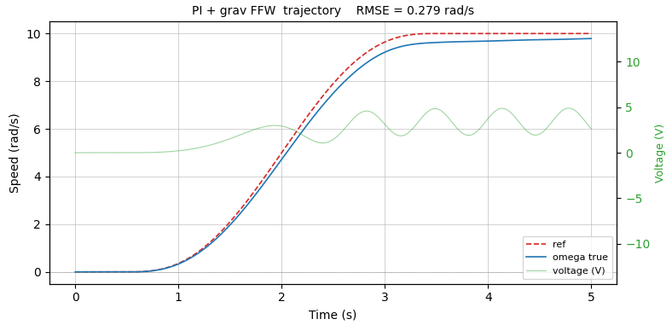






A3 Vertical Pendulum Control
Classical Control
To achieve better performance, we can improve the controller by understanding the dynamics of the system. This allows us to incorporate feedforward control. Specifically, a disturbance feedforward term compensates for the gravitational effects, while a reference feedforward term generates the required control input to drive the system toward the desired target. Unlike a PI controller, which reacts only after an error occurs, the reference feedforward term acts proactively, enabling faster and more accurate tracking when no disturbances are present.
Reference feedforward
Disturbance feedforward
$$\int{dt}$$
$$ω^{∗}$$
PI
$$V_{base}$$
+
$$V$$
Clip to $±12V$
Plant
(Motor+Rod)
$$ω$$
$$±$$
Feedforward Controller Design
RMSE = 0.450
From
and
Consider the steady-state condition where all derivatives vanish
and
Solve this we will get the feedforward that can be written as
RMSE = 0.279
Disturbance ffw
Reffernce ffw

Slide 6
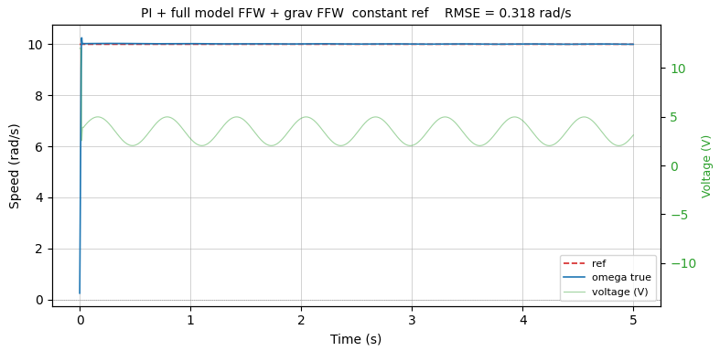
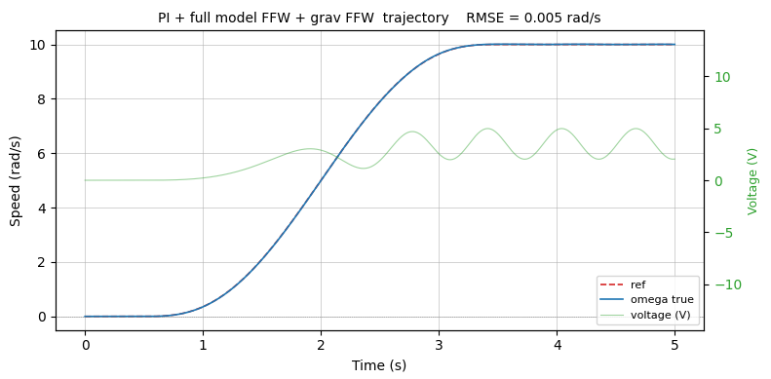
A4 Vertical Pendulum Control
Classical Control
To achieve better performance, we can improve the controller by understanding the dynamics of the system. This allows us to incorporate feedforward control. Specifically, a disturbance feedforward term compensates for the gravitational effects, while a reference feedforward term generates the required control input to drive the system toward the desired target. Unlike a PI controller, which reacts only after an error occurs, the reference feedforward term acts proactively, enabling faster and more accurate tracking when no disturbances are present.
Reference feedforward
Disturbance feedforward
$$\int{dt}$$
$$ω^{∗}$$
PI
$$V_{base}$$
+
$$V$$
Clip to $±12V$
Plant
(Motor+Rod)
$$ω$$
$$±$$
Feedforward Controller Design
RMSE = 0.318
From
and
Consider the steady-state condition where all derivatives vanish
and
Solve this we will get the feedforward that can be written as
RMSE = 0.005
Disturbance ffw
Reffernce ffw

Slide 7






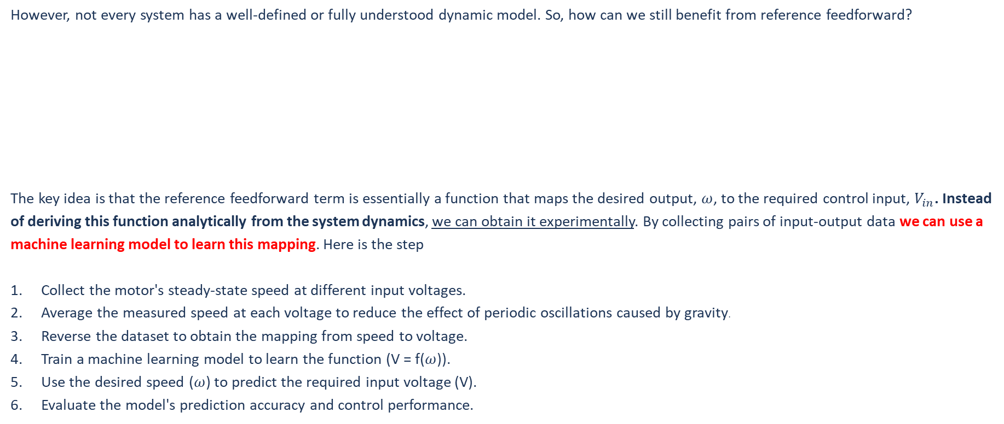


A5 Vertical Pendulum Control
Machine Learning Replaced Reference Feedforward
However, not every system has a well-defined or fully understood dynamic model. So, how can we still benefit from reference feedforward?
The key idea is that the reference feedforward term is essentially a function that maps the desired output, $ω$, to the required control input, $V_{in}$. Instead of deriving this function analytically from the system dynamics, we can obtain it experimentally. By collecting pairs of input-output data we can use a machine learning model to learn this mapping. Here is the step
Collect the motor's steady-state speed at different input voltages.
Average the measured speed at each voltage to reduce the effect of periodic oscillations caused by gravity.
Reverse the dataset to obtain the mapping from speed to voltage.
Train a machine learning model to learn the function (V = f($ω$)).
Use the desired speed ($ω$) to predict the required input voltage (V).
Evaluate the model's prediction accuracy and control performance.
Reference feedforward
Disturbance feedforward
$$\int{dt}$$
Voltage | Speed
1.0 | 1.0
2.0 | 2.0
3.0 | 3.0
??? | 4.0
$$ω^{∗}$$
PI
$$V_{base}$$
+
$$V$$
Clip to $±12V$
Plant
(Motor+Rod)
$$ω$$
$$ω^{∗}$$
Reference feedforward (ML)
$$V_{ref}$$
$$±$$

Slide 8
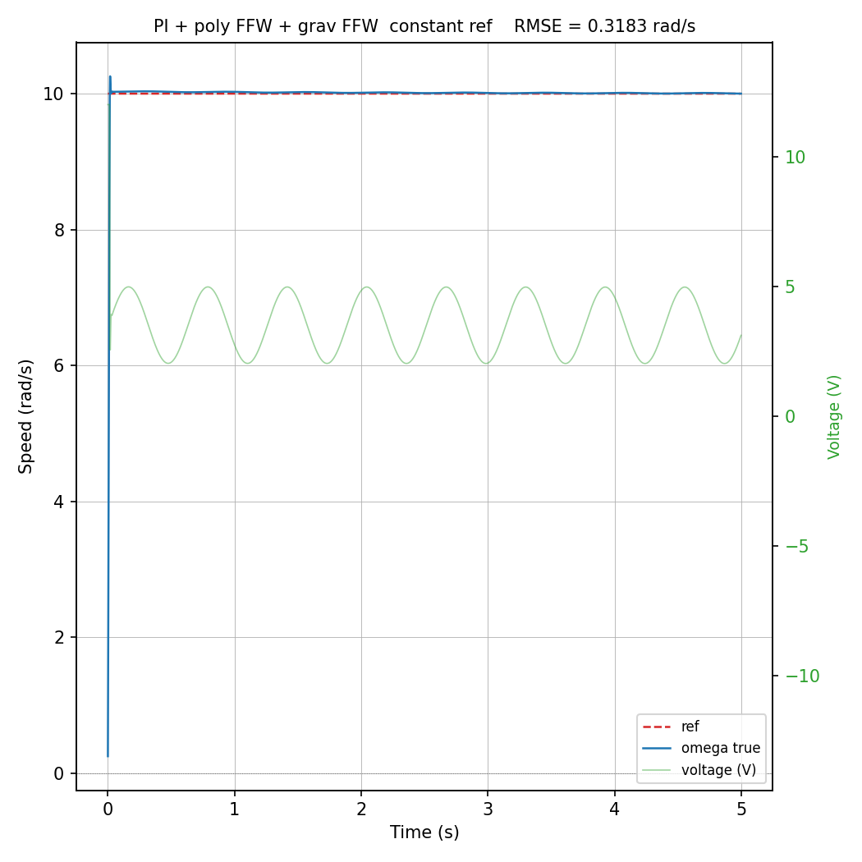
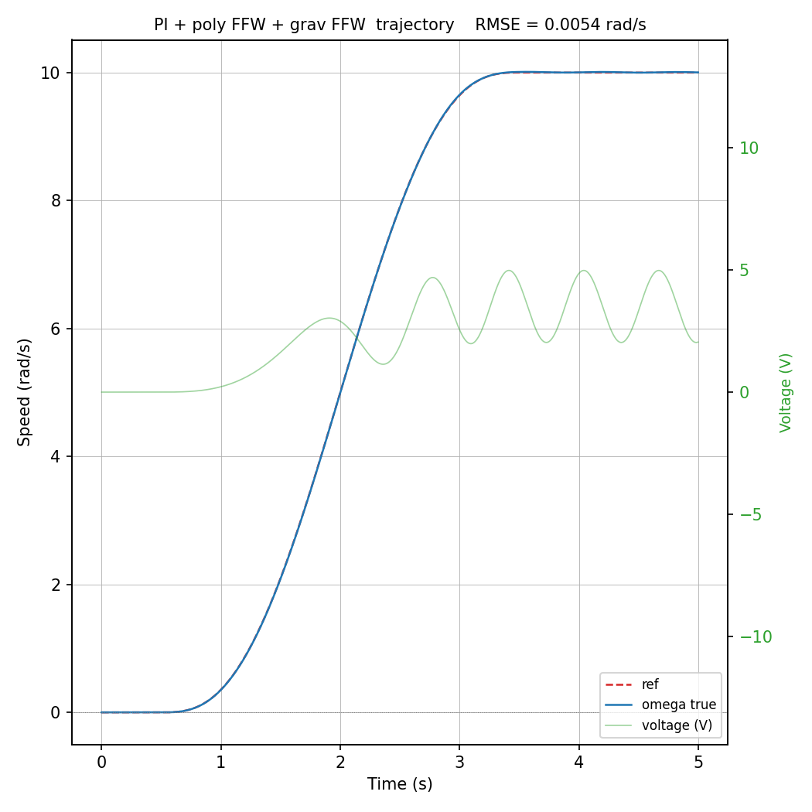
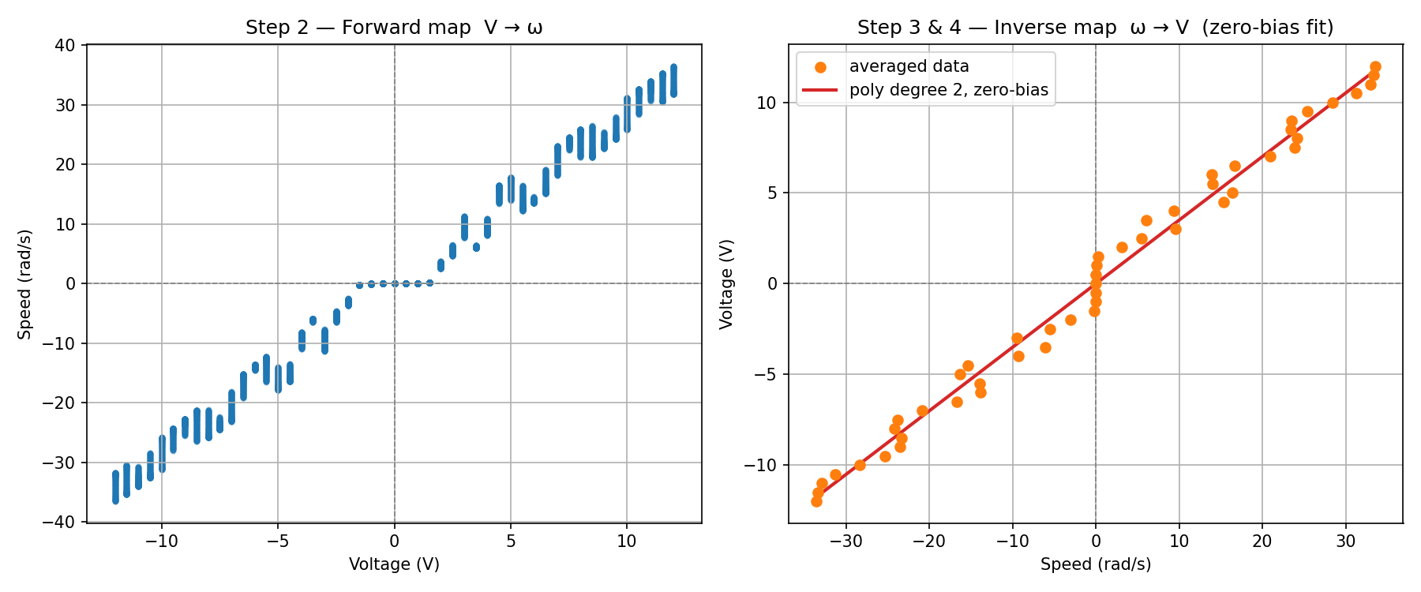
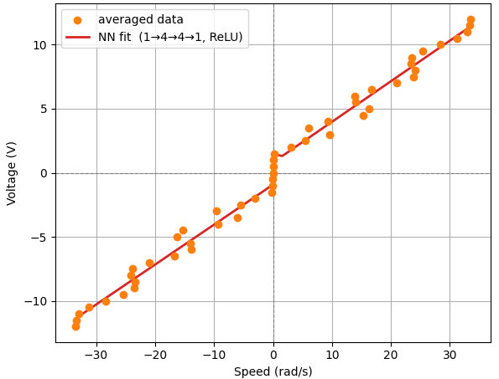
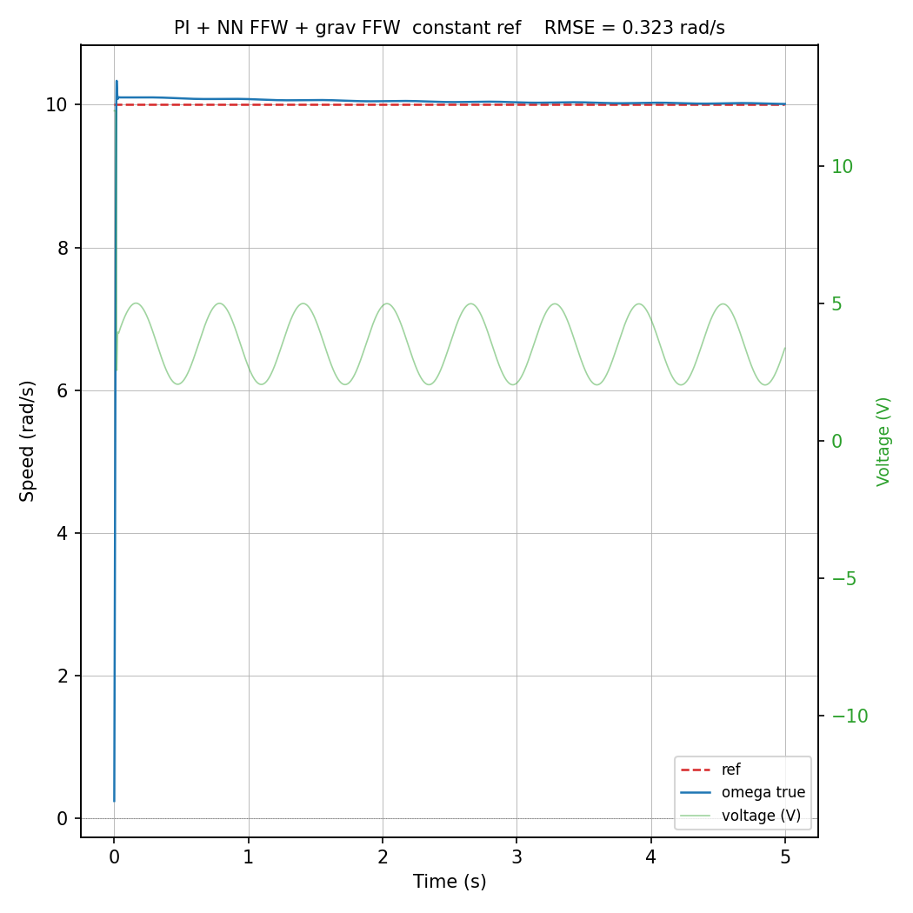
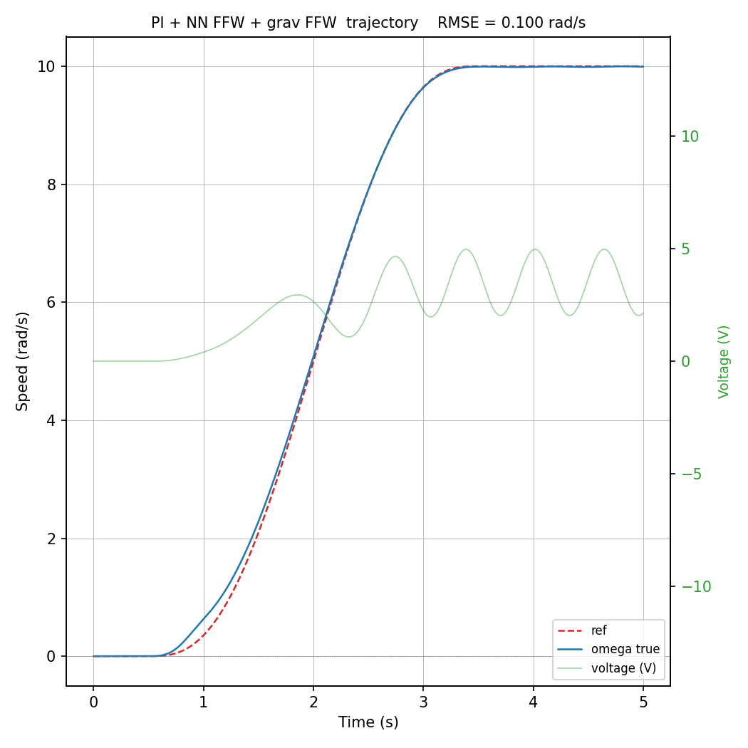
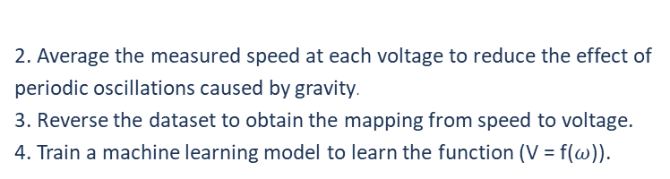

A6 Vertical Pendulum Control
Machine Learning Replaced Reference Feedforward
Input layer: 1
Output layer: 1
Model: Linear Regression
RMSE = 0.729
RMSE = 0.322
RMSE = 0.005
1.Collect the motor's steady-state speed at different input voltages.
Input layer: 1
Hidden layer: 16, 16
Output layer: 1
Epochs: 10000
Activation: ReLU
Loss: MSE
RMSE = 0.579
RMSE = 0.323
RMSE = 0.1
2. Average the measured speed at each voltage to reduce the effect of periodic oscillations caused by gravity.
3. Reverse the dataset to obtain the mapping from speed to voltage.
4. Train a machine learning model to learn the function (V = f($ω$)).
$$ω^{∗}$$
Reference feedforward (ML)
$$V_{ref}$$

Slide 9

A7 Vertical Pendulum Control
Conclusion
Metric | PI (c) | PI (t) | PI + full model FFW (c) | PI + full model FFW (t) | PI + poly FFW + grav FFW (c) | PI + poly FFW + grav FFW (t) | PI + NN FFW + grav FFW (c) | PI + NN FFW + grav FFW (t)
RMSE (rad/s) | 0.4950 | 0.3217 | 0.3183 | 0.0053 | 0.3183 | 0.0054 | 0.4450 | 0.2714
MAE (rad/s) | 0.3248 | 0.2476 | 0.0294 | 0.0043 | 0.0298 | 0.0044 | 0.2904 | 0.2308
Control effort | 17.4124 | 11.1069 | 17.6503 | 11.2862 | 17.6509 | 11.2866 | 17.3144 | 11.0674
Machine learning can reduce the need for full analytical understanding of the system. It can achieve performance almost the same as a fully analytical model and already simplifies system identification by avoiding explicit estimation of parameters such as damping (b) and back-EMF constant (k_b). A simple linear regression model can already reproduce behavior close to a fully derived physical model.
$$ω^{∗}$$
Reference feedforward (ML)
$$V_{ref}$$
Disturbance ffw
Reffernce ffw

Slide 10




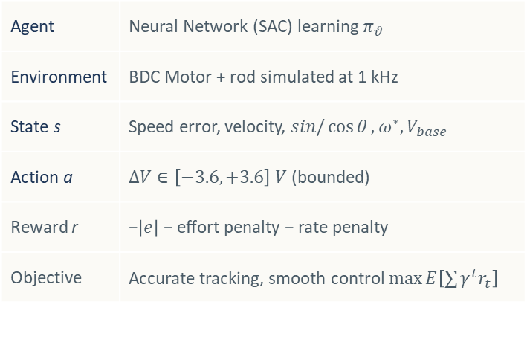
A1 Vertical Pendulum Control - Introduction
Residual Reinforcement Learning for Speed Control
A pure PI controller compensates the speed error but ignores gravity and the nonlinear dynamics of the system. Adding a feedforward term requires an accurate physical model. The residual approach lets us learn that correction directly from interaction with the system, with no knowledge of the motor parameters.
Agent | Neural Network (SAC) learning $π_{θ}$
Environment | BDC Motor + rod simulated at 1 kHz
State s | Speed error, velocity, $sin/\cos{θ}, ω^{∗}, V_{base}$
Action a | $∆V∈\left[−3.6, +3.6\right] V$ (bounded)
Reward r | −$\left|e\right|$ − effort penalty − rate penalty
Objective | Accurate tracking, smooth control $\max{E\left[\sum{γ^{t}r_{t}}\right]}$
RL Policy
$$π_{θ}$$
$$\int{dt}$$
$$ΔV$$
$$ω^{∗}$$
PI
(Baseline)
$$V_{base}$$
+
$$V$$
Clip to $±12V$
Plant
(Motor+Rod)
$$ω$$
$$±$$
Fig. 1 - The policy does not replace the PI; it adds a bounded correction on top. Safety is guaranteed by design: |ΔV|≤3.6V and the total voltage never exceeds ±12V.
Main advantage. The policy learns what the PI cannot model (feedforward and gravity compensation) without ever seeing the motor equations.

Slide 11
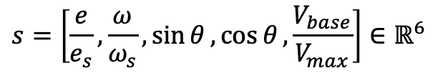
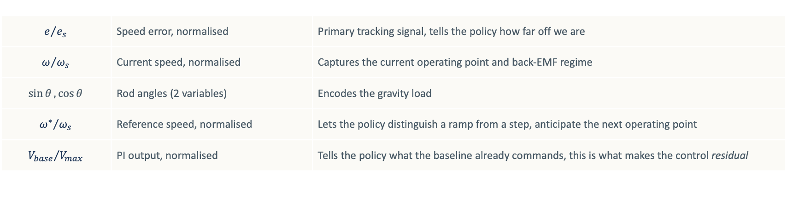
B2 RESIDUAL REINFORCEMENT LEARNING - Framework
State Observer
It is the interface between the system and the neural network.
At every step it collects raw measurements and converts them into the input vector. It does three things:
— selects only the variables needed to compute ΔV, discarding everything else;
— normalises each quantity so that training is numerically stable;
— re-encodes the rod angle as (sin θ, cos θ) to avoid the discontinuity at ±π.
$$s=\left[\frac{e}{e_{s}}, \frac{ω}{ω_{s}},\sin{θ}, \cos{θ}, \frac{V_{base}}{V_{max}}\right]∈ℝ^{6}$$
$$e/{e_{s}}$$ | Speed error, normalised | Primary tracking signal, tells the policy how far off we are
$$ω/{ω_{s}}$$ | Current speed, normalised | Captures the current operating point and back-EMF regime
$$\sin{θ},\cos{θ}$$ | Rod angles (2 variables) | Encodes the gravity load
$${ω^{∗}}/{ω_{s}}$$ | Reference speed, normalised | Lets the policy distinguish a ramp from a step, anticipate the next operating point
$${V_{base}}/{V_{max}}$$ | PI output, normalised | Tells the policy what the baseline already commands, this is what makes the control residual
$e_{s}=5 rad/s$, a moderately large tracking error; maps typical errors to $\sim 1$, saturation errors to $\sim 2$
$ω_{s}=12 rad/s$, just above the maximum reference ($12 rad/s$); keeps all speed features in [-1, 1]
All six features are clipped to [-10, 10] before entering the network, no unbounded inputs
The observer is minimal by design: 6 scalars, no history, no raw sensor data. The policy has exactly what it needs to compute the missing feedforward and nothing more.

Slide 12
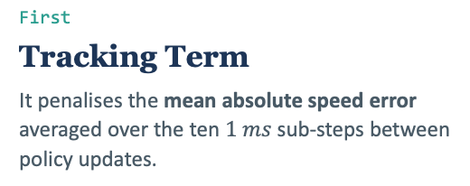
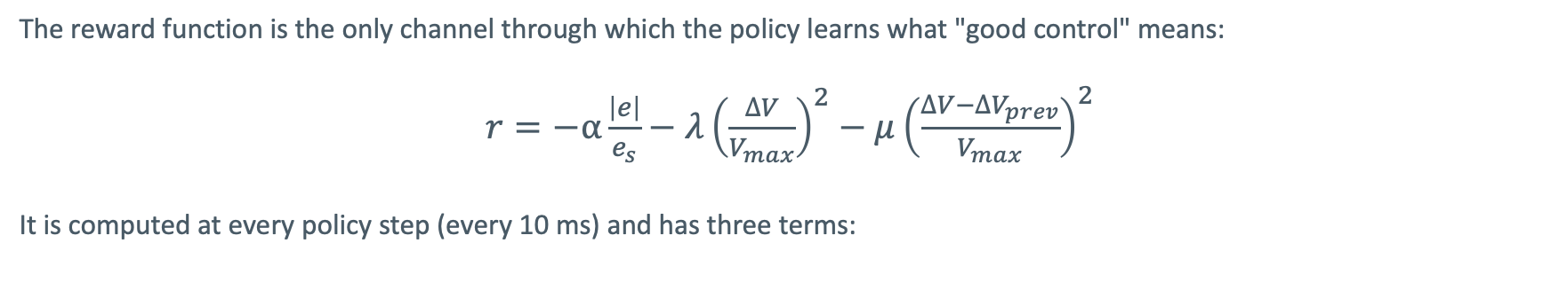
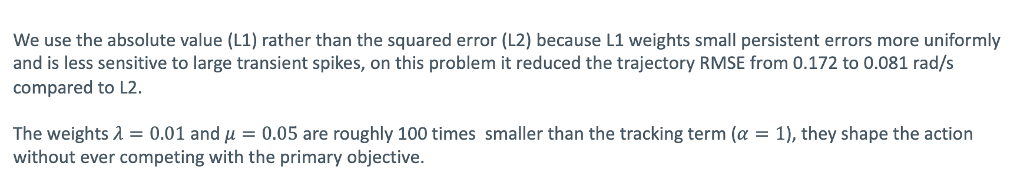
B3 RESIDUAL REINFORCEMENT LEARNING - Framework
Reward Function
The reward function is the only channel through which the policy learns what "good control" means:
$r=−α\frac{\left|e\right|}{e_{s}}−λ{\left(\frac{∆V}{V_{max}}\right)}^{2}−μ{\left(\frac{∆V−{∆V}_{prev}}{V_{max}}\right)}^{2}$
It is computed at every policy step (every 10 ms) and has three terms:
First
Tracking Term
It penalises the mean absolute speed error averaged over the ten $1 ms$ sub-steps between policy updates.
Second
Effort term
It penalises large residuals, keeping the PI in charge and preventing the policy from issuing unnecessary corrections.
Third
Rate Term
It penalises how much the correction changes between consecutive updates, suppressing chattering and producing a smoother voltage profile.
We use the absolute value (L1) rather than the squared error (L2) because L1 weights small persistent errors more uniformly and is less sensitive to large transient spikes, on this problem it reduced the trajectory RMSE from 0.172 to 0.081 rad/s compared to L2.
The weights $λ=0.01$ and $μ=0.05$ are roughly 100 times smaller than the tracking term ($α=1$), they shape the action without ever competing with the primary objective.

Slide 13
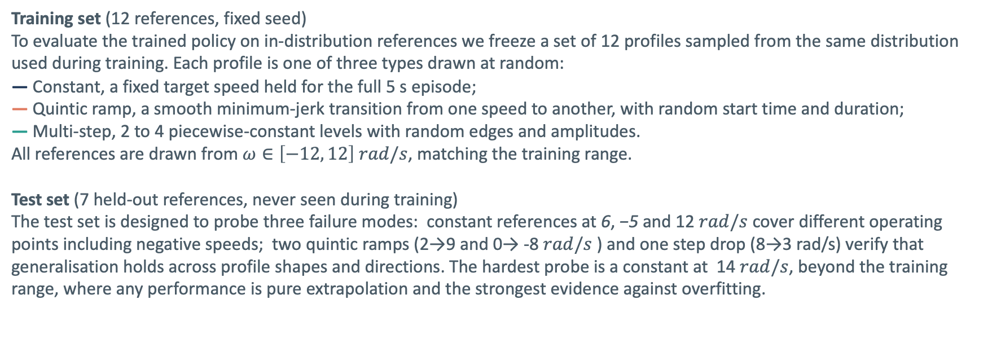
B4 RESIDUAL REINFORCEMENT LEARNING - Training
Training & Test set
Unlike supervised learning, there is no fixed dataset collected in advance. The policy trains online: at every step it interacts with the simulated motor, receives a reward, and updates its weights. The "dataset" is the distribution of speed references the environment samples during training.
Training set (12 references, fixed seed)
To evaluate the trained policy on in-distribution references we freeze a set of 12 profiles sampled from the same distribution used during training. Each profile is one of three types drawn at random:
— Constant, a fixed target speed held for the full 5 s episode;
— Quintic ramp, a smooth minimum-jerk transition from one speed to another, with random start time and duration;
— Multi-step, 2 to 4 piecewise-constant levels with random edges and amplitudes.
All references are drawn from $ω∈\left[−12, 12\right] rad/s$, matching the training range.
Test set (7 held-out references, never seen during training)
The test set is designed to probe three failure modes: constant references at 6, −5 and 12 $rad/s$ cover different operating points including negative speeds; two quintic ramps (2→9 and 0→ -8 $rad/s$ ) and one step drop (8→3 rad/s) verify that generalisation holds across profile shapes and directions. The hardest probe is a constant at 14 $rad/s$, beyond the training range, where any performance is pure extrapolation and the strongest evidence against overfitting.

Slide 14
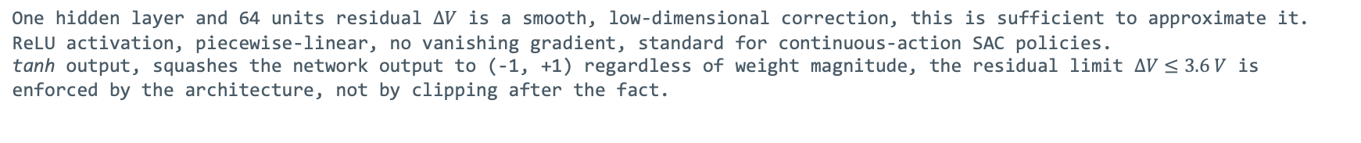
B5 RESIDUAL REINFORCEMENT LEARNING - Training
Neural Network Architecture
The correction $∆V$ the PI is missing depends on rod angle, operating speed, and reference profile in a nonlinear way and the input is a vector of six physical scalars with no spatial structure and no temporal ordering. An MLP is the natural choice: it learns an arbitrary smooth mapping from $ℝ^{6 }$to $ℝ^{1 }$with no inductive bias that would conflict with the problem structure.
MLP Policy Network — π_θ : ℝ⁶ → [−1, 1]
INPUT LAYER
HIDDEN LAYER
OUTPUT LAYER
6 features
W₁ ∈ ℝ⁶⁴ˣ⁶
64 units · ReLU
1 unit · tanh
W₂ ∈ ℝ¹ˣ⁶⁴
e / e_s
x₁
ω / ω_s
x₂
sin θ
x₃
·
·
tanh
ΔV
cos θ
x₄
·
∈[−1,1]
ω* / ω_s
x₅
tanh → [−1, 1]
V_base / V_max
x₆
× 64 units total
ReLU
Total trainable parameters: 6×64 + 64 + 64×1 + 1 = 513
One hidden layer and 64 units residual $∆V$ is a smooth, low-dimensional correction, this is sufficient to approximate it.
ReLU activation, piecewise-linear, no vanishing gradient, standard for continuous-action SAC policies.
tanh output, squashes the network output to (-1, +1) regardless of weight magnitude, the residual limit $∆V≤3.6 V$ is enforced by the architecture, not by clipping after the fact.

Slide 15
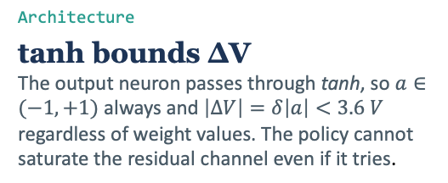
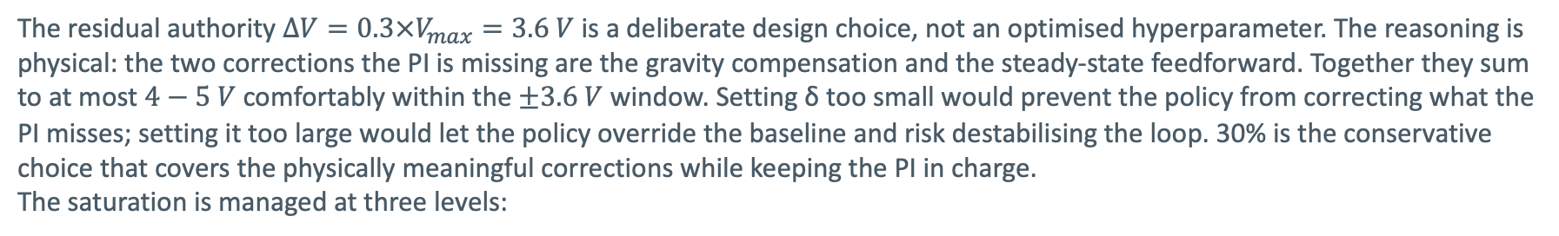
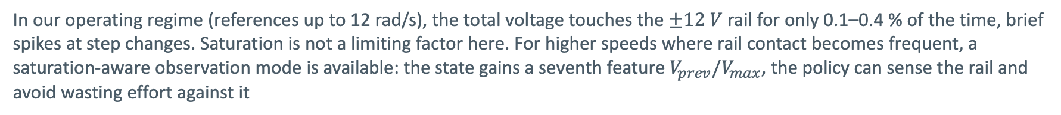


B6 RESIDUAL REINFORCEMENT LEARNING - Validation
Saturation and Residual Authority: Design Choice
The residual authority $∆V=0.3×V_{max}=3.6 V$ is a deliberate design choice, not an optimised hyperparameter. The reasoning is physical: the two corrections the PI is missing are the gravity compensation and the steady-state feedforward. Together they sum to at most $4−5 V$ comfortably within the $±3.6 V$ window. Setting δ too small would prevent the policy from correcting what the PI misses; setting it too large would let the policy override the baseline and risk destabilising the loop. 30% is the conservative choice that covers the physically meaningful corrections while keeping the PI in charge.
The saturation is managed at three levels:
Architecture
tanh bounds ΔV The output neuron passes through tanh, so $a∈(−1,+1)$ always and $\left|∆V\right|=δ\left|a\right|<3.6 V$ regardless of weight values. The policy cannot saturate the residual channel even if it tries.
Control Law
Hard clip before the motor $clip\left(V_{base}+∆V, −12, +12\right)$, PI and policy are summed first, then clipped. Neither component alone can push the motor beyond the hardware rail.
PI anti-windup
Prevents integrator blow-up The integrator is clamped so $K_{i}\int{e dt≤±V_{max}}$. Without this, a sustained error during a transient would wind the integrator to an arbitrarily large value, causing a slow oscillatory recovery once the error clears.
In our operating regime (references up to 12 rad/s), the total voltage touches the $±12 V$ rail for only 0.1–0.4 % of the time, brief spikes at step changes. Saturation is not a limiting factor here. For higher speeds where rail contact becomes frequent, a saturation-aware observation mode is available: the state gains a seventh feature $V_{prev}/V_{max}$, the policy can sense the rail and avoid wasting effort against it

Slide 16
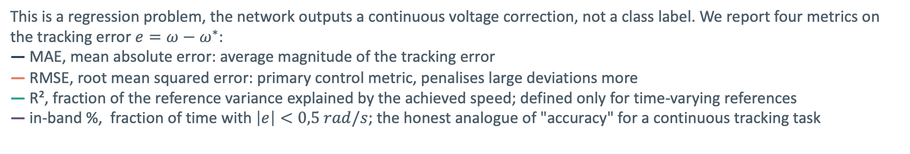
B7 RESIDUAL REINFORCEMENT LEARNING - Validation
Machine Learning Validation: Train Vs Test set
This is a regression problem, the network outputs a continuous voltage correction, not a class label. We report four metrics on the tracking error $e=ω−ω^{∗}$:
— MAE, mean absolute error: average magnitude of the tracking error
— RMSE, root mean squared error: primary control metric, penalises large deviations more
— R², fraction of the reference variance explained by the achieved speed; defined only for time-varying references
— in-band %, fraction of time with $\left|e\right|<0,5 rad/s$; the honest analogue of "accuracy" for a continuous tracking task
Set | MAE | RMSE | R2 | In-band %
Train (12 references) | 0.069 | 0.292 | 0.955 | 99.7%
Test (7 held-out) | 0.080 | 0.240 | 0.996 | 99.8%
Result. Test error is no worse than train on every metric, the policy has not memorised the training references, it has learned a general control strategy. R2 improves on the test set because held-out references are smoother and easier to track than the random multi-step profiles used during training. The gap between train and test RMSE goes in the safe direction: no overfitting.

Slide 17
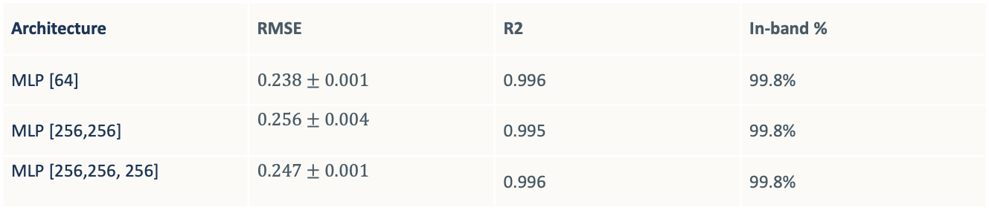
B8 RESIDUAL REINFORCEMENT LEARNING - Validation
Ablation Study: Network Depth and Seed Robustness
To verify that the architecture choice is not arbitrary and the results are not seed-dependent, we trained 3 architectures × 3 random seeds = 9 independent models and evaluated each on the held-out test set. All models use the same reward, hyperparameters and training budget (300k steps).
Architecture | RMSE | R2 | In-band %
MLP [64] | $$0.238±0.001$$ | 0.996 | 99.8%
MLP [256,256] | $$0.256±0.004$$ | 0.995 | 99.8%
MLP [256,256, 256] | $$0.247±0.001$$ | 0.996 | 99.8%
Depth does not help. The smallest network achieves the lowest RMSE. Adding layers and parameters makes performance slightly worse, the residual is a smooth, low-dimensional function that a shallow network approximates just as well, with less risk of overfitting the training distribution.
The result is robust, not lucky. The per-seed standard deviation for [64] is ±0.001, negligible. The [256,256] network shows higher variance (±0.004), meaning deeper models are more sensitive to initialisation. The multi-seed experiment confirms that the improvement over pure PI is a structural property of the residual architecture, not an artefact of a fortunate random seed.

Slide 18
B9 RESIDUAL REINFORCEMENT LEARNING - Validation
Closed-Loop Performance: Benchmark
All three controllers run on the same simulated plant, same references, same noise model. Performance is measured on the held-out test set, 7 references never seen during training, to avoid any information leak between the RL training and the evaluation.
Controller | MAE | RMSE | R2 | In-band %
PI (Baseline) | 0.281 | 0.411 | 0.988 | 85.2%
PI + poly + grav | 0.020 | 0.203 | 0.997 | 99.8%
RL residual | 0.078 | 0.240 | 0.997 | 99.8%
RL residual reduces the pure PI tracking error by 75% (RMSE 0.411 → 0.240) and closes most of the gap to the strong classical baseline (0.240 vs 0.203), without any knowledge of the motor parameters or the gravity model. The in-band percentage jumps from 85% to 99.8%, matching the feedforward controller exactly on that metric.
The residual does not fully match PI + poly + grav on RMSE. This is expected: the classical controller uses the exact physical model; the policy approximates it from data alone. The remaining gap (0.018 rad/s) is the cost of being model-free.

Slide 19
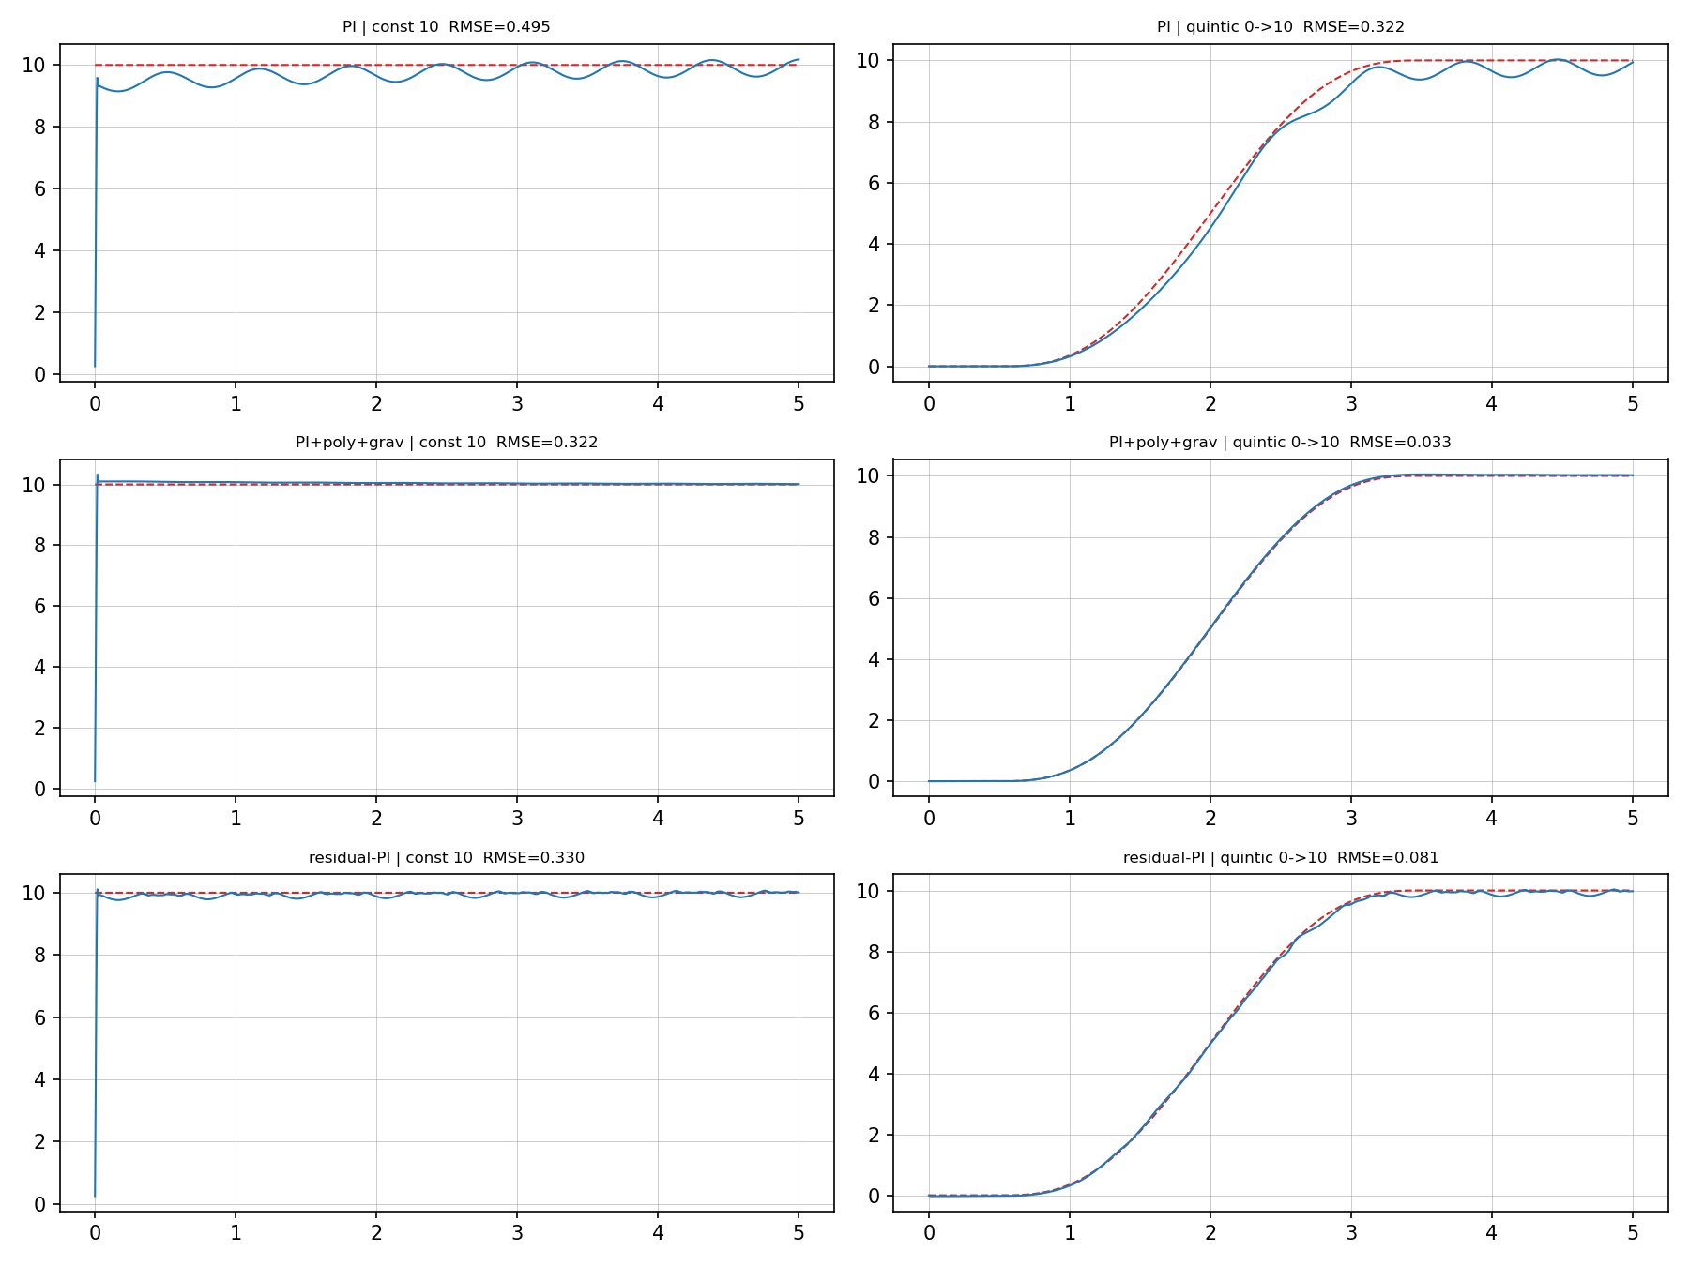
B10 RESIDUAL REINFORCEMENT LEARNING - Validation
Closed-Loop Performance: Controller Comparison
Each panel shows the achieved speed (blue) against the reference (dashed red) for one controller and one reference profile. RL Residual follows the reference closely on the quintic trajectory, where the PI alone shows a persistent steady-state offset, the learned ΔV compensates what the integrator cannot correct fast enough.

Slide 20
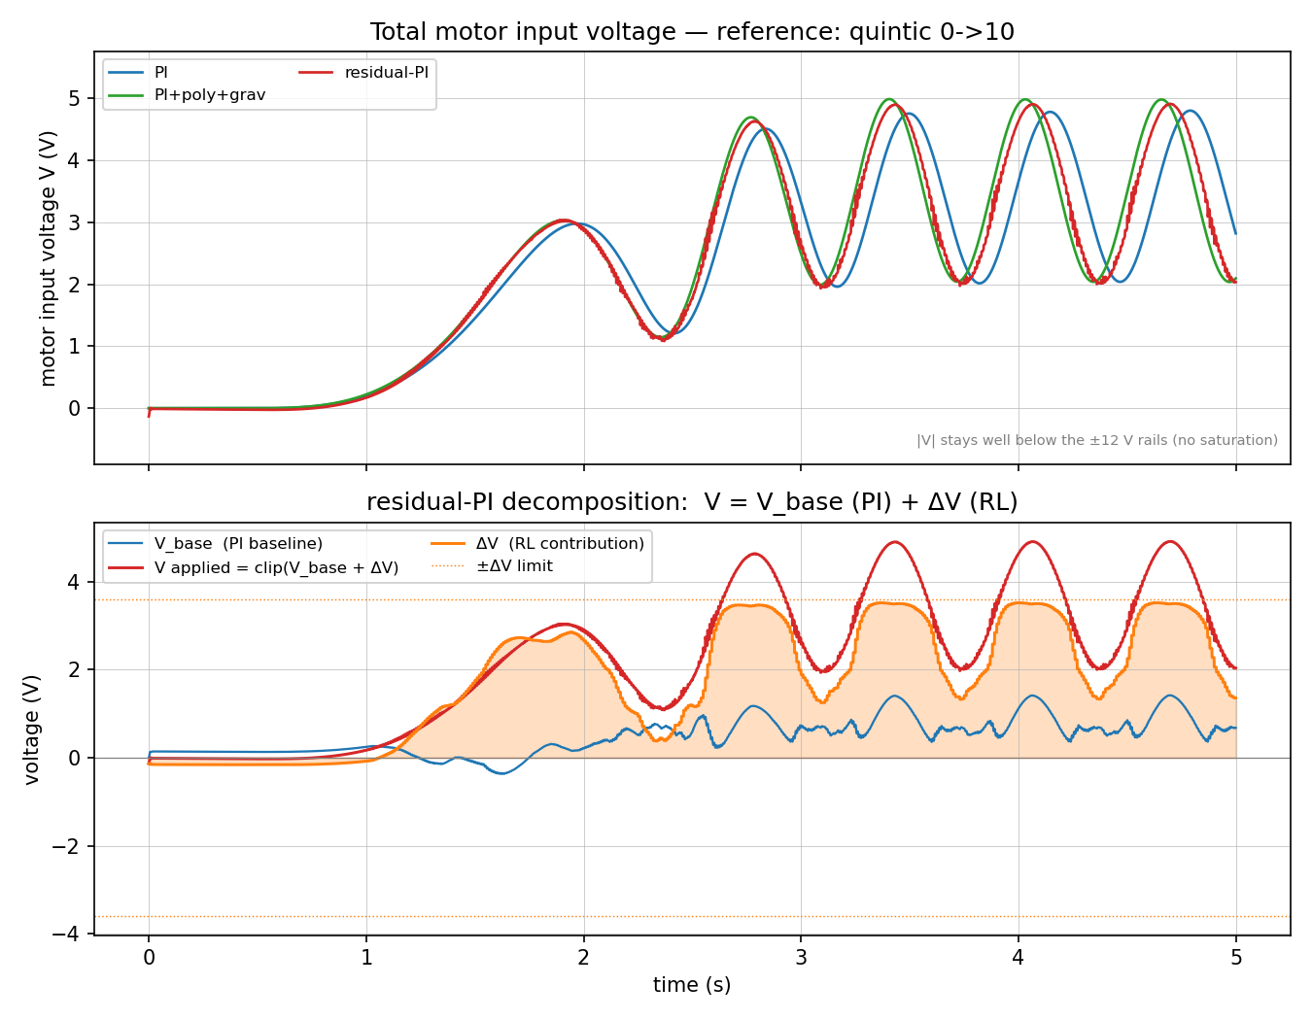
B11 RESIDUAL REINFORCEMENT LEARNING - Validation
Closed-Loop Performance: Voltage Decomposition
Total motor voltage for each controller. Bottom: the RL residual split into $V_{base}$ (PI baseline, blue) and $∆V$ (learned correction, orange). During transients ΔV is the dominant term, so the policy has implicitly learned the feedforward and gravity compensation that the PI baseline cannot provide.

Slide 21










C1 SAC-RL Controller Design
Can We Skip the Math? — SAC-RL Controller Design
Conventional Controller : PID + Feedforward
Proposed Controller: Soft Actor-Critic (SAC-RL)
Feedforward
$$ω^{∗}$$
PI
$$V_{base}$$
+
$$V$$
Clip to $±12V$
Plant
(Motor+Rod)
$$ω$$
$$ω^{∗}$$
State Observation
SAC
Policy Network
$$u(t)$$
Clip to $±12V$
Plant
(Motor+Rod)
$$ω$$
$$±$$
$$Feedback$$
$$V=f^{−1}(V_{ref})+PID(e)$$
$$V=π(s), s=[V_{ref}, V, e, ω, …]$$
Model-based Controller
Need a knowledge of the systems
Data-driven Controller
The systems learn from the rewards
PID + Feedforward
Requires system model f⁻¹(Vref)
Gains (Kp, Ki) tuned manually
Degrades if motor parameters drift
Feedforward only works near design point
SAC-RL
No model needed — learns from data
Policy tuned automatically via reward
Adapts implicitly through training
Generalizes across operating range

Slide 22

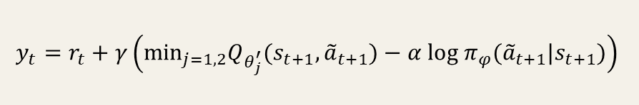
C2 SAC-RL Controller Design
Why SAC? — Pure RL, No Feedforward
Algorithm
SAC (Soft Actor-Critic): off-policy, reuses past experience via replay buffer. More sample-efficient than on-policy methods. Handles continuous action space natively.
Key Design Choices
No feedforward — SAC outputs total voltage V directly. Action LPF α=0.9* smooths commands. Replay buffer 300,000. Warmup 10,000 steps. 800,000* total training steps.
Training Signal
Reward penalizes 3 terms: tracking error, control effort, action roughness Setpoint changes every 1,000 steps (1 s). Episode = 3,000* steps. No prior physics knowledge required.
Reward Function
$$r_{t}=−e_{t}^{2}−0.01 V^{2}−1.0 (Δa)^{2}$$
SAC Learns (Bellman Target)
$$y_{t}=r_{t}+γ\left(\min_{j=1,2}Q_{θ_{j}^{′}}(s_{t+1}, {\tilde{a}}_{t+1})−α log π_{φ}({\tilde{a}}_{t+1}|s_{t+1})\right)$$
Reward Function Variables
Variable
Description
r_t
Reward at time step t
e(t) = ωref − ω
Speed tracking error
ė(t)
Rate of change of error (derivative)
u(t)
Control output / voltage command
we, wė, wu
Penalty weighting coefficients (1.0, 0, 0.01)
Bellman Target Variables
Key Insight
SAC requires zero physics knowledge. PI+FFW required manual derivation of gravity torque, inverse motor model, and careful gain tuning. Tradeoff: accuracy vs. engineering effort.
Variable
Description
y_t
Bellman target — supervised label for critic update
γ ∈ (0,1)
Discount factor — weights future vs. immediate reward
Q_θ'j
Target Q-network j (slow-updated copy, stabilises training)
α
Temperature — controls entropy / exploration strength
log π_φ(ã|s)
Log-prob of sampled action — entropy bonus
ã_{t+1}, s_{t+1}
Re-sampled action and next state (t+1 step)

Slide 23


C3 SAC-RL Controller Design
SAC Policy: INPUT → PARAMETER → OUTPUT
INPUT
PARAMETER
OUTPUT
Variable
Norm.
Purpose
Reward Function
− e² ：Penalise tracking error
− 0.05 V² ： Control effort (no saturation)
− 1.5 (Δa)² ：Smooth voltage changes
Training Setup
LPF coefficient α = 0.85
Total steps 500,000
Episode length 3,000 steps
Setpoint period 1,000 steps
Replay buffer 300,000
Warmup 5,000 steps
Action a = V ∈ [−V_max, V_max]
No feedforward added
e = ωref−ω
÷15
Tracking error
∫e dt
÷30
Error trend (anti-windup ±30)
sin(θ)
raw
Gravity disturbance
$$\hat{V}[k]=0.9 \hat{V}[k−1]+0.1 a[k]$$
ω (speed)
÷15
Current motor speed
ωref (target)
÷15
Speed setpoint
V_out = clip( V, −V_max, +V_max )
$$s_{t}=\left[\frac{e}{15}, \frac{∫e dt}{30}, sinθ, \frac{ω_{meas}}{15}, \frac{ω_{ref}}{15}\right]$$
Dataset: Training & Testing
TRAIN DATA
TEST DATA
Source: Simulation only (BDC Motor + pendulum)
Pre-fill: 30 eps × 3,000 steps = 90,000 transitions (PI+FF)
RL exploration: 600,000 steps SAC self-play (same simulator)
ωref: random constant ∈ [2, 15] rad/s per episode
Init: ω₀ ∈ [−15,15] rad/s, θ₀ ∈ [−45°,45°]
Sensor noise: σ = 0.2 rad/s (Gaussian)
Source: Same simulator, noise-free (σ = 0)
T1: 0 → 10 → 0 rad/s | 5 s | ramp 0.5 s
T2: 5 → 12 → 5 rad/s | 6 s | ramp 0.5 s
Profiles unseen during training (trapezoidal)
Metric: RMSE vs PI+gravity FF baseline
Key Point: Training uses random step references — Testing uses trapezoidal profiles (different shape, tests generalization)

Slide 24
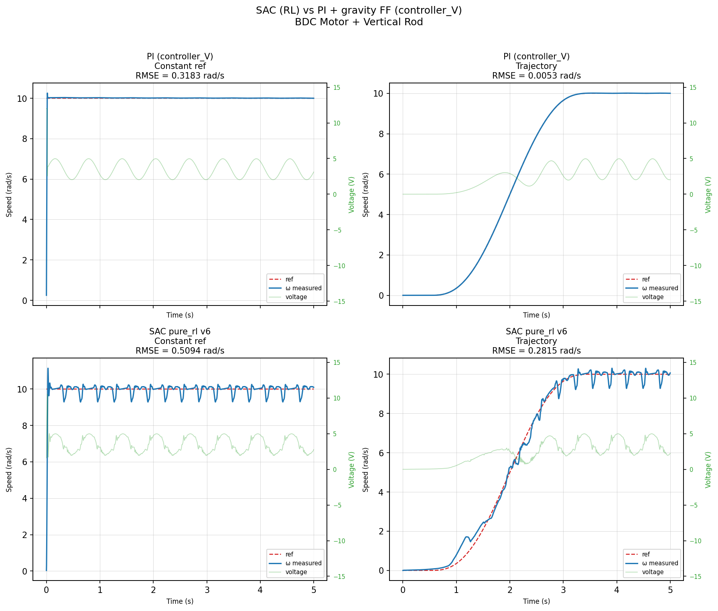
C4 SAC-RL Controller Design
Train Performance - Results
Controller | RMSE (rad/s)
 | Constant Reference | Trajectory
PI+FF Controller | 0.318 | 0.0053
SAC-RL Controller | 0.5094 | 0.2815
PI+FF uses exact model → lower RMSE expected
SAC uses zero model knowledge, learns from reward only
SAC generalises to unseen trajectory shapes
Trade-off: model accuracy vs model independence
Future work: more training steps, real hardware adaptation

Slide 25
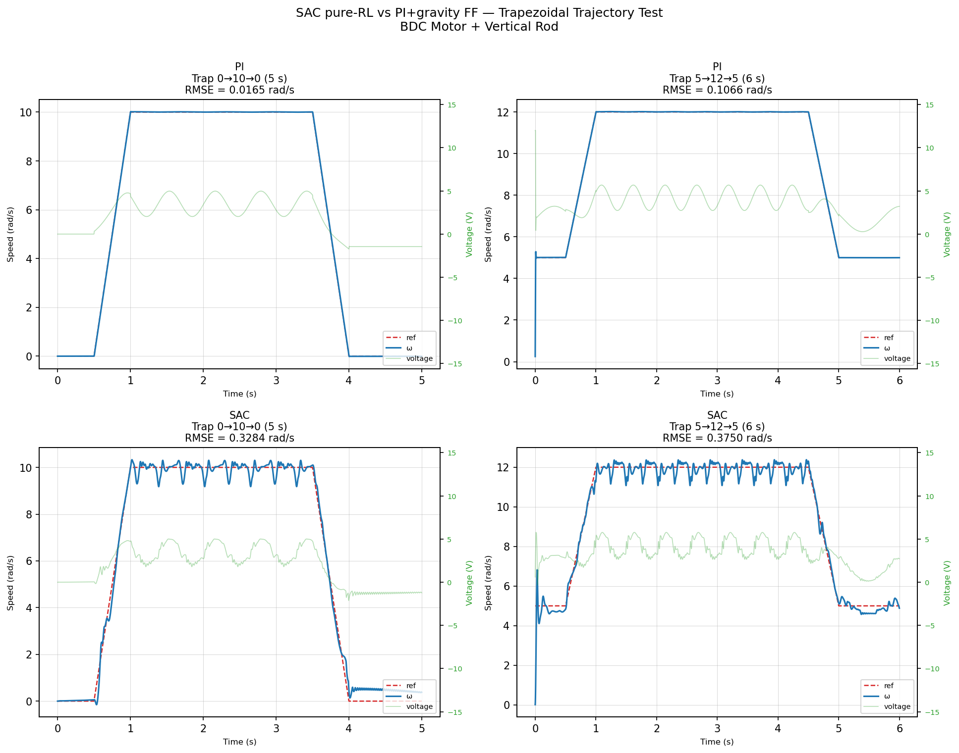
C5 SAC-RL Controller Design
Test Performance - Results
Controller | RMSE (rad/s)
 | T1 (0 → 10 → 0 rad/s | 5 s) | T2 (5 → 12 → 5 rad/s | 6 s)
PI+FF Controller | 0.0165 | 0.1066
SAC-RL Controller | 0.3284 | 0.3750
Ramp tracking: SAC ≈ PI ✓
Steady-state: SAC oscillates, PI smooth ✗
Return-to-zero: partial failure (out of training range
RMSE gap: 0.33 vs 0.017 — mostly from flat-top chatter

Slide 26
C6 SAC-RL Controller Design
Conclusion & Future Work of SAC-RL Controller Design
Key Findings
Trade-off
✓ SAC tracks trajectory without model knowledge
✓ PI+FF outperforms at steady-state — expected, uses exact physics
✓ SAC generalises to unseen trapezoidal profile
✗ Main limitation: steady-state oscillation (chatter)
⇄ Trade-off: model precision vs model-free adaptability
PI + Feedforward — precise but model-dependent
→ Needs exact motor model; brittle if system changes
SAC-RL — adaptive, no model required
→ Learns from reward; potential advantage under parameter drift
Future Work
▶ Longer training (1M+ interaction steps)
▶ Real hardware deployment & sim-to-real gap analysis
▶ Hybrid PI + SAC — model precision with RL adaptability
Model-free RL can replace manually-designed controllers
Next step: test on physical hardware
“The agent discovered ramp-following through reward alone. No physics, no feedforward, no manual tuning.”

Slide 27
D1 ML2 — SPEED FILTER: TASK & DATA
Denoise the speed of a nonlinear plant.
Recover the true motor speed from a noisy speed sensor and the known command voltage. The vertical rod adds a gravity torque ∝ sin θ, making the mechanics nonlinear and state-dependent — the property a learned filter can exploit.
— 210 trajectories, 6 s @ 1 ms, split 70/15/15 by trajectory — no time-step leaks between train and test.
— Excitation cycles step / ramp / random / mixed bipolar voltage.
— Sensor noise std 2–4 rad/s on a 21 rad/s swing → SNR ≈ 7× (14% noise).
— A chirp excitation is held out entirely for an out-of-distribution generalisation test.

Slide 28
D2 ML2 — METHODS
Classical baselines vs learned filters.
Baselines tuned on validation, evaluated on test: EMA (α tuned) and a steady-state Kalman filter on the nominal linear [i, ω] model — whose model omits the gravity term. Three learned filters share the same causal 64 ms window over [omega_noisy, voltage].
GRU
GRU (3 489 params)
Recurrent hidden state accumulates 64 ms of context. hidden = 32, 1 layer.
CNN
CNN (8 801 params)
Stacked causal 1-D convolutions. channels = 32, k = 8, depth = 2.
TCN
TCN (33 153 params)
Dilated causal convolutions. Receptive field = 91 ms. channels = 32, k = 4, 4 levels.
all learned filters → scalar omega_true
loss = RMSE optimiser = Adam early stop on val

Slide 29
D3 ML2 — RESULTS (IN-DISTRIBUTION TEST SET)
Learned filters cut error 51% below Kalman.
Raw — no filter | RMSE 2.97 rad/s (28.3 RPM) — reference
Kalman — tuned, linear model | RMSE 1.32 rad/s (12.6 RPM) +56 %
EMA — tuned α | RMSE 1.07 rad/s (10.2 RPM) +64 %
CNN | RMSE 0.80 rad/s ( 7.6 RPM) +73 %
GRU / TCN | RMSE 0.65 rad/s ( 6.2 RPM) +78 %
Model-based ≠ better. The tuned linear Kalman (1.32) actually loses to a plain tuned EMA (1.07): its linear model can't represent the rod's gravity torque, so its model-mismatch outweighs its model-based advantage.

Slide 30
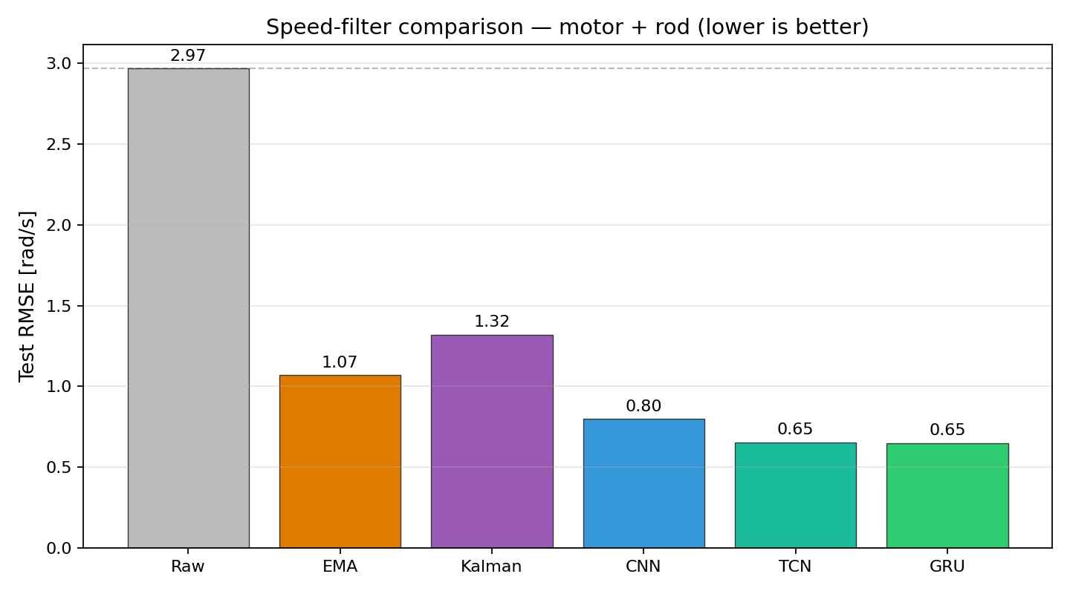
D4 ML2 — COMPARISON
Every neural filter beats every classical one.
— A 64-sample moving average barely helps — the rod swings fast enough that its lag cancels its smoothing.
— EMA and Kalman land at 1.1–1.3 rad/s — a useful but limited linear fit.
— GRU / TCN reach 0.65 rad/s — a 78% cut from the raw sensor and 51% below the tuned Kalman.
Fig. 1 — test-set RMSE by method (motor + rod, lower is better).

Slide 31
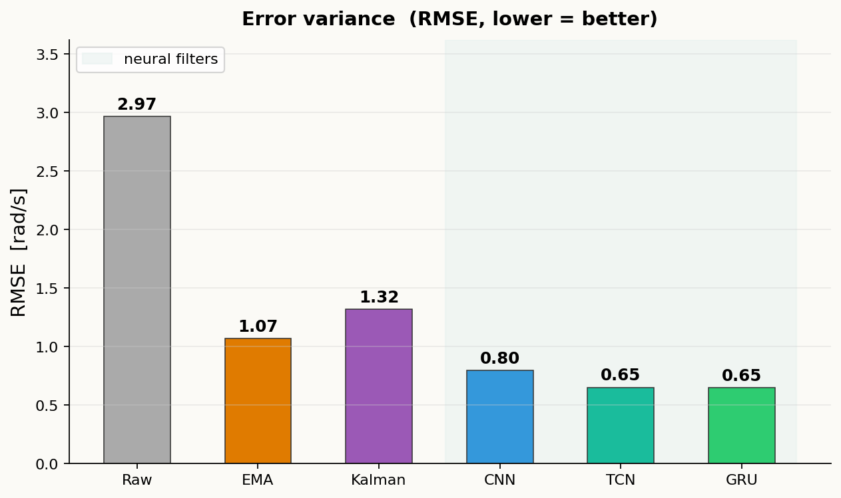
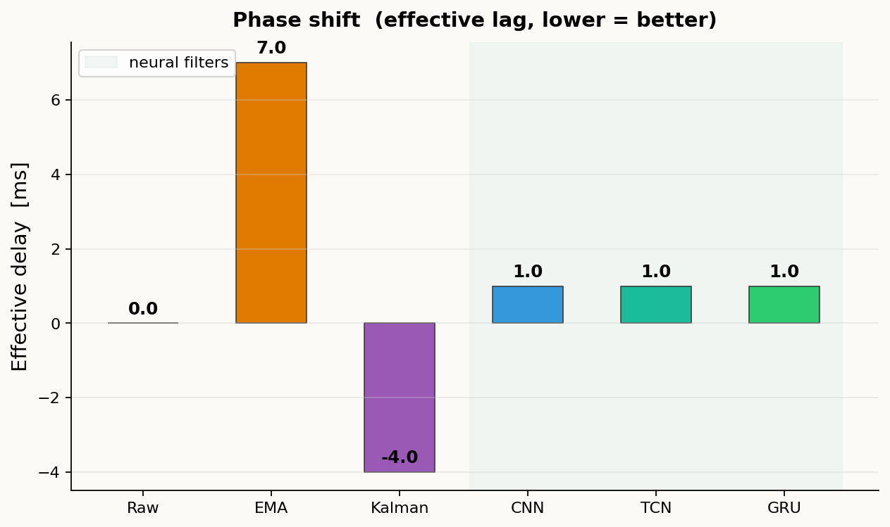
D5 ML2 — RESULTS: VARIANCE & DELAY
Neural filters win on both axes.
Variance (RMSE) and phase lag (effective delay) are independent failure modes. A good filter must minimize both — not just one.
Error std (RMSE, rad/s) — lower is better
Effective phase lag (ms) — lower is better
EMA: 7 ms lag, GRU/TCN: 1 ms. EMA halves RMSE vs raw but costs 7 ms of lag at α = 0.872. Neural filters cut RMSE a further 39 % AND reduce lag to one sample — faster response, less noise.

Slide 32
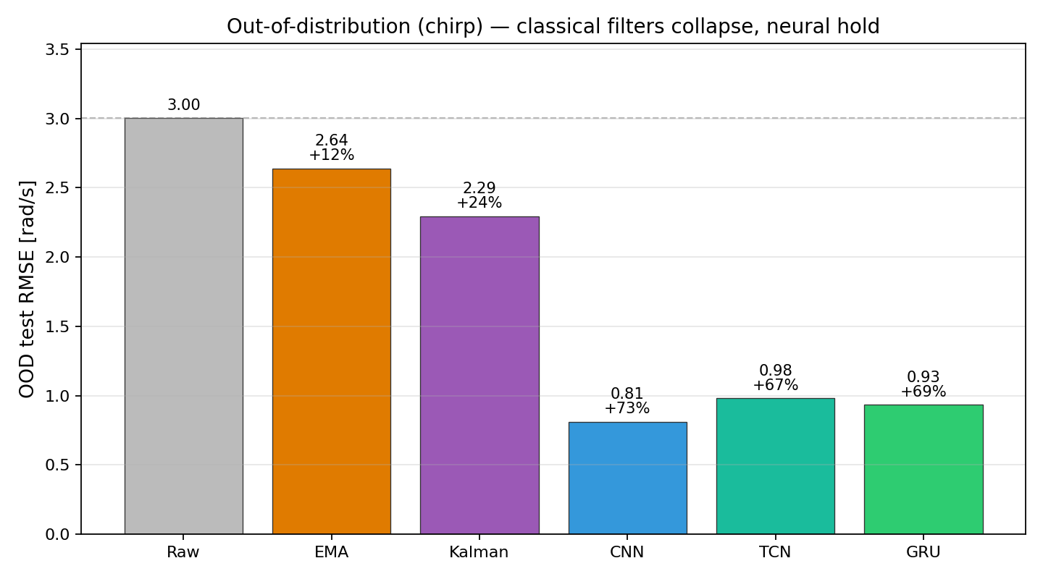
D6 ML2 — GENERALISATION (UNSEEN EXCITATION)
Classical filters break on unseen inputs.
Raw — no filter | 3.00 rad/s — reference
EMA — tuned | 2.64 rad/s +12 % (was +64 %)
Kalman — tuned | 2.29 rad/s +24 % (was +56 %)
TCN | 0.98 rad/s +67 % holds
GRU | 0.93 rad/s +69 % holds
CNN | 0.81 rad/s +73 % holds
Generalisation gap. On a chirp sweep never seen in training, EMA and Kalman collapse — implicitly tuned to the training spectrum — while neural filters hold +67–73 %, having learned the dynamics, not the excitation.
Fig. 2 — OOD (chirp) RMSE: classical filters collapse, neural hold.

Slide 33
AI IN ELECTRICAL ENGINEERING | Group 14 | 30 June 2026 |
Thank you !
Members
Alessandro Carlino | 3125999080
Riad Mohamed Attou | 3125999081
Phanpasorn Laor-iam | 3125999087
Paweekorn Buasakorn | 3125999096
Vladimir Serezhin | 3126999010

