Slide 1
AI IN ELECTRICAL ENGINEERING
[Presentation title]
[Short subtitle — one sentence describing the project]
[Author 1] · [Author 2]
[Author 3] · [Author 4]
Course
AI in Electrical Engineering
[University]
[Year]

Slide 2
TABLE OF CONTENTS
Outline.
I
Physical setup & dataset
Two-inertia servo ODE, chirp training excitation, multisine test.
II
ML1 — Motor identification
[Friend's section] Sparse identification of motor dynamics.
III
ML2 — Backlash compensation
GRU, CNN, TCN: per-window normalisation, architectures, results.
IV
Conclusion
Key numbers, takeaways, and future directions.

Slide 3
01 PHYSICAL SETUP & DATASET
[Physical setup & dataset]

Slide 4
02 ML1 — MOTOR IDENTIFICATION
[ML1 — motor identification]

Slide 5
02 ML1 — RESULTS
[ML1 — results & validation]

Slide 6
03 ML2 — FEATURE ENGINEERING
Per-window velocity normalisation.
Backlash error ≈ damper lag ∝ motor velocity. The chirp (train) is 2.4× faster than the multisine (test). A fixed error_std from training causes 2.3× over-correction on test — all models score worse than rigid coupling.
local_vel = std( diff(enc_m_window) ) ← velocity proxy per window
enc_m_rel[t] = (enc_m[t] − enc_m[t₀]) / local_vel ← input feature
y_norm = (θ_l − enc_m/N) / (local_vel / N) ← target
pred_error = model_output × (local_vel / N) ← denorm at inference
— Both input and target scale with the same local speed — the ratio is constant across train and test.
— After the fix, normalised-target std ratio train vs test: 1.06× (was 2.3×).
— Window W = 64 steps = 64 ms provides enough velocity history without excessive delay.

Slide 7
04 ML2 — MODEL ARCHITECTURES
Three architectures, three context lengths.
GRU
GRU (3 489 params)
Recurrent hidden state h accumulates 64 ms of context. hidden = 32, 1 layer.
CNN
CNN (8 801 params)
Stack of valid 1-D convolutions. Receptive field = 15 ms. channels = 32, k = 8, depth = 2.
TCN
TCN (33 153 params)
Dilated causal convolutions. Receptive field = 91 ms. channels = 32, k = 4, 4 levels.
All models: input (B, 64, 2) — [enc_m_rel, pwm_norm] — output scalar per-window normalised error. Loss: MSE. Optimiser: Adam lr = 1e-3.
RF_CNN = (k−1) × depth × 2 + 1 = 15 steps
RF_TCN = (k−1) × (2^levels − 1) × 2 + 1 = 91 steps

Slide 8
05 ML2 — RESULTS (TEST SET, 30 S MULTISINE)
TCN +48 %, GRU +29 % vs rigid coupling.
Rigid coupling — enc_m / N | RMSE 0.102 mrad (0.0058°) — reference
Output encoder — enc_o | RMSE 0.323 mrad (0.0185°) −217 %
CNN — valid conv, RF = 15 ms | RMSE 0.117 mrad (0.0067°) −14.8 %
GRU — W = 64 ms, hidden 32 | RMSE 0.072 mrad (0.0041°) +29.4 %
TCN 🏆 — dilated, RF = 91 ms | RMSE 0.052 mrad (0.0030°) +48.4 %
Why CNN fails. Its 15 ms receptive field cannot estimate velocity from a noisy quantised encoder. GRU (64 ms) and TCN (91 ms) are long enough to smooth the quantisation noise and measure velocity accurately.
Error is damper-induced lag proportional to motor velocity. A longer context gives a better velocity estimate — which directly explains the receptive-field ordering.

Slide 9
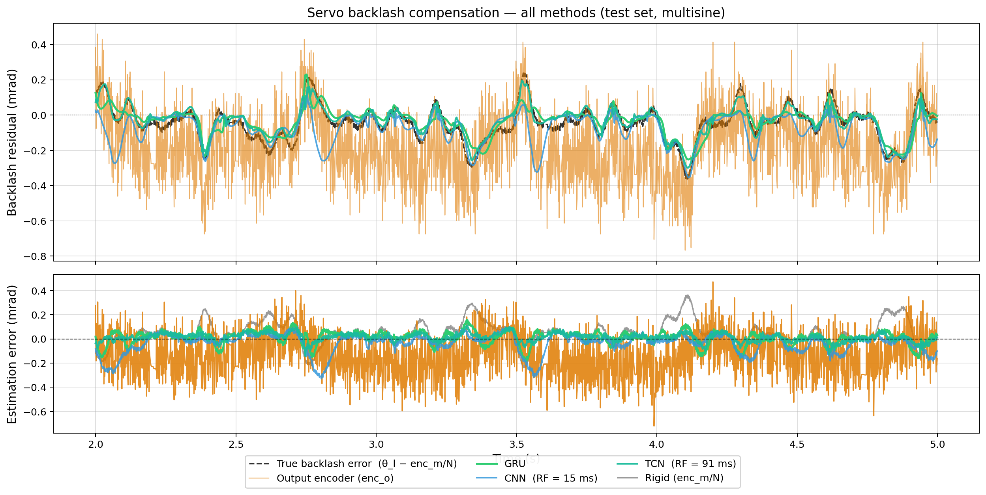
06 ML2 — COMPARISON FIGURE (ZOOM 2–5 S)
TCN tracks the true backlash error closely.
— True backlash error (dashed) stays within ±0.6 mrad — damper lag, not dead-zone hysteresis.
— TCN follows the oscillation; GRU close behind; CNN adds noise instead of removing it.
— Rigid coupling error oscillates in phase with motor velocity — confirming the v-proportional mechanism.
Fig. 1 — backlash residual and estimation error, zoom 2–5 s (test set, multisine).

Slide 10
07 ML2 — ANALYSIS
The gear spring never fires.
In the simulation, T_mesh = kg·dz + cg·(ω_m − N·ω_l). The spring kg·dz fires only when |φ| > gap_motor = 1 rad. But φ = θ_m − N·θ_l stays within ±0.03 rad throughout all runs.
φ = θ_m − N·θ_l ≤ 0.03 rad « gap_motor = 1.0 rad
→ dz = 0 → T_mesh = cg·(ω_m − N·ω_l) always
τ_l = Jl / (N²·η·cg) = 5e-3 / 42.5 ≈ 0.12 ms
— The task is predicting damper lag — proportional to velocity — not dead-zone hysteresis.
— Longer context improves the velocity estimate from noisy quantised encoder data.
— TCN (91 ms) > GRU (64 ms) > CNN (15 ms) — result follows directly from context length.
Next step. Reduce the output gap to 0.001 rad so the spring activates — that would stress-test hysteresis learning and likely widen the gap between GRU and TCN.

Slide 11
08 CONCLUSION
[Conclusion]

