Slide 1
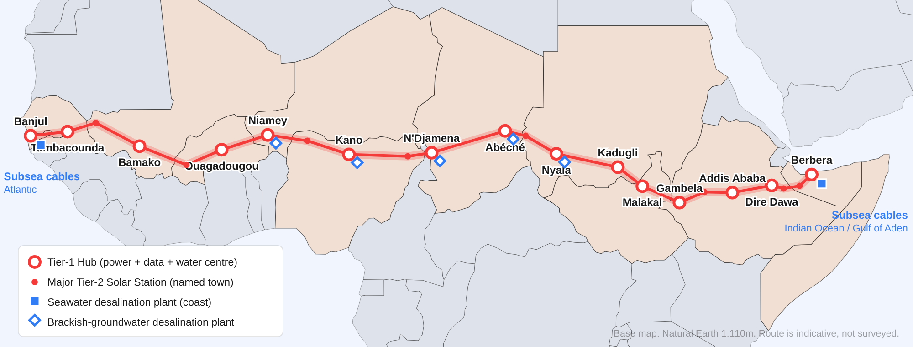
CONCEPT DESIGN · 2026 Project Founder
05-10-2026 Riad Ahmed -UK
Somalia–Gambia Trans-Sahel Corridor
One straight infrastructure strip from Berbera to Banjul carrying water, desalination, solar power and a 14-layer communication backbone

Slide 2
THE IDEA
One corridor, four systems, 11 countries
Lay water, solar power and every practical type of communication side by side in a single right-of-way from the Somali coast to the Gambian coast.
7,966 km
11
~11 GW
14
buildable route (≈ 4,950 miles)
countries crossed
solar PV + 25 GWh batteries
communication layers, 4 independent paths
~790k m³
6
~515
$44–80B
desalinated water per day
hydraulic water zones
stations (hubs, solar, relays)
over 15–20 years, phased
Distance check: the original estimate was 3,000 miles. Berbera–Banjul is 6,692 km (4,158 mi) in a straight line; a buildable route through towns and terrain is about 7,966 km (4,950 mi). Everything is sized for the longer route.
Somalia–Gambia Trans-Sahel Corridor · concept design, not surveyed
2 / 14

Slide 3
ALIGNMENT
Route: Berbera → Banjul along the Sahel belt
Berbera · Hargeisa · Jijiga · Dire Dawa · Addis Ababa · Gambela · Malakal · Kadugli · Nyala · Abéché · N'Djamena · Maiduguri · Kano · Sokoto · Niamey · Ouagadougou · Bamako · Kayes · Tambacounda · Banjul. Follows the Great Green Wall band (≈ 9–14°N). Indicative only, not surveyed.
Somalia–Gambia Trans-Sahel Corridor · concept design, not surveyed
3 / 14

Slide 4
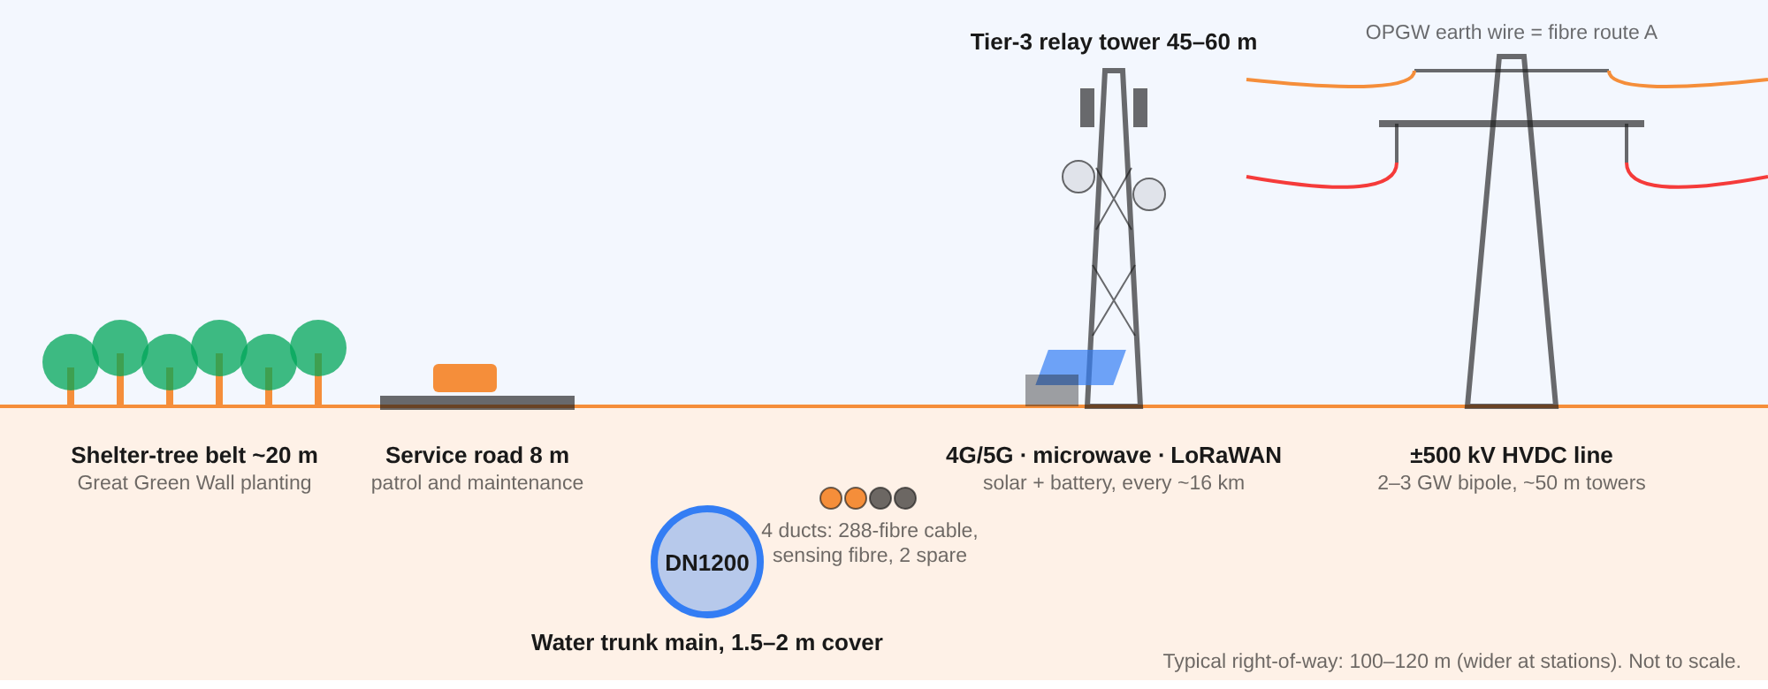
CORRIDOR CROSS-SECTION
Everything shares one strip of land
Water main and fibre ducts share one trench. HVDC towers carry a second fibre (OPGW). One service road and one security perimeter serve all layers, saving land, trenching and patrol cost.
Somalia–Gambia Trans-Sahel Corridor · concept design, not surveyed
4 / 14

Slide 5
SOLAR POWER
Three sizes of solar station
Tier | Spacing | Count | Solar + storage | Main equipment
Tier-1 hub | ~500 km | ~15 | 300 MW–1 GW PV, 0.6–2 GWh battery | HVDC converter, data centre, Internet Exchange Point, control room, water treatment or desalination, workshop, heliport
Tier-2 solar station | ~80 km | ~100 | 20–50 MWp, 40–100 MWh | Pump station, reservoir, DWDM amplifier/ROADM, fibre sensing, 60 m tower, drone dock, community services
Tier-3 relay | ~16 km | ~400 | 30–100 kWp PV, 200–400 kWh battery | 45–60 m tower: 4G/5G, microwave hop, LoRaWAN, CCTV/thermal camera, valve chamber, Wi-Fi
■ ~11 GW PV, ~25 GWh batteries across all stations, connected by a ±500 kV HVDC line (≈ 2–3 GW).
■ Links national grids East and West African power pools; surplus power is sold to towns along the line.
■ Built for the Sahel single-axis trackers, waterless robotic cleaning, shaded and ventilated equipment shelters.
Somalia–Gambia Trans-Sahel Corridor · concept design, not surveyed
5 / 14

Slide 6
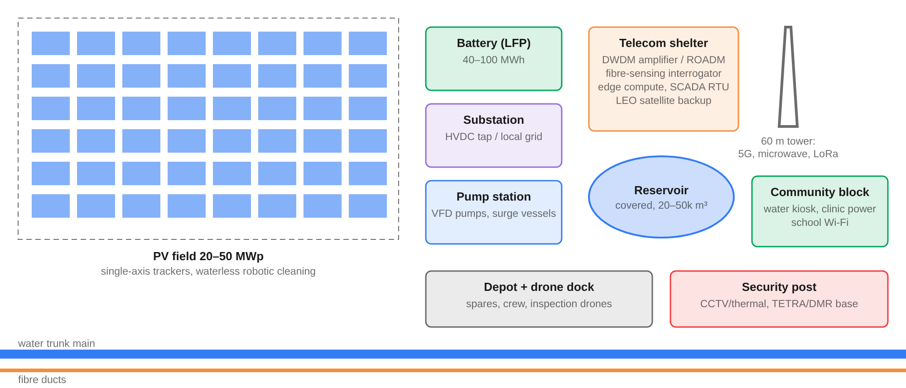
STATION LAYOUT
Inside a Tier-2 solar station
Every station also gives back locally: free water kiosk, clinic power and school Wi-Fi.
Somalia–Gambia Trans-Sahel Corridor · concept design, not surveyed
6 / 14

Slide 7
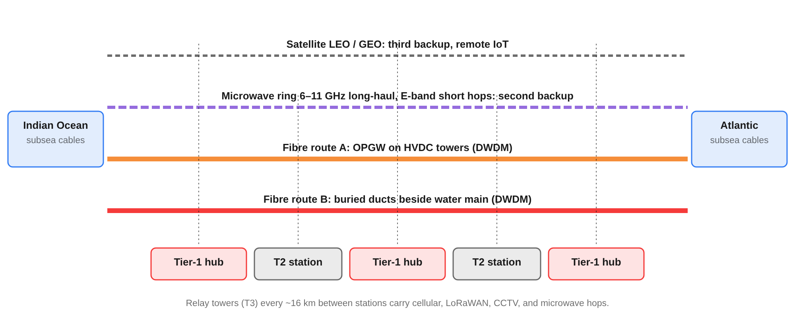
COMMUNICATIONS
Four independent communication paths
Strategic value: with subsea cable landings at both coasts, the corridor becomes a land route for internet traffic between the Indian Ocean and the Atlantic, as an alternative to the Red Sea / Suez path. Leasing that capacity can help pay for the project.
Somalia–Gambia Trans-Sahel Corridor · concept design, not surveyed
7 / 14

Slide 8
COMMUNICATIONS
14 communication layers
1
Buried DWDM fibre beside the water main
8
Fibre sensing acoustic + temperature: leaks, digging, intrusion
2
OPGW fibre on the HVDC towers
9
Satellite LEO/GEO backup and remote IoT
3
Subsea interconnects cable landings at both coasts
10
Mission-critical voice TETRA/DMR and HF
4
Microwave ring 6–11 GHz long haul, E-band short hops
11
OT control IEC 61850, IEC 60870-5-104, DNP3
5
Public 4G/5G coverage along the full route
12
Community services Wi-Fi, community FM, telemedicine, e-learning
6
Private LTE/5G operations and crews
13
Drones BVLOS inspection, ADS-B receivers
7
IoT sensors LoRaWAN, NB-IoT, LTE-M
14
Data centres + IXPs operations and security centres
Red: backbone paths · Blue: access and sensing · Navy: operations and services. All 14 layers together cost about 1–2% of the project.
Somalia–Gambia Trans-Sahel Corridor · concept design, not surveyed
8 / 14

Slide 9
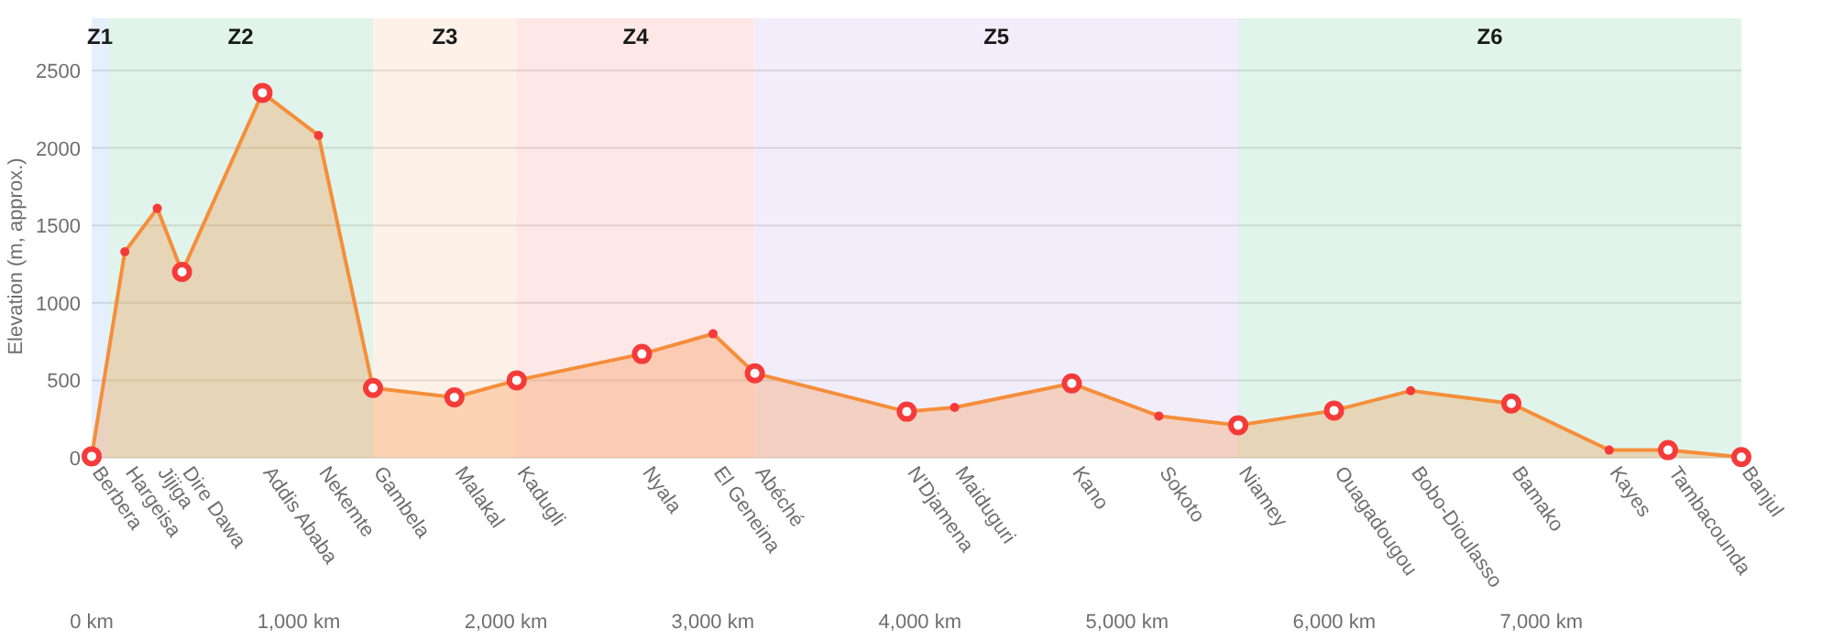
WATER
Water: six zones, not one coast-to-coast pipe
■ Why zones? Pumping seawater over the Ethiopian Highlands (≈ 2,355 m) would use a huge amount of energy.
■ Local sources first rivers, aquifers, rainwater, plus desalination.
■ Valved interties move surplus water to the driest section (Darfur–eastern Chad).
Zone | Section | Main sources
Z1 Gulf of Aden | Berbera–Hargeisa | Seawater desalination at Berbera; lift 1,300–1,600 m
Z2 Ethiopian Highlands | Jijiga–Nekemte | Rainwater harvesting, small dams, groundwater
Z3 Nile basin | Gambela–Malakal | Baro–Sobat / White Nile (needs Nile Basin agreement)
Z4 Darfur–Ouaddaï | Kadugli–Abéché | Deep aquifers, sand dams, brackish desalination (driest zone)
Z5 Lake Chad–Niger | N'Djamena–Niamey | Chari–Logone, aquifers, Niger River, brackish desalination
Z6 Niger–Senegal–Gambia | Ouagadougou–Banjul | Niger, Senegal and Gambia rivers; Atlantic desalination at Banjul
Somalia–Gambia Trans-Sahel Corridor · concept design, not surveyed
9 / 14

Slide 10
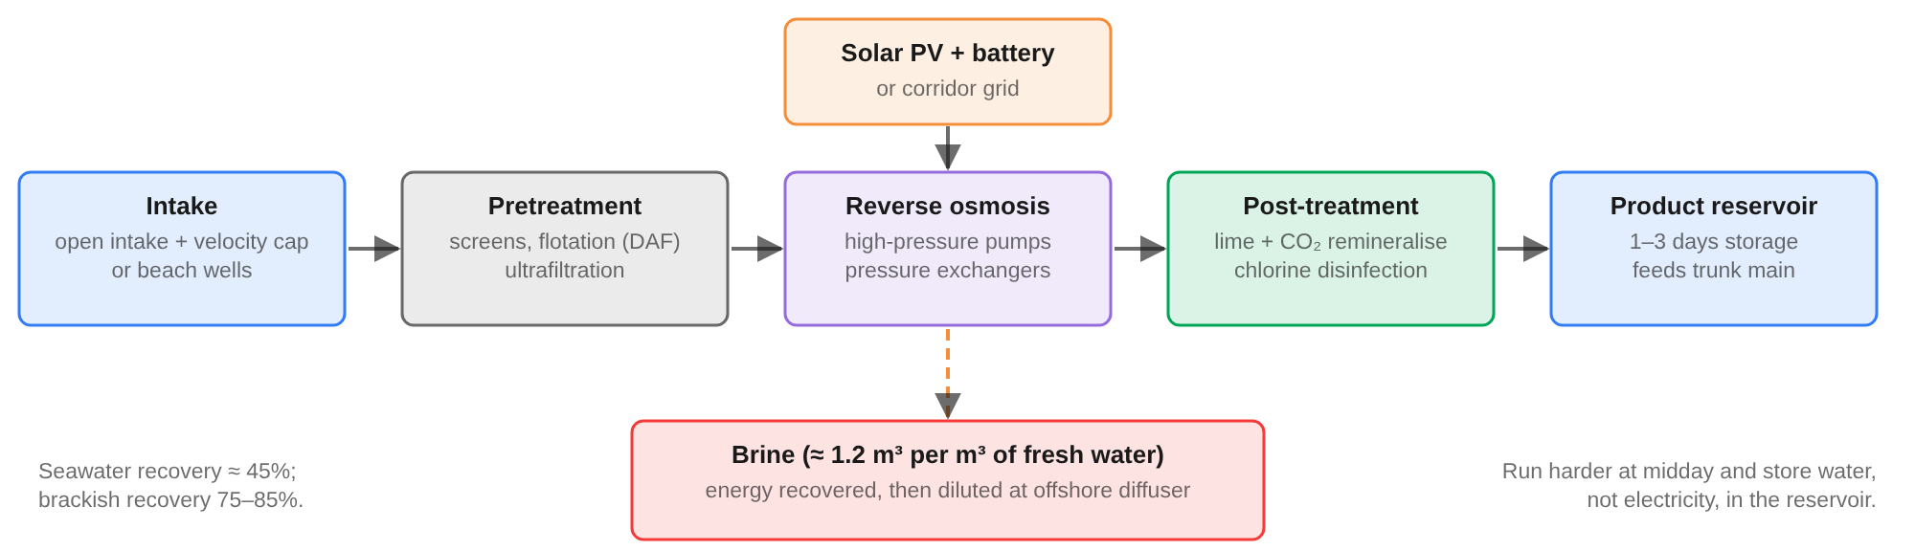
DESALINATION
Desalination plants powered by corridor solar
2
5
30
440 MWp
seawater plants (Berbera, Banjul)
inland brackish-water plants
solar container units
solar for desalination
Seawater RO uses ~3–3.5 kWh/m³; brackish RO ~0.5–1.5 kWh/m³. Plants run hardest at midday and store water in covered reservoirs (1–3 days), so fewer batteries are needed. Full build ≈ 790,000 m³/day, enough for ~16 million people at 50 L/day.
Somalia–Gambia Trans-Sahel Corridor · concept design, not surveyed
10 / 14

Slide 11
DESALINATION
Where the desalination plants go
Plant | Zone | Capacity m³/day | Brine disposal | Serves
Berbera seawater RO | Z1 | 100,000 → 300,000 | Offshore diffuser 1–2 km out | Berbera, Hargeisa, Jijiga (pumped up to the plateau)
Banjul seawater RO | Z6 | 150,000 → 300,000 | Offshore diffuser 1–2 km out | Greater Banjul, Gambia valley to Tambacounda; Dakar backup
Nyala brackish RO | Z4 | 35,000 | Evaporation ponds + salt recovery | Hub city and nearby stations
Abéché brackish RO | Z4 | 35,000 | Evaporation ponds + salt recovery | Hub city and nearby stations
N'Djamena brackish RO | Z5 | 50,000 | Evaporation ponds + salt recovery | Hub city and nearby stations
Kano brackish RO | Z5 | 30,000 | Evaporation ponds + salt recovery | Hub city and nearby stations
Niamey brackish RO | Z5 | 25,000 | Evaporation ponds + salt recovery | Hub city and nearby stations
Solar containers (×30) | Z4–Z5 | 100–1,000 each | Lined ponds at station | Villages and herders far from the main pipe
Water cost ≈ $0.5–1.0/m³ (seawater) and $0.2–0.4/m³ (brackish). Inland sites assume salty groundwater is available; well surveys must confirm salinity and yield. Inland brine never drains to rivers or aquifers.
Somalia–Gambia Trans-Sahel Corridor · concept design, not surveyed
11 / 14

Slide 12
INVESTMENT
Cost: $44–80 billion over 15–20 years
■ Water main is the biggest item, about a third of the total (incl. pump stations).
■ Communications cost only ~1–2%, so they are built first and earn revenue early.
■ Revenue fibre capacity leasing, power sales, water sales, corridor services.
■ Caveat planning-level ranges from typical unit costs, not surveys or bids.
Somalia–Gambia Trans-Sahel Corridor · concept design, not surveyed
12 / 14

Slide 13
IMPLEMENTATION
Build in five phases
Yr 0
Yr 5
Yr 10
Yr 15
Yr 20
Phase 0 Feasibility, treaties, surveys
Yr 0–2
11-state treaty, LiDAR route survey, impact studies, financing
Phase 1 Digital spine first
Years 1–5
Fibre, relay towers, cellular, IoT, satellite, cable landings
Phase 2 Solar stations + HVDC
Years 3–10
Pilot sections Banjul–Bamako and Berbera–Jijiga with first desal modules
Phase 3 Water zones
Years 5–18
Six hydraulic zones, full desalination, interties, tree belt
Phase 4 Corridor economy
Year 8 onward
Farming, cold chains, data centres, trade hubs; self-funding O&M
Somalia–Gambia Trans-Sahel Corridor · concept design, not surveyed
13 / 14

Slide 14
NEXT STEPS
Risks and open decisions
Key risks
Decisions needed
■ Security: conflict areas in Somalia, Sudan, Lake Chad and central Sahel. Mitigate with local benefit-sharing, buried assets, fibre intrusion sensing.
■ Shared rivers: Nile, Niger, Lake Chad, Senegal, Gambia need basin-body agreements.
■ Climate: dust, heat over 45 °C, flash floods and moving dunes.
■ Groundwater: inland desalination depends on confirmed brackish aquifers.
■ 1. Eastern start: Berbera (used here), Mogadishu or Bosaso.
■ 2. Central route: northern Nigeria via Kano (used here) or Niger via Zinder–Maradi.
■ 3. Governance: a treaty body backed by the AU / AfDB to own and run the corridor.
■ 4. First step: fund feasibility studies and a pilot section at each coast.
Somalia–Gambia Trans-Sahel Corridor · concept design, not surveyed
14 / 14

