Slide 1
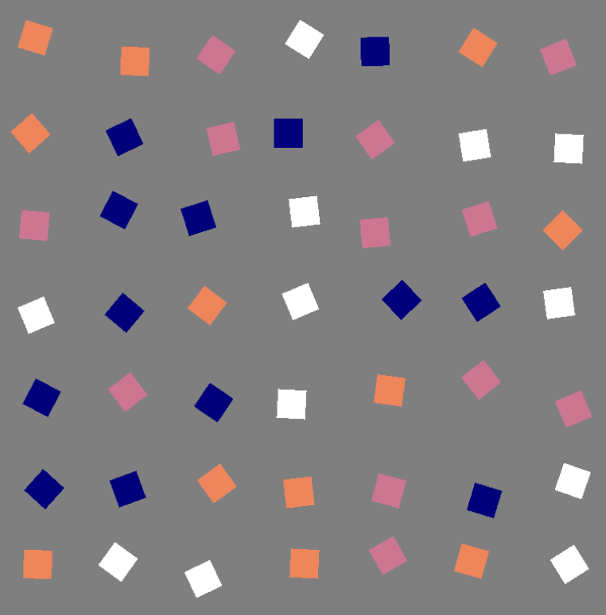
Class weights (b_{AvB})
Stick/Switch (b_{s})
Proximity (ρ_{δ})
Direction (ρ_{ψ})
Preference for target 1
Preference for target 2
High switch
High Stick
Low proximity
High proximity
Forwards
Backwards

Slide 2
Absolute direction
Preference for horizontal directions
Preference for vertical directions

