Slide 1
Badji Mokhtar – Annaba UNIVERSITY
Faculty of Engineering Sciences
Computer science department
Artificial intelligence speciality
LSTMs Classifiers Fusion For Multi-Label Text Classification
Supervisor: Nabiha Azizi
President: Amirouche Radia
Examiner: Guessoum Souad
Presented by:Berranem Mahdi
Notes:
Good afternoon , Thank you all for being here. first, I would like to [present myself my name is Berranem Mahdi, I’m here to do a presentation about my master thesis work which is about LSTMs Classifiers ..

Slide 2
work plan
Introduction
Feature Extraction
LSTM for Sequence Modeling
01
02
03
04
Methodology
05
Implementation
06
Conclusion and perspective
Notes:
Let's begin with presenting the main points that I will be focusing on today.
First we begin with an introduction ,next we will be talking about feature extraction, then we move on to LSTM for sequence Modeling, then we proceed to the proposed approach. Last but not least we conclude this presentation with a conclusion and some perspectives for future works.

Slide 3
01
Motivation
Problematic
Introduction
Objectif
Notes:
The introduction part is divided into three main parts :
●Motivation
●Problematic
●Objectif

Slide 4
01 Introduction
Rapid decision-making and effective process automation
Motivation
Tackle real world problems
Notes:
The Motivation for doing this work is primarily an interest of developing a rapid decision-making and effective process automation that tackles real world problems

Slide 5
01 Introduction
Traditional methods of feature extraction require handcrafted features.
Problematic
This method could be error-prone and time-consuming
No individual classifier can be effective in dealing with all classification problems.

Slide 6
01 Introduction
For best text representation we have been investigated an intelligent feature extraction which is GloVe word embedding model
Objectif
Several architectures based LSTM and their fusion have been experimented on and evaluated for the task of multi-label text classification
Notes:
A way to solve this problematic is to develop a fusion classifier that uses an intelligent feature extractor which is glove.

Slide 7
01 Introduction
What is the feature extraction technique for a better text document representation ?
Which LSTM Architecture is the best for Multi-Label Text classification ?

Slide 8
02
Feature Extraction

Slide 9
02 Feature Extraction
It consists of extracting a list of words from text data, and transforming it into a collection of features that a classifier can use.
Traditional methods like bag of words.
Intelligent Feature such as Glove, word2vec,and ELMO.
Notes:
1) FE plays a major role in TC as it has a direct impact on the classification performance
2) FE techniques can be divided into two categories:
Traditional methods
Intelligent FE

Slide 10
03
Recurrent neural networks
LSTM for Sequence Modeling
Long Short-Term Memory

Slide 11
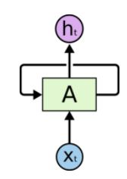
03 LSTM for Sequence Modeling
Recurrent neural networks
RNNs are the most used type of ANN’s for sequence modeling.
RNN have a problem which is Gradient vanishing.
Notes:
2) But sadly enough the simple architecture of

Slide 12
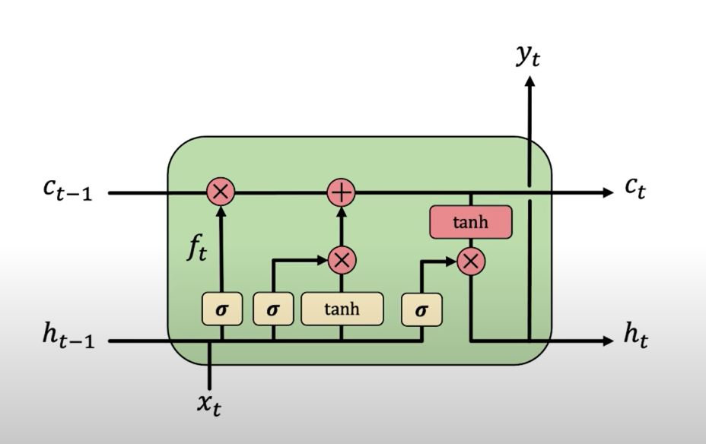
03 LSTM for Sequence Modeling
LSTM models contain computational blocks that control information flow
Long Short-Term Memory
Notes:
LSTM cells are able to control the information flow

Slide 13
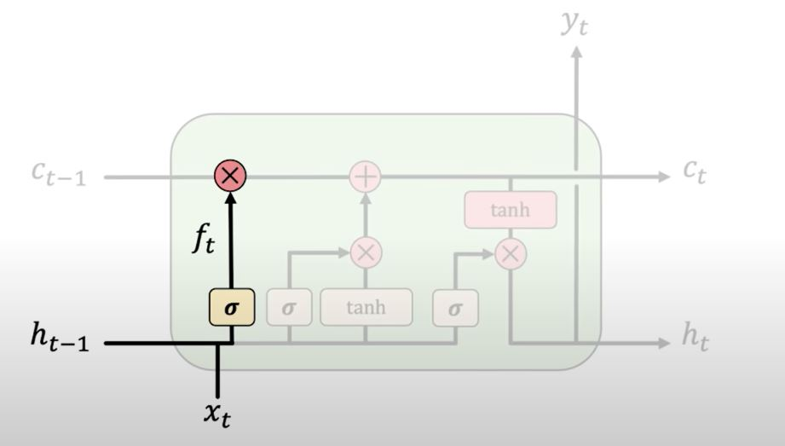
03 LSTM for Sequence Modeling
How do LSTMs work?
1)Forget 2)Store 3)Update 4)Output
Long Short-Term Memory
Notes:
With this gate LSTMs forget the irrelevant parts of the previous state

Slide 14
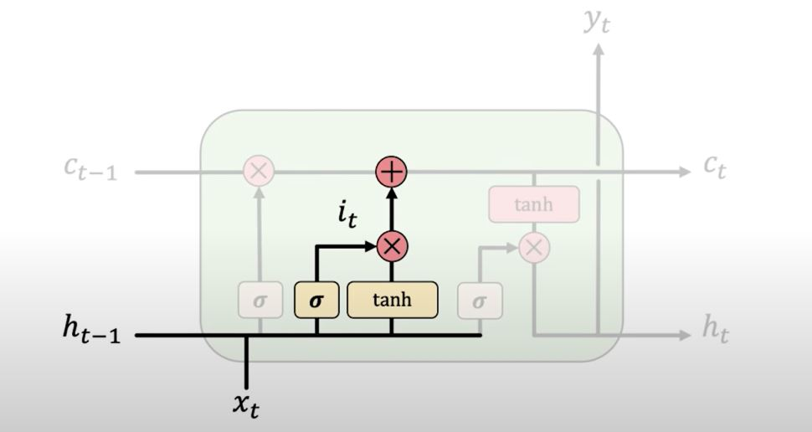
03 LSTM for Sequence Modeling
1)Forget 2)Store 3)Update 4)Output
Long Short-Term Memory
Notes:
This gate allow to LSTMs to store the relevant new information into the cell store

Slide 15
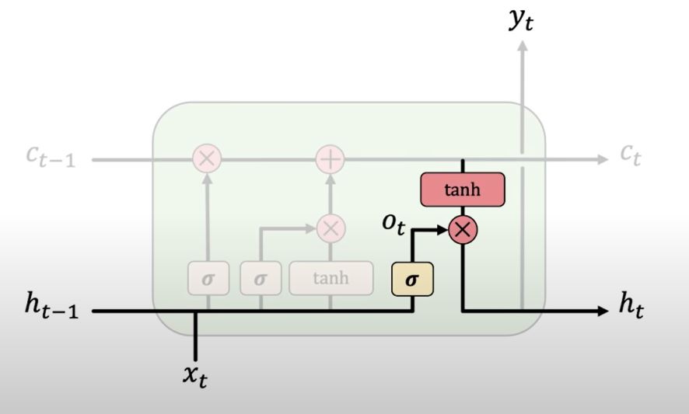
03 LSTM for Sequence Modeling
1)Forget 2)Store 3)Update 4)Output
Long Short-Term Memory
Notes:
LSTMs selectively update cell state values.

Slide 16
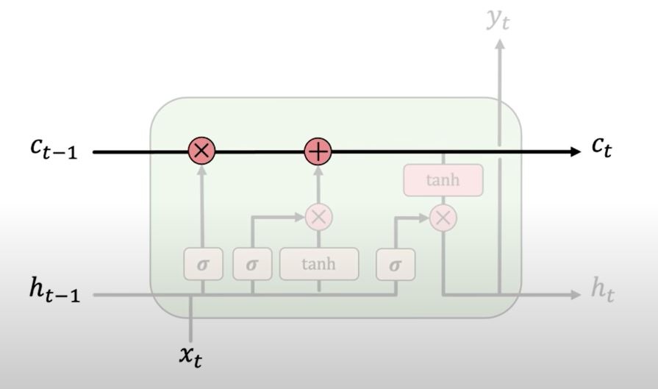
03 LSTM for Sequence Modeling
1)Forget 2)Store 3)Update 4)Output
Long Short-Term Memory
Notes:
The output gate controls what information is sent to the next time step

Slide 17
04
Methodology

Slide 18
04 Methodology
The system architecture
Dataset
Test Data
Output 1
Output 2
Fusion
Predicted Labels
Preprocessing
Static selection based-relevance
Prediction of the Subgroup
Lowercasing
Output n
Noise removal
Stop word removal
Output 1
Lemmatization
All
The models
Prediction
Of all the models
Fusion
Predicted Labels
Output 2
Tokenization
Output n
Feature Extraction
Model 1
Model 2
Model n
Glove
Train Data
Training Models
Feature vectors
Notes:
as shown in the slide here a scheme about the system architecture , in the next slides i ll be discussing more the different phases

Slide 19
04 Methodology
Data Preprocessing
The hemodynamic effects of epinephrine were prospectively studied in 13 patients
Original Data
Dataset
the hemodynamic effects of epinephrine were prospectively studied in 13 patients
Lowercasing
Preprocessing
Lowercasing
the hemodynamic effects of epinephrine were prospectively studied in patients
Noise removal
Noise removal
Stop word removal
hemodynamic effects epinephrine prospectively studied patients
Stop Word removal
Lemmatization
Tokenization
Lemmatization
hemodynamic effects epinephrine prospectively study patient
Tokenization
[‘hemodynamic’,’effects’,’epinephrine’, ‘prospectively’,’study’,’ patient’]
Notes:
the first stage of our system is data preprocessing, and the main goal of it is to reduce the size of data and keep it informative.

Slide 20
04 Methodology
Feature Extraction(GloVe)
Word vectors put words to a format of a vector space.
GloVe captures both global statistics and local statistics of a data, in order to come
up with word vectors.
GloVe model use the global word-word co-occurrence matrix to make the embedding.
Feature Extraction
Glove
Feature vectors
Notes:
Just to refresh,1, where similar words cluster together and different words repel
to derive semantic relationships between words 2
3 and the resulting representations showcase interesting linear substructures of the word vector space.

Slide 21
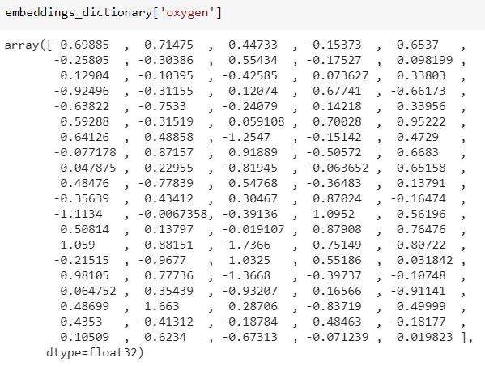
04 Methodology
Feature Extraction(GloVe)
Example of vector of the word oxygen produced by Glove model.
Notes:
as shown in slide is

Slide 22
04 Methodology
Model Architectures
The models are based on LSTM
Train Data
LSTM1
LSTM2
Training Models
CLSTM1
CLSTM2
Model 1
BLSTM1
Model 2
BLSTM2
Model n
Notes:
We have investigated a several of recent architectures based on LSTM
Namely :
LSTM CLSTM BLSTM and we have expiremented for each architecture with different parameters.

Slide 23
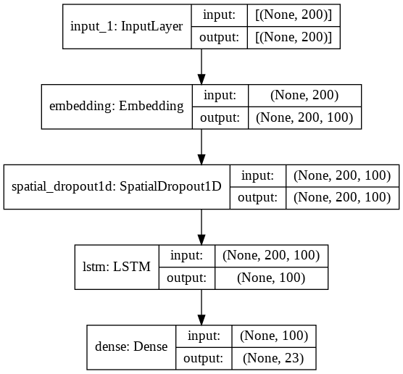
04 Methodology
Model Architectures
LSTM1 Architecture
LSTM2 Architecture
Embedding layer
LSTM layer
LSTM layer
Dropout layer
Dence layer
Notes:
The LSTM model archi consists of a LSTM layer and an embedding layer , the experiment we did is by adding another LSTM layer to the model

Slide 24
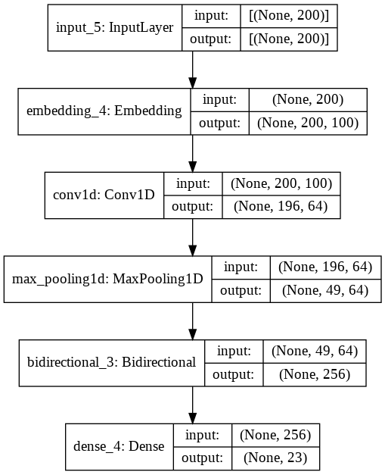
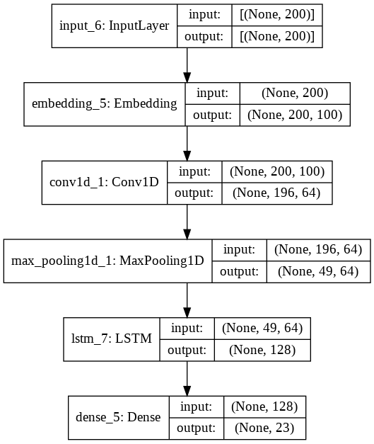
04 Methodology
Model Architectures
CLSTM1 Architecture
CLSTM2 Architecture
Notes:
The LSTM model archi consists of a 1D conv layer and biderctoinnel LSTM layer and an embedding layer , the experiment we did is by switching the biderctoinnel layer into a LSTM layer .

Slide 25
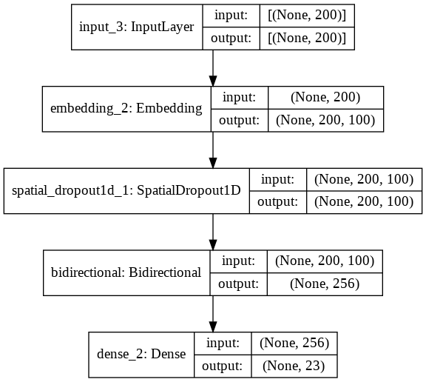
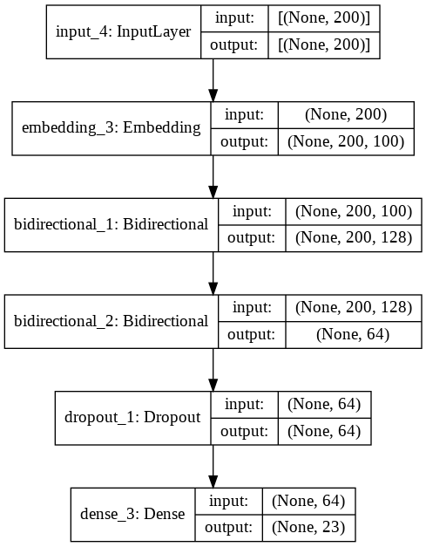
04 Methodology
Model Architectures
BLSTM1 Architecture
BLSTM2 Architecture
Notes:
The LSTM model archi consists of a biderctoinnel LSTM layer and an embedding layer , the experiment we did is by adding another biderctoinnel LSTM layer to the model

Slide 26
04 Methodology
Testing Phase
Test Data
Output 1
All
The models
Prediction
Of all the models
Fusion
Predicted Labels
Output 2
Output n
Notes:
in this slide we can see the process of the testing in our system ,first we get predictions from the different models then we apply the fusion based on majority voting to get the predicted labels .

Slide 27
04 Methodology
Testing Phase
Test Data
Output 1
selection based-relevance
Prediction of the Subgroup
Predicted Labels
Output 2
Fusion
Output n
Notes:
The same as we explained in the previous slide but fusion only the prediction from selected models (based on performance).

Slide 28
04 Methodology
Testing Phase
Fusion
Each classifier participates independently on the same problem.
Combine the outputs of all classifiers
The majority voting principal

Slide 29
05
Tech used
Implementation
Description of the data set
Resultat

Slide 30
05 Implementation
Tech Used
Python
Google Colab
keras
Notes:
The entire project was implemented with Python programming language using Google Colab Cloud Service that supports Keras

Slide 31
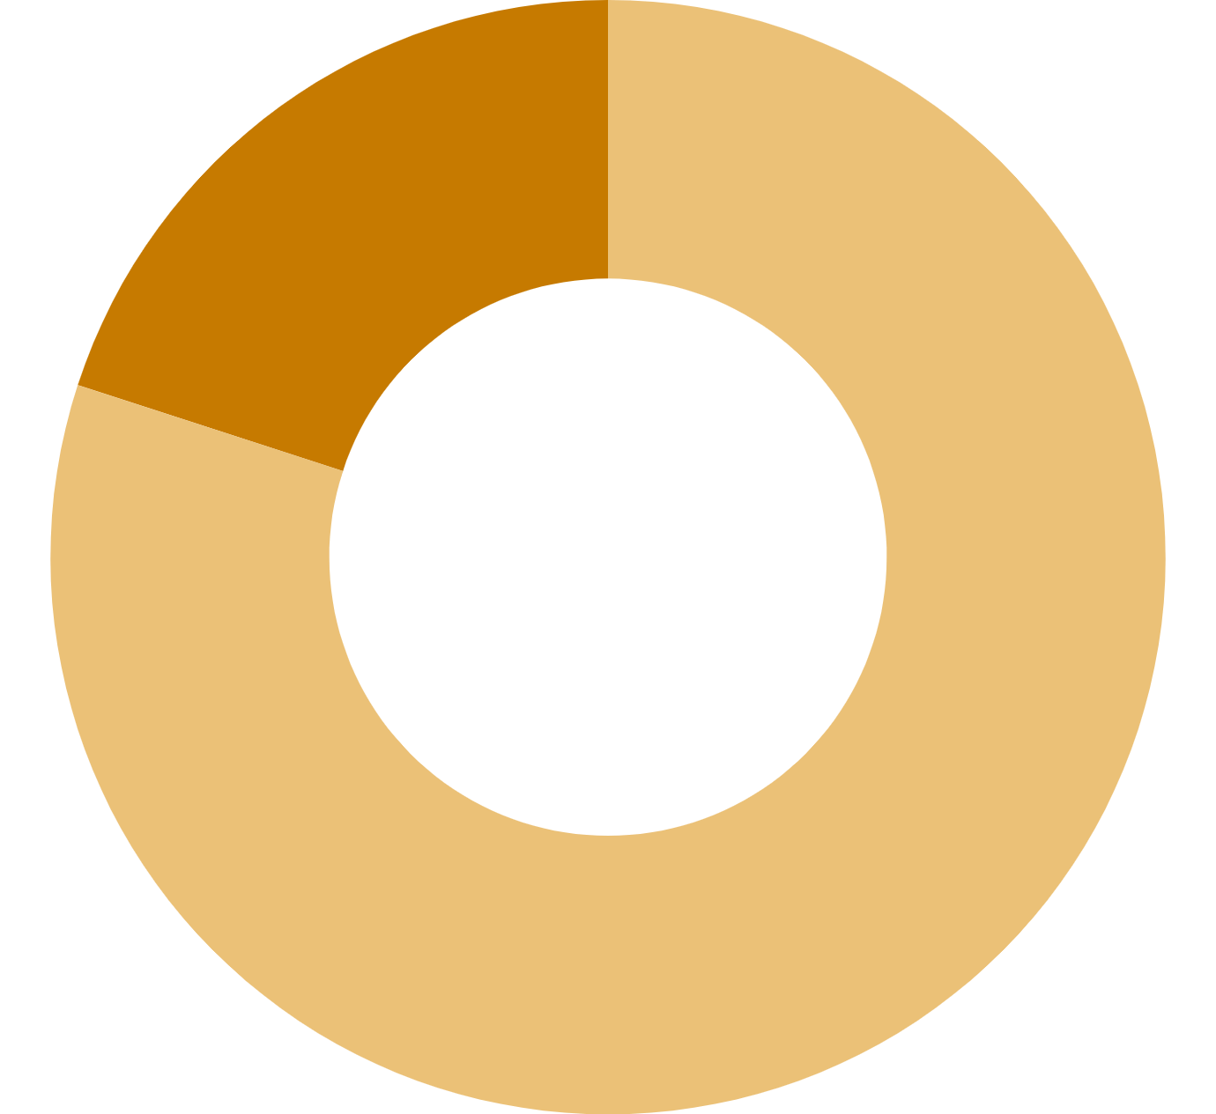
05 Implementation
Description of the data set
The Ohsumed collection is a subset of the MEDLINE database.
Bibliographic dataset of important peer-reviewed medical literature maintained by the National Library of Medicine.
Test phase
20%
With 13,929 documents distributed in 23 categories of cardiovascular diseases.
80%
Train phase
Notes:
the dataset is splited in

Slide 32
05 Implementation
Resultat
The results obtained for each classifier
 | Precision | Recall | F1-score | Accuracy
LSTM1 | 0.75 | 0.53 | 0.621 | 0.575
LSTM2 | 0.62 | 0.48 | 0.542 | 0.51
CLSTM1 | 0.67 | 0.48 | 0.555 | 0.52
CLSTM2 | 0.67 | 0.49 | 0.564 | 0.54
BLSTM1 | 0.72 | 0.55 | 0.642 | 0.577
BLSTM2 | 0.70 | 0.49 | 0.574 | 0.55
Notes:
the table shown the results of the six models, based on F1 score the outperform model is
in the next three slides we will see the visualisation of the evaluation metric and the loss function during the training process.

Slide 33
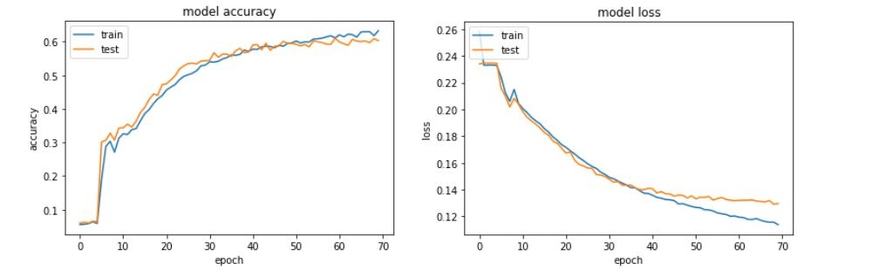
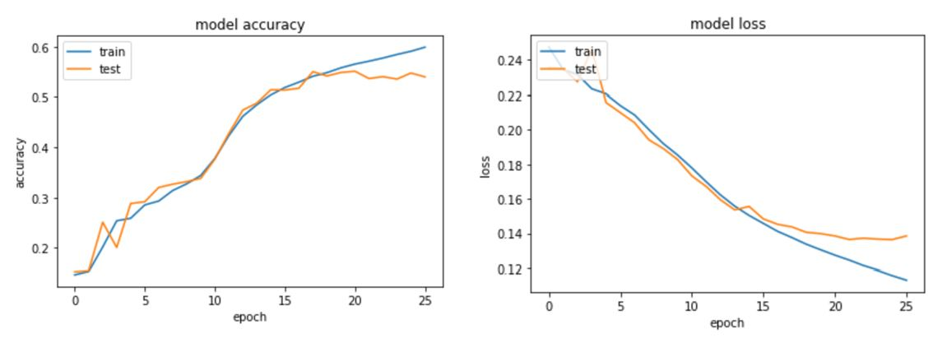
05 Implementation
LSTM1
LSTM2

Slide 34
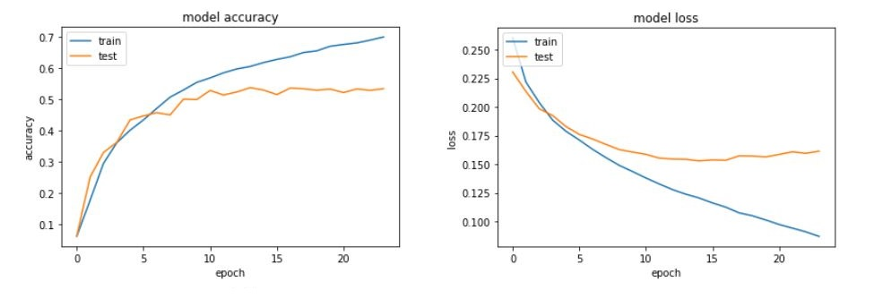
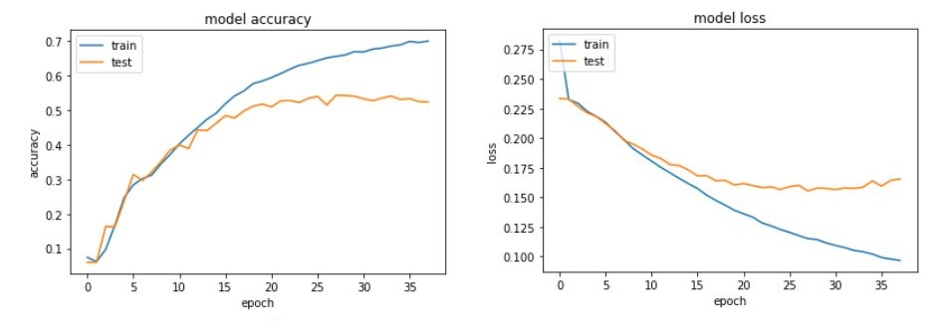
05 Implementation
CLSTM1
CLSTM2

Slide 35
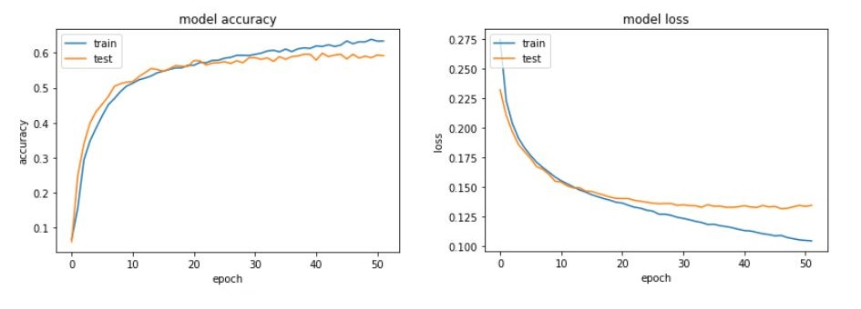
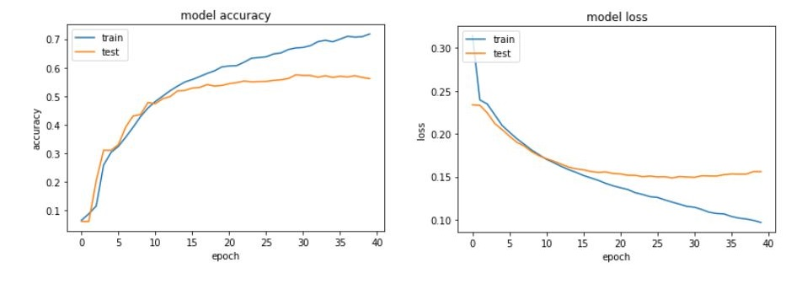
05 Implementation
BLSTM1
BLSTM2

Slide 36
05 Implementation
Resultat
The compared result with the previous stady
 | LSTM1 | LSTM2 | CLSTM1 | CLSTM2 | BLSTM1 | BLSTM2 | Previous Study
Accuracy | 0.575 | 0.51 | 0.52 | 0.54 | 0.577 | 0.55 | 0.51
Notes:
We also compare our findings with state-of-the art.
As shown in the following Table, our model accuracy outperforms the compared study in all the models except LSTM 2.

Slide 37
05 Implementation
Resultat
The results obtained for each classifier and their Fusion.
 | LSTM1 | LSTM2 | CLSTM1 | CLSTM2 | BLSTM1 | BLSTM2 | FAP
Precision | 0.75 | 0.62 | 0.67 | 0.67 | 0.72 | 0.70 | 0.75
Recall | 0.53 | 0.48 | 0.48 | 0.49 | 0.55 | 0.49 | 0.54
F1-score | 0.621 | 0.542 | 0.555 | 0.564 | 0.624 | 0.574 | 0.63
Accuracy | 0.575 | 0.51 | 0.52 | 0.54 | 0.577 | 0.55 | _

Slide 38
05 Implementation
Resultat
The results obtained for each classifier and their Fusion.
 | LSTM1 | LSTM2 | CLSTM1 | CLSTM2 | BLSTM1 | BLSTM2 | FAP | FSP
Precision | 0.75 | 0.62 | 0.67 | 0.67 | 0.72 | 0.70 | 0.75 | 0.77
Recall | 0.53 | 0.48 | 0.48 | 0.49 | 0.55 | 0.49 | 0.54 | 0.54
F1-score | 0.621 | 0.542 | 0.555 | 0.564 | 0.624 | 0.574 | 0.63 | 0.63
Accuracy | 0.575 | 0.51 | 0.52 | 0.54 | 0.577 | 0.55 | _ | _

Slide 39
05 Implementation
Resultat
Till now we noted that the FSP produced better results than the other models based on the F1-score in the revews results, but we also want to concentrate on the computation of errors in each class based on the confusion matrix

Slide 40
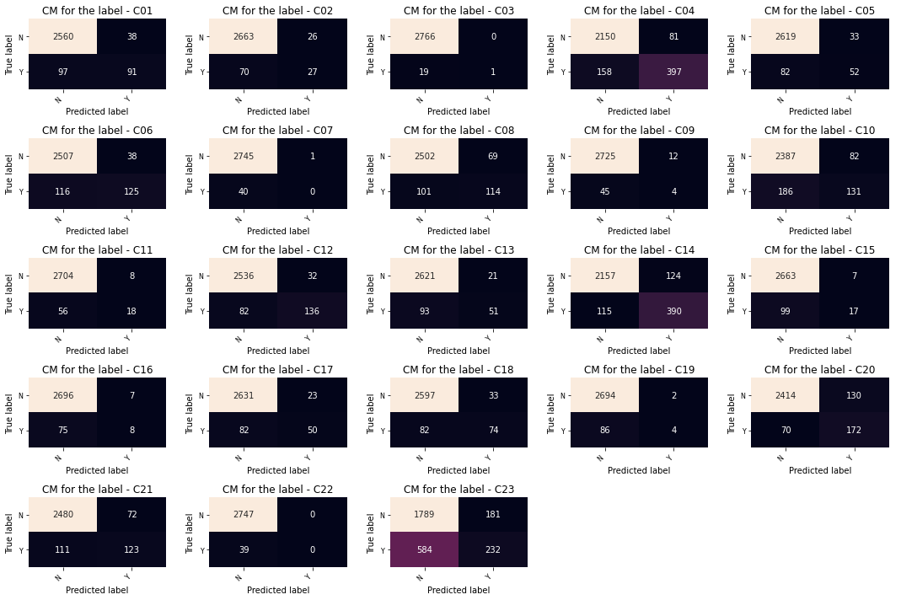
05 Implementation
Confusion matrix for outperform model
TN C01
TN C23

Slide 41
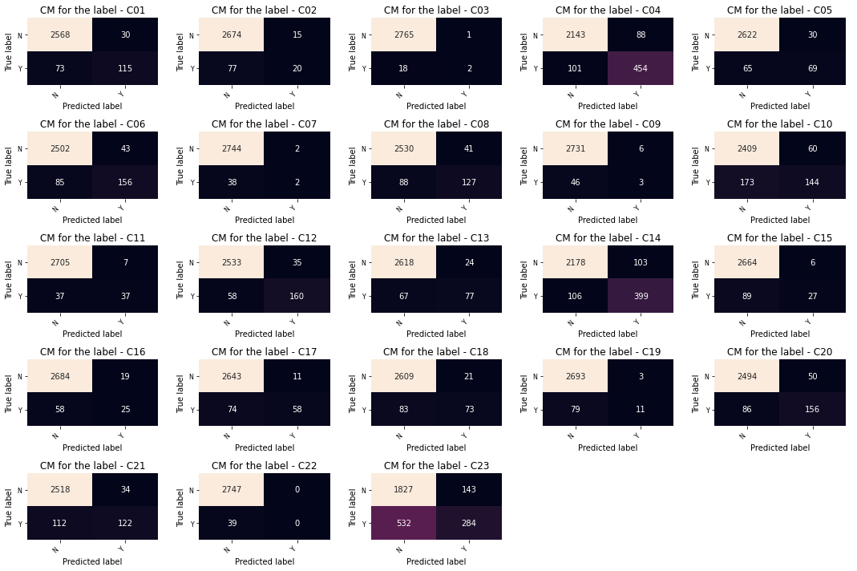
05 Implementation
Confusion matrix for FSP

Slide 42
05 Implementation
Resultat
The misclassification rate is kind of high for all the models, especially in the label 23, but the fusion technique lowered the misclassification rate with at least 2%.
The fusing of several complementary and diverse classifiers leads to a smaller error than that obtained with a single classifier.

Slide 43
06
Conclusion
Conclusion
And perspective
Perspective

Slide 44
06 Conclusion and perspective
Conclusion
In this thesis we have presented a multi-label text classification approach.
We worked with GloVe the state-of-art method for word embedding.
We use a several architectures based LSTM and their Fusion .
After implementing and testing our architectures, we ended up with acceptable performance.

Slide 45
06 Conclusion and perspective
Perspective
Developing an algorithm or technique that can handle multi-Label data imbalance.
Use a cooperation of two types of feature representation.
Take into account the relationship between labels and see their influence on system performance.
Notes:
The study can be extended by
to find the optimal feature vector for better represent textual data

Slide 46
Thank you for your attention

