Slide 1

Badji Mokhtar University – Annaba
Computer Science Department
Computer Systems and Decision
Classification of flood zones
for a decision support system
Supervisor : Hassina Seridi-Bouchelaghem
President : Legrini Samira
Examiner : Habes Mohamed Raouf
Presented By : Hachemane Riad
2021 - 2022

Slide 2
1. Introduction

Slide 3
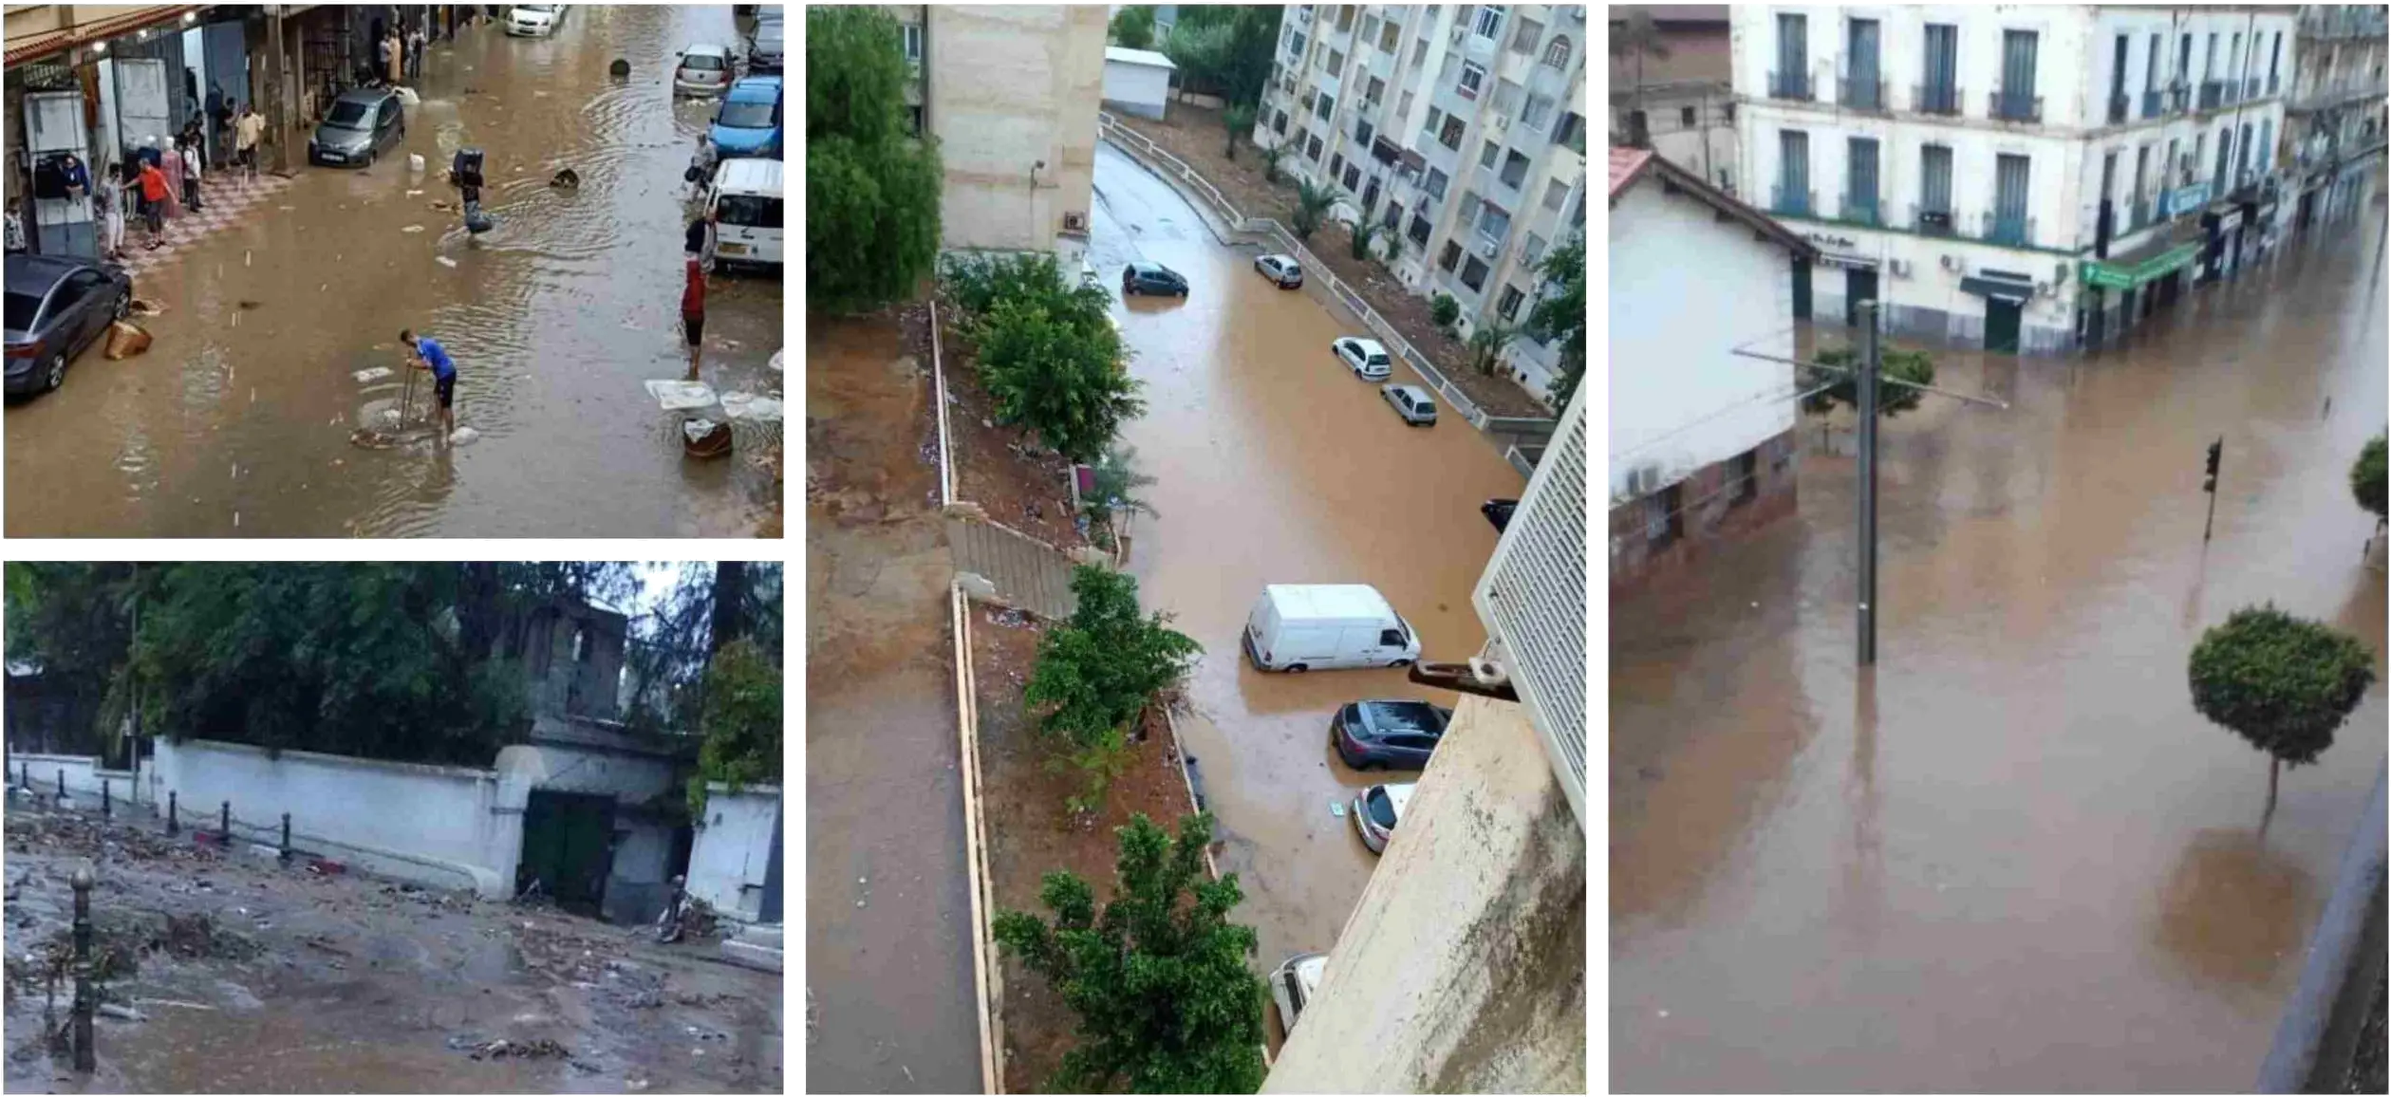
Context: Floods are a deadly threat.

Slide 4
Problematic
Traditional flood susceptibility models based on hydrological process tend to be unreliable.
The classification of flood intensity in certain areas is done through a mathematical equation with the help of experts.
Potential solutions
In recent years Machine learning methods have resulted in significant improvements in flood modeling.
Class decomposition is the process of segmenting each class into a number of homogeneous sub-classes.

Slide 5

Our Objectives
In an effort to create a decision support system
Compare the classification capabilities of machine learning methods in flood susceptibility.
Assess the possibility that there is more insight to uncover from datasets through decomposition with clustering.

Slide 6
2. Implementation

Slide 7
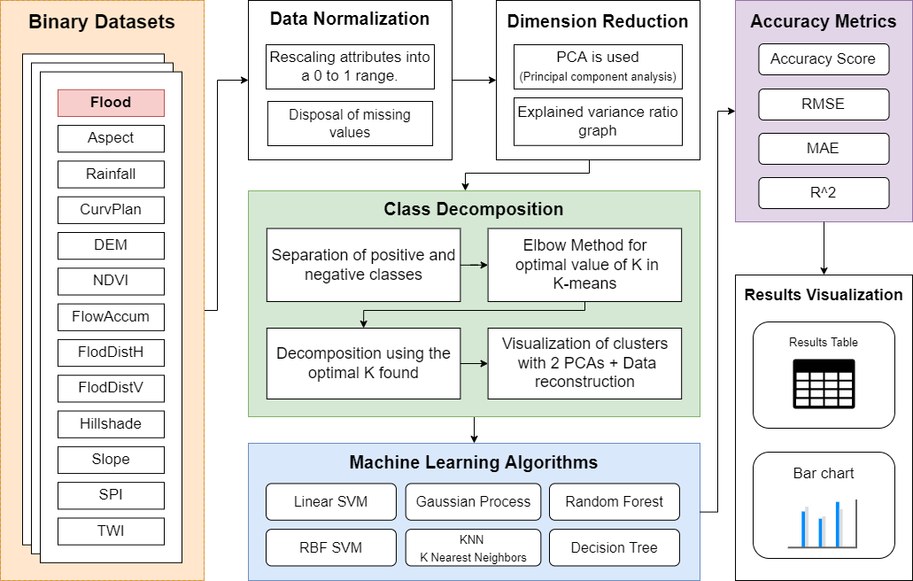
System Architecture

Slide 8
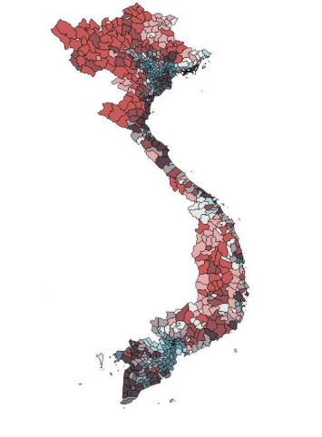
Dataset
The dataset that we will be running our evaluation on is of a Vietnamese basin
12 flood related features.
1675 records in total.
827 are positive (flood).
848 are negative (non-flood).
Vietnam Flood Susceptibility Map

Slide 9

Dataset
Testing
30%
The training set contains 70% of the data while the testing set contains the remaining 30%.
70%
Training

Slide 10
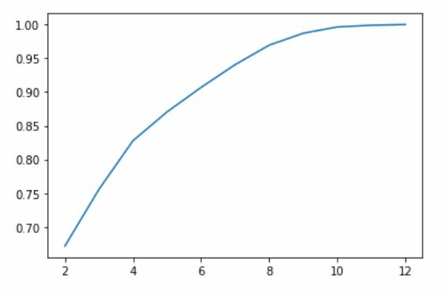
Dimensionality Reduction
Reducing the number of feature with PCA
8 features are explaining 97% of the dataset’s variance.
A Dimensionality Reduction from 12 to 8 features is therefore applied.
% of variance explained
No of components

Slide 11
Class Decomposition
Class decomposition is process of segmenting each class of a dataset into homogeneous sub-classes.
Clustering is a natural way to accomplish this.
We choose to use K-means Clustering for this project.

Slide 12
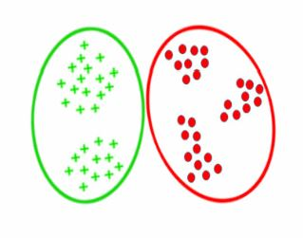
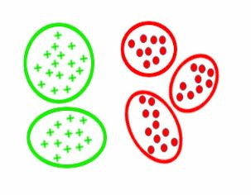
Class Decomposition
Clustering
K-means
Hierarchical Clustering
Etc ...

Slide 13
ML Algorithms Used
Gaussian Process
Artificial Neural Network
Decision Tree
Random Forest
K Nearest Neighbors
Linear SVM
Radial Basis SVM

Slide 14
3. Results

Slide 15
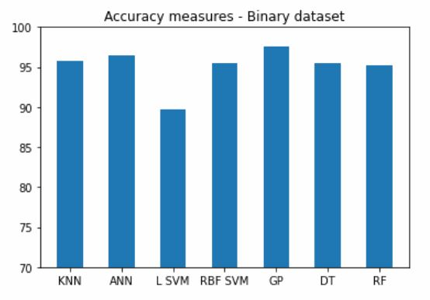
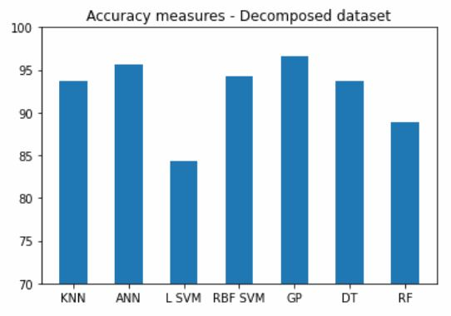
Results – Bar chart
Binary
Decomposed

Slide 16
Results – Comparative table – Binary dataset
Model | ACC | RMSE | MAE | R2
KNN | 95.83% | 0.0417 | 0.0417 | 0.8329
ANN | 96.42% | 0.0358 | 0.0358 | 0.8568
L SVM | 89.66% | 0.1034 | 0.1034 | 0.5863
RBF SVM | 95.43% | 0.0457 | 0.0457 | 0.8170
GP | 97.61% | 0.0239 | 0.0239 | 0.9045
DT | 95.43% | 0.0457 | 0.0457 | 0.8170
RF | 95.23% | 0.0477 | 0.0477 | 0.8091

Slide 17
Results – Comparative table – Decomposed dataset
Model | ACC | RMSE | MAE | R2
KNN | 93.64% | 0.3201 | 0.1252 | 0.8518
ANN | 95.63% | 0.3797 | 0.1173 | 0.8242
L SVM | 84.29% | 1.3698 | 0.4314 | 0.3657
RBF SVM | 94.23% | 0.4215 | 0.1392 | 0.8048
GP | 96.62% | 0.3101 | 0.0954 | 0.8564
DT | 93.64% | 0.3380 | 0.1312 | 0.8435
RF | 88.87% | 0.6064 | 0.2286 | 0.7192

Slide 18
Results Discussion
Top preforming models are the Gaussian Process Classifier and Artificial Neural network.
From 2 classes to 6 classes with only ≈1% difference in model accuracy.

Slide 19
Conclusion
We conclude after going from 2 classes to 6 classes with only ≈1% difference that there’s a pattern or meaning in the generated clusters that the classifiers are able to apprehend and perceive.

Slide 20
Perspective
There is room for further enhancements on the models for them to reach their optimal performance.
To find out what the generated clusters represent, we are waiting the response of our colleges from the department of hydraulics for the projection and mapping of our decomposed dataset.

Slide 21
Thank you for your attention

