Slide 1
BU7150 — Business Decision Optimization
Nonlinear Programming Practice Problems
Goal Programming
Dr. Isilay Talay
Assistant Professor in Operations and Supply Chain Management
Date 02/14/2022

Slide 2
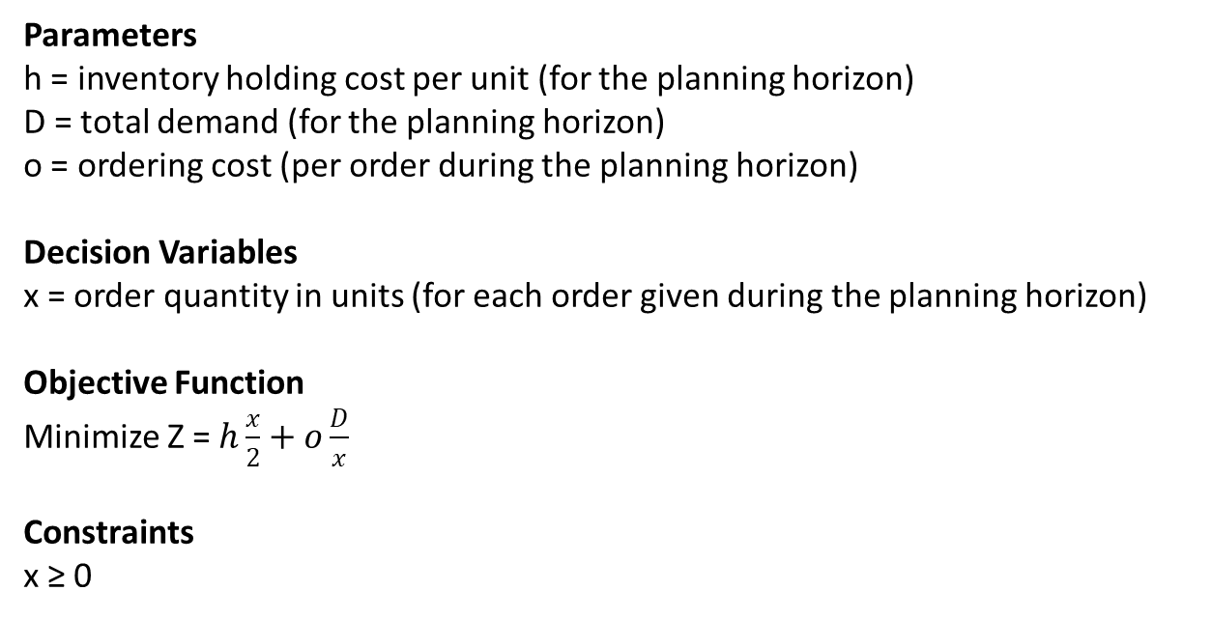
Nonlinear Programming Practice Problems
The Standard Economic Order Quantity (EOQ) Model
Parameters
h = inventory holding cost per unit (for the planning horizon)
D = total demand (for the planning horizon)
o = ordering cost (per order during the planning horizon)
Decision Variables
x = order quantity in units (for each order given during the planning horizon)
Objective Function
Minimize Z = $h\frac{x}{2}+o\frac{D}{x}$
Constraints
x ≥ 0

Slide 3

Nonlinear Programming Practice Problems
The Standard Economic Order Quantity (EOQ) Model
Two ways to solve:
1) Algebraically
$$Z=h\frac{x}{2}+o\frac{D}{x}$$
$$\frac{dZ}{dx}=\frac{h}{2}+oD\left(\frac{−1}{x^{2}}\right)$$
$$\frac{d^{2}Z}{dx^{2}}=oD\left(\frac{2}{x^{3}}\right)≥0$$
$$\frac{dZ}{dx}=\frac{h}{2}+oD\left(\frac{−1}{x^{2}}\right)=0 →x=\sqrt{\frac{2oD}{h}}$$

Slide 4
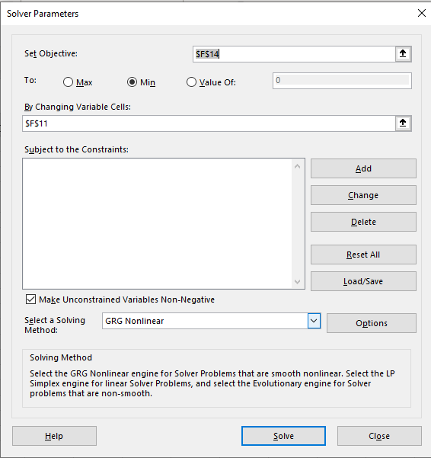
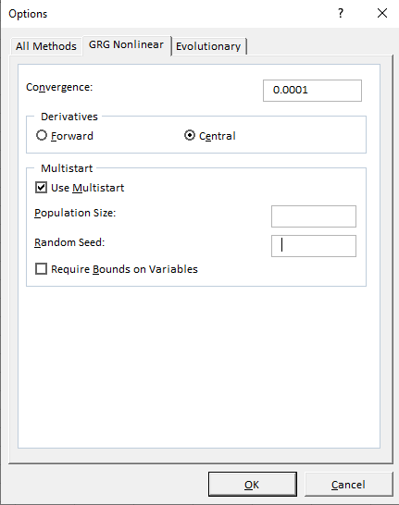
Nonlinear Programming Practice Problems
The Standard Economic Order Quantity (EOQ) Model
Two ways to solve:
2) Computationally
Excel Solver – ‘GRG Nonlinear’ Method, GRG: Generalized Reduced Gradient
Start from an arbitrary point
Detect when partial derivatives become zero
Could end up with local optimum if there is no convexity/concavity

Slide 5



Nonlinear Programming Practice Problems
The Standard Economic Order Quantity (EOQ) Model – World Class Furniture
The case without any space or budget constraints
$$x=\sqrt{\frac{2oD}{h}}$$
$$Z=h\frac{x}{2}+o\frac{D}{x}$$
$$\sum_{i=1}^{5}{Z_{i}}=\sum_{i=1}^{5}{h_{i}\frac{x_{i}}{2}}+o_{i}\frac{D_{i}}{x_{i}}$$

Slide 6

Nonlinear Programming Practice Problems
The Standard Economic Order Quantity (EOQ) Model – World Class Furniture
The case with total space and budget constraints
$$\sum_{i=1}^{5}{Z_{i}}=\sum_{i=1}^{5}{h_{i}\frac{x_{i}}{2}}+o_{i}\frac{D_{i}}{x_{i}}$$

Slide 7
Nonlinear Programming Practice Problems
The Standard Economic Order Quantity (EOQ) Model – World Class Furniture
The case with total space and budget constraints

Slide 8
Nonlinear Programming Practice Problems
The Standard Economic Order Quantity (EOQ) Model – World Class Furniture
The case with total space and budget constraints

Slide 9
Nonlinear Programming Practice Problems
Canning Consultants: The OPAC Assessment
Why were the services of this consultant needed?
Why are the assessments needed for the properties?
How does the valuation technique ‘Quality Point’ used by Canning Consultants work?

Slide 10
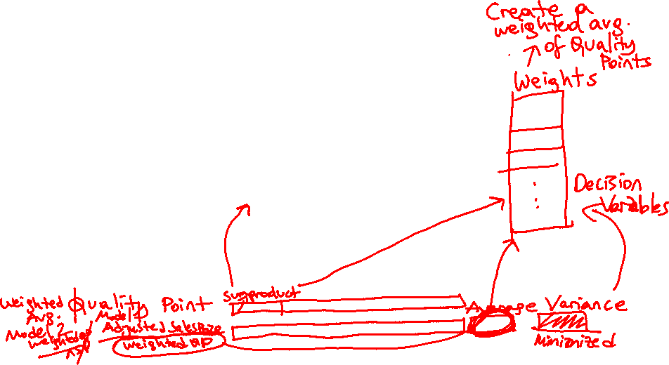
Nonlinear Programming Practice Problems
Canning Consultants: The OPAC Assessment
Comparables for 195 Dufferin

Slide 11
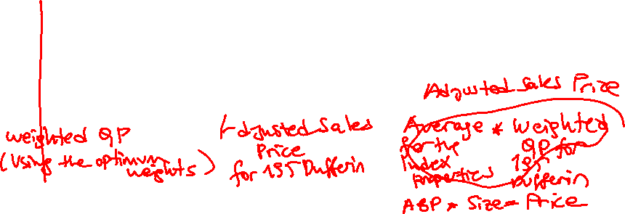
Nonlinear Programming Practice Problems
Canning Consultants: The OPAC Assessment
Calculations for 195 Dufferin
4) What are the strengths and weaknesses of Canning’s approach?

Slide 12
Goal Programming
Introduction
What could a company or non-profit organization be trying to achieve that would require mathematical programming (e. g. linear and nonlinear programming)?
Revisiting Rolls Bakery - with multiple objectives
Original version
x₁: Dinner roll cases (DRC)
x₂: Sandwich roll cases (SRC)
Max (Total Contribution to Net Profit) Z = 400 x₁ + 300 x₂
subject to
10 x₁ + 15 x₂ ≤ 150 (machine hours)
x₁ ≥ 3 (demand for product 1)
x₂ ≥ 4 (demand for product 2)
x₁ , x₂ ≥ 0 (non-negativity constraints)
x₁* = 9, x₂* = 4
Z*=$4,800
Use of machine hours is 150 hours

Slide 13

Goal Programming
Introduction
Revisiting Rolls Bakery - with multiple objectives
Step 1)
List the new set of goals
-Meeting the weekly demand
-Not over producing more than 2 lots per product
-Not doing overtime at the machine
-Making maximum possible profit
Step 2)
Goal priority order
Aspiration level for each goal
Goal priority values (level of punishment for deviation per unit from achieving that goal)
Goal 2, Aspiration Level: 3 DRC 4 SRC Value: 300
Goal 1, Aspiration Level: 5 DRC 6 SRC Value: 300
Goal 3, Aspiration Level: 150 hours Value: 20
Goal 4, Aspiration Level: $4800 Value: 10

Slide 14
Goal Programming
Introduction
Revisiting Rolls Bakery - with multiple objectives
Step 3: Formulate the problem as a simple LP model
Step 4: Define deviational variables for each goal
Step 5: Write Goal Programming (GP) and system (LP oriented) constraints
Step 6: Add non-negativity constraints for functional and deviational variables
Step 7: Determine the variables to be minimized in the objective function
Step 8: Write the objective function with the matching priorities

Slide 15

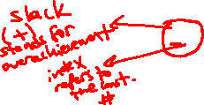
Goal Programming
Introduction
Revisiting Rolls Bakery - with multiple objectives
Step 3: Formulate the problem as a simple LP model
Step 4: Define deviational variables for each goal
x₁: Dinner roll cases (DRC)
x₂: Sandwich roll cases (SRC)
Max (Total Contribution to Net Profit) Z = 400 x₁ + 300 x₂
subject to
10 x₁ + 15 x₂ ≤ 150 (machine hours) (1)
x₁ ≥ 3 (demand for product 1) (2)
x₂ ≥ 4 (demand for product 2) (3)
x₁ ≤ 5 (Not over producing more than 2 lots per product for product 1) (4)
x₂ ≤ 6 (Not over producing more than 2 lots per product for product 2) (5)
x₁ , x₂ ≥ 0 (non-negativity constraints) (6)
$$Deviational$$
$$Variables$$
$$s_{6}^{+}, s_{6}^{−}$$
$$s_{1}^{+}, s_{1}^{−}$$
$$s_{2}^{+}, s_{2}^{−}$$
$$s_{3}^{+}, s_{3}^{−}$$
$$s_{4}^{+}, s_{4}^{−}$$
$$s_{5}^{+}, s_{5}^{−}$$

Slide 16
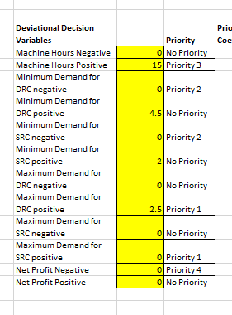
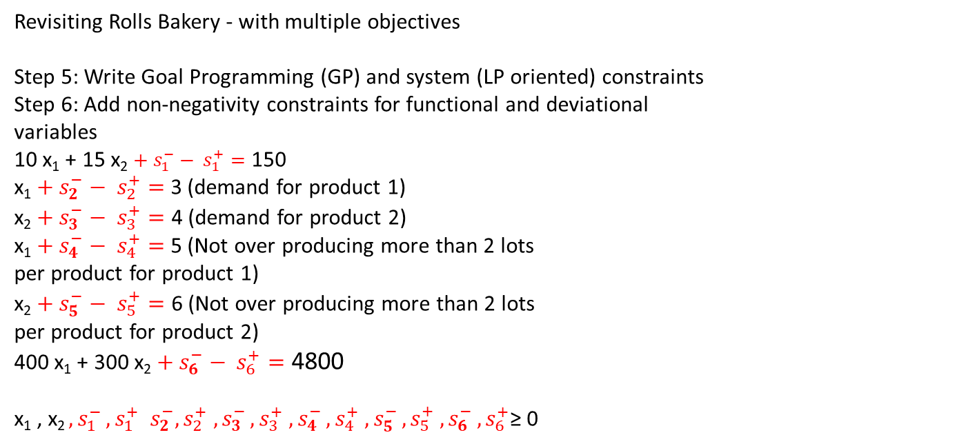


Goal Programming
Introduction
Revisiting Rolls Bakery - with multiple objectives
Step 5: Write Goal Programming (GP) and system (LP oriented) constraints
Step 6: Add non-negativity constraints for functional and deviational
variables
10 x₁ + 15 x₂ ${{+ s}_{1}^{−}− s}_{1}^{+}=$ 150
x₁ ${{+ s}_{2}^{−}− s}_{2}^{+}=$ 3 (demand for product 1)
x₂ ${{+ s}_{3}^{−}− s}_{3}^{+}=$ 4 (demand for product 2)
x₁ ${{+ s}_{4}^{−}− s}_{4}^{+}=$ 5 (Not over producing more than 2 lots
per product for product 1)
x₂ ${{+ s}_{5}^{−}− s}_{5}^{+}=$ 6 (Not over producing more than 2 lots
per product for product 2)
400 x₁ + 300 x₂ ${{+ s}_{6}^{−}− s}_{6}^{+}=$ 4800
x₁ , x₂ ${{, s}_{1}^{−}, s}_{1}^{+}$ ${{ s}_{2}^{−}, s}_{2}^{+}$ ${{, s}_{3}^{−}, s}_{3}^{+}$ ${{,s}_{4}^{−}, s}_{4}^{+}$ ${{, s}_{5}^{−}, s}_{5}^{+}$ ${{, s}_{6}^{−}, s}_{6 }^{+}$≥ 0
$${s_{1}^{−}, s}_{1}^{+}$$

Slide 17
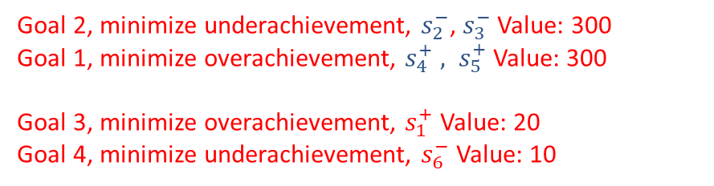
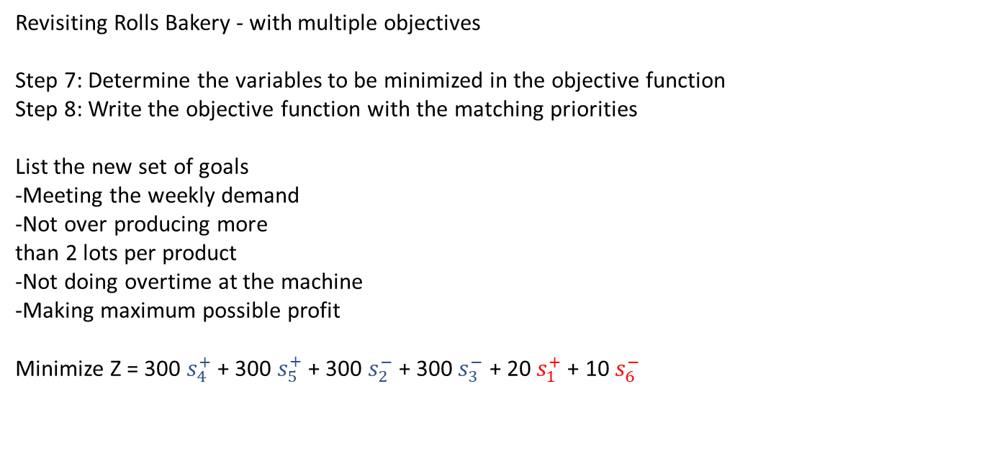
Goal Programming
Introduction
Revisiting Rolls Bakery - with multiple objectives
Step 7: Determine the variables to be minimized in the objective function
Step 8: Write the objective function with the matching priorities
List the new set of goals
-Meeting the weekly demand
-Not over producing more
than 2 lots per product
-Not doing overtime at the machine
-Making maximum possible profit
Minimize Z = 300 $s_{4}^{+}$ + 300 $s_{5}^{+}$ + 300 $s_{2}^{−}$+ 300 $s_{3}^{−}$ + 20 $s_{1}^{+}$+ 10 $s_{6}^{−}$
Goal 2, minimize underachievement, $s_{2}^{−}$, $s_{3}^{−}$ Value: 300
Goal 1, minimize overachievement, $s_{4}^{+}$ ${, s}_{5}^{+}$ Value: 300
Goal 3, minimize overachievement, $s_{1}^{+}$ Value: 20
Goal 4, minimize underachievement, $s_{6}^{−}$ Value: 10

Slide 18
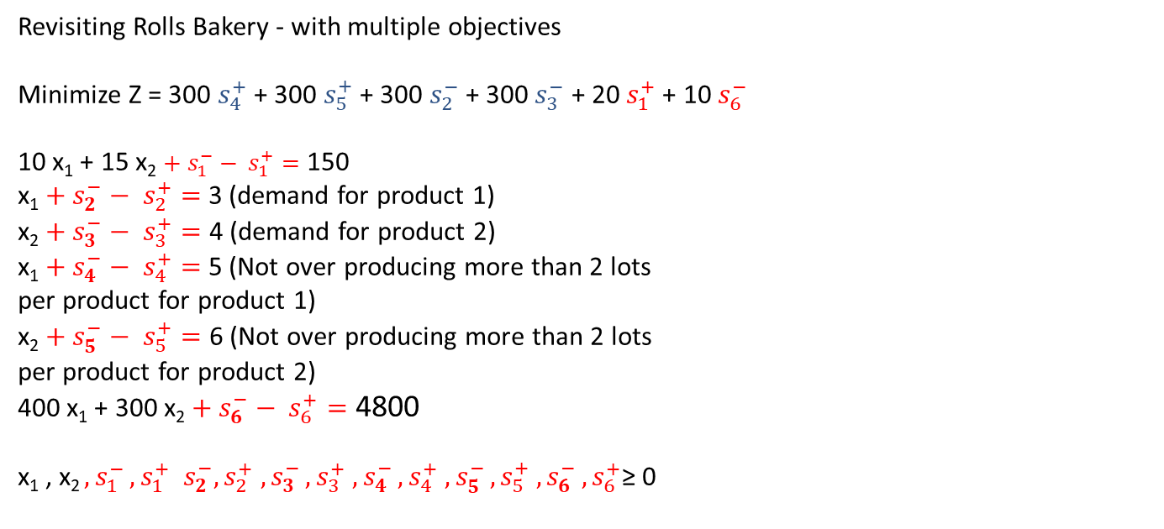
Goal Programming
Introduction
Revisiting Rolls Bakery - with multiple objectives
Minimize Z = 300 $s_{4}^{+}$ + 300 $s_{5}^{+}$ + 300 $s_{2}^{−}$+ 300 $s_{3}^{−}$ + 20 $s_{1}^{+}$+ 10 $s_{6}^{−}$
10 x₁ + 15 x₂ ${{+ s}_{1}^{−}− s}_{1}^{+}=$ 150
x₁ ${{+ s}_{2}^{−}− s}_{2}^{+}=$ 3 (demand for product 1)
x₂ ${{+ s}_{3}^{−}− s}_{3}^{+}=$ 4 (demand for product 2)
x₁ ${{+ s}_{4}^{−}− s}_{4}^{+}=$ 5 (Not over producing more than 2 lots
per product for product 1)
x₂ ${{+ s}_{5}^{−}− s}_{5}^{+}=$ 6 (Not over producing more than 2 lots
per product for product 2)
400 x₁ + 300 x₂ ${{+ s}_{6}^{−}− s}_{6}^{+}=$ 4800
x₁ , x₂ ${{, s}_{1}^{−}, s}_{1}^{+}$ ${{ s}_{2}^{−}, s}_{2}^{+}$ ${{, s}_{3}^{−}, s}_{3}^{+}$ ${{,s}_{4}^{−}, s}_{4}^{+}$ ${{, s}_{5}^{−}, s}_{5}^{+}$ ${{, s}_{6}^{−}, s}_{6 }^{+}$≥ 0

Slide 19
Post-Lecture Practice
1) Asllani, A. (2014). Business Analytics with Management Science Models and Methods. Ch. 5 – World Class Furniture Goal Programming
2) Apoorva: A facility location dilemma, for next and the following session Hint: We will need binary integer decision variables Case: https://hbsp.harvard.edu/tu/8d5cd5fc , Spreadsheet: https://hbsp.harvard.edu/tu/f89b894e

